Slide 1
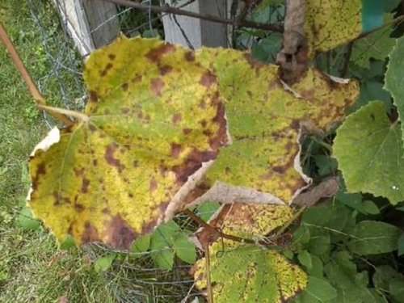
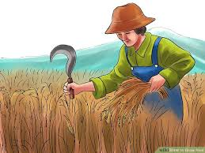
IDEA OF APPROACH
In improving the working conditions of farmers to incline agricultural theme with technologies. In the proposed solution, Convolution Neural Networks is used to predict the crop disease and to serve that crop disease with the input to Artificial Neural Network including the real time conditions such as temperature, humidity which will predict the actual days of spreading with their particular cure.
The integration of these neural networks (Convolution and Artificial) with IOT to sense the favourable condition and to indicate using smart alarms operated with phones.
ARTIFICIAL NEURAL NETWORKS:
The algorithm will be forward propagating and backward propagating for Input layers consisting of disease predicted above, temperature, Humidity. This will predict the days of spreading as well as the cure of fertilizers.
CONVOLUTIONAL NEURAL NETWORKS:
It is the first algorithm which will predict the type of
Disease in a particular region using image-processing and taking real time image of crop using the technology of open cv.

Slide 2
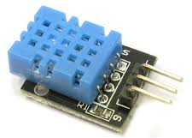
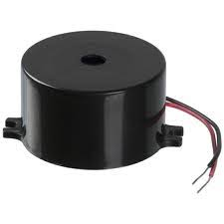
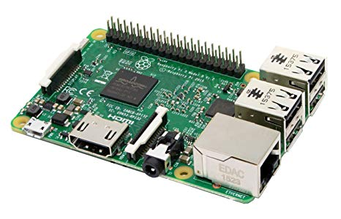
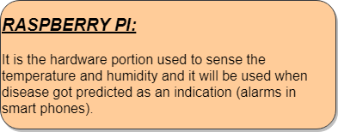
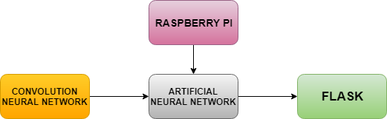
HARDWARE DEVICES USED:
SENSOR FOR
TEMPERATURE AND
HUMIDITY
BUZZER
TECHNOLOGY STACK

Slide 3
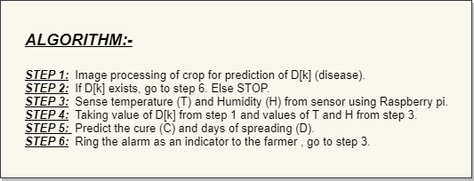
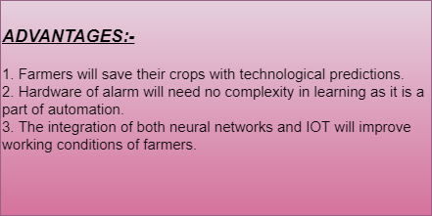
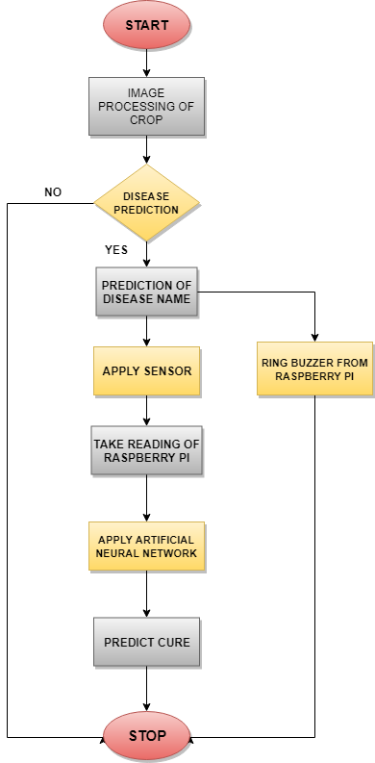
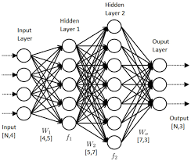
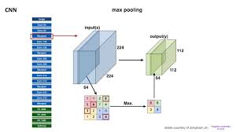
FLOWCHART:
NEURAL NETWORK:

