Slide 1

Compositional Schemes in Runtime Enforcement
Mid-Term Project Presentation
Srishti Gupta (24CS06016)
Under the supervision of Dr. Srinivas Pinisetty
School of Electrical and Computer Sciences
Indian Institute of Technology Bhubaneswar

Slide 2
Motivation
Safety-critical systems must satisfy multiple correctness properties.
Static verification cannot guarantee compliance during execution.
Runtime Enforcement (RE) dynamically monitors and edits system outputs.
Conflicts arise while enforcing multiple properties concurrently.
Need for compositional schemes balancing correctness and permissiveness.

Slide 3
Problem Statement
Existing RE mechanisms (Serial, Monolithic) are overly restrictive.
Conflicts between multiple properties lead to inconsistent outputs.
Need modular, scalable, and minimally intrusive compositional RE.

Slide 4
Literature Review
• Runtime Enforcement Monitors: Composition, Synthesis and Enforcer (2012): foundational models; lacks conflict resolution.
• Predictive Runtime Enforcement (2015): reduced latency; limited to single property.
• Bounded Memory RE (2019): supports constrained systems; accuracy trade-off.
• Probabilistic Bounded-Memory RE (2024): balances correctness vs performance.
• Compositional Enforcement of RE (2020): serial/parallel composition; open conflicts.
• Compositional RE Revisited (2022): defines sound parallel rules; complex trade-offs.

Slide 5
Contribution
Implemented Serial, Monolithic, Least Effort, and Exclusive Enforcers.
Introduced Grouping Techniques: AND, OR, k-of-n, Priority.
Formalized DFA-based runtime enforcement framework.
Analyzed trade-offs between correctness and permissiveness.

Slide 6
Runtime Enforcement Framework
Definition: Ensures outputs satisfy property ϕ by modifying events.
Formal Function: Eϕ : Σ* → Σ*
Key Properties: Soundness, Transparency, Monotonicity.
Operation: Monitor → Evaluate → Edit/Release → Output → Repeat.

Slide 7
Example of Runtime Enforcement
Property ϕ: Every 'a' must be followed by 'b'.
Input: a c b
Step 1: 'a' blocked (waiting for 'b'); Step 2: 'c' ignored; Step 3: 'b' forms valid prefix.
Result: Output sequence satisfies ϕ maintaining transparency.

Slide 8
Grouping Techniques
OR Grouping: system valid if any property holds.
k-of-n Grouping: valid if at least k properties hold.
Priority Grouping: high-priority properties enforced first.
Applications: fault tolerance, redundancy, safety prioritization.

Slide 9
AND and OR Grouping
AND: valid only if all properties hold → strongest correctness.
OR: valid if any property holds → maximum permissiveness.
Examples: Safety constraints (AND); backup restoration (OR).

Slide 10
Strict Enforcer Types
Strict Serial: applies properties sequentially (P1→P2→P3).
Strict Monolithic: combined product automaton enforcing all at once.
Strict Parallel: concurrent enforcement; intersection of accepted events.
Trade-off: highest correctness vs lowest permissiveness.

Slide 11
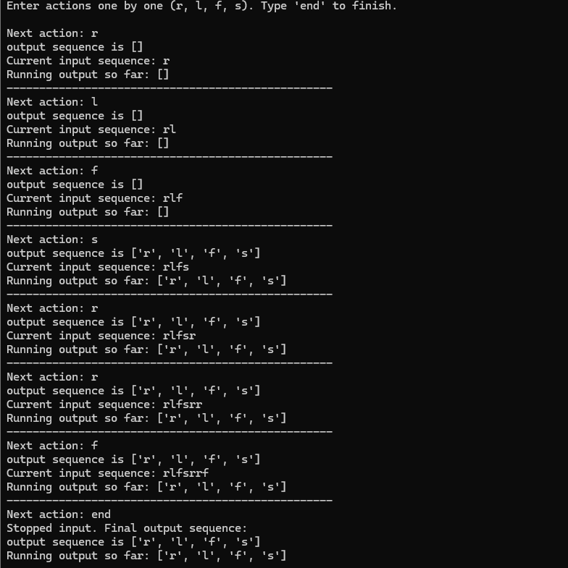
Strict Enforcer Output
Figure 1: Strict Serial Enforcer Output

Slide 12
Least Effort Enforcer Types
Least Effort Serial: sequential, releases event if any enforcer allows it.
Least Effort Monolithic: disjunctive product DFA (A∨); event allowed if ≥1 accepts.
Least Effort Parallel: merges outputs via logical OR; maximizes permissiveness.

Slide 13
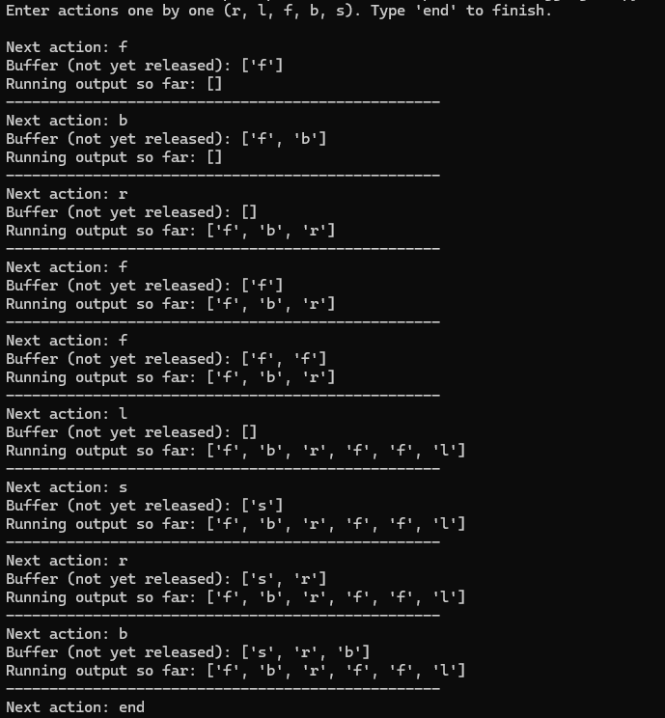
Least Effort Enforcer Outputs
Figure 2: Least Effort Monolithic Enforcer Output

Slide 14
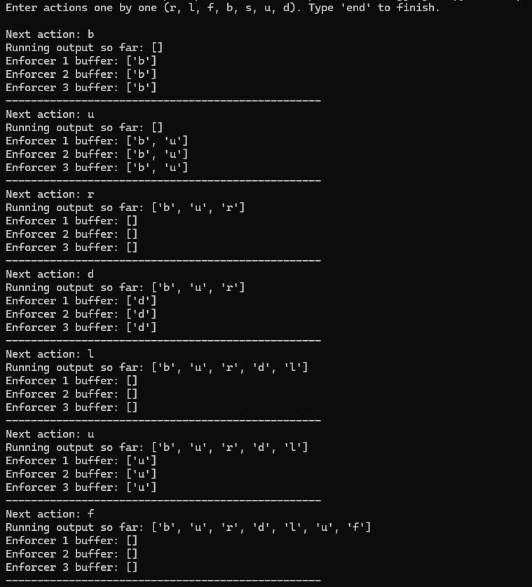
Least Effort Enforcer Outputs
Figure 3: Least Effort Parallel Enforcer Output (1)

Slide 15
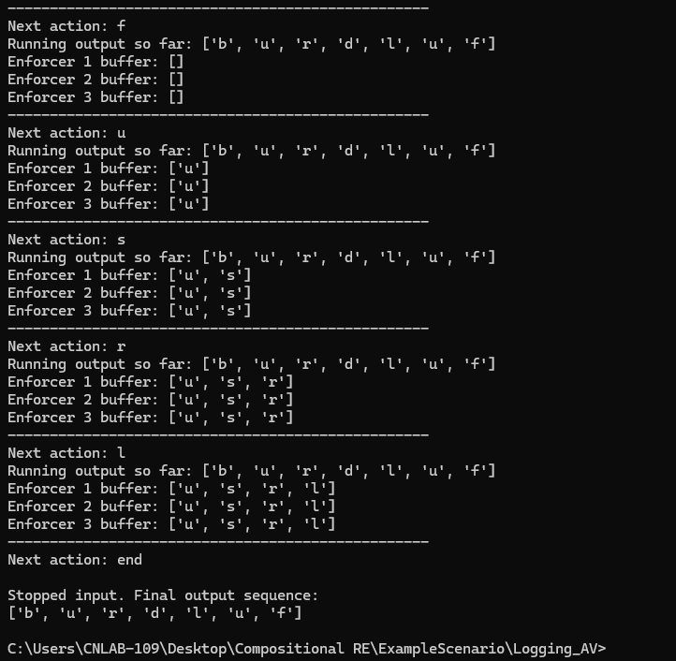
Least Effort Enforcer Outputs
Figure 4: Least Effort Parallel Enforcer Output (2)

Slide 16
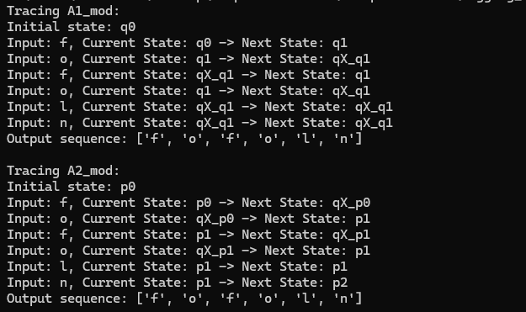
Exclusive Enforcer
Figure 5: Modified Automata for Exclusive Enforcer

Slide 17
Conclusion
Explored compositional runtime enforcement schemes.
Implemented Serial, Monolithic, Least Effort, and Exclusive enforcers.
Introduced AND, OR, k-of-n, and Priority groupings.
Established balance among soundness, transparency, and scalability.

Slide 18
Future Work
Extend Exclusive Enforcer with adaptive conflict resolution.
Explore k-of-n grouping for configurable tolerance.
Implement Priority-based grouping for safety-critical systems.
Integrate probabilistic and performance-aware composition.

Slide 19
References
1. Pinisetty et al., Runtime Enforcement Monitors..., 2012.
2. Falcone et al., Predictive Runtime Enforcement, 2015.
3. Pinisetty et al., Bounded Memory RE, 2019.
4. Shankar et al., Probabilistic Bounded-Memory RE, 2024.
5. Pinisetty et al., Compositional Enforcement of RE, 2020.
6. Pinisetty et al., Compositional RE Revisited, 2022.

