Slide 1
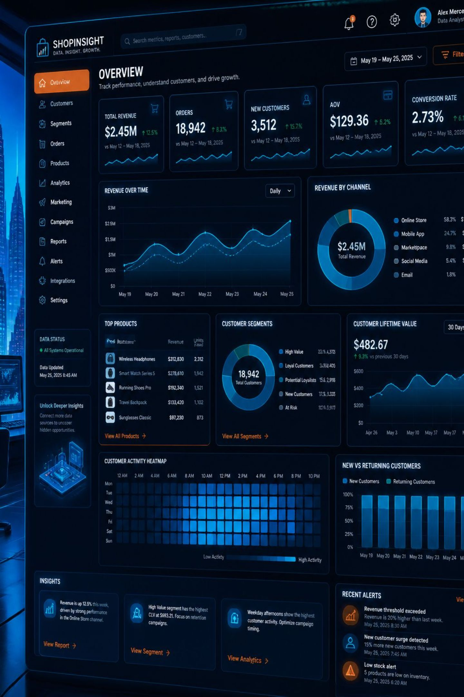
Customer Shopping Behavior Analysis
Uncovering insights from 3,900 transactions across product categories — spending patterns, customer segments, and subscription behavior to guide strategic decisions.

Slide 2
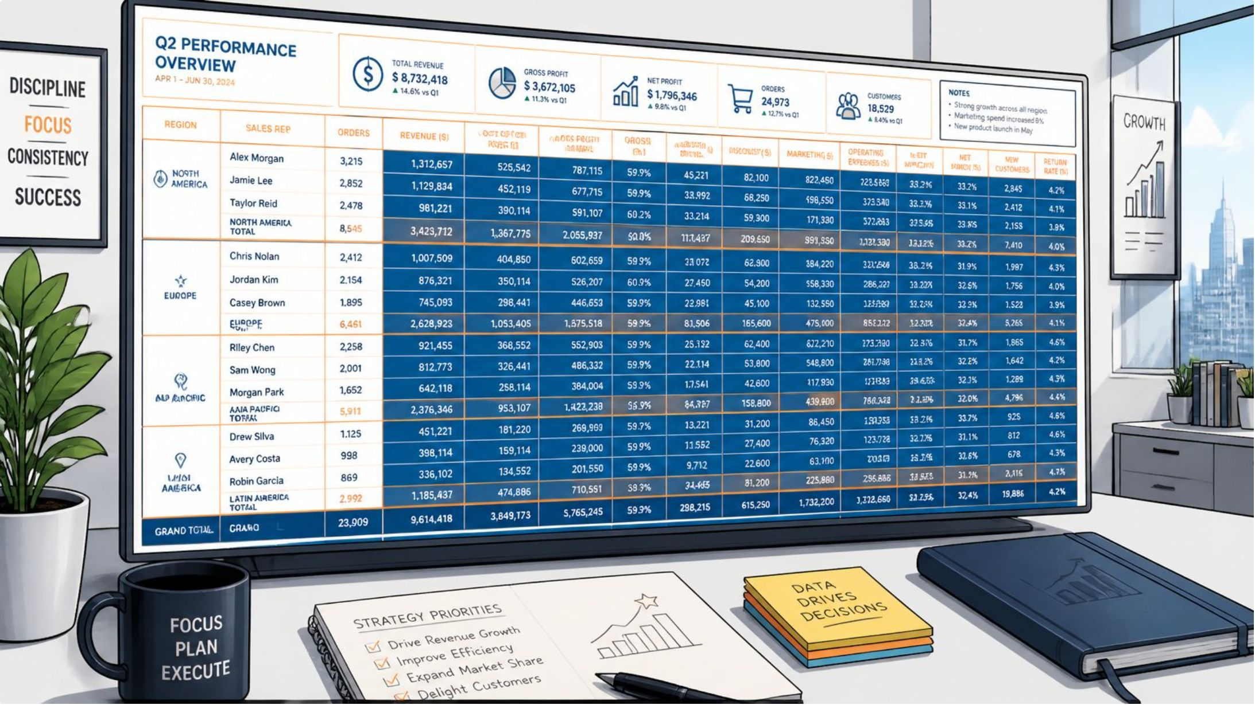
Dataset at a Glance
Key Features
Demographics: Age, Gender, Location, Subscription Status
Purchase Details: Item, Category, Amount, Season, Size, Color
Behavior: Discount, Promo Code, Frequency, Review Rating, Shipping Type
3,900 Rows
18 Columns
37 Missing
Individual purchase records
Rich feature set
Values in Review Rating

Slide 3

Data Preparation in Python
01
Load & Explore
Imported via pandas; used df.info() and df.describe() for structure and statistics.
02
Clean Missing Data
Imputed 37 missing Review Rating values using median rating per product category.
03
Standardize & Engineer
Renamed columns to snake_case; created age_group and purchase_frequency_days; dropped redundant promo_code_used.
04
Database Integration
Loaded cleaned DataFrame into PostgreSQL for SQL analysis.

Slide 4
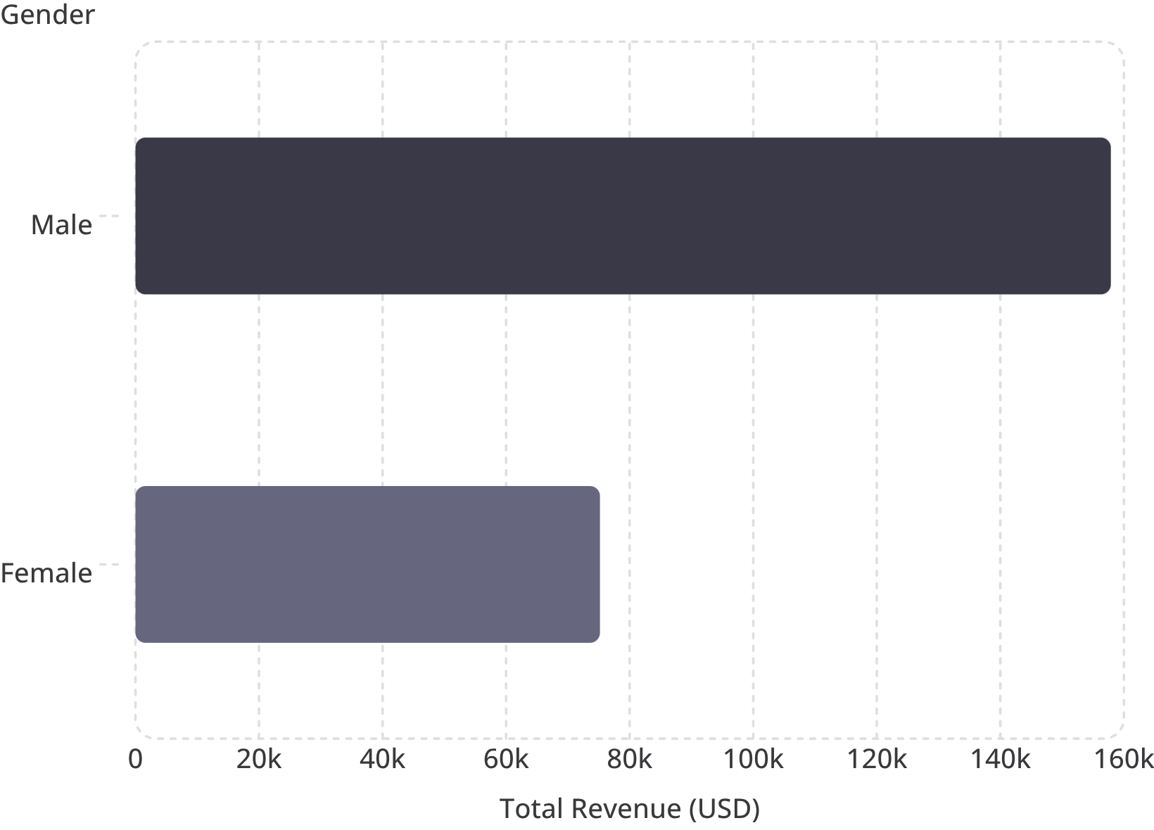

Revenue by Gender
Key Insight
Male customers generated $157,890 in total revenue — more than double the $75,191 from female customers across 3,900 transactions.
Male customers account for ~68% of total revenue in this dataset.

Slide 5
Product Ratings & Discount Patterns
Top 5 Products by Avg Rating
Most Discounted Products
Item
Avg Rating
Item
Discount Rate
Gloves
3.86
Hat
50%
Sandals
3.84
Sneakers
49%
Boots
3.82
Coat
49%
Hat
3.80
Sweater
48%
Skirt
3.78
Pants
47%
Hats lead both in discount rate (50%) and rank among top-rated products — a strong candidate for promotional campaigns.

Slide 6
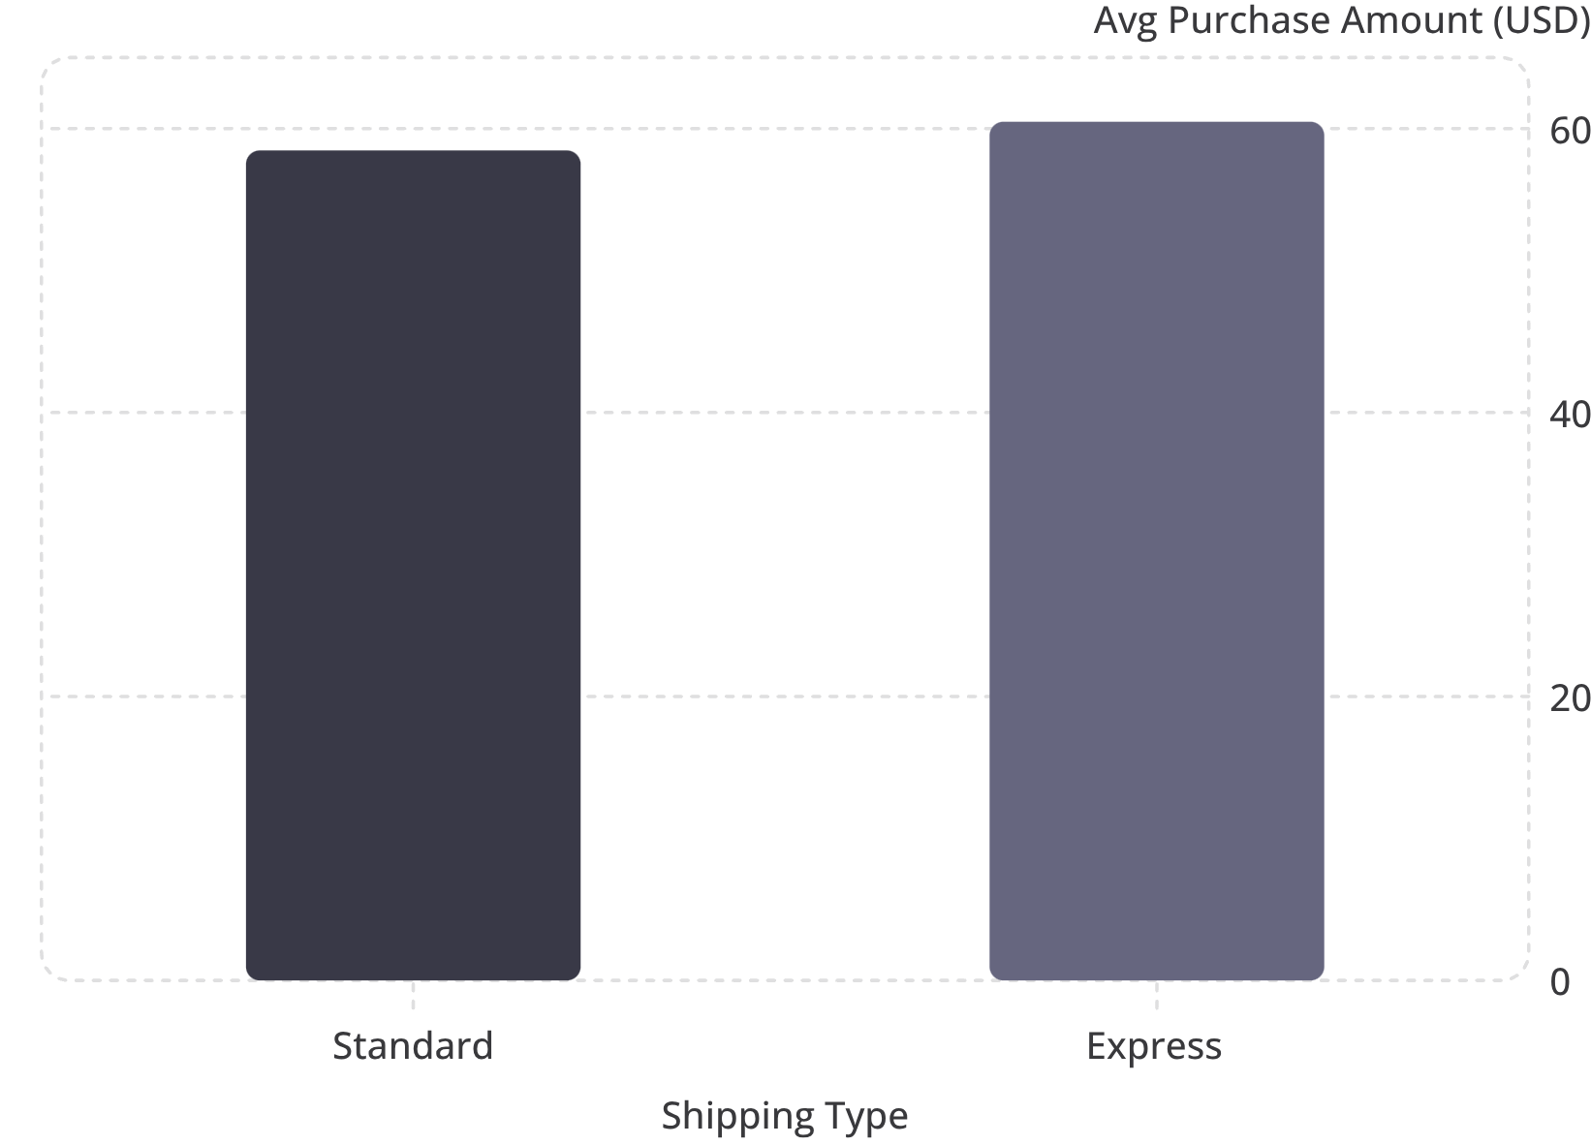
Shipping & Subscription Analysis
Subscribers vs. Non-Subscribers
Status
Customers
Avg Spend
Total Revenue
Subscribed
1,053
$59.49
$62,645
Not Subscribed
2,847
$59.87
$170,436
Express shipping yields slightly higher average spend ($60.48 vs $58.46). Non-subscribers drive more total revenue but at lower conversion — a key growth opportunity.

Slide 7

Customer Segmentation
3,116
701
Loyal Customers
Returning
80% of the base — highest repeat purchase frequency
18% — potential to convert to Loyal with incentives
83
New Customers
2% — early engagement critical for retention
Of customers with more than 5 purchases, 958 are subscribed vs. 2,518 not subscribed — repeat buyers show strong subscription potential.

Slide 8
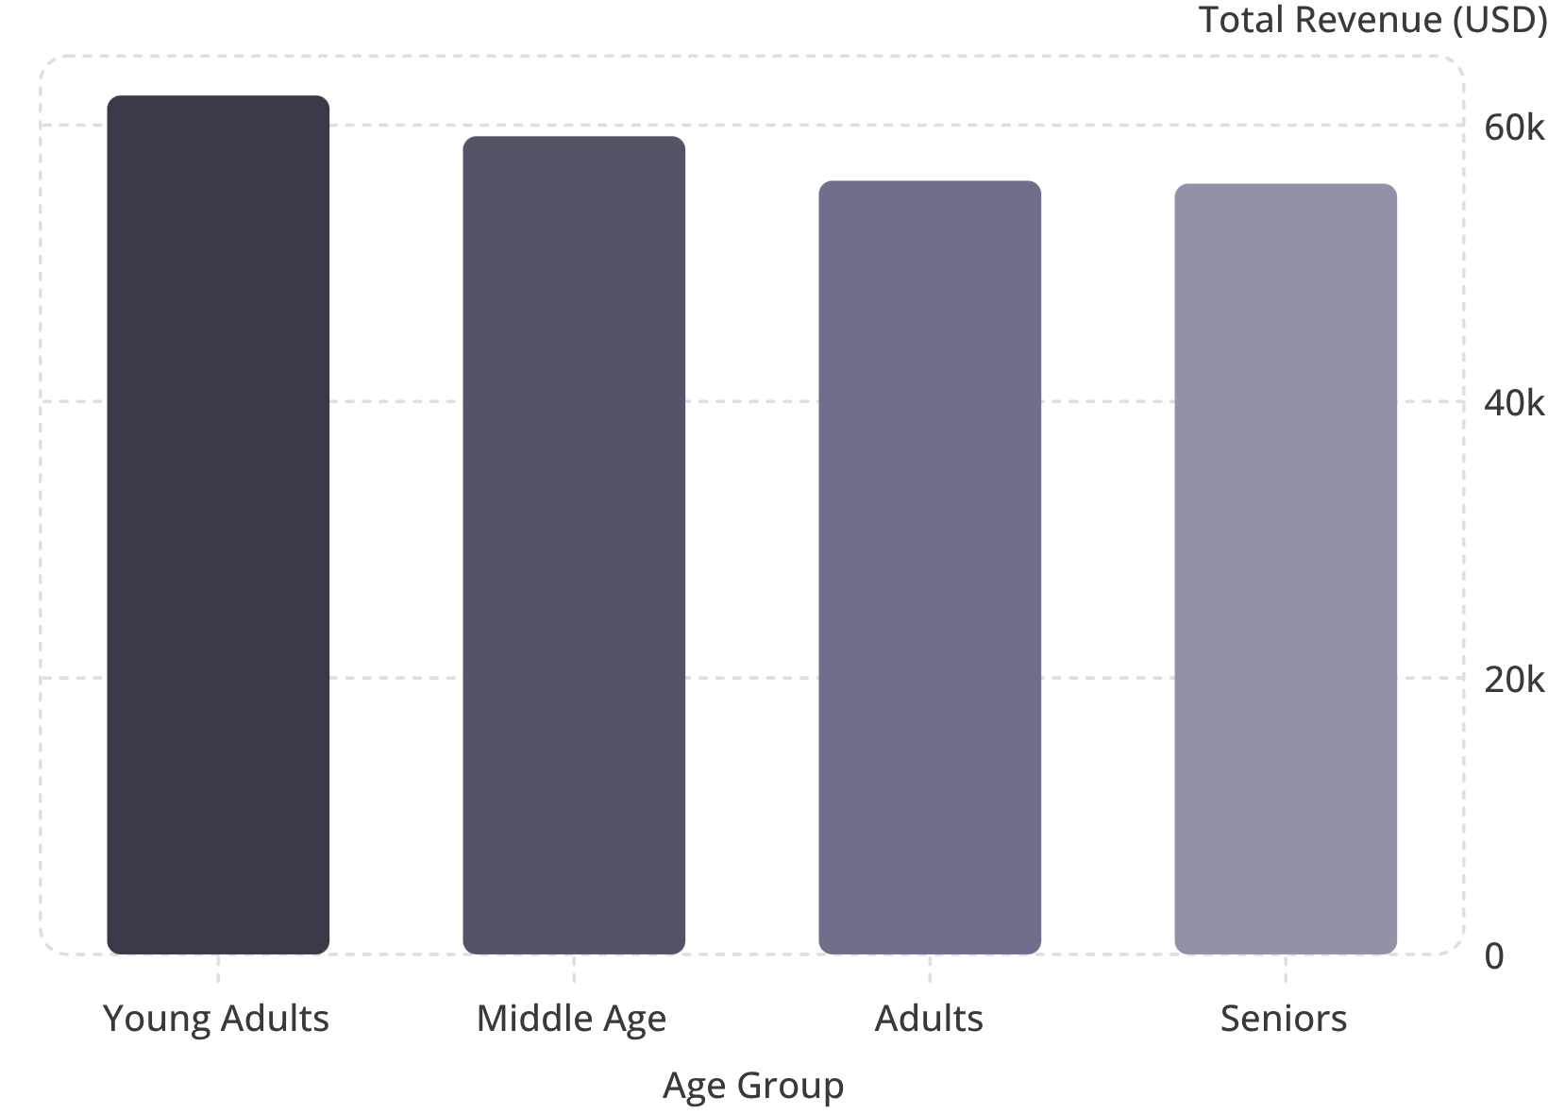
Revenue by Age Group
Key Takeaway
Young Adults lead revenue contribution at $62,143, with a relatively even distribution across all age groups — suggesting broad market appeal.
Sales volume is highest among Young Adults (~950 customers) and Middle Age (~900 customers).

Slide 9
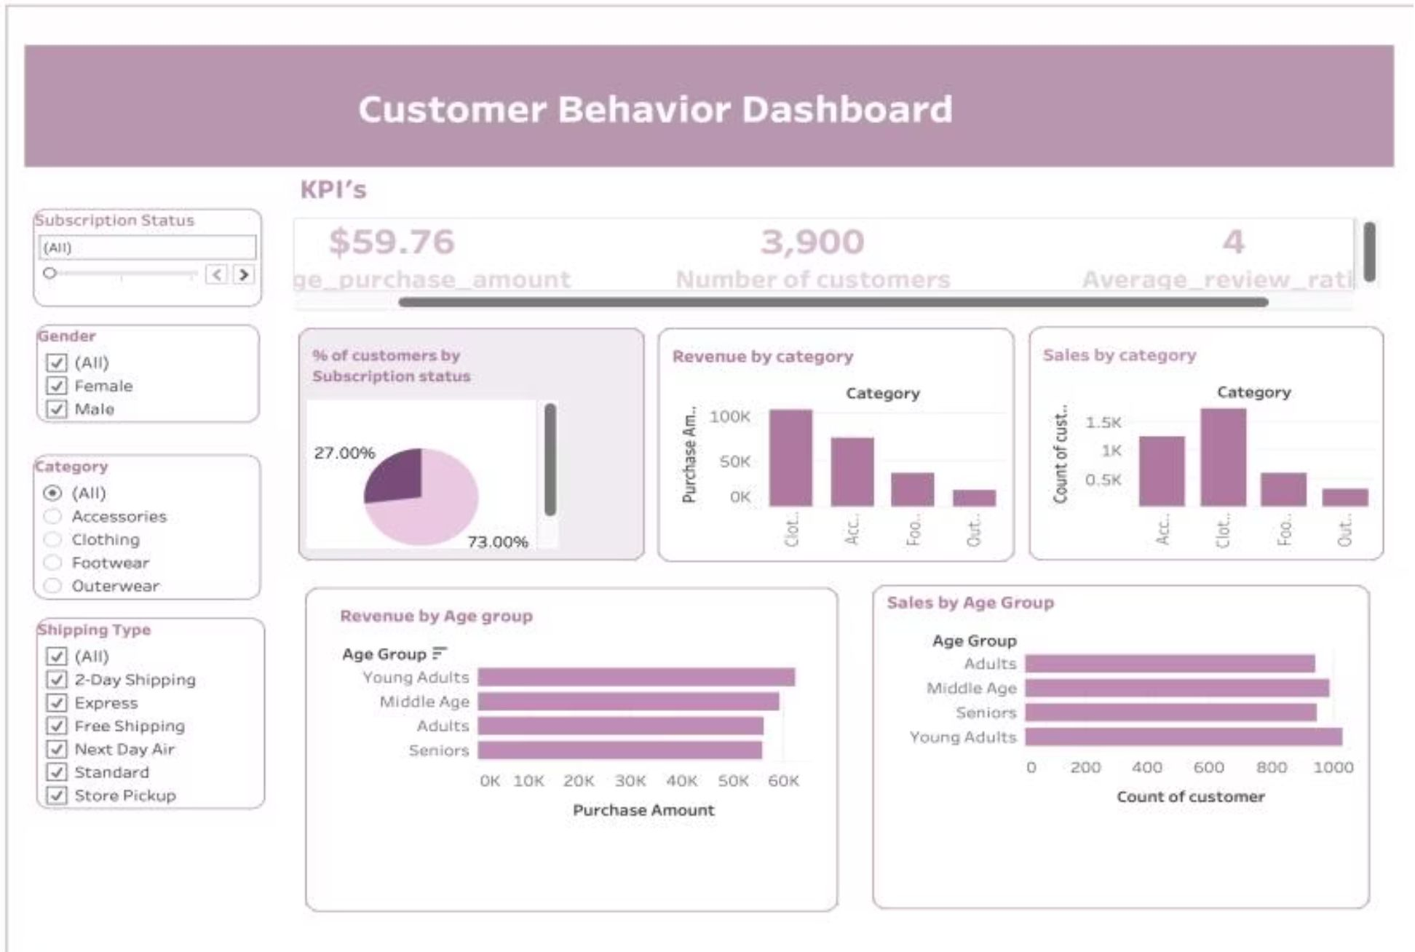
Tableau Dashboard Overview
Dashboard KPIs
Interactive filters include Gender, Category, Shipping Type, and Subscription Status for drill-down analysis.
Avg Purchase
Total Customers
Avg Review Rating
Subscription Rate
$59.76 per transaction
3,900 records analyzed
4.0 out of 5
73% subscribed

Slide 10





Business Recommendations
Boost Subscriptions
Promote exclusive subscriber benefits to convert the 27% non-subscribed base.
Loyalty Programs
Reward repeat buyers to move Returning customers into the Loyal segment.
Review Discount Policy
Balance sales boosts with margin control — 50% of Hat purchases use discounts.
Targeted Marketing
Focus on high-revenue age groups and Express-shipping users for maximum ROI.

