Slide 1

WIPRO NGA Program_26SUB0726_JAVA J2EE INTEGRATION
Capstone Project Presentation – 23 June 2026
Project Title Here – Hotel Room Reservation System
Presented by - 70248_Shana_Shekh
70244_Srishti_Nehra
www.rpsconsulting.in

Slide 2

Project Overview
Content:
The Hotel Reservation Management System is a web-based application.
It helps customers book rooms and manage reservations online.
Admin can manage hotels, rooms, customers, billing, and payments.
The system is built using Spring Boot with REST APIs and MySQL database.
It supports role-based access for Admin and Customer.
2024 - RPS Consulting all rights reserved

Slide 3
Project Overview
Key Features:
User authentication (Admin & Customer)
Room booking and cancellation
Billing and payment management
Dashboard for analytics
Secure login using JWT
2024 - RPS Consulting all rights reserved

Slide 4
Tools And Technologies
Backend:
Java
Spring Boot
Spring Security (JWT Authentication)
Hibernate / JPA
2024 - RPS Consulting all rights reserved

Slide 5
Tools And Technologies
Frontend:
Thymeleaf (Server-side rendering)
HTML, CSS, JavaScript
Database:
MySQL
2024 - RPS Consulting all rights reserved

Slide 6
Tools And Technologies
Tools:
Maven
Postman
Swagger UI
Eclipse
Architecture:
Layered Architecture (Controller → Service → Repository)
2024 - RPS Consulting all rights reserved

Slide 7
Project Design
Architecture Flow:
Client (Browser/Postman)
↓
Controller Layer (API)
↓
Service Layer (Business Logic)
↓
Repository Layer (Database Access)
↓
MySQL Database
2024 - RPS Consulting all rights reserved

Slide 8
Project Design
Key Design Principles:
MVC Architecture
DTO Pattern for data transfer
Mapper layer for conversion
JWT-based security
Role-based access control
2024 - RPS Consulting all rights reserved

Slide 9
Project Design
Modules:
Authentication Module
Admin Management
Customer Management
Hotel And Room Management
Reservation Module
Billing And Payment Module
Dashboard Module
2024 - RPS Consulting all rights reserved

Slide 10
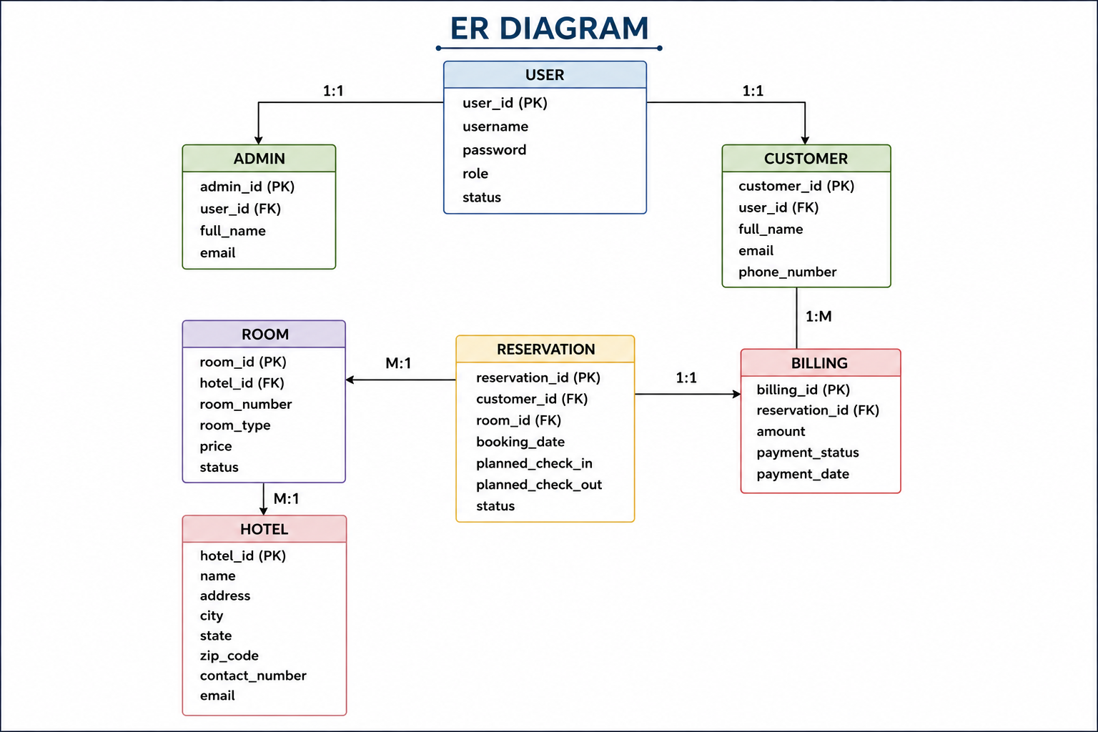
Database Design (ER Diagram)
2024 - RPS Consulting all rights reserved

Slide 11
Database Design (ER Diagram)
Relationship Explanation:
User → Admin : One-to-One
User → Customer : One-to-One
Customer → Reservation : One-to-Many
Room → Reservation : One-to-Many
Hotel → Room : One-to-Many
Reservation → Billing : One-to-One
2024 - RPS Consulting all rights reserved

Slide 12
Project Structure
Package Structure:
com.hotel.Hotel_Reservation_Management
│
├── controller
├── service
├── serviceImpl
├── repository
├── entity
├── dto
├── mapper
├── security
├── config
├── util
├── validator
├── enums
├── exception
2024 - RPS Consulting all rights reserved

Slide 13
Project Structure
Explanation:
Controller → Handles API requests
Service → Business logic
Repository → Database operations
Entity → Database tables
DTO → Data transfer
Mapper → Entity ↔ DTO conversion
Security → Authentication & JWT
Config → System configuration
Util → Helper methods
Validator → Input validation
2024 - RPS Consulting all rights reserved

Slide 14
Detailed Test Cases
Unit testing is done using JUnit 5 and Mockito
Tests are written for Controller and Service layers
Room Module Test Cases
Create Room → Room created successfully with valid data
Get Room by ID → Correct room details returned
Get All Rooms → List of rooms returned
Get Rooms by Hotel → Rooms filtered by hotel ID
Update Room → Room details updated successfully
Delete Room → Room deleted successfully
2024 - RPS Consulting all rights reserved

Slide 15
Detailed Test Cases
Service Layer Tests
Room creation service tested with mocked repository
Room retrieval tested using mock data
Room update and delete operations verified
Testing Tools Used
JUnit 5 → Unit testing framework
Mockito → Mocking dependencies
Assertions → Validate expected results
All major CRUD operations are tested
Mockito ensures isolated testing
Ensures system reliability and correctness
2024 - RPS Consulting all rights reserved

Slide 16
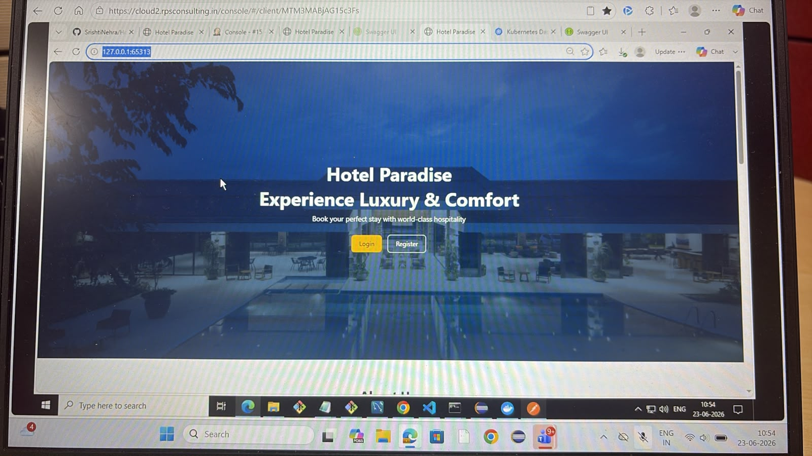

Slide 17
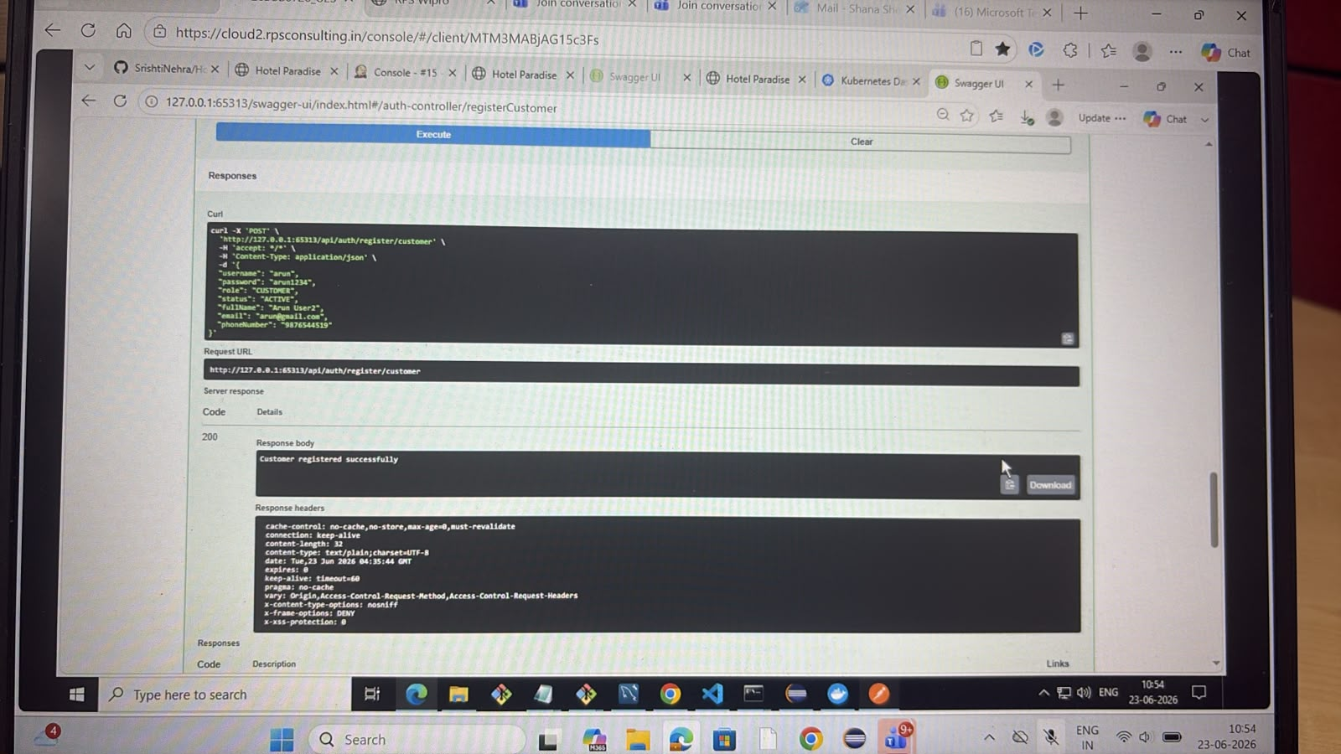

Slide 18
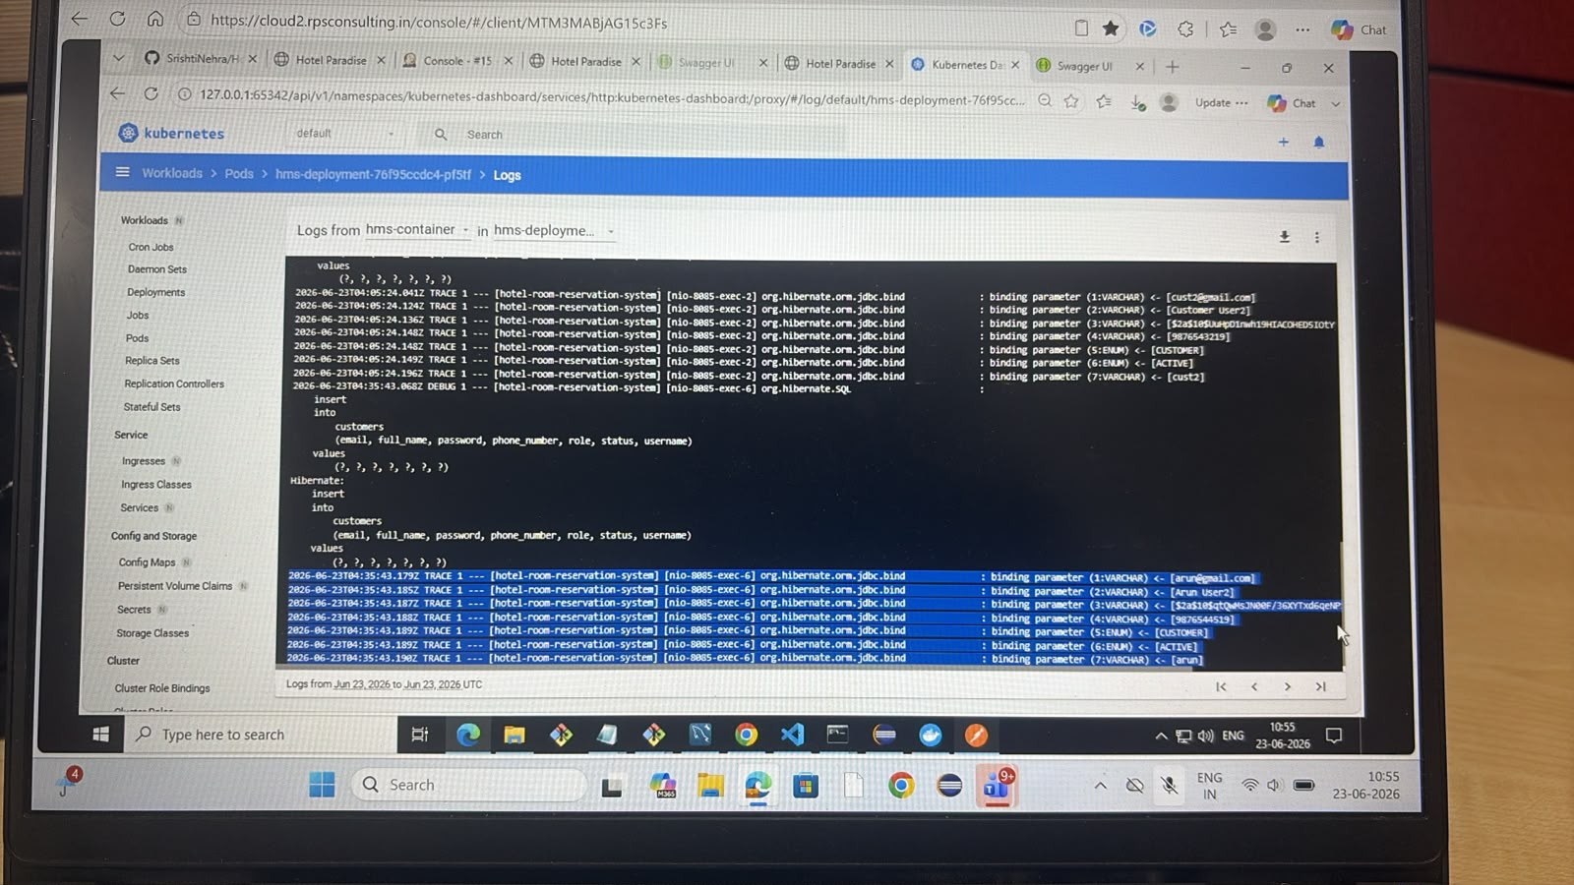

Slide 19
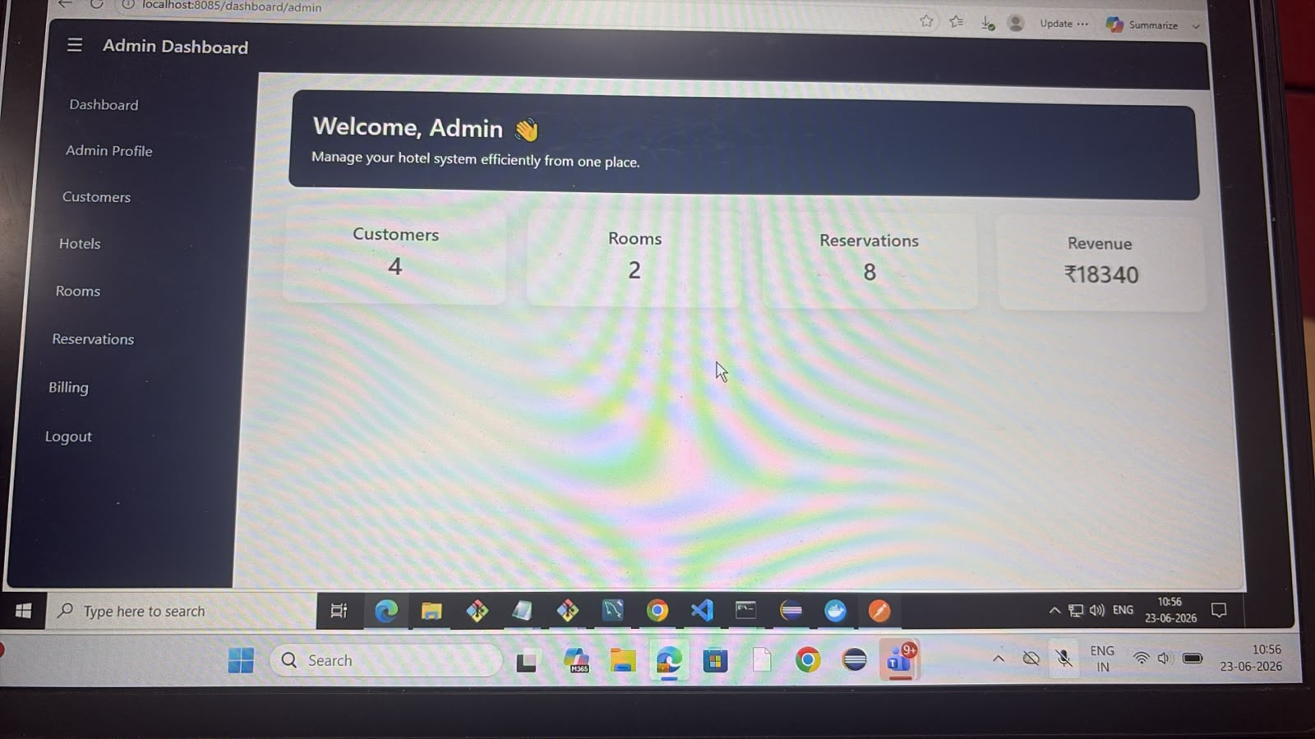

Slide 20
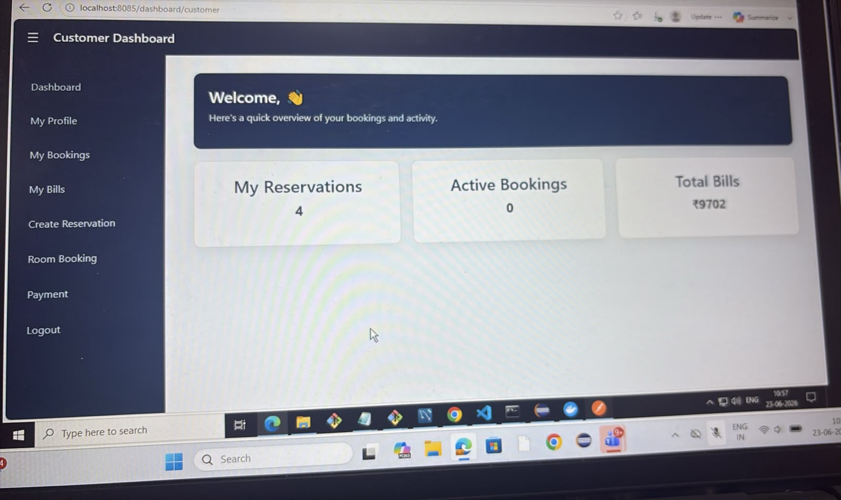

Slide 21
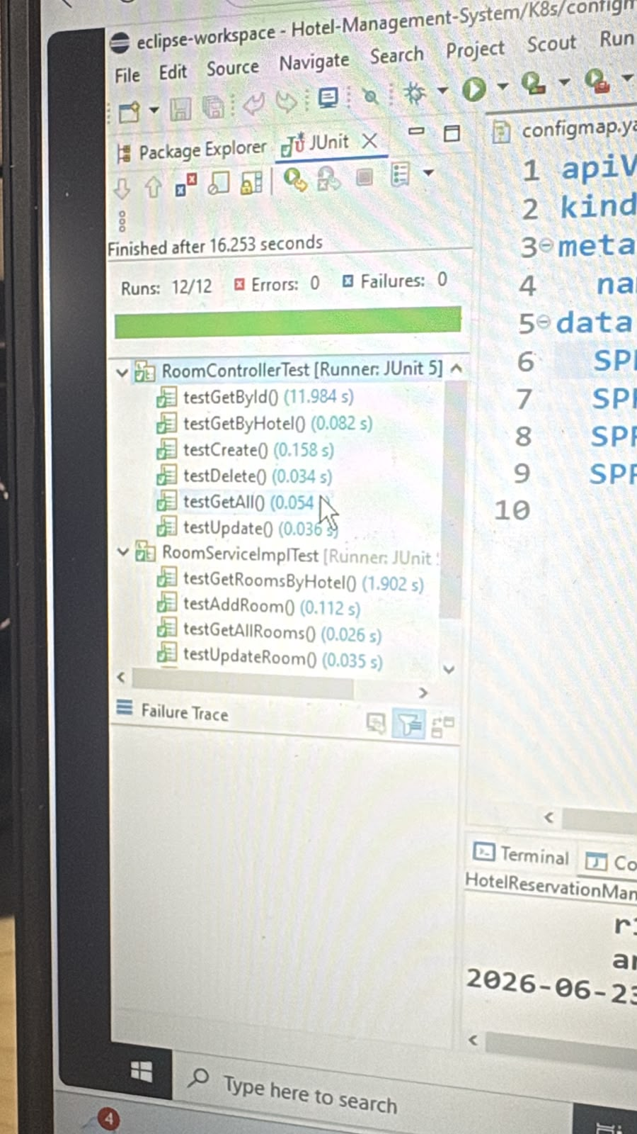

Slide 22
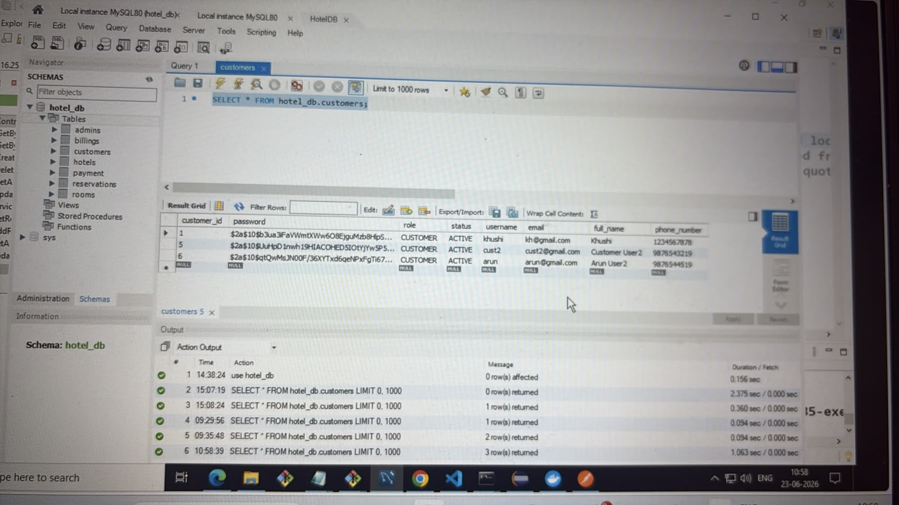

Slide 23
Conclusion
Content:
The project successfully implements a complete hotel booking system.
It provides secure authentication using JWT.
Role-based access ensures security for Admin and Customer.
System efficiently manages hotels, rooms, reservations, billing, and payments.
It demonstrates real-world enterprise-level Spring Boot architecture.
2024 - RPS Consulting all rights reserved

Slide 24
Thank You
2024 - RPS Consulting all rights reserved

