Slide 1
Problem statement 06-
Incident Postmortem Generator
SYNERGY-2026
Team: Power Rangers
Members: Gurnoor Kaur-2427030134
Srishti Pilania-2427030095
Ananya Sharma-2427030109
Kanakpreet Kaur- 2427030168

Slide 2
Problem Statement
Production incidents require postmortems, but writing them manually from messy logs and notes is slow and often skipped causing teams to repeat the same failures. Our tool uses an LLM to auto-generate a structured postmortem draft, saving hours of work.

Slide 3
Proposed Solution:
Our tool takes raw alert logs and on-call notes and uses an LLM to automatically generate a structured postmortem draft including summary, timeline, root cause, impact, and action items. This matters because postmortems are often delayed or skipped when writing them is slow, causing teams to lose critical learnings and repeat the same failures.
Innovation:
The output isn't just a text summary it's a structured document with clearly separated fields:category,company,link, description, and score that evaluates output quality against real postmortems used as reference. Because it's structured (JSON), it can be directly rendered into an editable report in the UI, stored, searched, or exported not just read once and forgotten.

Slide 4
Technical Feasibility:
Built on Gemini API : no model training or custom ML infra needed, realistic for the hackathon timeframe
Reliability engineering around the LLM : strict JSON schema, output validation, and data normalization so the app doesn't break on messy or malformed input
Already validated : working parser tested on 227 real postmortems, plus a tested prompt template producing structured output
Low technical risk : standard REST API calls, no complex deployment or infrastructure

Slide 5
Solution Architecture & Design
End-to-end pipeline: raw signal in, evaluated postmortem out
Raw Incident Signal : Input layer. Alert logs, timeline notes, and monitoring snippets extracted from real incident data (danluu/post-mortems) form the starting facts for each case.
LLM Generation Layer :Core IP. A structured prompt template sends the raw signal to the LLM (Gemini API), which returns a strict JSON output.
Structured Postmortem : Output layer. The generated draft is broken into standard fields: summary, root cause, timeline, and action items,mirroring how real engineers write postmortems.
Evaluation Engine : Validation layer. The generated draft is scored against the real postmortem for that incident using similarity metrics + an LLM-as-judge, producing an objective benchmark score.

Slide 6
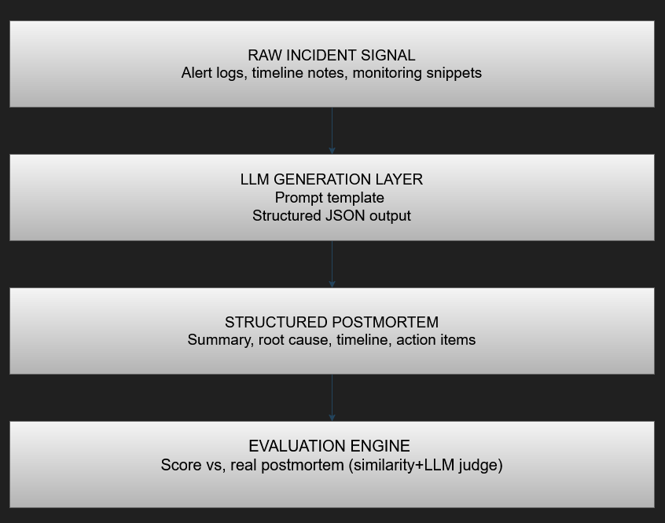
Each incident flows through four stages: from raw signal to a scored, structured postmortem ;giving both a usable draft and a measurable quality benchmark.

Slide 7
Initial Progress:
GitHub repo live : structured folders: /backend, /frontend, /data, /docs
Data pipeline built & tested : parsed 227 real postmortems from a public dataset into structured JSON
LLM prompt script working :raw input → validated structured postmortem JSON
Wireframes ready : input screen + editable report screen + output screen
README documented : problem statement, architecture, tech stack, status

Slide 8
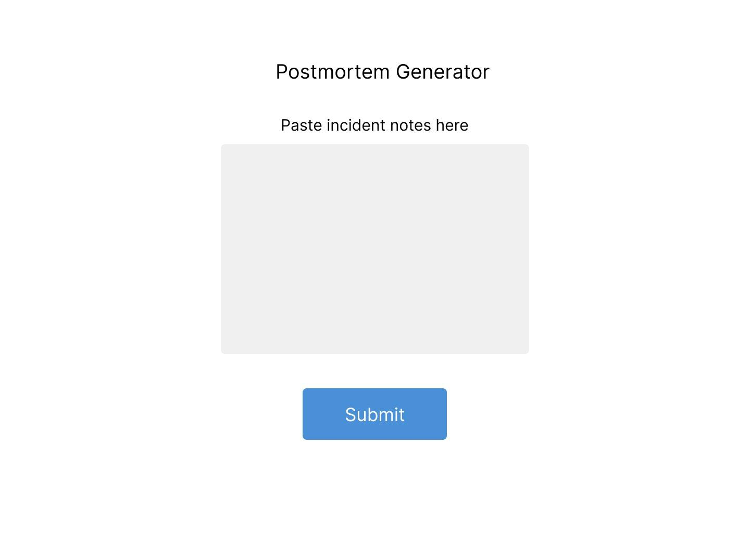
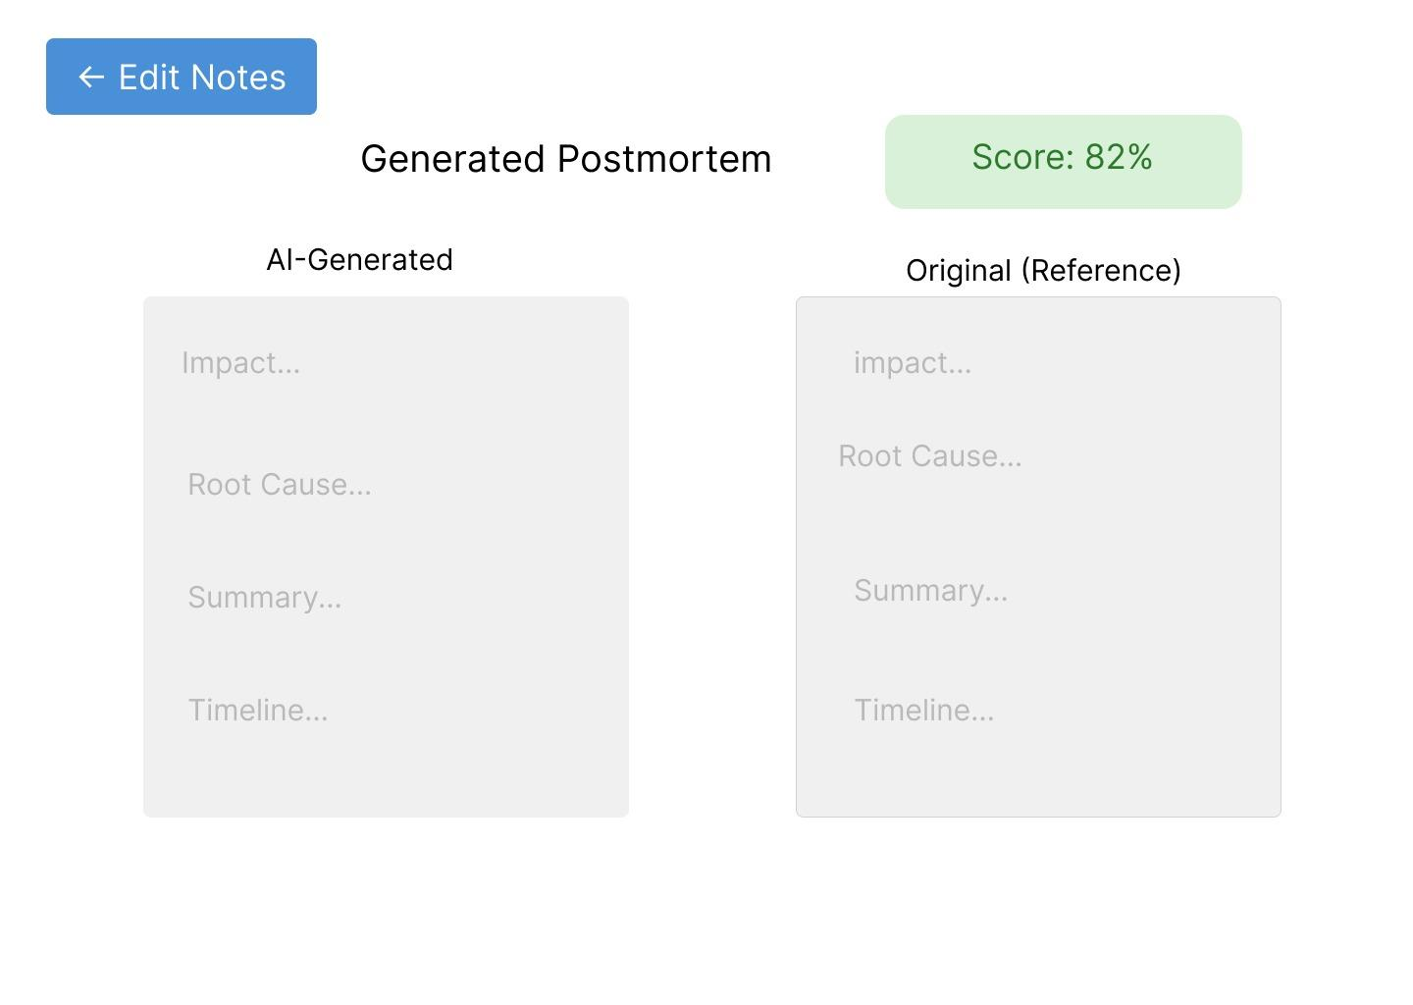
INITIAL PROGRESS-
WIREFRAME:
INPUT SCREEN:
OUTPUT SCREEN:

Slide 9
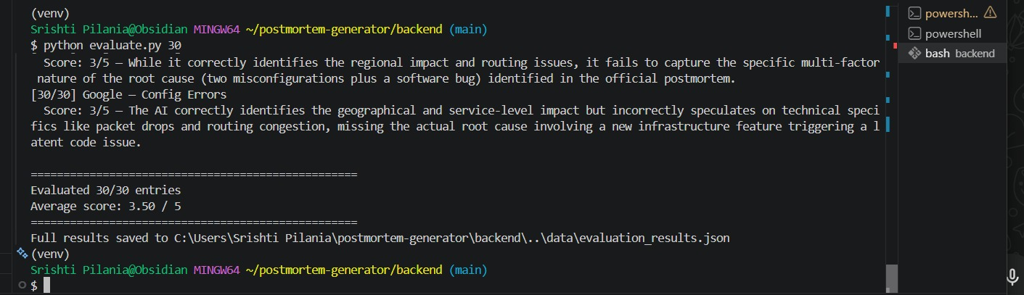
PROOF OF CONCEPT:

Slide 10
Team Readiness & Execution Plan
Coding (2 members) - building the data pipeline, LLM prompt script, and backend integration
Presentation & Docs (2 members) -PPT, README, wireframes, and demo prep
Active GitHub commits - from all 4 members, ongoing through both milestones.

Slide 11
THANK YOU

