Slide 1
About Me
2011 Ph.D of CS in THU
high performance computing
MapReduce, Pregel, …
2011-2016 MSRA
distributed systems
large scale machine learning
Minerva, mxnet…
2016- FMA Technology
graph computing
graph database

Slide 2
Tensorflow Programming
2019 Tsinghua Deep Learning Summer School
Wenguang Chen
Dept. of Computer Science and Technology
Tsinghua University

Slide 3

Hello World: handwritten digits classification
?
0
0
0
0
0
0
0
0
1
0
0
1
8
9
28*28 pixels
10*1 one-hot vector
MNIST = Mixed National Institute of Standards and Technology
Download the dataset at http://yann.lecun.com/exdb/mnist/

Slide 4
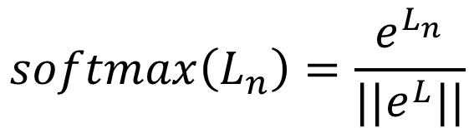
Simple model: softmax classification
784 pixels
$$h\left(x\right)=softmax(X.W+b)$$
28x28
pixels
...
where
...
$$softmax\left(L_{n}\right)=\frac{e^{L_{n}}}{||e^{L}||}$$
softmax
0
1
2
9

Slide 5



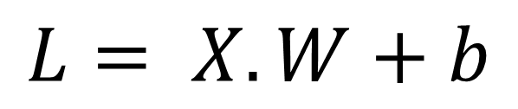


For efficiency, 100 images at a time
10 columns
^{w}0,0 ^{w}1,0 ^{w}2,0 ^{w}3,0 ^{w}4,0 ^{w}5,0 ^{w}6,0 ^{w}7,0 ^{w}8,0
^{w}0,1 ^{w}1,1 ^{w}2,1 ^{w}3,1 ^{w}4,1 ^{w}5,1 ^{w}6,1 ^{w}7,1 ^{w}8,1
^{w}0,2 ^{w}1,2 ^{w}2,2 ^{w}3,2 ^{w}4,2 ^{w}5,2 ^{w}6,2 ^{w}7,2 ^{w}8,2
^{w}0,3 ^{w}1,3 ^{w}2,3 ^{w}3,3 ^{w}4,3 ^{w}5,3 ^{w}6,3 ^{w}7,3 ^{w}8,3
^{… w}0,9
^{… w}1,9
^{… w}2,9
^{… w}3,9
^{… w}4,9
^{… w}5,9
^{… w}6,9
^{… w}7,9
^{… w}8,9
$$W$$
784 lines
x
x
x
$$L= X.W+b$$
X : 100 images, one per line, flattened
x
x
x
x
…
x
^{w}783,0 ^{w}783,1 ^{w}783,2
^{… w}783,9
^{L}0,0 ^{L}0,1 ^{L}0,2 ^{L}0,3 ^{L}1,0 ^{L}1,1 ^{L}1,2 ^{L}1,3 ^{L}2,0 ^{L}2,1 ^{L}2,2 ^{L}2,3 ^{L}3,0 ^{L}3,1 ^{L}3,2 ^{L}3,3 ^{L}4,0 ^{L}4,1 ^{L}4,2 ^{L}4,3
…
^{L}99,0 ^{L}99,1 ^{L}99,2
……L_{0,9}
^{… L}1,9
^{… L}2,9
^{… L}3,9
^{… L}4,9
^{… L}99,9
+
b₀ b₁ b₂ b₃ … b₉
$$X$$
$$b$$
+ Same biases on all lines

Slide 6

Loss function
0 | 1 | 2 | 3 | 4 | 5 | 6 | 7 | 8 | 9
0 | 0 | 0 | 0 | 0 | 0 | 1 | 0 | 0 | 0
Cross entropy:
computed probabilities
actual probabilities, “one-hot” encoded
$$−\sum{Y_{i}.log⁡(hx_{i})}$$
this is a “6”
0.1 | 0.2 | 0.1 | 0.3 | 0.2 | 0.1 | 0.9 | 0.2 | 0.1 | 0.1
0 | 1 | 2 | 3 | 4 | 5 | 6 | 7 | 8 | 9

Slide 7
Training process (pseudo code)
for iteration in range(1:100):
for batch in mini_batches:
x, y = batch.input, batch.label
hx = softmax(Wx + b)
loss = sum(y * log(hx))
gradw = grad(loss, W)
gradb = grad(loss, b)
W += gradw * alpha
b += gradb * alpha
784 pixels
28x28
pixels
...
softmax
...
0
1
2
9

Slide 8

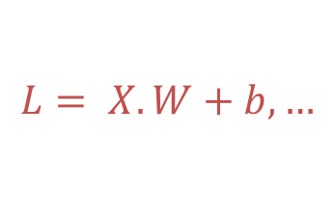
Coding deep learning: challenges
Running matrix operations efficiently
Getting derivatives right
Scheduling operations
Hardware
Distributed training
$$L= X.W+b,…$$
$$gradw=grad\left(loss, W\right), …$$

Slide 9
Challenges
Running matrix operations efficiently
Getting derivatives right
Scheduling operators
Distributed training
Debugging

Slide 10
Running matrix operations efficiently
Everyone can write matrix multiplication, but very few can do it efficiently…
c = (double *) calloc(sizeof(double), n*n);
/* Multiply n x n matrices a and b */
void mmm(double *a, double *b, double *c, int n) {
int i, j, k;
for (i = 0; i < n; i++)
for (j = 0; j < n; j++)
for (k = 0; k < n; k++)
c[i*n + j] += a[i*n + k] * b[k*n + j];
}

Slide 11
Example: Matrix Multiplication
c = (double *) calloc(sizeof(double), n*n);
/* Multiply n x n matrices a and b */
void mmm(double *a, double *b, double *c, int n) {
int i, j, k;
for (i = 0; i < n; i++)
for (j = 0; j < n; j++)
for (k = 0; k < n; k++)
c[i*n + j] += a[i*n + k] * b[k*n + j];
}
j
c
a
b
=
*
i

Slide 12
Blocked Matrix Multiplication
c = (double *) calloc(sizeof(double), n*n);
/* Multiply n x n matrices a and b */
void mmm(double *a, double *b, double *c, int n) {
int i, j, k;
for (i = 0; i < n; i+=B)
for (j = 0; j < n; j+=B)
for (k = 0; k < n; k+=B)
/* B x B mini matrix multiplications */
for (i1 = i; i1 < i+B; i++)
for (j1 = j; j1 < j+B; j++)
for (k1 = k; k1 < k+B; k++)
c[i1*n+j1] += a[i1*n + k1]*b[k1*n + j1];
}
matmult/bmm.c
j1
c
a
b
c
=
*
+
i1
Block size B x B
Notes:
How large is B? what happens if the matrix is not square matrix

Slide 13
Running matrix operations efficiently
Fortunately, many matrix operations are standard:
Matrix-matrix multiplication, matrix-vector multiplication, matrix addition, matrix-vector addition, …
MKL, OpenBLAS, cuBLAS, …
And you can access these libraries with python
numpy
Notes:
numpy

Slide 14
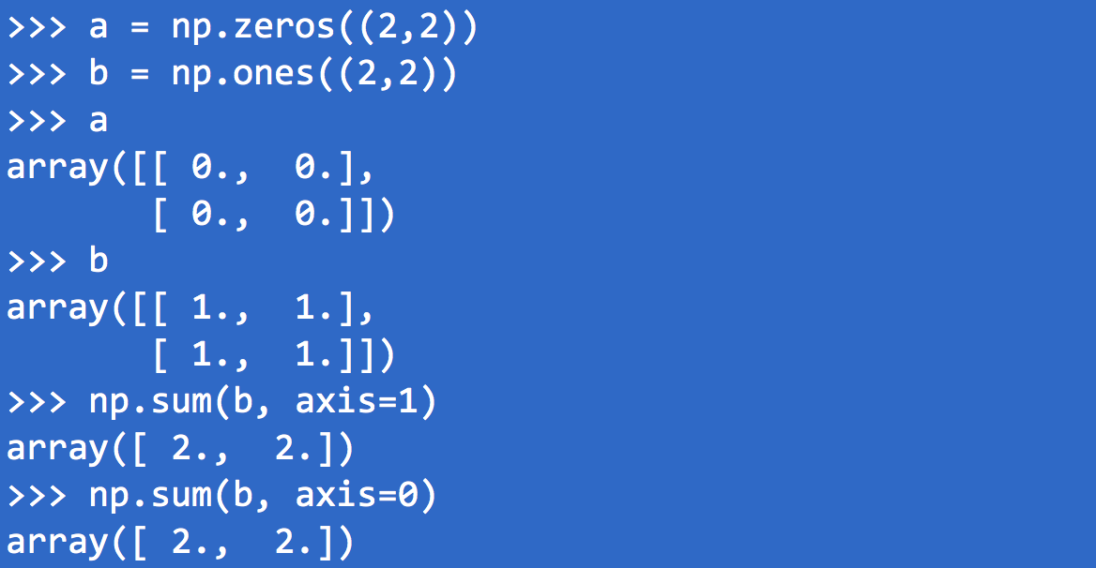
Programming with Matrix
A quick review on Numpy’s matrix support
What is the result of c = np.sum(b, axis=1) + np.sum(a, axis=0)?

Slide 15
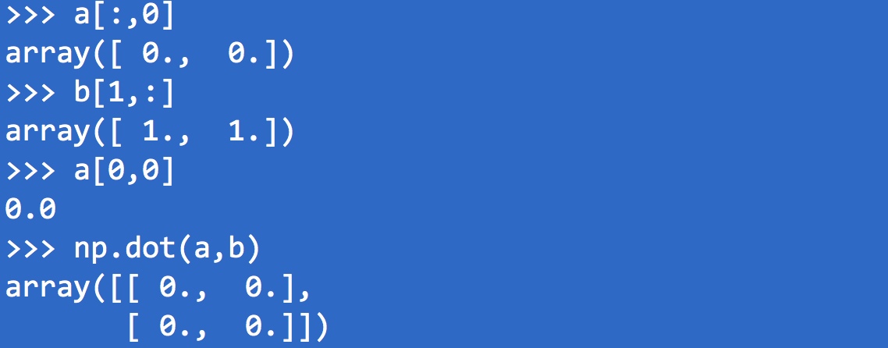
Numpy(cont’d)
What is the result of a[1,2] ?

Slide 16
Is Numpy good enough for NN?
Numpy
Does not include common operations in NN such as Softmax, RELU, sigmoid, …
Does not have support for GPU( as well as other accelerators)
Need to code derivatives manually
Tensorflow
Support more NN specific functions
More hardware platforms*
Can do derivatives automatically

Slide 17




Chips For Deep Learning?
Small set of basic operations:
Matrix algebra
Large market
Allows development of special purpose chips

Slide 18
Chips: Performance/Power
Type | Chip | Performance | Power
CPU | Xeon E7-8894 v4 | 2.6TFlops (single precision) | 50W
FPGA | Stratix 10 2800 | 9.2TFlops (single precision) | 100W
GPU | nVidia V100 | 125TFlops (For deep learning) | 300W
TPU | Cambricon MLU100 | 166TFlops (for deep learnings, with reduced weight) | 100W

Slide 19
Chips: Software Support
GPU: cuDNN
CPU: MKL-dnn
FPGA: MKL-dnn
TPU:

Slide 20
Programming with Tensorflow
Describe a mathematic function
Optimize the parameters of the function
Tensor and operators are provided to write these functions
tensor shapes:
X[100, 748]
W[748,10]
b[10]
HX = tf.nn.softmax(tf.matmul(X, W) + b)
Operator:matrix multiply
broadcast on all lines
Underlying implementation leverages matrix libraries like cuDNN and MKL

Slide 21
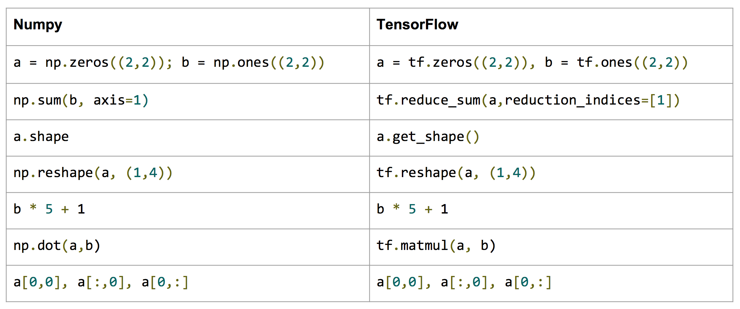
Numpy to Tensorflow*
*Stanford CS224d Tensorflow Tutorial

Slide 22
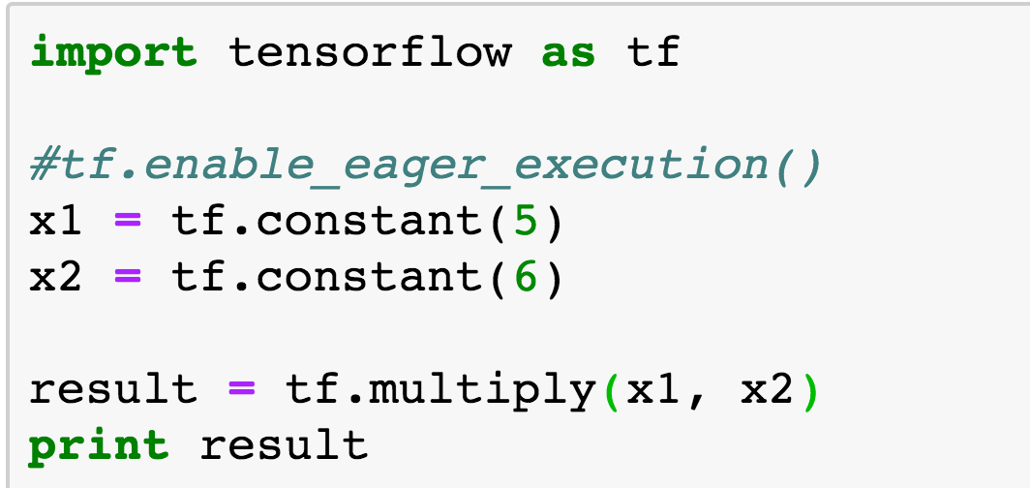
A simple example
Notes:
Tensorflow_programming.ipynb

Slide 23
Phases of Tensorflow Programs
Phase 1
Build a computation graph(Neural Network)
At this phase, no real calculation operations are triggered
Phase 2
Compute
Usually triggered by run()
X
W
Y
*
dot
b
+
reduce_sum
softmax
minus
log
cross_entropy

Slide 24
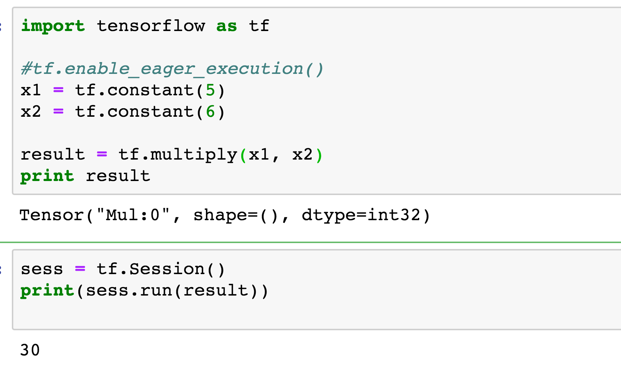
Use session

Slide 25
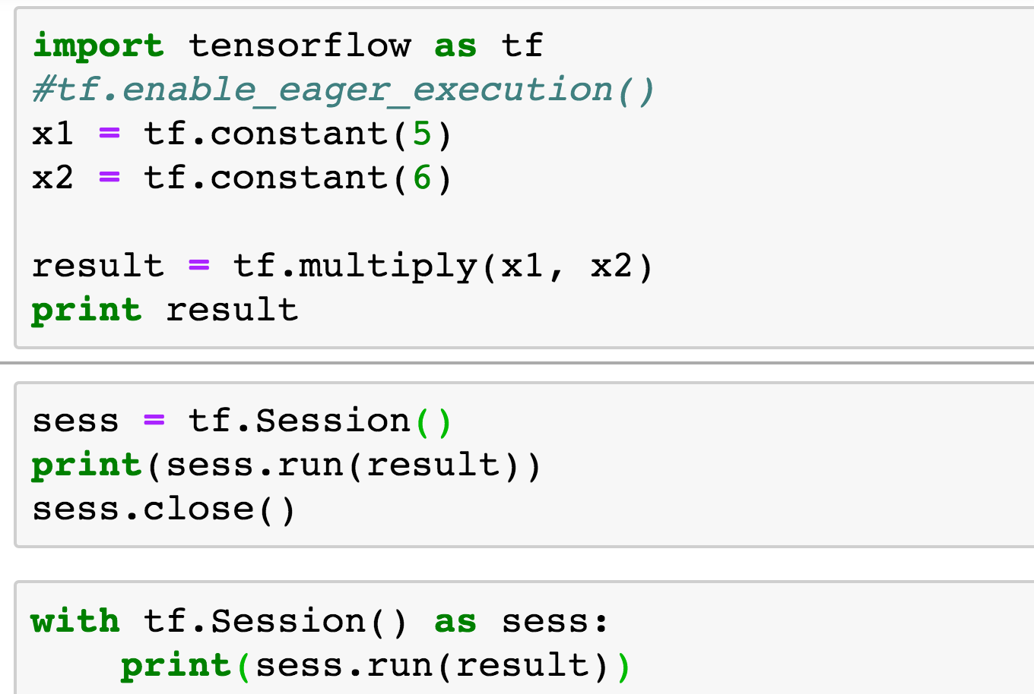
“With” statement

Slide 26
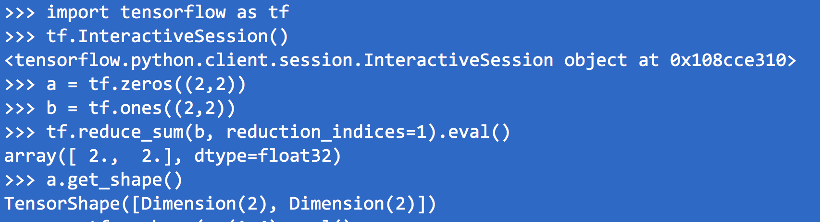
Use InteractiveSession
InteractiveSession : Keep a default session open
c.eval() : session.run(c)

Slide 27
Challenges
Running matrix operations efficiently
Getting derivatives right
Scheduling operators
Distributed training
Debugging

Slide 28
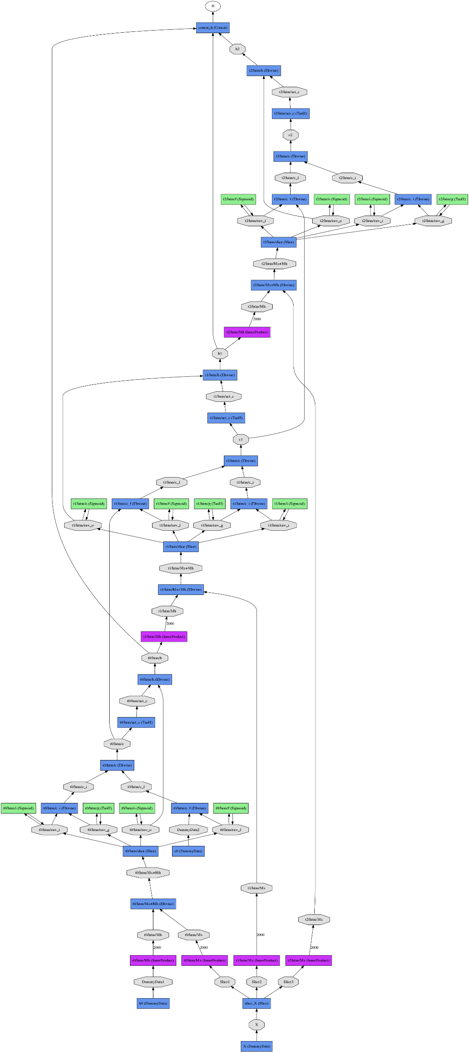
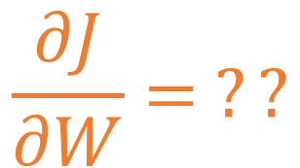
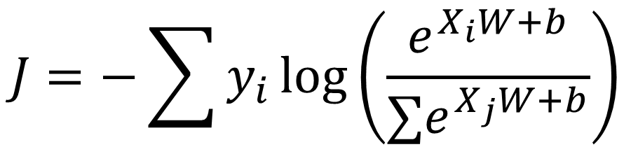
Getting derivatives right
$$J=−\sum{y_{i}\log\left(\frac{e^{X_{i}W+b}}{∑e^{X_{j}W+b}}\right)}$$
$$\frac{∂J}{∂W}= ??$$
Calculating derivatives by hand is error-prone
Especially with complex networks
We should do it automatically

Slide 29




Automatically calculate derivatives
Describe the network as a function
X is unknown at the time of definition
W and b have initial values, but should be changed during training
10 columns
^{w}0,0 ^{w}1,0 ^{w}2,0 ^{w}3,0 ^{w}4,0 ^{w}5,0 ^{w}6,0 ^{w}7,0 ^{w}8,0
^{w}0,1 ^{w}1,1 ^{w}2,1 ^{w}3,1 ^{w}4,1 ^{w}5,1 ^{w}6,1 ^{w}7,1 ^{w}8,1
^{w}0,2 ^{w}1,2 ^{w}2,2 ^{w}3,2 ^{w}4,2 ^{w}5,2 ^{w}6,2 ^{w}7,2 ^{w}8,2
^{w}0,3 ^{w}1,3 ^{w}2,3 ^{w}3,3 ^{w}4,3 ^{w}5,3 ^{w}6,3 ^{w}7,3 ^{w}8,3
^{… w}0,9
^{… w}1,9
^{… w}2,9
^{… w}3,9
^{… w}4,9
^{… w}5,9
^{… w}6,9
^{… w}7,9
^{… w}8,9
$$W$$
784 lines
x
x
x
$$L= X.W+b$$
X : 100 images, one per line, flattened
x
x
x
x
…
x
^{w}783,0 ^{w}783,1 ^{w}783,2
^{… w}783,9
^{L}0,0 ^{L}0,1 ^{L}0,2 ^{L}0,3 ^{L}1,0 ^{L}1,1 ^{L}1,2 ^{L}1,3 ^{L}2,0 ^{L}2,1 ^{L}2,2 ^{L}2,3 ^{L}3,0 ^{L}3,1 ^{L}3,2 ^{L}3,3 ^{L}4,0 ^{L}4,1 ^{L}4,2 ^{L}4,3
…
^{L}99,0 ^{L}99,1 ^{L}99,2
……L_{0,9}
^{… L}1,9
^{… L}2,9
^{… L}3,9
^{… L}4,9
^{… L}99,9
+
b₀ b₁ b₂ b₃ … b₉
$$X$$
$$b$$
+ Same biases on all lines

Slide 30
Placeholders and variables
Both are symbols
Variables are used to represent weights that need to be trained (W and b)
Placeholders are used for non-changing data (X, Y)

Slide 31
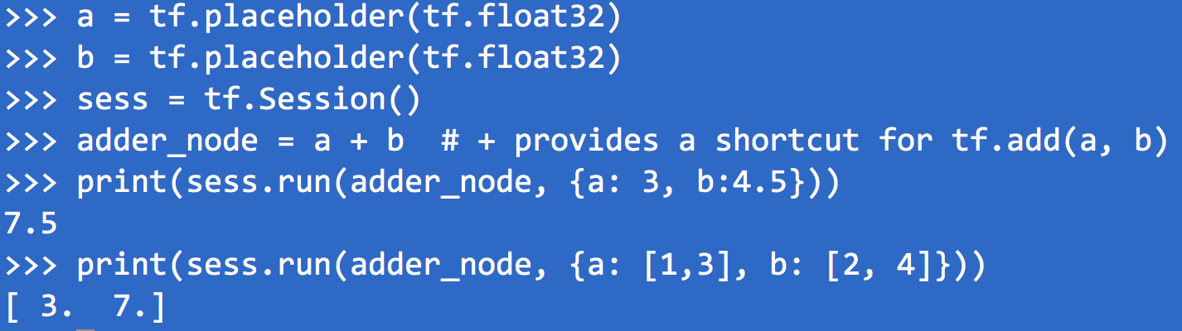
Placeholder Example
Notes:
Check placeholder.ipynb

Slide 32
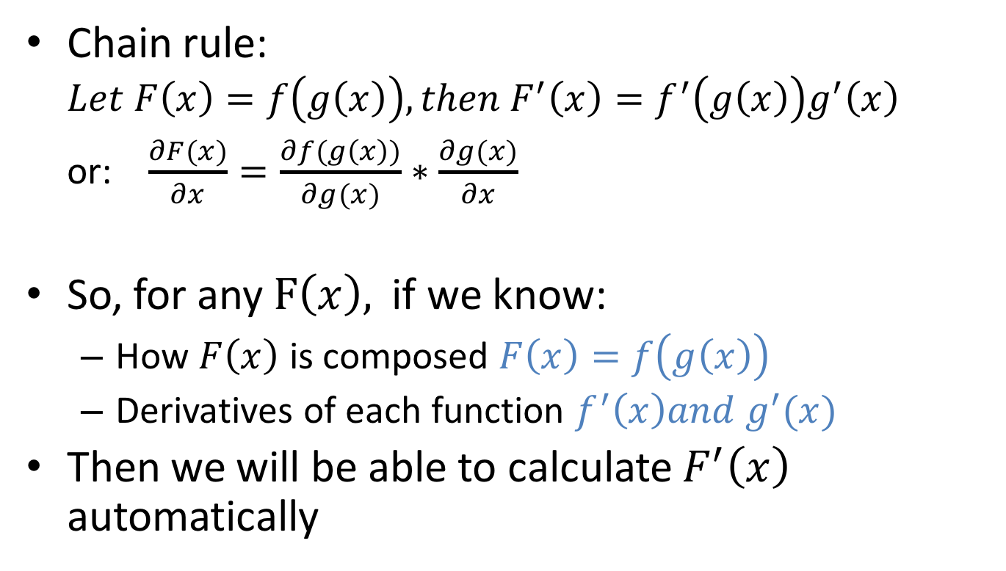
Auto-derivative: principle
Chain rule:
$$Let F\left(x\right)=f\left(g\left(x\right)\right), then F^{′}\left(x\right)=f^{′}\left(g\left(x\right)\right)g^{′}\left(x\right)$$
or: $\frac{∂F(x)}{∂x}=\frac{∂f(g\left(x\right))}{∂g(x)}∗\frac{∂g(x)}{∂x}$
So, for any $F\left(x\right),$ if we know:
How $F\left(x\right)$ is composed $F\left(x\right)=f\left(g\left(x\right)\right)$
Derivatives of each function $f^{′}\left(x\right)and g^{′}(x)$
Then we will be able to calculate $F^{′}\left(x\right)$ automatically

Slide 33
Auto-derivative: tracking dependencies
Tracking function composition through symbolic graph
Code
Symbolic Graph
A = tf.Variable(‘A’)
B = tf.Variable(‘B’)
A
B
*
C = A * B
D = tf.Variable(‘D’)
C
D
*
E = C * D
E
E = A * B * D

Slide 34
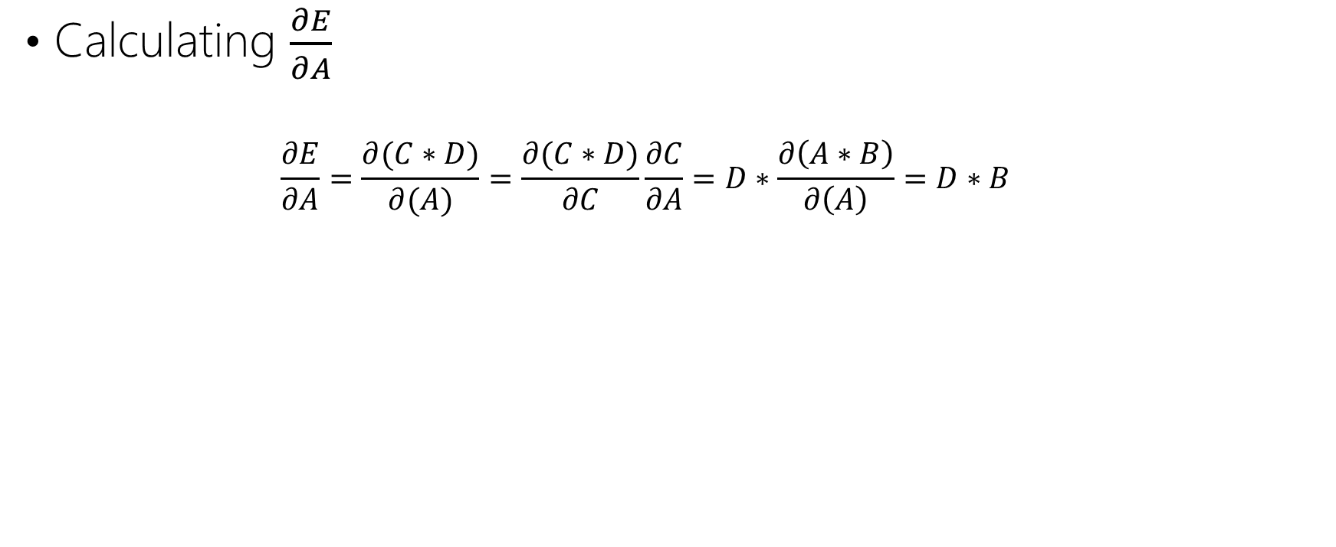


Auto-derivative: using dependencies
Calculating $\frac{∂E}{∂A}$
$$\frac{∂E}{∂A}=\frac{∂(C∗D)}{∂(A)}=\frac{∂(C∗D)}{∂C}\frac{∂C}{∂A}=D∗\frac{∂\left(A∗B\right)}{∂\left(A\right)}=D∗B$$
forward pass
backward propagation
A
B
B
*
C
D
$$\frac{∂C}{∂A}$$
D
*
*
E
$$\frac{∂E}{∂A}$$
Notes:
the partial derivative of E with respect to A

Slide 35





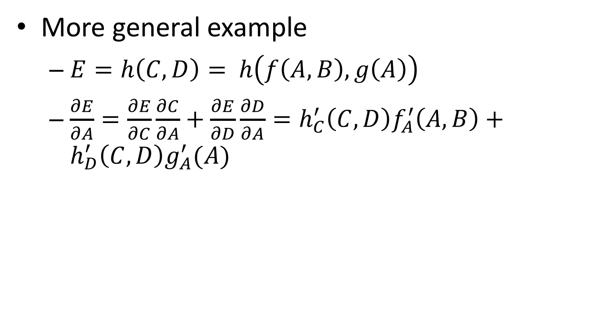
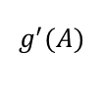





Auto-derivative: more general example
More general example
$E={h\left(C, D\right)=}_{ }h\left(f\left(A,B\right), g\left(A\right)\right)$
$\frac{∂E}{∂A}=\frac{∂E}{∂C}\frac{∂C}{∂A}+\frac{∂E}{∂D}\frac{∂D}{∂A}=h_{C}^{′}\left(C,D\right)f_{A}^{′}\left(A,B\right)+h_{D}^{′}\left(C,D\right)g_{A}^{′}(A)$
B
A
$$g^{′}$$
C
D
B
A
$$f^{′}$$
$$h_{C}^{′}$$
$$h_{D}^{′}$$
f
g
$$f_{ }^{′}(A,B)$$
$$g_{ }^{′}(A)$$
$$h_{C}^{′}\left(C,D\right)$$
$$h_{D}^{′}\left(C,D\right)$$
C
D
$$h_{C}^{′}\left(C,D\right)f_{A}^{′}\left(A,B\right)$$
$$h_{D}^{′}\left(C,D\right)g_{A}^{′}(A)$$
h
E
+
$$\frac{∂E}{∂A}$$

Slide 36
Auto-derivatives: usage
backward() is defined for every native operation (matmul, softmax, sigmoid, …)
User writes “symbolic” code to construct the forward graph
tf.gradients() provides auto calculated derivatives

Slide 37
Example auto derivative code
HX = tf.nn.softmax(tf.matmul(X, W) + b)
J = -tf.reduce_sum(Y * tf.log(HX))
gradw = tf.gradients(J, W)
gradb = tf.gradients(J, b)
X, Y, W, b, HX, J are all symbols
This is like writing a formula, then feed each symbol with real data
Notes:
Check auto_derivated.ipynb

Slide 38
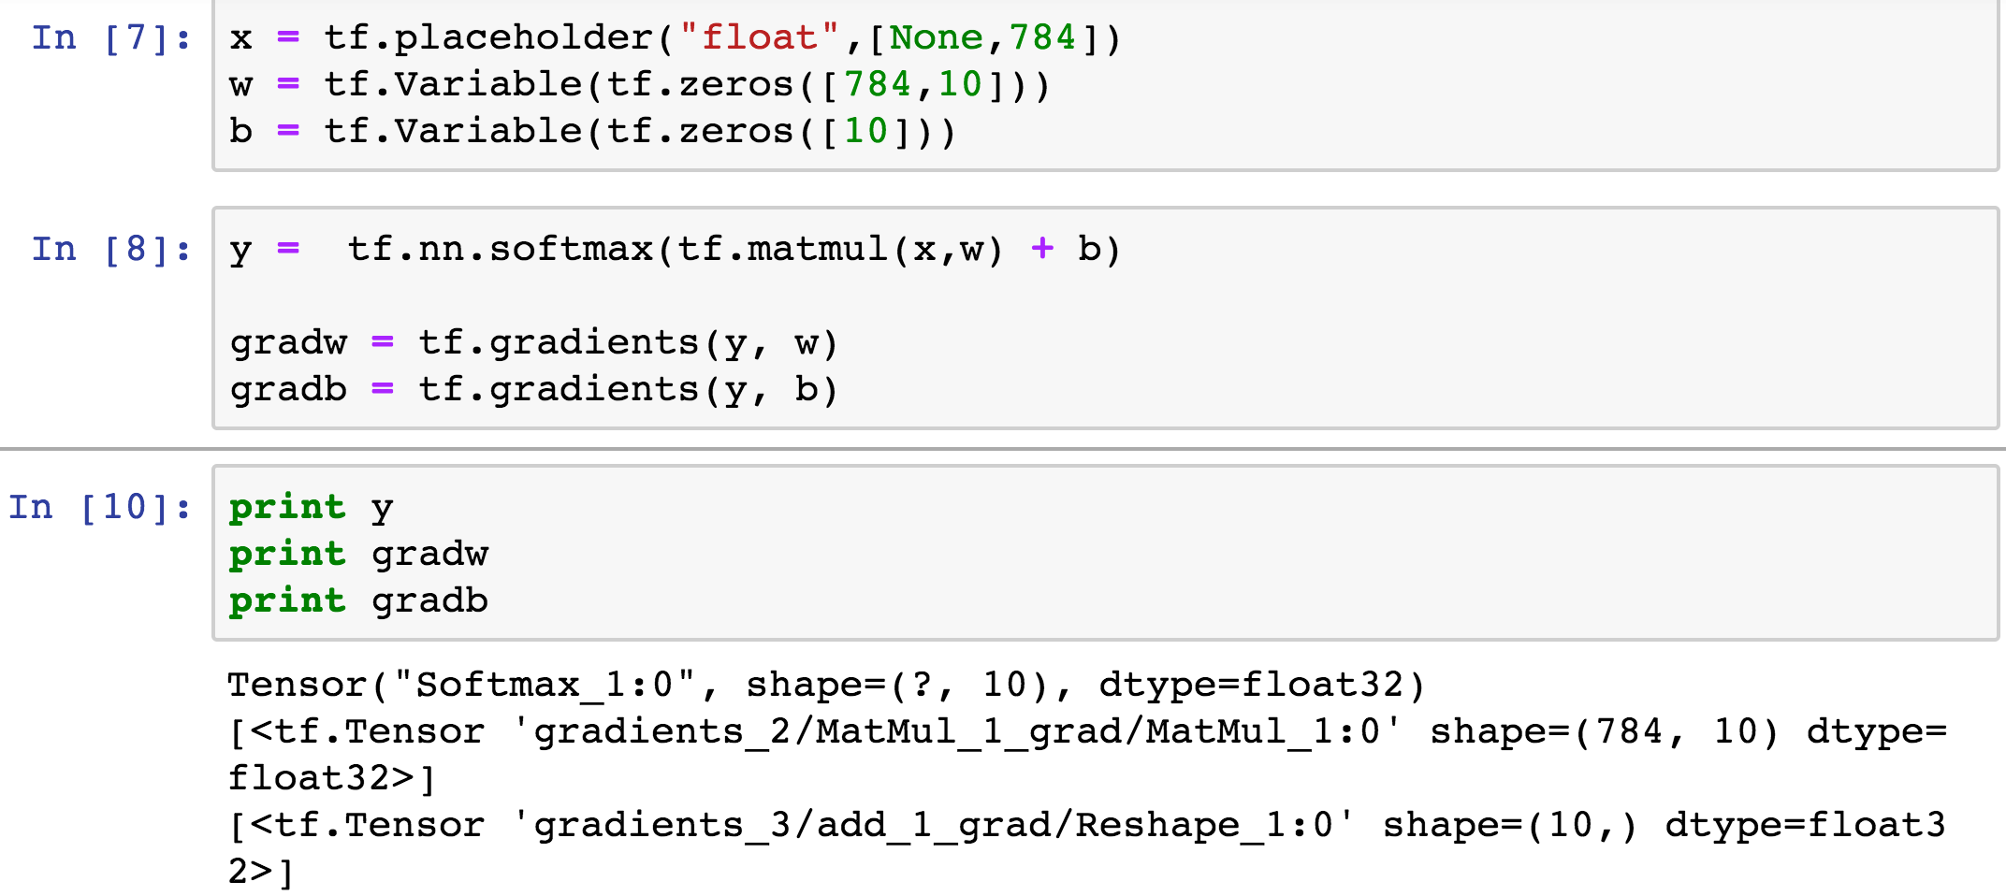
A derivative example

Slide 39
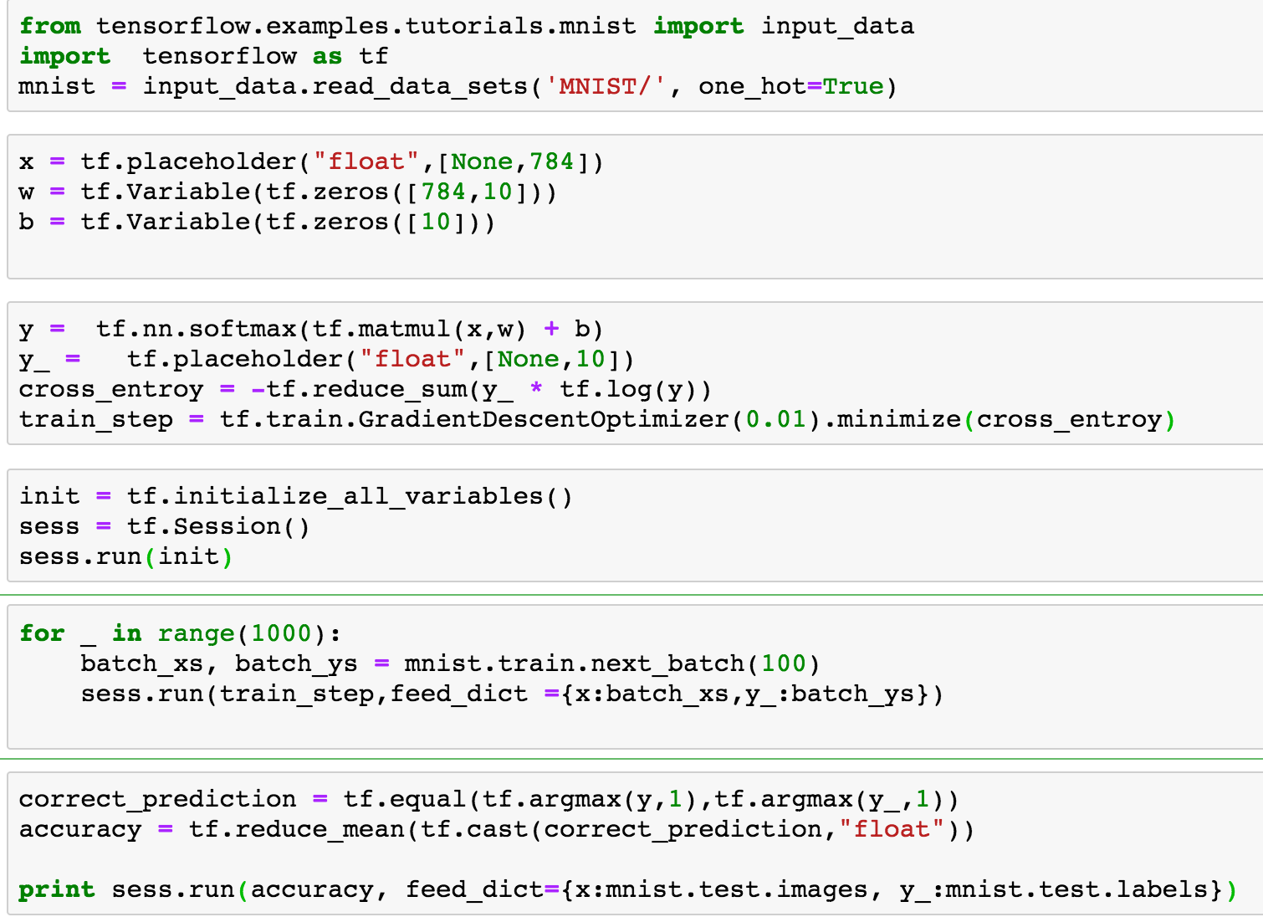
A softmax program example

Slide 40
Build the Tensorflow Graph
Placeholder variables used to change the input to the graph.
Model variables that are going to be optimized so as to make the model perform better.
The model which is essentially just a mathematical function that calculates some output given the input in the placeholder variables and the model variables.
A cost measure that can be used to guide the optimization of the variables.
An optimization method which updates the variables of the model.

Slide 41
What the code really does
X
W
Y
Creates a computation graph
Run for 1000 iterations:
Feed each mini-batch to X and Y
Calculate loss function (cross_entropy)
Calculate the gradients with auto-derivatives
Update W and b
optimizer.minimize(cross_entropy)
*
dot
b
+
reduce_sum
softmax
minus
log
cross_entropy

Slide 42
Challenges
Running matrix operations efficiently
Getting derivatives right
Scheduling operators
Distributed training
debug

Slide 43
Scheduling operators
A lot of operators to be run
Multiple devices: CPU, GPU, FPGA, network…
Doing it right: dependency tracking
Efficiency: parallelism
Restrictions: GPU memory limit

Slide 44
Read dependency
Code
Dependency Order
A = 2
B = A + 1
C = A + 2
D = B * C
A = 2
C = A + 2
B = A + 1
D = B * C
dependency
operations

Slide 45
Write dependency
Code
Dependency Order
A = 2
B = A + 1
…
B = A * 2
A = 2
B = A + 1
B = A * 2

Slide 46
Implicit dependency: delete
Code
Dependency Order
A = 2
B = A + 1
…
A.__del__()
A = 2
B = A + 1
A.__del__()

Slide 47
Implicit dependency: shared resource
Code
Dependency Order
rnd = RandomGenerator()
# The usages of same random number generator need to be serialized.
B = rnd.uniform(10, -10)
C = rnd.uniform(10, -10)
rnd=RandomGenerator()
B=rnd.unifrom()
C=rnd.uniform()

Slide 48
Tracking dependency with DAG
Directed Acyclic Graph, in which:
Operation is a node
Dependency is an edge
Operation with no incoming edges can be executed
Satisfied dependency edge is removed
A = 2
C = A + 2
B = A + 1
D = B * C

Slide 49
Tracking dependency with DAG
A = 2
C = A + 2
B = A + 1
D = B * C

Slide 50
Tracking dependency with DAG
A = 2
C = A + 2
B = A + 1
D = B * C

Slide 51
Tracking dependency with DAG
A = 2
C = A + 2
B = A + 1
D = B * C

Slide 52
Tracking dependency with DAG
A = 2
C = A + 2
B = A + 1
D = B * C

Slide 53
Tracking dependency with DAG
A = 2
C = A + 2
B = A + 1
D = B * C

Slide 54
Tracking dependency with DAG
A = 2
C = A + 2
B = A + 1
D = B * C

Slide 55
Scheduling for efficiency
Different scheduling policy may yield different performance
Breath-first:
high parallelism
high memory pressure
Depth-first:
low parallelism
good temporal locality
small memory footprint
Critical path first:
Nodes on critical path always get highest priority

Slide 56
Kernel Fusion
NNs are expressed as a lot of operations, executed as “kernels”
Matrix multiplication
Matrix addition
Softmax
Sigmoid
…
Each kernel needs to read-calculate-write
Eats up memory bandwidth
Launch kernel may have overhead
~10us for GPU

Slide 57
Kernel Fusion
B = -A
C = exp(B)
D = 1 + C
E = 1/D
E = sigmoid(A),
where:
sigmoid(x) = 1/(1+exp(-x))
Reduces kernel invocation from 4 to 1
Reduces launch overhead
Reduces memory bandwidth consumption
Reduces memory pressure

Slide 58
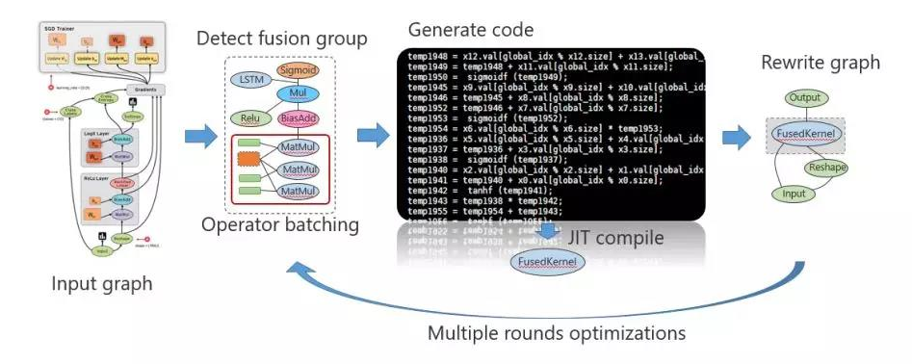
Kernel Fusion
Manual
Write sigmoid, softmax, etc.
Compile-time
Use C++ template
mshadow, eigen, uBLAS
Runtime JIT
TVM, Taco, XLA

Slide 59
Scheduling with resource constraint
GPU memory is very limited: 16GB maximum
GPU need as much parallelism as possible
Need to balance parallelism and memory consumption

Slide 60
Challenges
Running matrix operations efficiently
Getting derivatives right
Scheduling operators
Distributed training
debug

Slide 61
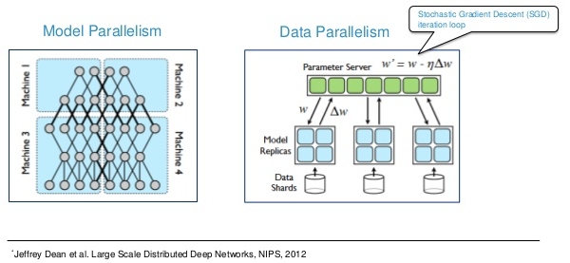
Data Parallelism & Model Parallelism
Data parallel: model is replicated, data is partitioned
Model parallel: model is partitioned, data is replicated

Slide 62

Data Parallel Training
In each iteration:
each worker reads different mini-batch of size M, produces gradient
communicate to produce aggregated gradient
update weights
weights
weights
weights
Communication
gradient
gradient
gradient

Slide 63
Parameter Server
Parameter server
2. Aggregate gradient for each parameter
1. Push gradients
Model replicas
Data partitions
Workers
Notes:
One popular way to synchronize between the workers is using parameter servers.
In this approach, after a worker produces a gradient, it will push the gradient to the parameter server.
The parameter server will aggregate the gradients from the workers, and then use the aggregated gradient to update the model.

Slide 64
Distributed Tensorflow
Enables training on multiple machines
Implemented with Parameter Server
Allows both synchronous and asynchronous training

Slide 65
Communication Cost in distributed training
In each iteration, each worker at least send/receive data the same size as the model
For ImageNet, this is typically 100~500MB
If we communicate too frequently, communication can become bottleneck
Even worse, communication cost can grow O(NP) or O(NlogP) if not carefully designed

Slide 66
Dealing with Communication: Hardware
High-bandwidth network
56Gbps RoCE
100Gbps Infiniband
RDMA
Reduces latency from 20us to 1us
In-network reduction

Slide 67
Asynchronous communication
Compute Nth data while communicating gradient of (N-1)th part
Or, more generally, tolerate N-t staleness
Overlap communication with computation
Tolerate stragglers

Slide 68
Communication Threshold
Communicate only gradients that are big enough
Reduces amount of data to transfer
G
index
3
4
1e-5
1e-6
1e-6
1e-2
2e-2
1e-7
1e-8
1e-7
gradients
1e-2
1e-2

Slide 69
Gradient Encoding
Instead of 32bit floats to represent gradients
We can use 16bit
8bit
Even 1bit

Slide 70
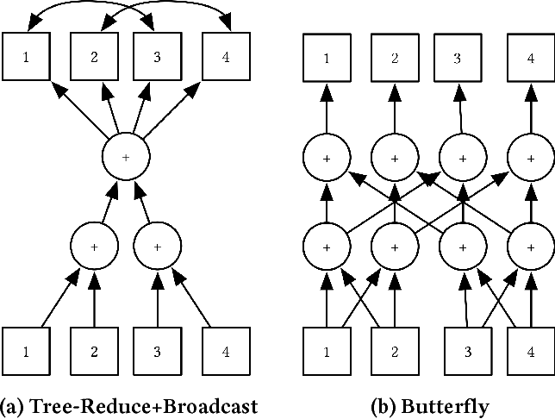

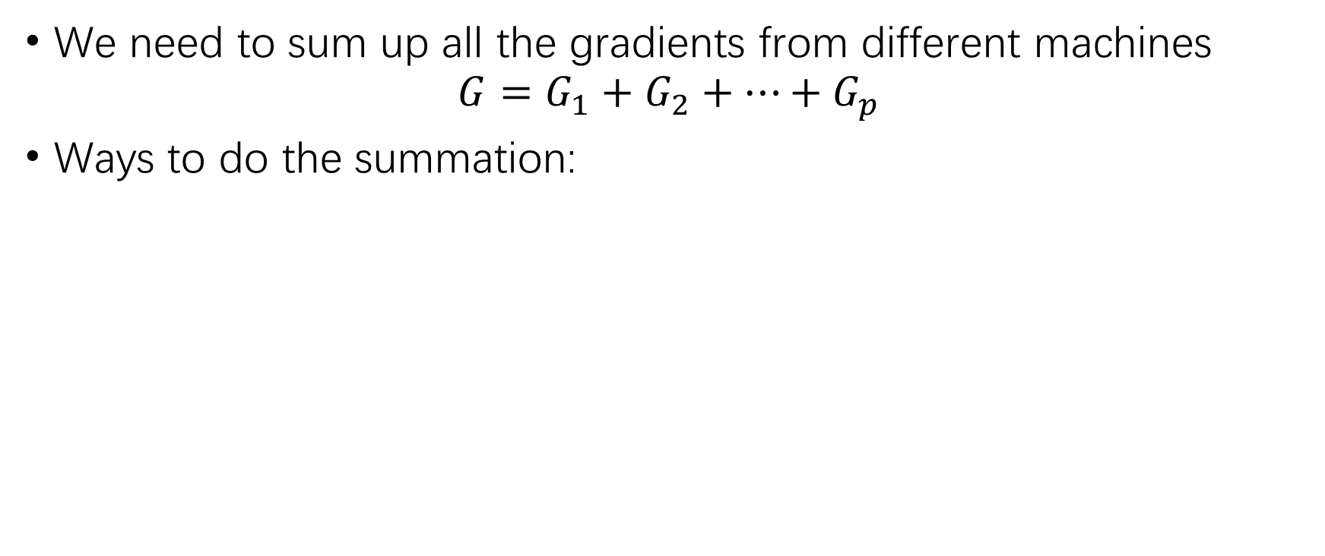




AllReduce
We need to sum up all the gradients from different machines
$$G=G_{1}+G_{2}+…+G_{p}$$
Ways to do the summation:
$$G_{}$$
$$G_{1}$$
$$G_{2}$$
$$G_{3}$$
$$G_{p}$$
O(NP)
O(NlogP)
O(N)

Slide 71
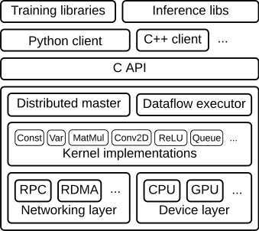
Summary: Tensorflow architecture

Slide 72
Challenges
Running matrix operations efficiently
Getting derivatives right
Scheduling operators
Distributed training
debug

Slide 73
Debugging used to be difficult
What TF programs look like:
Build a model
Run it with session.run()
X
Y
*
W
dot
a,c = sess.run([cross_entropy],
feed=train_data)
b
+
reduce_sum
This is a black box!
softmax
minus
log
cross_entropy

Slide 74
Eager mode or debug
Use eager mode with newest TF
Use debug
…
sess = tf_debug.LocalCLIDebugWrapperSession(sess)
sess.run(…)
Now we can print the internal nodes of the graph:
pt prints value of a tensor
li list inputs of a tensor
lo list recipients of a node
…

Slide 75
MISC
Pytorch
Mxnet
Caffee
Keras
Tensorflow 2.0

Slide 76

Pytorch
Developed by Facebook
Originally developed on LUA, then rewritten with Python
Dynamic graph, easier to write & debug, but less efficient

Slide 77

mxnet
Jointly effort of several DL framework teams
MSRA Minerva, U Washington cxxnet, NUS Purion, CMU Parameter Server
Now supported by Apache foundation
Supports both static and dynamic graphs

Slide 78
Caffee
Developed by UC Berkeley
Originally developed with C++, no other programming interface
Reads model from Prototxt file
Caffee 2 was developed in Facebook, now merged into Pytorch

Slide 79
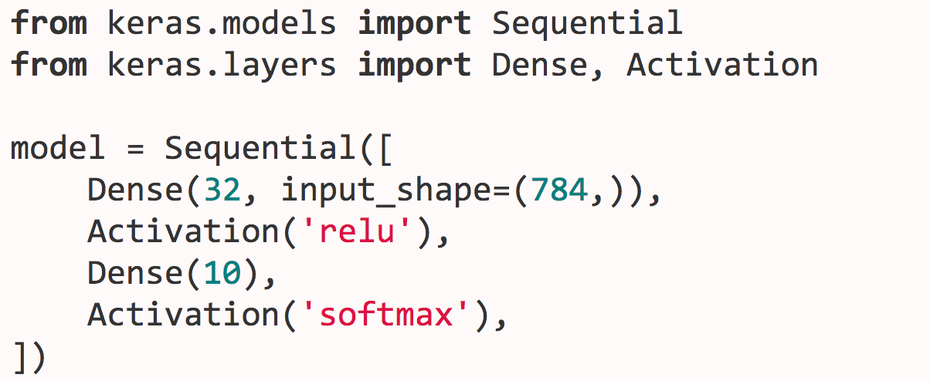
Keras
Higher level framework
Built on top of Tensorflow, mxnet, pytorch …

Slide 80
Tensorflow 2.0
Provides tf.data to load data
Eager execution made default
No more tf.Session
Tightly integrated with Keras

Slide 81
Lab
Subset of CAPTCHA
Step 1
Run a existing program
Step 2
Given a Keras program with missing statement, make it running
Step 2
Improve the network to get better result

