Slide 1
INPUT FEATURE SET
ENCODER
Task 2
DEEP NETWORK
OUTPUT 2 = HEALTHY/FAILED
Task 1
AUTOENCODER
L₂: Classification Loss
LATENT
SPACE
DECODER
OUTPUT 1 = INPUT
L₁: Reconstruction Loss
L_{p}: Sparse Penalty
Total Framework Loss = L₁ + L₂ + L_{p}

Slide 2
PROSSO10200 | PROSSO10400 | … | PDE_CLUTCH
12.31 | 41.4 | … | 0
… | … | … | …
123.4 | 145.2 | … | 1
x1 | x2 | … | xn
0.3 | 0.4 | … | 0
… | … | … | …
6.5 | 3.4 | … | 1
STATE
HEALTHY - 0
FAILED - 1
HEALTHY - 0
INPUT DATA SPLIT
75%/25% split for healthy data
70%/30% split for failed data

Slide 3
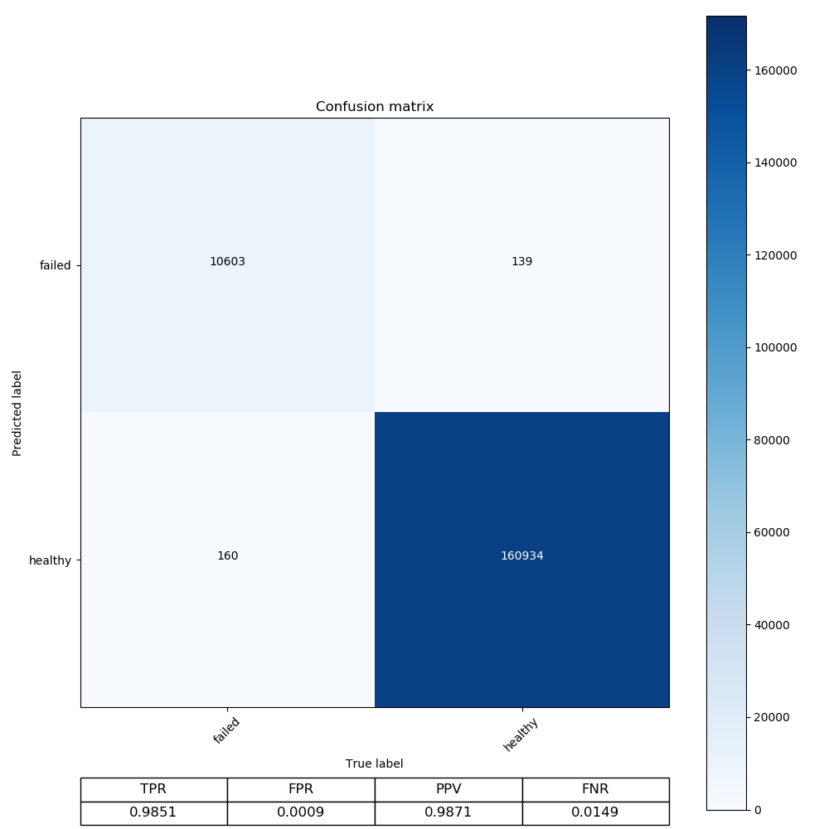

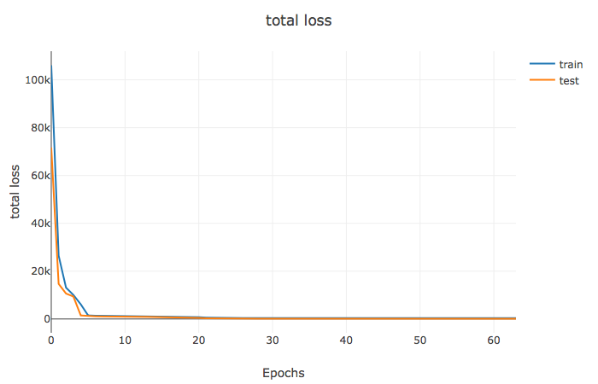
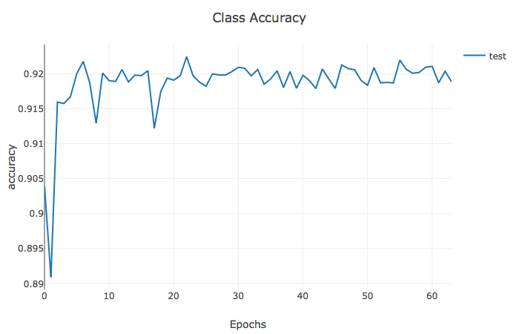
Neural Network…4 hidden layers
Current Progress for new architecture

Slide 4
