Slide 1
Quicken Loans
Data Science Case Study
- Srishti Singh

Slide 2
Agenda
01
04
02
05
03
Introduction
Model Evaluation
Data Analysis
Improvements
Data Modeling
Q&A
06

Slide 3
Introduction

Slide 4
About the Case Study
Data from direct marketing campaigns of a European banking institution.
The campaings were based on phone calls to the clients, to access if the product (bank term despoit) would be subcribed by the customer.
Understand the data and deduce relevant insights from it.
Evaluate the current predictive model and suggest improvements.

Slide 5
Timeline
EDA
And Modeling
Improvements
Understand the data
Model Evaluation

Slide 6
02. Data Analysis

Slide 7
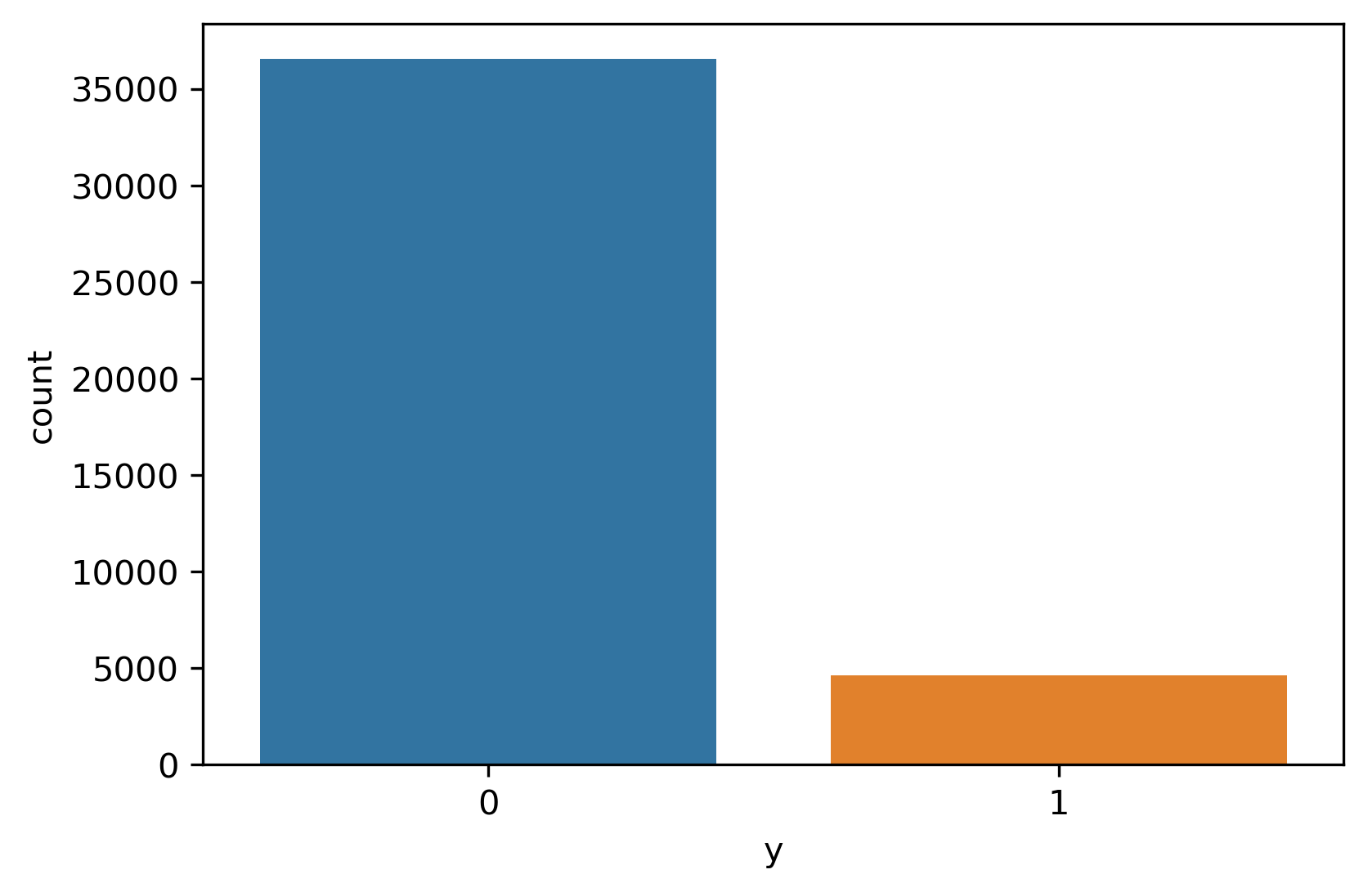
Data Description
One Data File (20 features and 41188 records)
20 Features:
  10 Numerical Features
  10 Categorical Features
41188 records:
  Imbalanced dataset (11% Target rate)
    88.7% not subscribed
    11.3% subscribed
  Each row corresponds to each client
Target Column:
  “Yes” -> Subscribed (1)
  “No” -> Not Subscribed (0)
Model Performance:
  Probability of subscribing based on current model

Slide 8
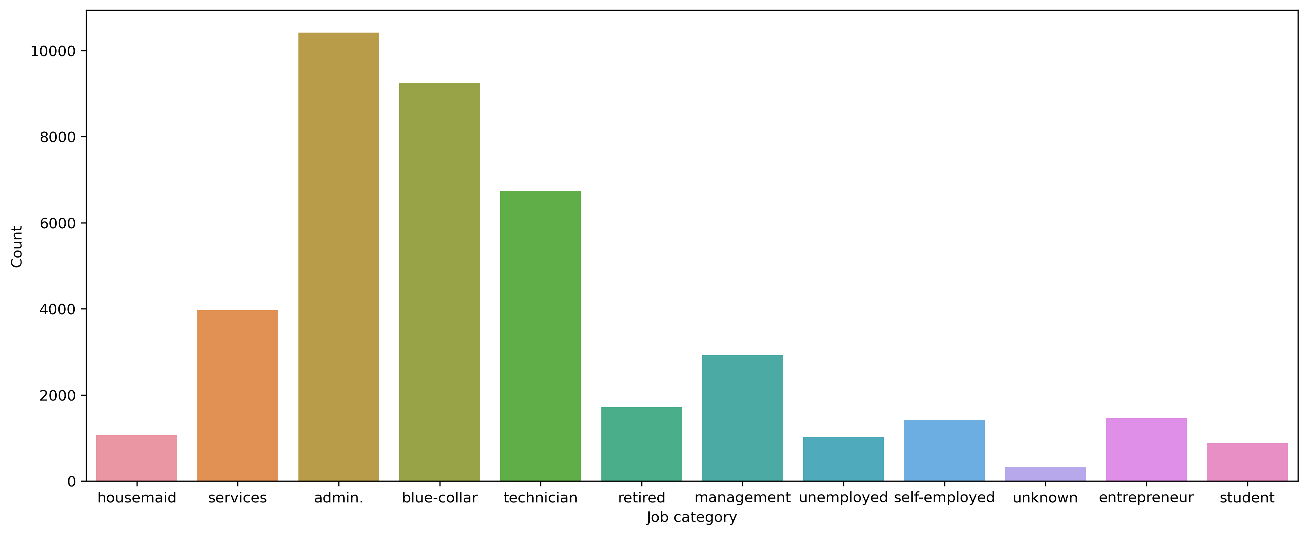
Exploratory Data Analysis
Admin, Blue-collar and Technician jobs form the bulk of the data.
Take Away:

Slide 9
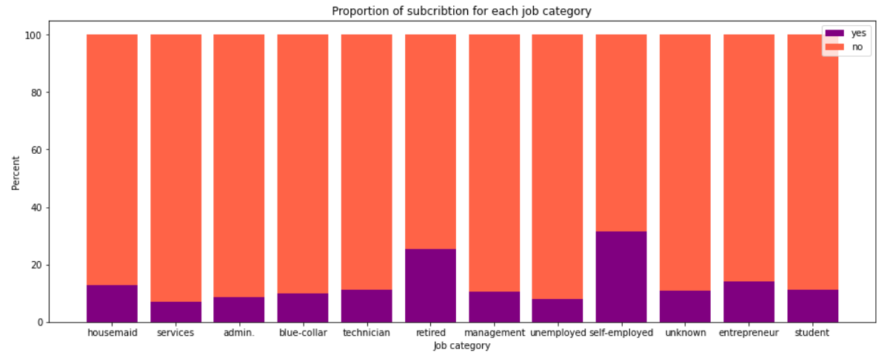
Exploratory Data Analysis
More clients who are retired or self-employed are subscribing.
Take Away:

Slide 10
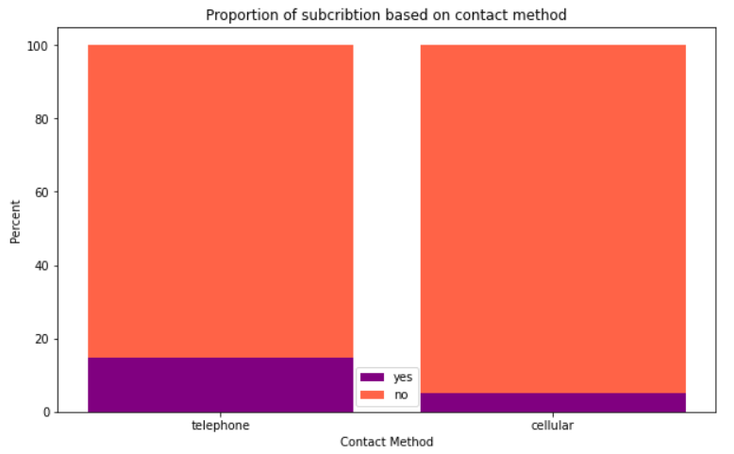
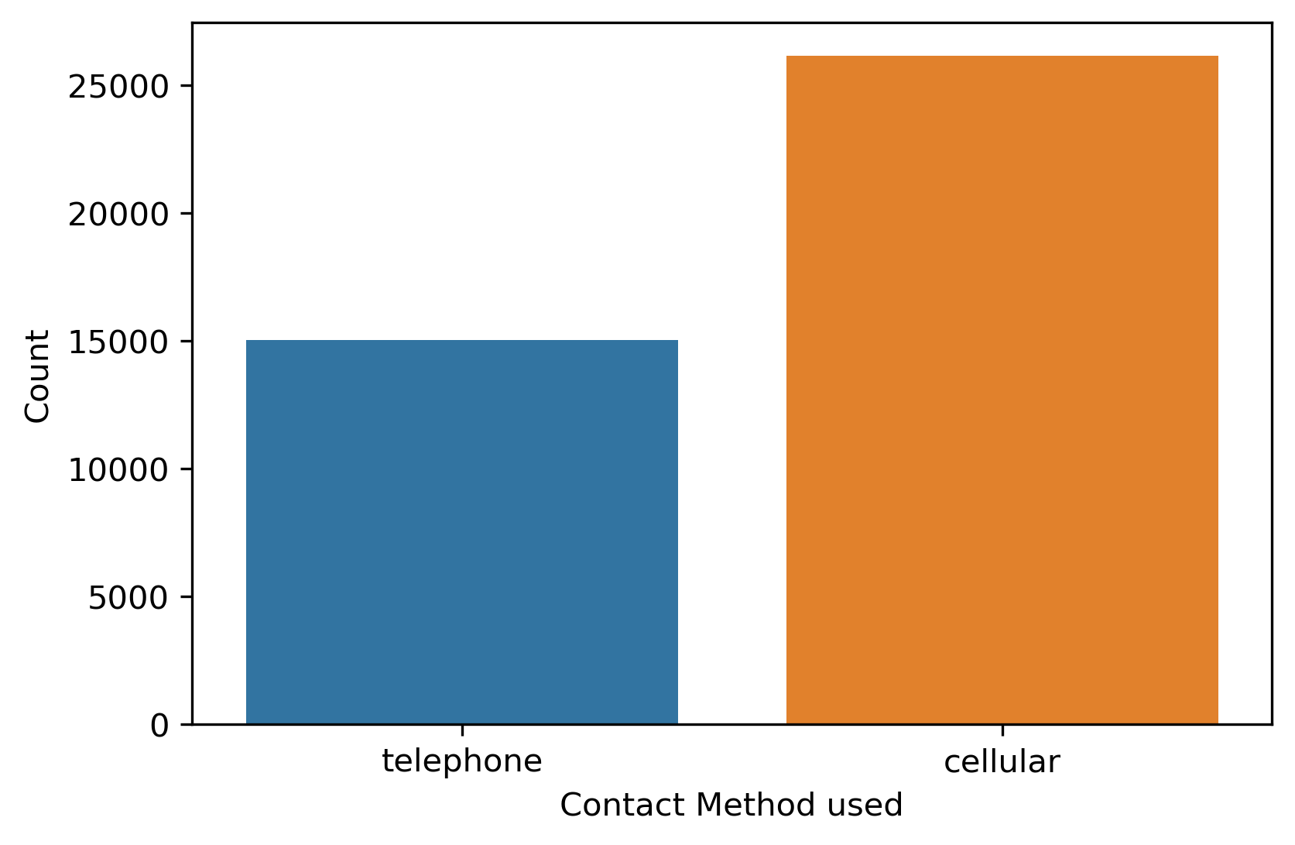
Exploratory Data Analysis
Take Away:
More subscribers from telephone contact.

Slide 11
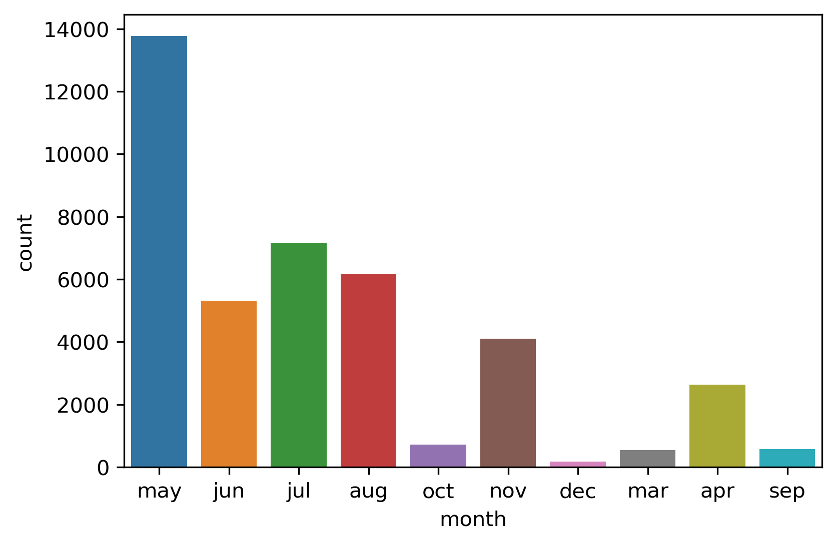
Exploratory Data Analysis
More contacts in the month of May.
Take Away:

Slide 12
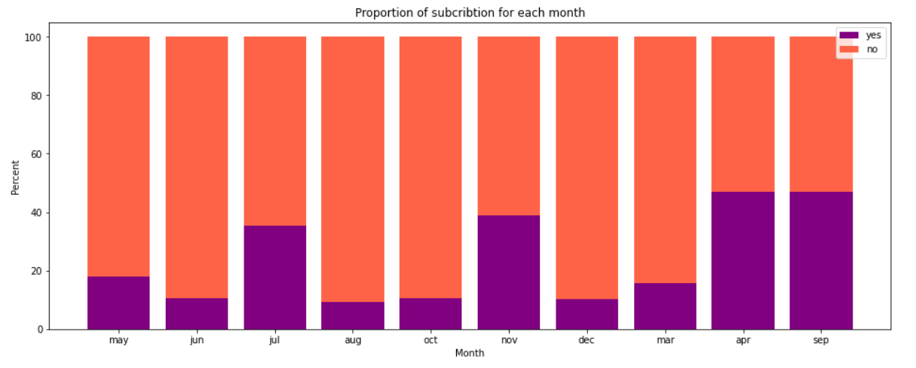
Exploratory Data Analysis
More subscribers in the month of April, September, November and July.
Take Away:

Slide 13
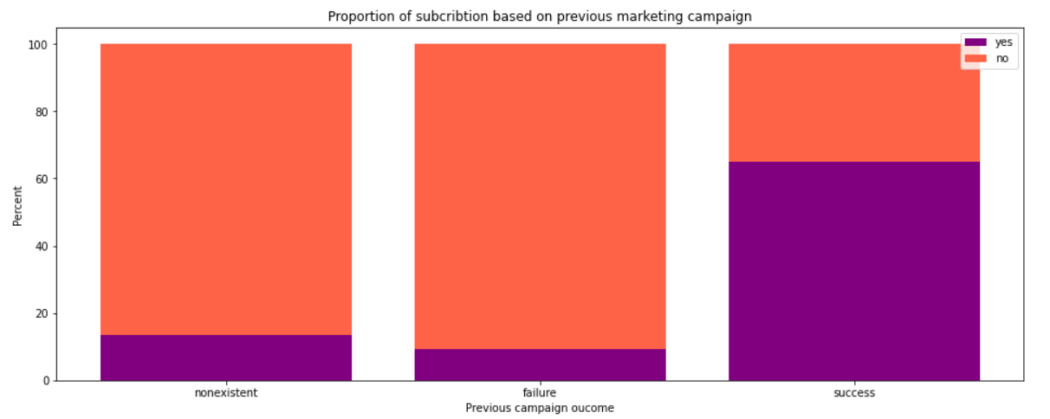
Exploratory Data Analysis
More likely to subscribe if previous campaign was successful.
Take Away:

Slide 14
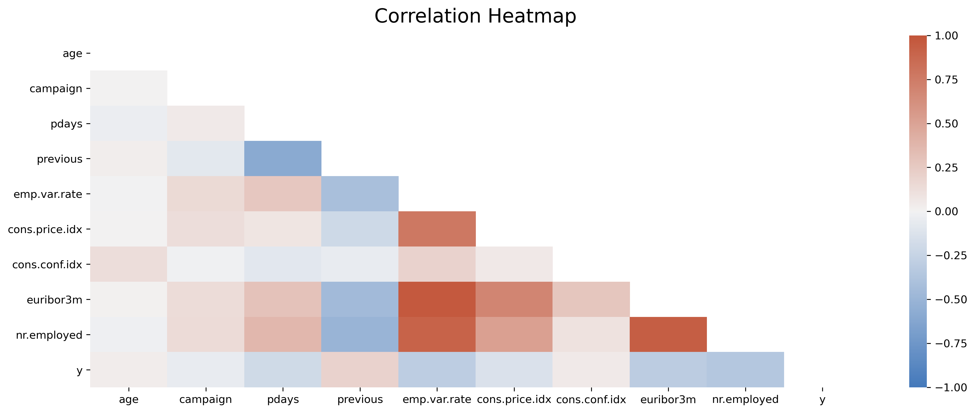
Exploratory Data Analysis
Highly correlated features!

Slide 15
03. Data Modeling

Slide 16
Data Preprocessing
No missing values.
10k rows with “unknown” values for a few categorical features.
12 duplicate records were removed.
Removed “Duration” feature.
Encoded target column using Label Encoder.
  1 = “Yes”
  0 = “No”
Scaled the numerical features.
Encoded the categorical features using One Hot Encoder.
Dropped the Model Predictions and y from the features data-frame.
Stored the transformed data-frame.
  41176 records
  62 features

Slide 17
Development Pipeline
Sampling Methods
Data Preprocessing
Up/Down Sampling
Classification Model
Predictions
Random Under Sampling
Random Over Sampling
K-means SMOTE
Algorithms that take class imbalance into account.

Slide 18
04. Model Evaluation

Slide 19
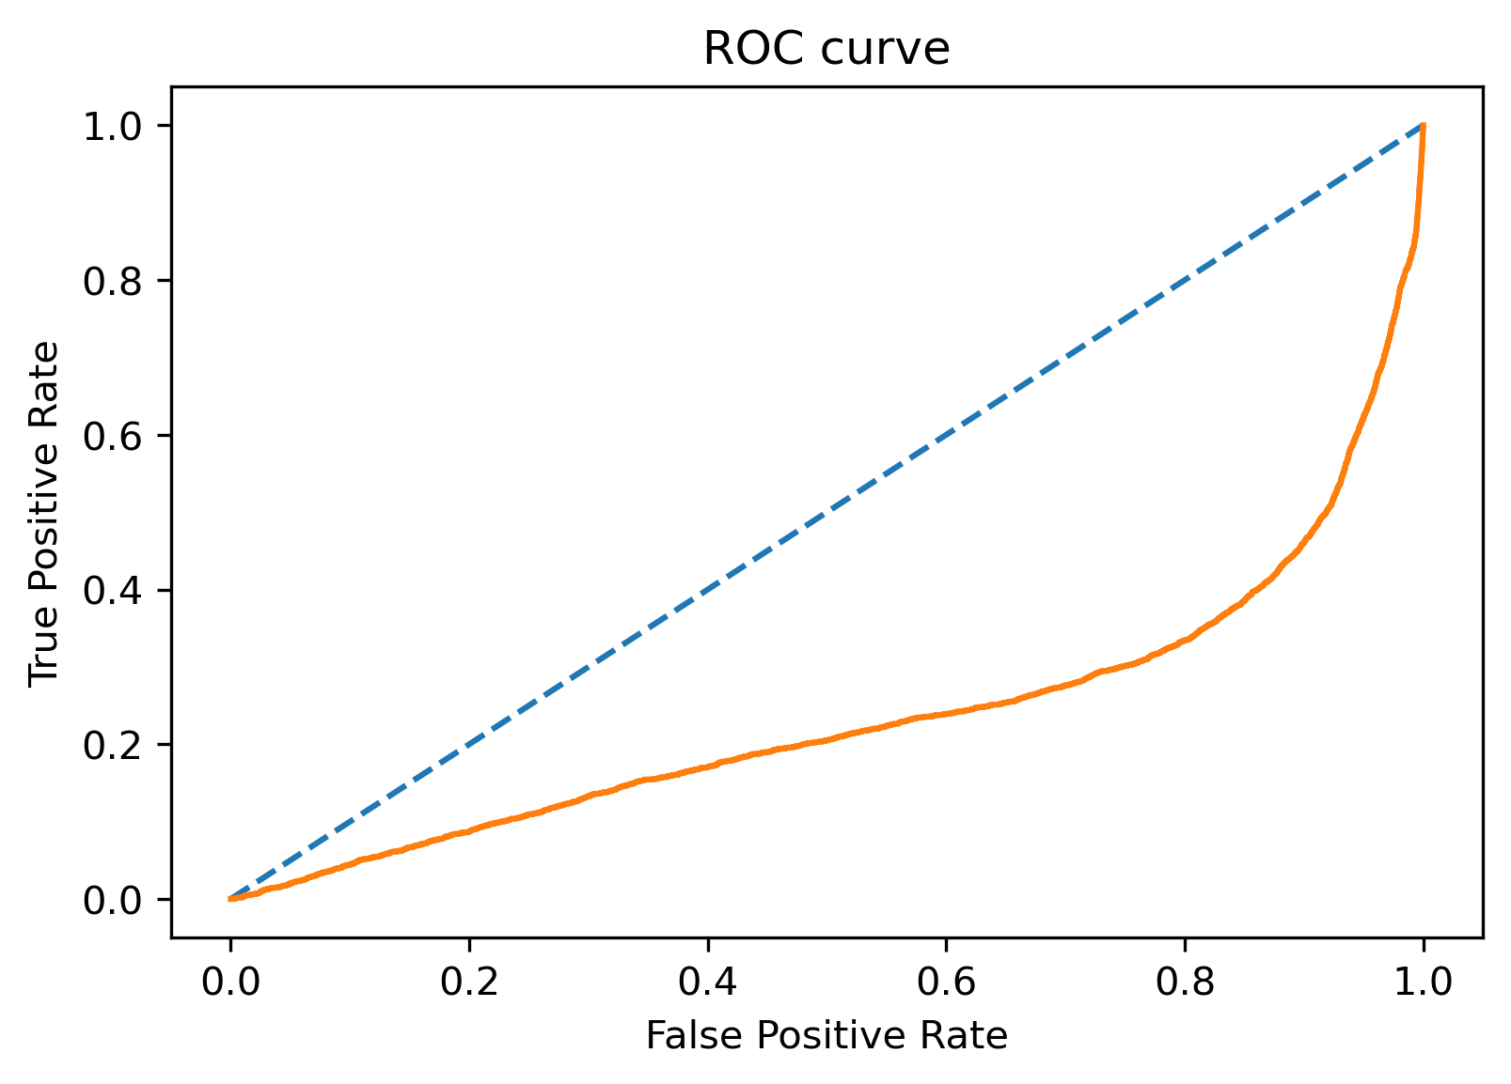
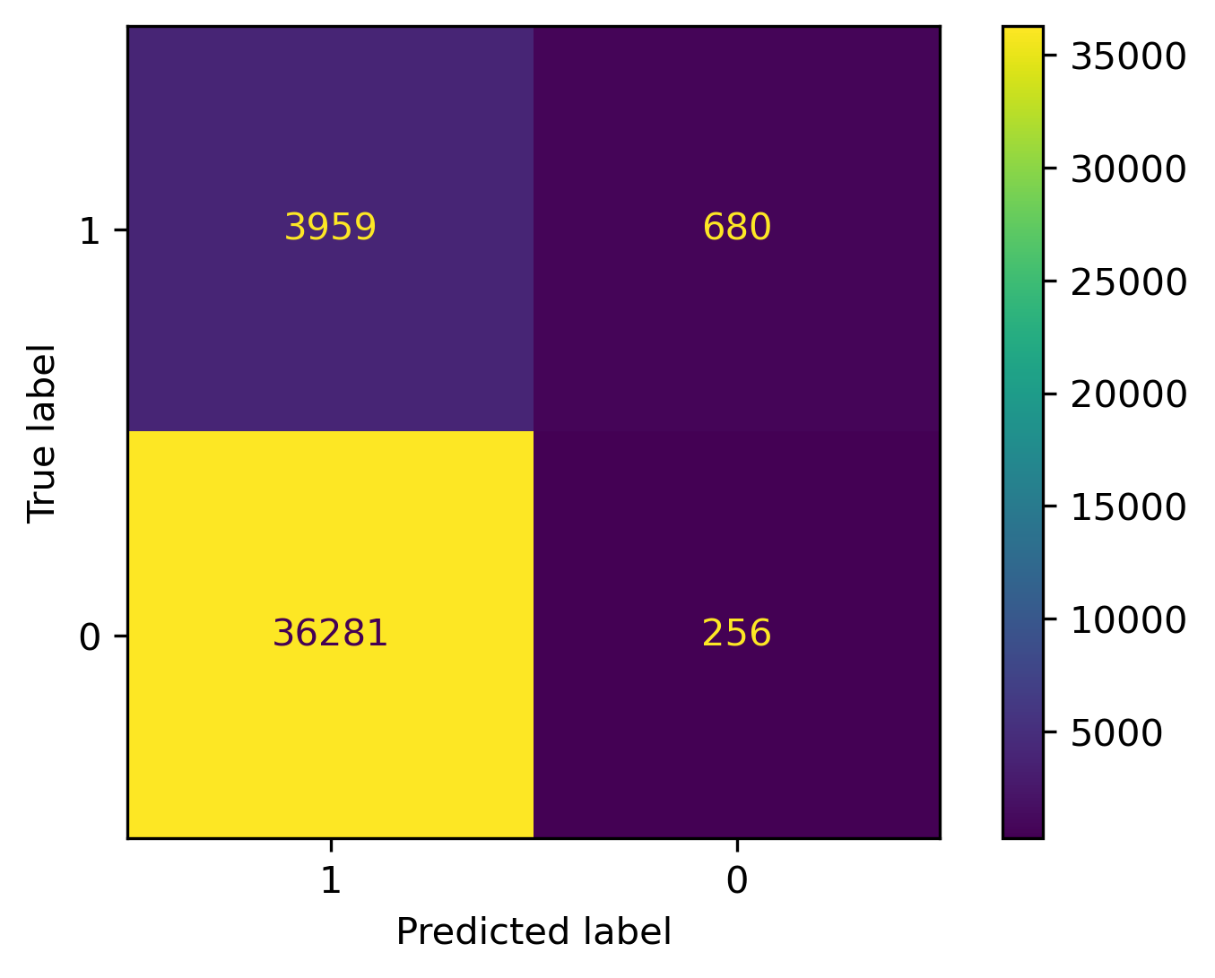
Results from current model
Accuracy = 10%, but NOT a good measure of performance.
Confusion Matrix

Slide 20
Results from current model
Metrics:
Precision: 9.8%
Recall: 85.3%
F1: 0.176
Lift: 0.873
Precision: What proportion of positively predicted records were truly positive.
Recall: What proportion of true positive records in the data were correctly classified.
F1: A weighted average of precision and recall.
Lift: The degree to which predictions are better than randomly generated predictions.
Notes:
Lift: What percentage of positive labels are present in a data sample which has a high probability of having positive labels.

Slide 21
05. Improvements

Slide 22
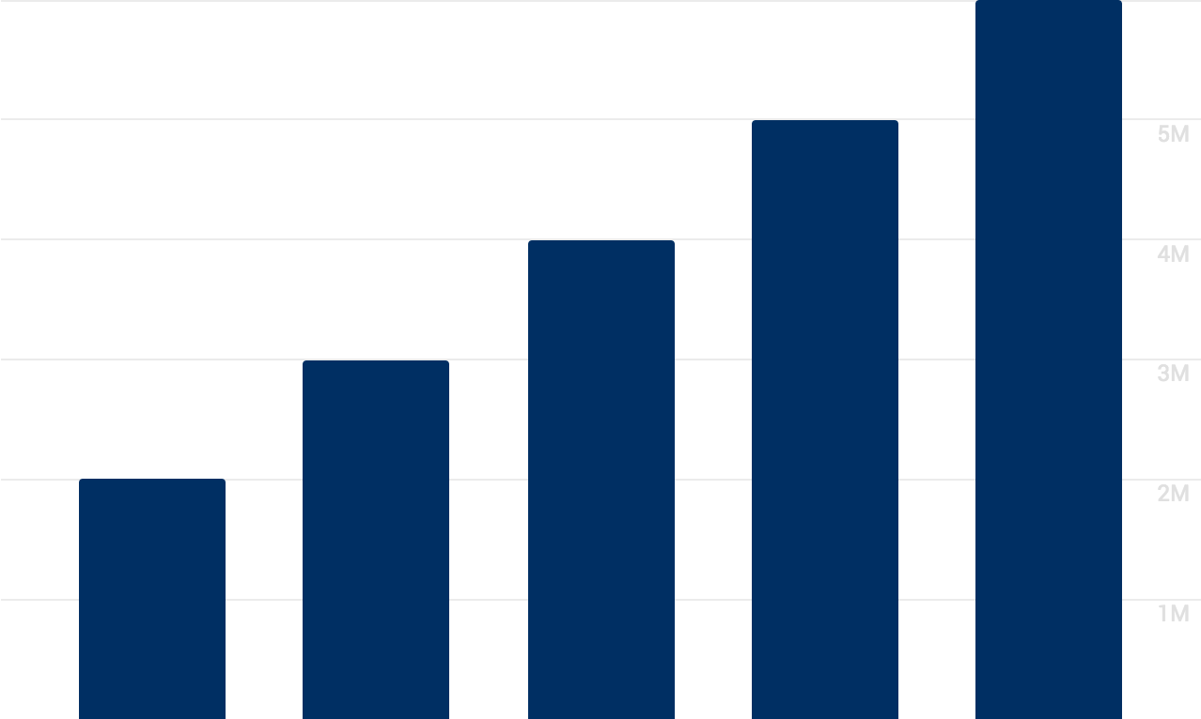
Challenges
Class Imbalance Ratio
Low precision metric and Lift score
Time Constraints

Slide 23
Future Work
Use sampling techniques as described, preferably k-means SMOTE.
Use tree-based models like Random Forest.
Explore models with boosting techniques like XgBoost.
Explore model explainability techniques like LIME and SHAP to get better insights before contacting a client.
Leverage model deployment strategies to deploy the model to production.

Slide 24
Results from XgBoost model
Metrics:
Precision: 40%
Recall: 61.7%
F1: 0.483
Lift: 3.367
Precision: What proportion of positively predicted records were truly positive.
Recall: What proportion of true positive records in the data were correctly classified.
F1: A weighted average of precision and recall.
Lift: The degree to which predictions are better than randomly generated predictions.
Notes:
Lift: What percentage of positive labels are present in a data sample which has a high probability of having positive labels.

Slide 25
Thank You
Questions?
Feedback!
Template credits: www.slidesgo.com

