Slide 1
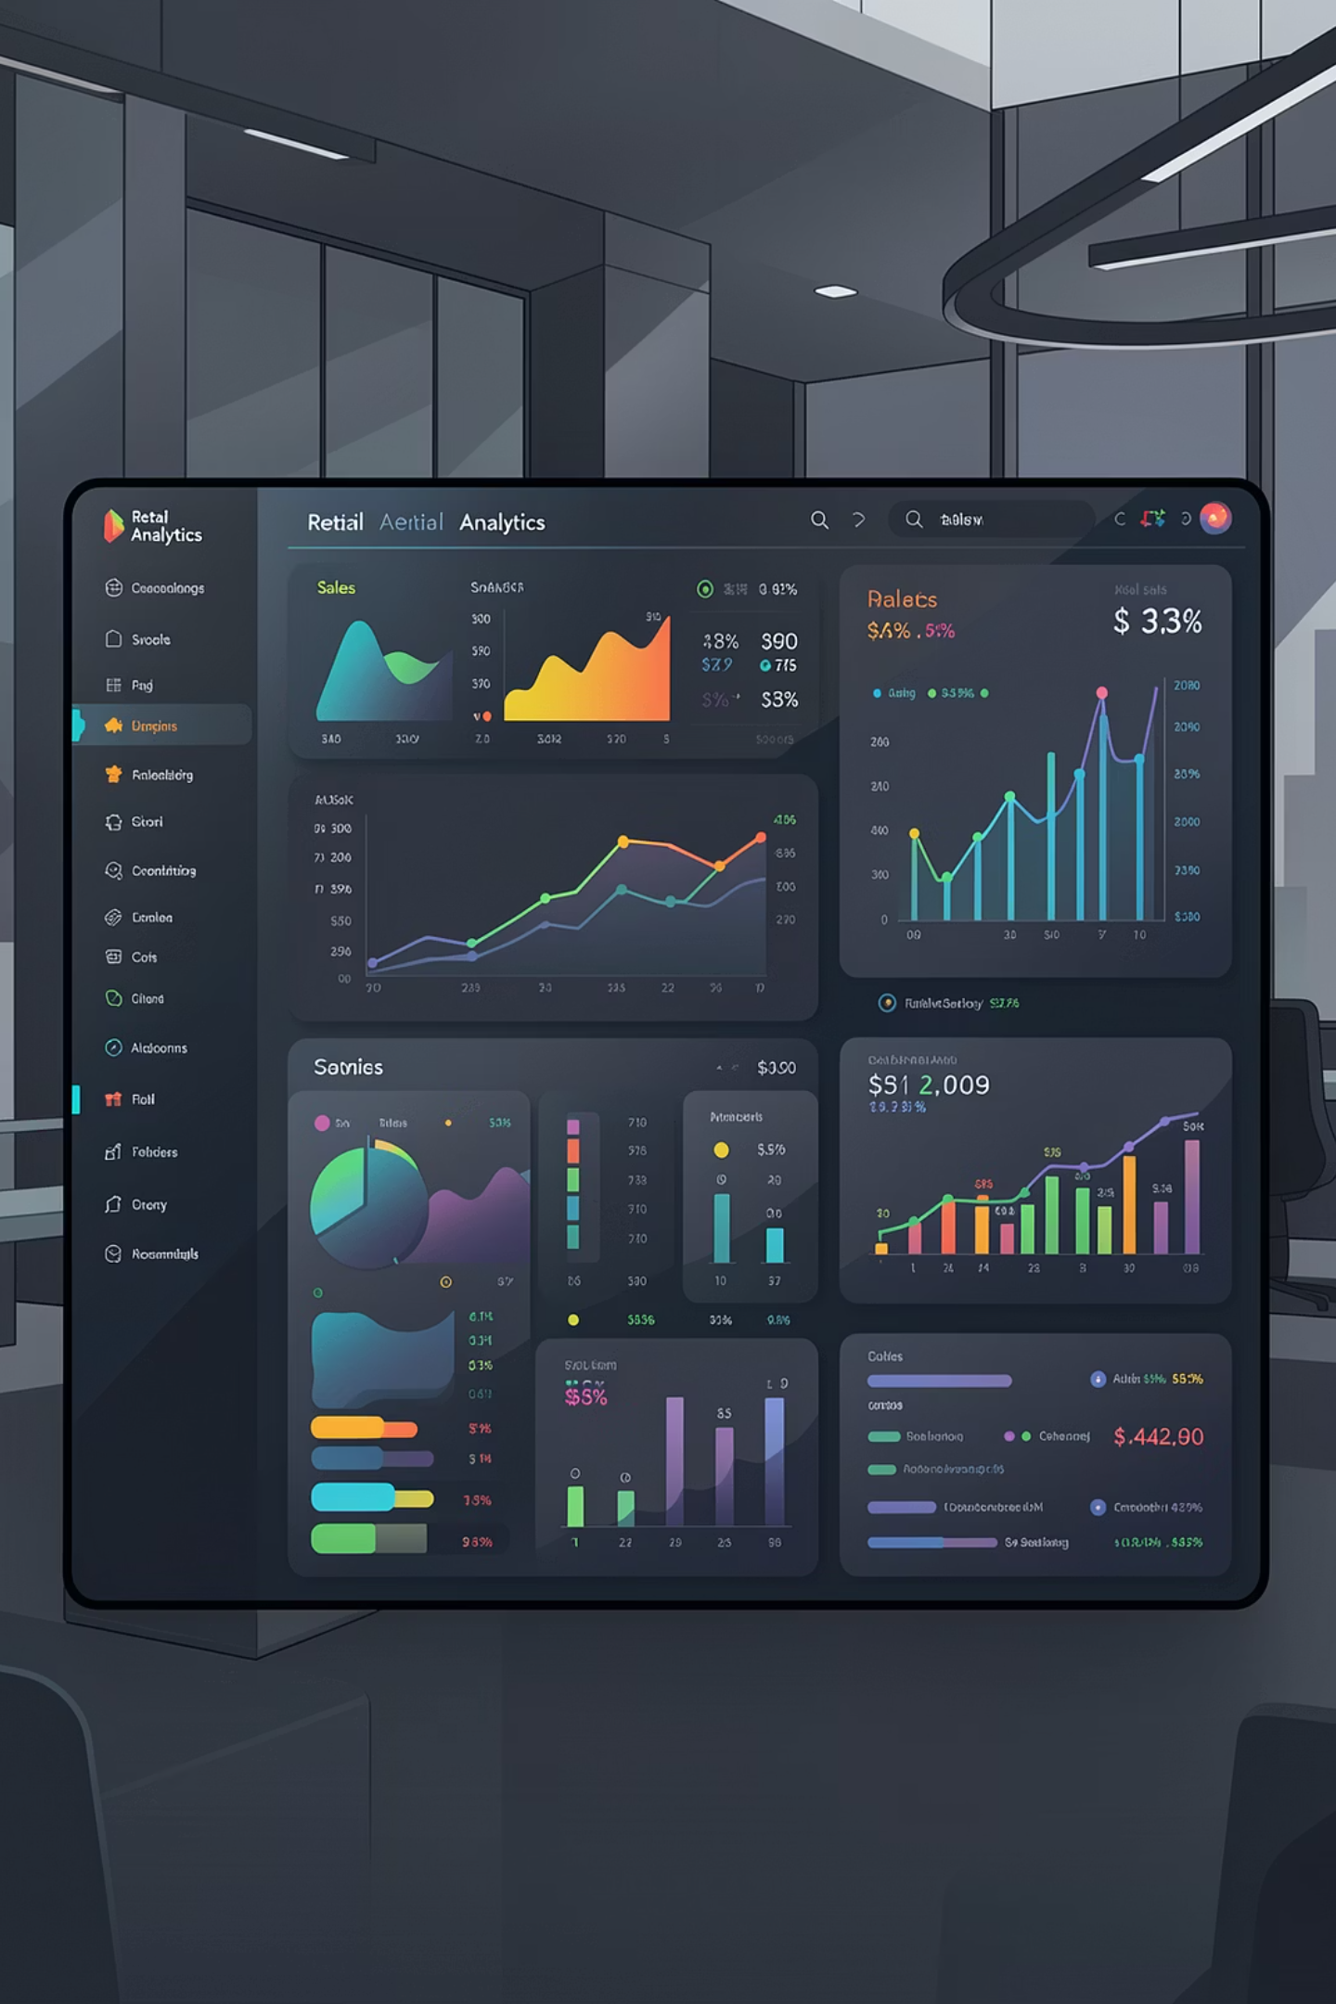
Customer Shopping Behavior Analysis
5,000 purchases analyzed across demographics, categories, and behavior patterns

Slide 2
Dataset Overview
5,050
17
50
Transactions
Features
Duplicates
Rows in dataset
Data columns
Removed entries
Key Features
Missing Data
Demographics (Age, Gender, Location)
Purchase details (Category, Amount, Season)
Behavior (Discount, Frequency, Rating)
556 Purchase Amount values
370 Size values
601 Review Ratings

Slide 3
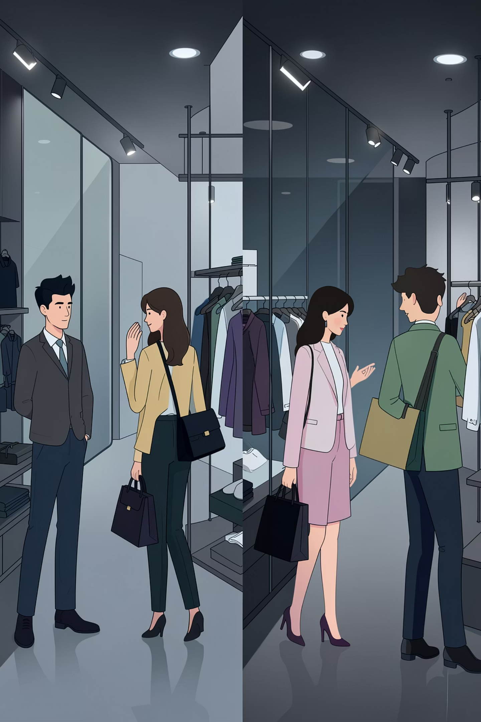
Revenue by Gender
Male Customers
$390,965 total revenue
3,018 customers
Female Customers
$352,060 total revenue
2,032 customers

Slide 4
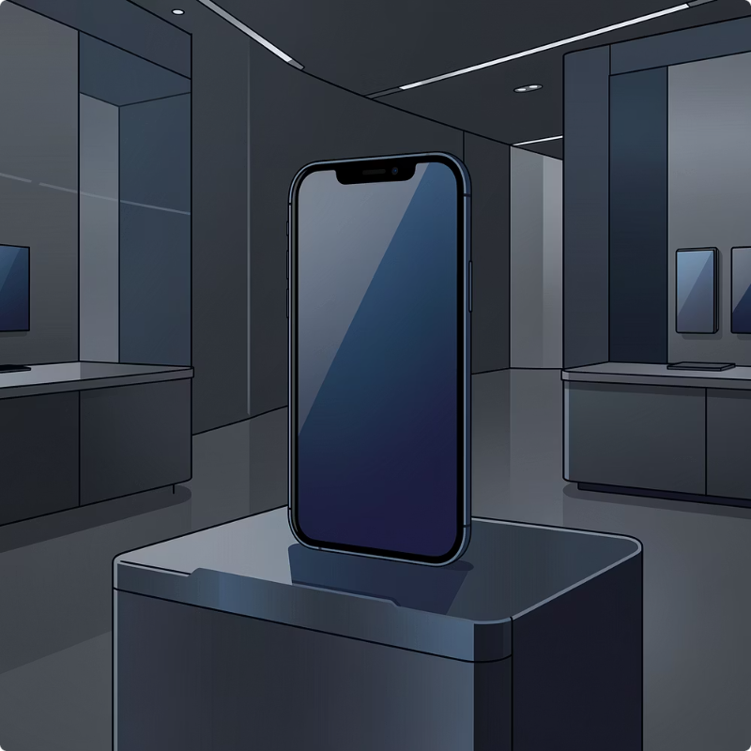
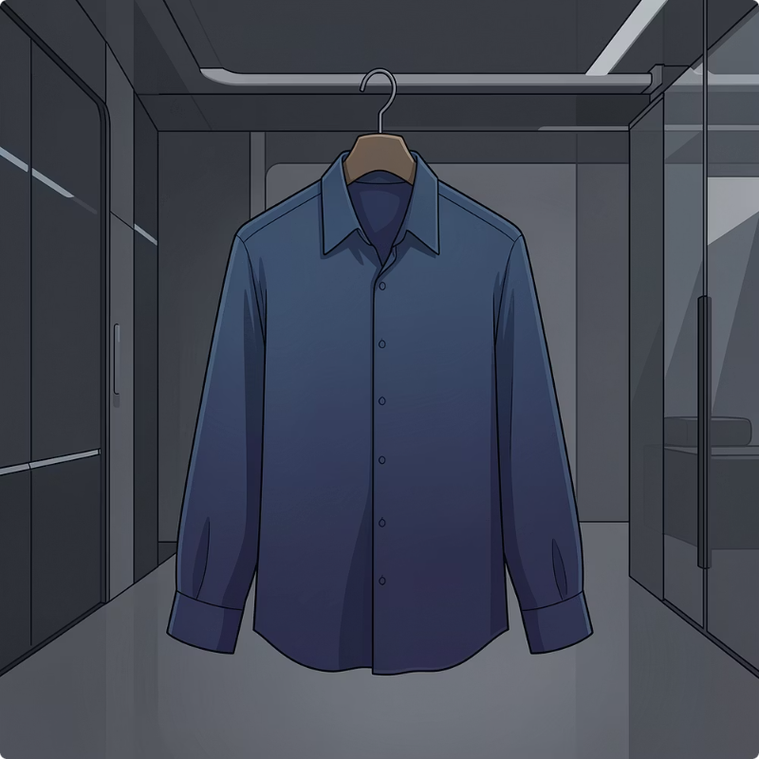
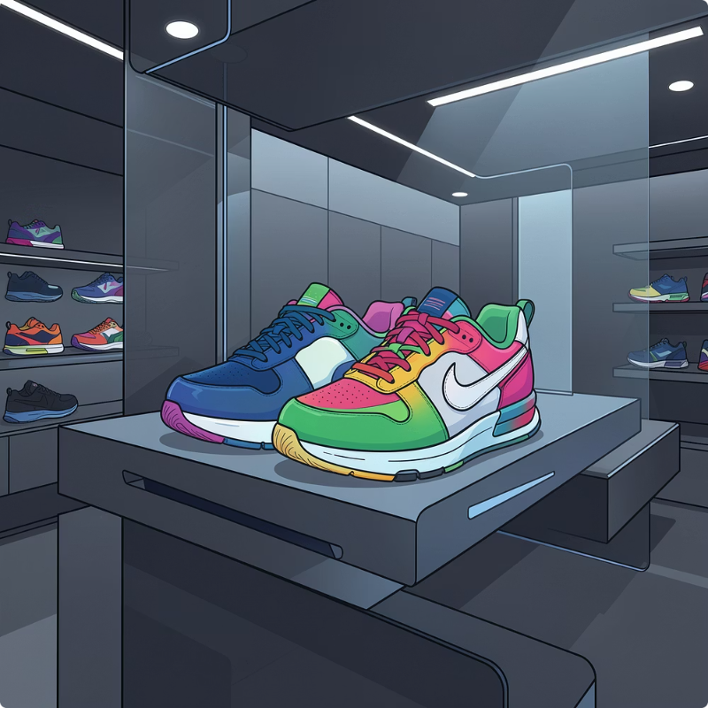

Top Products by Category
Electronics
Clothing
Footwear
Accessories
Phone: 171 units
Shirt: 315 units
Shoes: 303 units
Jewelry: 171 units
Headphones: 166 units
Pants: 171 units
Sandals: 160 units
Bag: 164 units

Slide 5

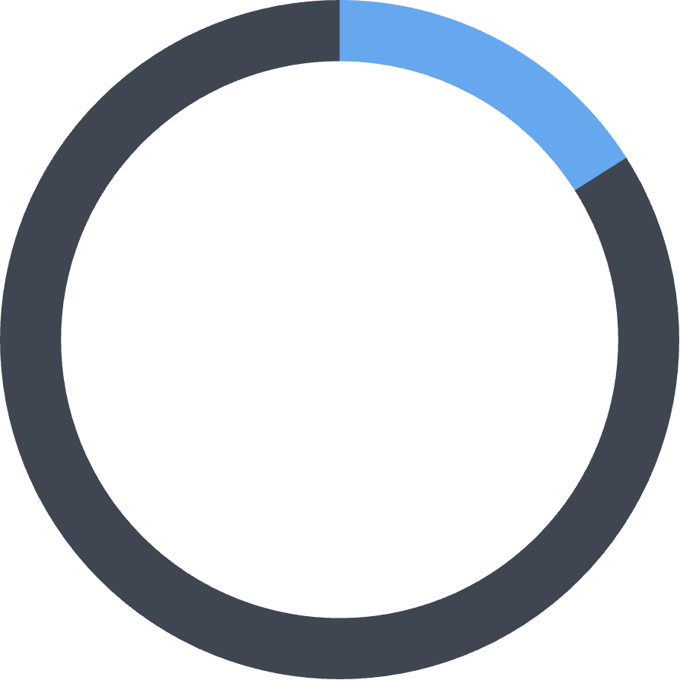

Customer Segmentation
81%
16%
2%
Loyal
Returning
New
4,098 customers with repeat purchases
805 customers making second purchases
97 first-time customers

Slide 6

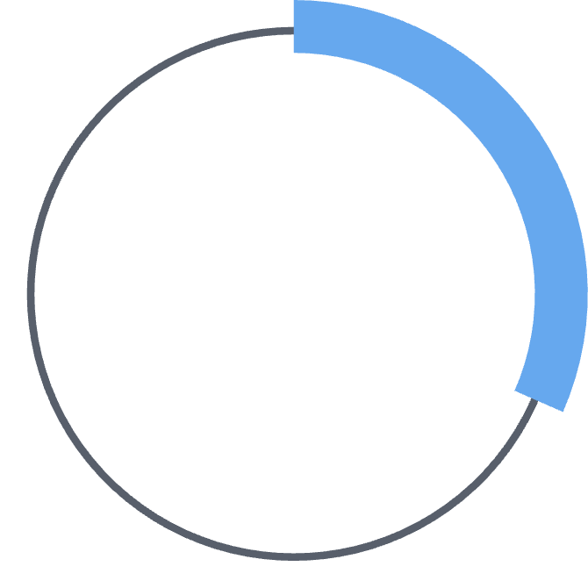

Subscription Performance
Key Finding
Subscribers spend $270 avg vs non-subscribers $166 avg
Untapped potential for retention and recurring revenue
31.58%
68.42%
Subscribers
Non-Subscribers
1,579 customers
3,421 customers

Slide 7




Age Group Analysis
34%
32%
Senior
Young Adult
Highest revenue: $260,598
Highest volume: 1,548 purchases
22%
12%
Middle-aged
Adult
$246,846 revenue
$229,950 revenue

Slide 8

Shipping & Satisfaction
Express Shipping
Standard Shipping
Average Rating
$358 avg purchase
$341 avg purchase
3.62/5 stars
Higher spending customers
Most common option
Moderate satisfaction

Slide 9
Key Business Insights
01
02
03
Electronics = Premium Revenue
Clothing = Traffic Driver
Outerwear Underperforms
Highest sales volume at ~1,900 units
Lowest revenue and sales—needs reassessment
Highest revenue at ~$500K despite lower volume
04
05
Seniors = High Value
Young Adults = Frequent Buyers
Generate most revenue per transaction
Highest purchase frequency—upsell opportunity

Slide 10







Strategic Recommendations
Increase Subscriptions
Expand Electronics
First-month discounts, loyalty rewards, exclusive deals
More variety, bundle accessories, promote premium products
Boost Clothing Value
Target Seniors
Cross-sell accessories, premium collections, bundle discounts
Personalized recommendations, VIP programs, priority support
Upsell Young Adults
Improve Satisfaction
Bundle offers, premium suggestions, app promotions
Analyze ratings, enhance service, faster issue resolution

