Slide 1


CHANDIGARH UNIVERSITY
EVENT PLANNING
BUDGET & PROPOSAL
Plan Today | Celebrate Tomorrow
MINOR PROJECT • COMPUTING APTITUDE
Submitted by: Srishti Shubham
UID: 26BCD10379
Section: 26BCD6B
Campus Carnival 2026 | 12 Dec 2026

Slide 2
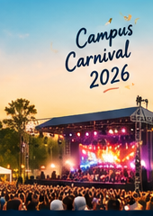

1. Abstract & Event Proposal
Campus Carnival 2026
This project presents a practical event proposal and a structured budget for a fictional university campus carnival.
The plan covers the event purpose, audience, programme, venue requirements, logistics, suppliers and financial controls.
Microsoft Excel is used to estimate costs, plan income, compare vendor quotations and track payments. The proposal is documented in Word and presented through PowerPoint.
EVENT SNAPSHOT
Date: 12 Dec 2026
Venue: Campus grounds
Attendance: 300
Audience: 300 students, faculty members and invited guests
2/7

Slide 3
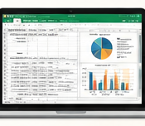
2. Demo & Excel Workbook
A connected planning workbook
• Dashboard – budget summary and charts
• Event Setup – event details and assumptions
• Detailed Budget – itemised expense estimates
• Income Plan – ticket and sponsorship estimates
• Vendor Tracker – quotation comparisons
• Payment Schedule – advance and pending payments
• Event Timeline – tasks, dates and responsibilities
Workbook formulas calculate totals, contingency and funding gap.
3/7

Slide 4
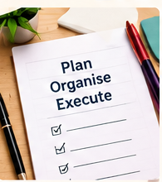
3. Project Objectives & Development Process
What the project aims to achieve
• Prepare an item-wise event budget with realistic estimates.
• Identify income sources and calculate the funding gap.
• Compare supplier quotations before selecting vendors.
• Plan event tasks, deadlines and payment milestones.
• Present financial information through clear charts.
Process: Define event → Estimate → Compare → Track → Review
4/7

Slide 5
4. Technologies Implemented & Key Features
EXCEL
WORD
POWERPOINT
Budget calculations, formulas, tables, dashboard charts and payment tracking
Structured project report, proposal details, assumptions and conclusion
Seven-slide visual proposal with charts, timeline and key findings
Main project features
• Detailed budget with 22 expense line items
• Income plan for tickets and sponsorships
• Vendor quote comparison and payment schedule
• Event timeline with tasks and milestones
5/7

Slide 6
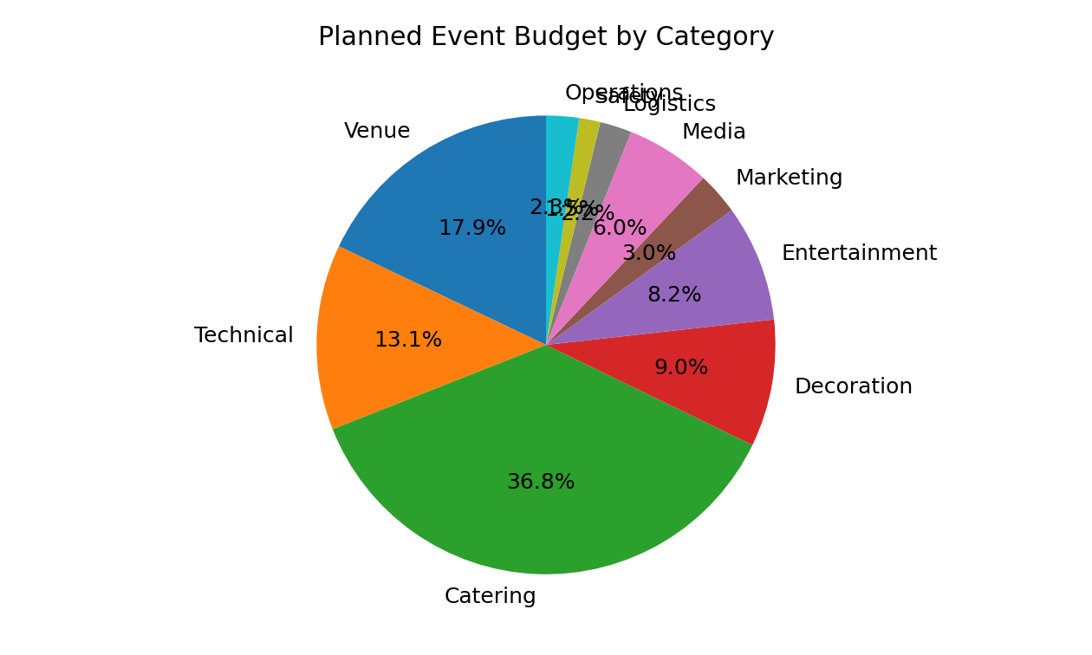
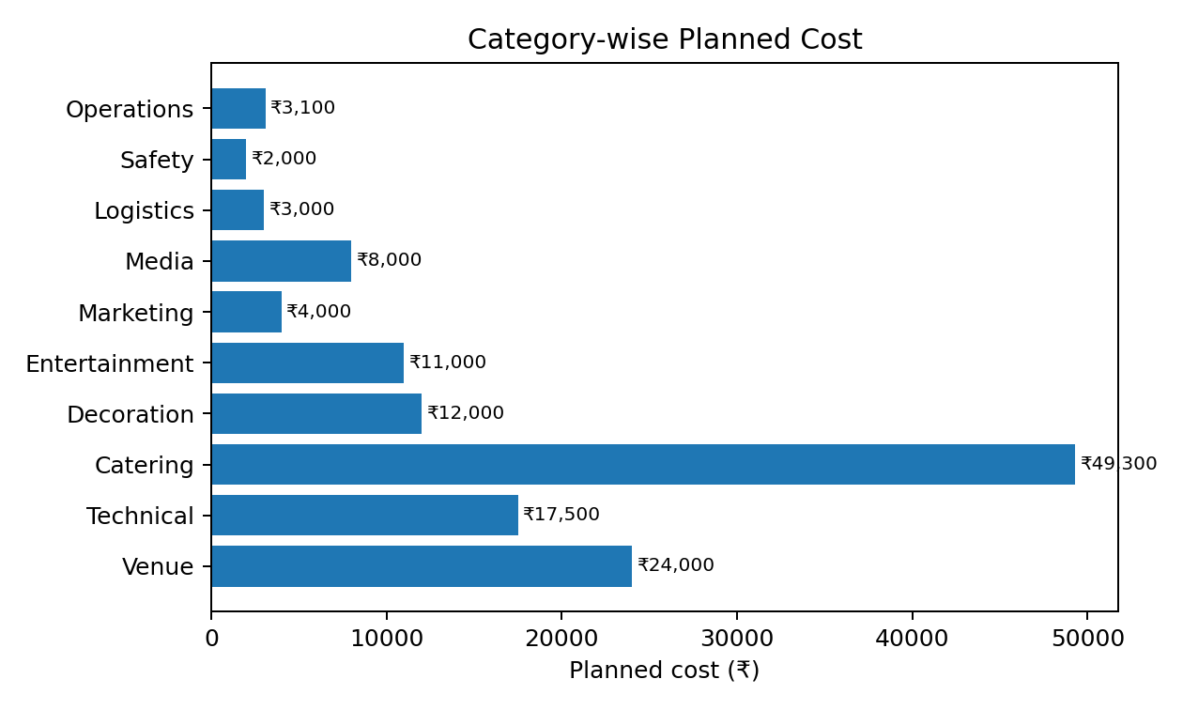
5. Budget Overview & Financial Insights
BUDGET SUMMARY
Direct expenses
₹1,33,900
Contingency (10%)
₹13,390
Total planned budget
₹1,47,290
KEY INSIGHTS
RECOMMENDATIONS
Expected income
₹1,25,000
• Contingency protects against unexpected costs.
• Expected income covers most, but not all, of the budget.
• Seek sponsorships to close the funding gap.
• Confirm vendor quotes and monitor payments.
Funding gap
₹22,290
Cost per attendee: ₹490.97
6/7

Slide 7
6. Timeline & Conclusion
PLANNING MILESTONES
• Week 1 – confirm event concept, date and venue
• Week 2 – collect quotations and finalise budget
• Week 3 – arrange promotion, vendors and logistics
• Event week – confirm payments, setup and safety
• After event – review expenses and prepare report
A clear budget, realistic timeline and regular tracking help make the event achievable and financially responsible.
THANK YOU!
Srishti Shubham • UID 26BCD10379 • 26BCD6B

