Slide 1

Inventra Intelligent Inventory Management System

Slide 2
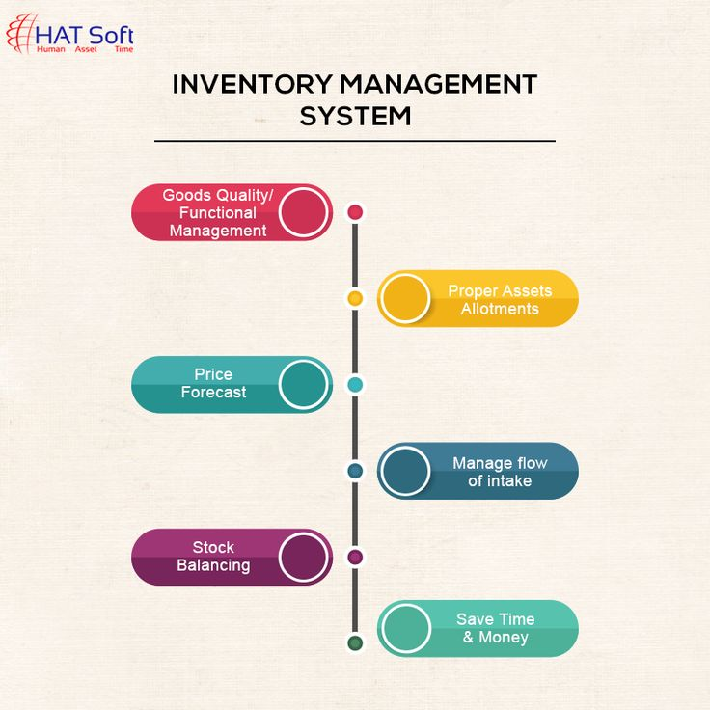
Meaning Of the project
Inventra is an Inventory Management System that automates stock tracking, forecasting, and order management.
It aims to reduce human errors, optimize stock levels, and improve business efficiency.
The system intelligently predicts inventory needs and ensures smooth supply chain operations.
Inventra = Inventory + Intelligent Automation

Slide 3
Problem Statement
01
02
03
04
05
06
Not Knowing the exact stock level
Mismanaging daily stock movements
Losing track of Sales and purchases
Manual errors in stock calculation
Difficulty preparing Reports
Understock and Overstock

Slide 4
Proposed System
Solution
The Inventra Intelligent Inventory Management System is designed to overcome the drawbacks of traditional inventory handling methods by introducing automation, intelligence, accuracy, and real-time visibility. The system focuses on optimizing stock flow, reducing human errors, and improving decision-making through AI-powered forecasting.
Introduces automation in inventory management
Provides real-time stock visibility
Uses AI for demand forecasting
Implements intelligent reorder management
Manages supplier information efficiently
Offers secure user authentication
Provides comprehensive reporting & analytics

Slide 5
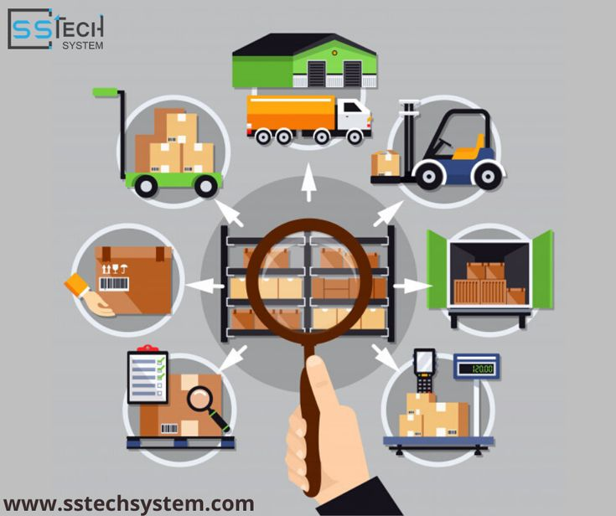
Number of Modules
1. Authentication Module
2. Inventory Management Module
3. Forecasting (AI Prediction) Module
4. Supplier Management Module
5. Reporting & Analytics Module
6. Sales & Billing Integration Module
7. Notification & Alerts Module
8. Audit & Activity Log Module

Slide 6
Working
1. Authentication & User Management Module: Handles login, signup, roles, permissions.
2. Inventory Management Module:Product creation, stock-in, stock-out, categorization.
3. Forecasting (AI Prediction) Module:Predicts future stock needs using past patterns.
4. Supplier & Purchase Order Management Module:Stores supplier details, creates purchase orders..
5. Reporting & Analytics Module:Generates charts, summaries, trends, stock movement reports.
6. Sales & Billing Integration Module:Connects sales/billing data with inventory.
7. Notification & Alerts Module:Low-stock alerts ,Expiry alertsRe-order reminders ,notifications.
8. Audit & Activity Log Module:Records all user actions for transparency,Helps in security and error tracking.

Slide 7
System Configuration
Hardware Requirements:
Processor: Intel i5 or higher
RAM: 8GB minimum
Storage: 256GB SSD
Software Requirements:
Backend: Java / Spring Boot
Frontend: HTML, CSS, JavaScript
Database: MySQL / PostgreSQL
OS: Windows / Linux

Slide 8

Architecture Configuration
Authentication (JWT (Secure communication)): JWT ensures only authorized users can access the system by securely verifying their identity during every request.
Notification engine (Email/SMS) :Automatically sends alerts such as low-stock, reorder reminders, and system notifications via email or SMS
Services : Stock, Product, User, Report
Stock Service
Manages all stock-in, stock-out, and quantity updates in real time.
Product Service
Handles creation, updating, and categorization of all products.
User Service
Controls user accounts, roles, permissions, and authentication flow.
Report Service
Generates analytical reports like stock summary, sales trends, and forecasting insights.

Slide 9

Authentication & User Management
The Authentication Module manages user login, registration, and access control.
Classes in Module 1
1. User
Use: Stores user information (name, email, role).
Purpose: Identifies each user in the system.
2. AuthController
Use: Handles login, signup, and logout API requests.
Purpose: Receives user input and communicates with AuthService.
3. AuthService
Use: Validates credentials, encrypts passwords, generates JWT tokens.
Purpose: Core logic of authentication and authorization.
4. UserRepository
Use: Interacts with the database to fetch/save user records.
Purpose: Provides CRUD operations for users.
5. JwtUtil
Use: Generates, validates, and refreshes JWT tokens.
Purpose: Ensures secure communication between client and server.

Slide 10
Database Schema
Table: users
Column Name | Type | Description
user_id (PK) | INT | Unique user identifier
name | VARCHAR(100) | User full name
email | VARCHAR(150) | Unique email for login
password | VARCHAR(255) | Encrypted password
role | VARCHAR(50) | Admin / Manager / Staff
created_at | DATETIME | Account creation time
updated_at | DATETIME | Last update timestamp

Slide 11
Database Schema
 | Column Name | Type | Description
 | role_id (PK) | INT | Unique role ID
 | role_name | VARCHAR(50) | Role type
Table: roles
Table: user_roles
Column Name | Type | Description
user_id (FK) | INT | Linked to users table
role_id (FK) | INT | Linked to roles table

Slide 12
Purchase order
Stock re-order
Bill
Inventory Management
Inventory drops
Stock rises
Invoice
Sales order

Slide 13
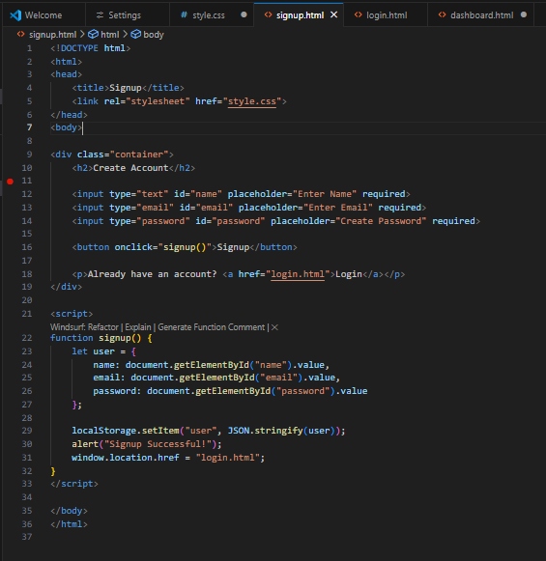
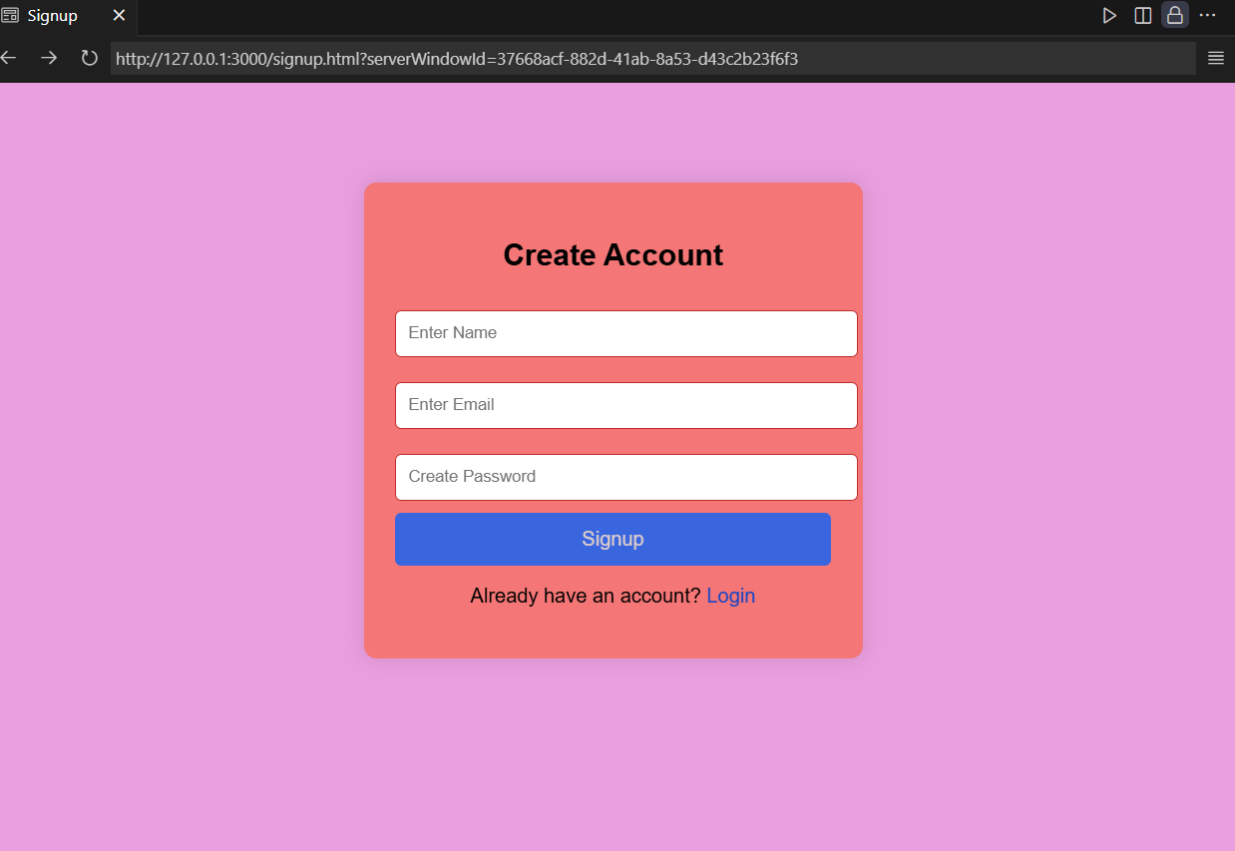
Codes with Output:
Signup page:

Slide 14
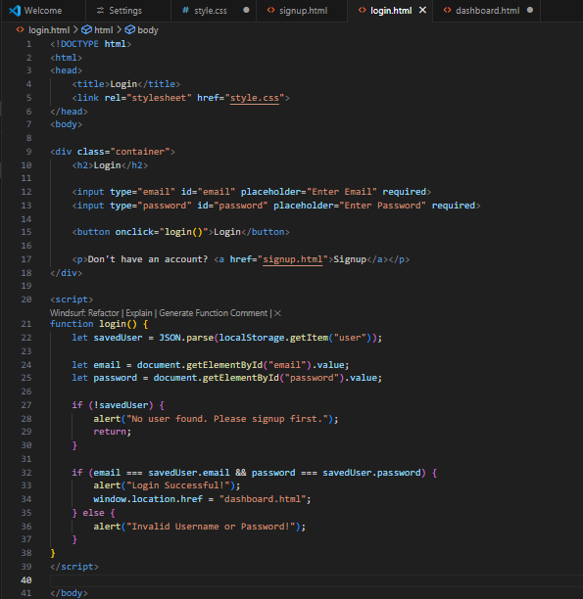
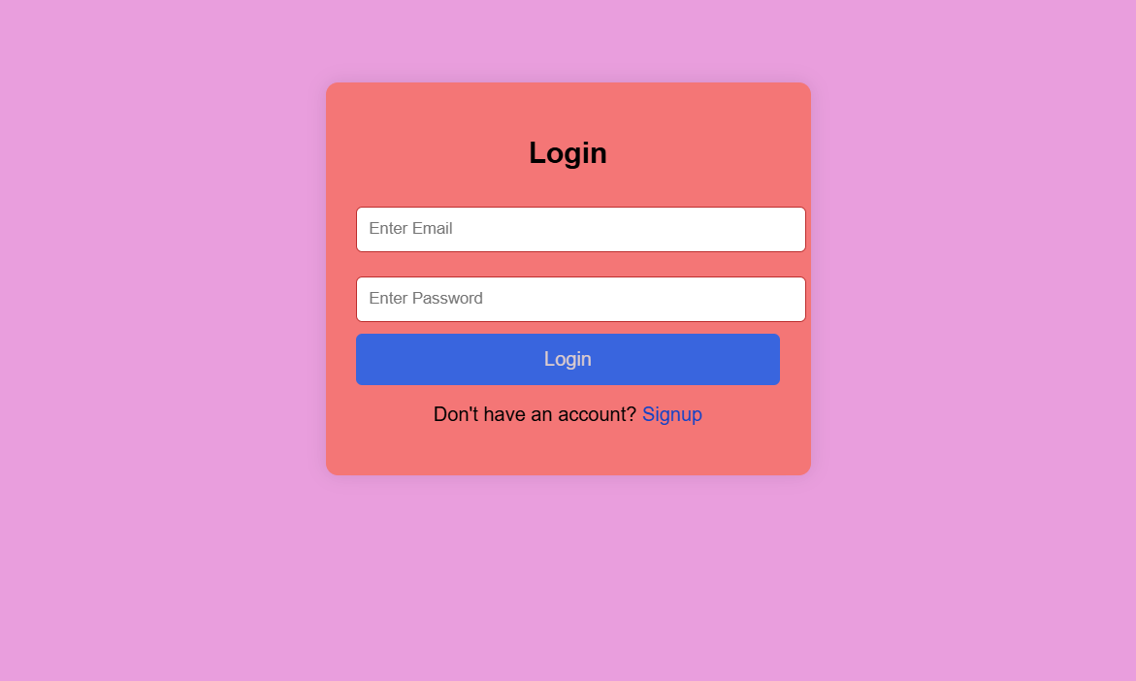
Login page:

Slide 15
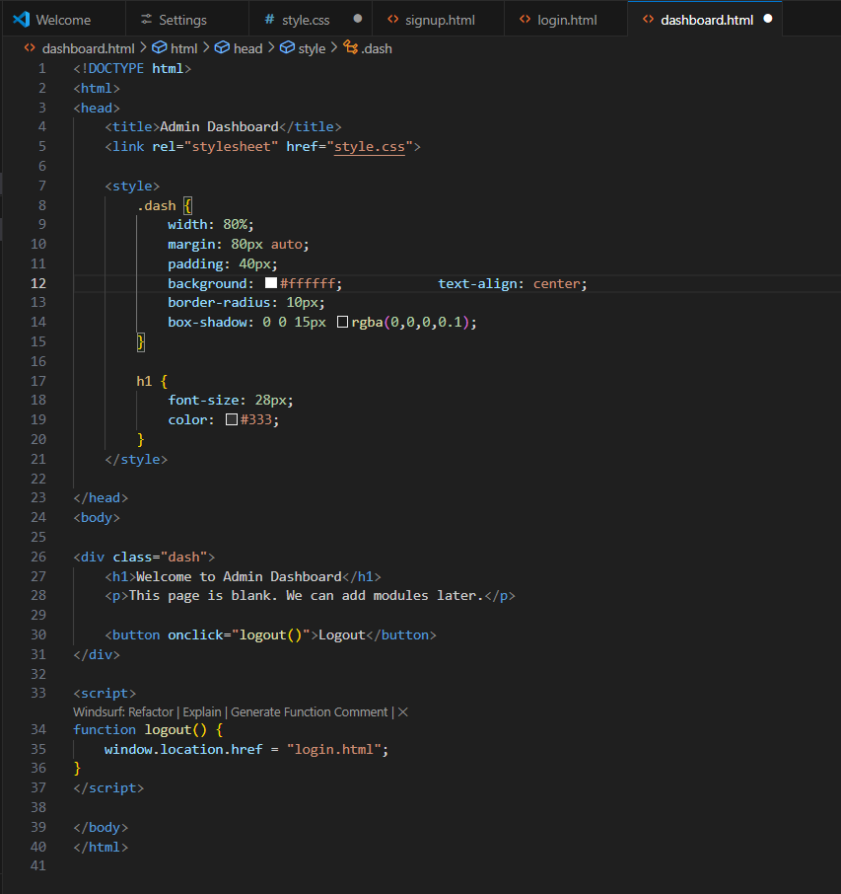
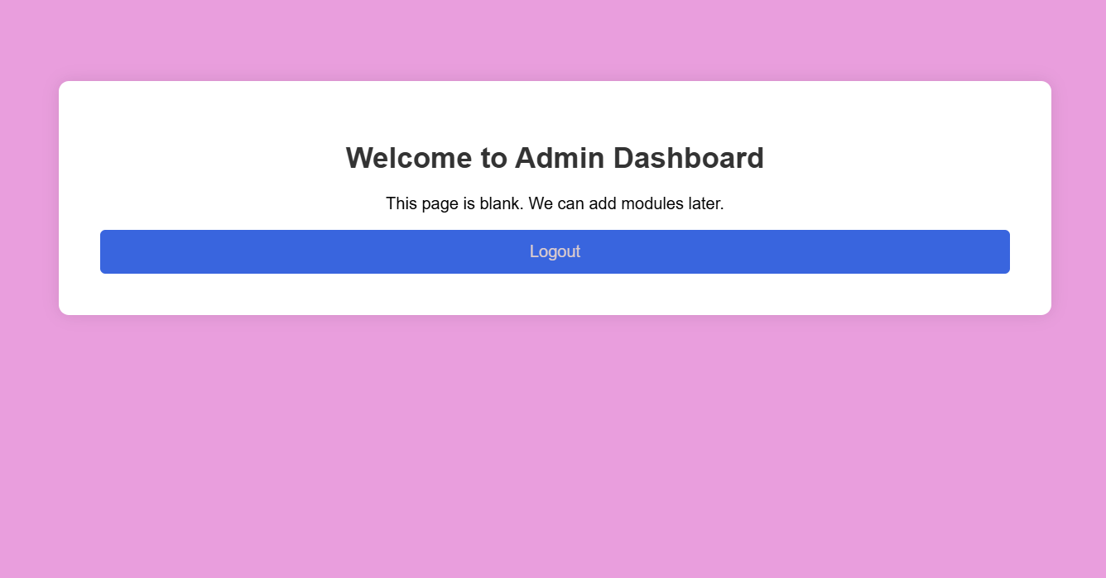
Dashboard page:

Slide 16
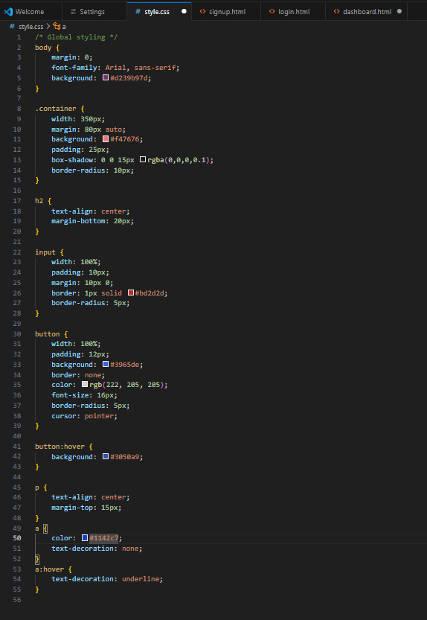
CSS Codes:

Slide 17


