Slide 1
REAL TIME FACE RECOGNITION BASED ATTENDANCE MONITORING SYSTEM
PROJECT MENTOR : Dr MANOJ KUMAR
TEAM MEMBERS : 20R25A0420- K.VAMSI ANURAG
19R21A04K7- J.SRISRI
19R21A04K2- B.NAGA SESHU
20R25A0421- V.VIKAS
Department of ECE

Slide 2

List of Content
AIM AND OBJECTIVES
ABSTRACT
MOTIVATION
INTRODUCTION
LITERATURE SURVEY
FLOWCHART
METHODOLOGY
ADVANTAGES
RESULTS
CONCLUSIONS
REFERENCES

Slide 3
AIM AND OBJECTIVES
AIM:
The aim of this project is to develop a Face recognition based attendance monitoring system.
OBJECTIVE:
This technology can be applied in several important areas like organizations, educational institutions, companies, etc..
The purpose of this project is to create a face recognition system that can recognize faces in the data base to the testing images and mark the attendance.

Slide 4
ABSTRACT
Face recognition is a process of identifying or confirming an individual’s identity using their face and a database.
This report describes the theory and process of implementing a face recognition system using the computing software.
Image processing technique is used to recognize and extract face features.
This information is then used for detecting faces against a given database to the raw data and mark the student attendance.
This can be use as an one of the biometric attendance system

Slide 5
MOTIVATION
The primary motivation behind taking up this project is to detect and recognize the face’s from user to the images present in the database. Instead of taking manual attendance daily, this can be much useful in educational Institutions and organizations for daily verification of user or candidate.

Slide 6
INTRODUCTION
The general manual attendance system is in use for taking attendance in various educational institutes.
So apart from these we would like to introduce an new attendance monitoring system which uses human face to recognize the student and mark the attendance
Here we use an high resolution camera to capture the faces of the person and recognize and mark the attendance.

Slide 7
Cont...
Finger print based system gives of more secured identification but whereas in face recognition based system gives us faster results
To justify this we can observe the speed of face unlock and fingerprint locks in our smart phones.
Also by marking the attendance we will send an conformation mail to the respective person about the attendance with the date and time.

Slide 8
LITERATURE SURVEY
[1] Chinimilli, Bharath Tej, et al. "Face recognition based attendance system using haar cascade and local binary pattern histogram algorithm." 2020 4th international conference on trends in electronics and informatics (ICOEI)(48184). IEEE, 2020.

Slide 9
Cont…
This paper presented an automatic face recognition system based on HAAR cascade.
Haar Cascades for Face Recognition is a machine learning-based approach in which a cascade function is trained from positive and negative images to detect objects in other images. Initially, the algorithm needs a lot of positive images (images of faces) and negative images (images without faces) to train the classifier.
Local Binary Patterns (LBP) is a texture descriptor used in computer vision and image analysis. It can also be used for face recognition.

Slide 10
Cont…
[2] Ahamed, H., Alam, I., & Islam, M. M. (2018). HOG-CNN Based Real Time Face Recognition. 2018 International Conference on Advancement in Electrical and Electronic Engineering (ICAEEE). doi:10.1109/icaeee.2018.8642989

Slide 11
Cont….
This paper presented an automatic face recognition system based on HOG and CNN.
HOG uses single direction for each pixel and the resulted features from HOG are used for face detection.
Local Binary Patterns (LBP) is a texture descriptor used in computer vision and image analysis. It can also be used for face recognition.
CNN training algorithm was applied to recognize faces based on encoded face and previously stored encoded face.

Slide 12
Cont….
[3] Arsenovic, M., Sladojevic, S., Anderla, A., & Stefanovic, D. (2017). FaceTime — Deep learning based face recognition attendance system. 2017 IEEE 15th International Symposium on Intelligent Systems and Informatics (SISY). doi:10.1109/sisy.2017.8080587

Slide 13
Cont….
This survey is mainly uses the cnn(convultional neural network) in which it will be useful to overcome the smaller datasets.Where CNN is used for mainly larger data sets .This survey uses the eignfaces for face recognition.
These eignfaces are not more accurate than the face encodings.This model is based on taking more number of input images per employee and detecting the accuracy of the each employees i.e taking the images of the person like frontal face,side faces,right and left,noises,blurred.However eignfaces is faster and easier to implement.

Slide 14
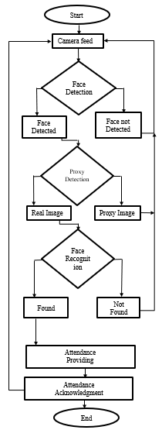
FLOW CHART

Slide 15
METHODOLOGY
The proposed methodology starts with the registration of students into the system i.e., adding the students database. Following methodology has few main stages such as Convolutional Neural Network ,capturing images, pre-processing of the images is used for face detection, developing a dataset of images, the further face recognition is done by comparing those images to the data base images
Image Capture: The high-resolution camera which is used for capturing video is used to take frontal images of the students.
Pre-processing: The images are converted from RGB to Grayscale.
Face Detection is done to match the data with the existing database.

Slide 16
Cont..
CNN : Convolutional Neural Network (CNN) is a deep learning algorithm that is primarily used in image and video analysis tasks such as image recognition, object detection, and facial recognition. CNNs consist of multiple layers of convolutional which are trained using a large number of input images to recognize patterns and features in the images.
OpenCV: OpenCV (Open Source Computer Vision Library) is an open-source computer vision and machine learning software library. It is used to handle video streams and to perform image processing tasks such as face detection, face recognition, and drawing rectangles around the detected faces.
Datetime: The datetime module supplies classes for working with dates and times. In this code, it is used to get the current date and time for recording attendance.

Slide 17
ADVANTAGES
Accuracy: The use of face recognition technology in attendance management ensures accuracy in recording attendance, reducing errors and inaccuracies that can occur in manual attendance recording.
Cost-Effective: Implementing a face recognition-based attendance system can be cost-effective in the long run. It eliminates the need for paper-based attendance systems, reducing paper and printing costs, and also reduces the time and resources required to manually record and manage attendance.
Easy Integration: The system can be easily integrated into existing school or university management systems, allowing for seamless integration and ease of use.
Time-Saving: The system saves time for both students and teachers as they do not have to spend time taking and recording attendance manually. This can allow teachers to focus on teaching, and students to focus on learning.

Slide 18
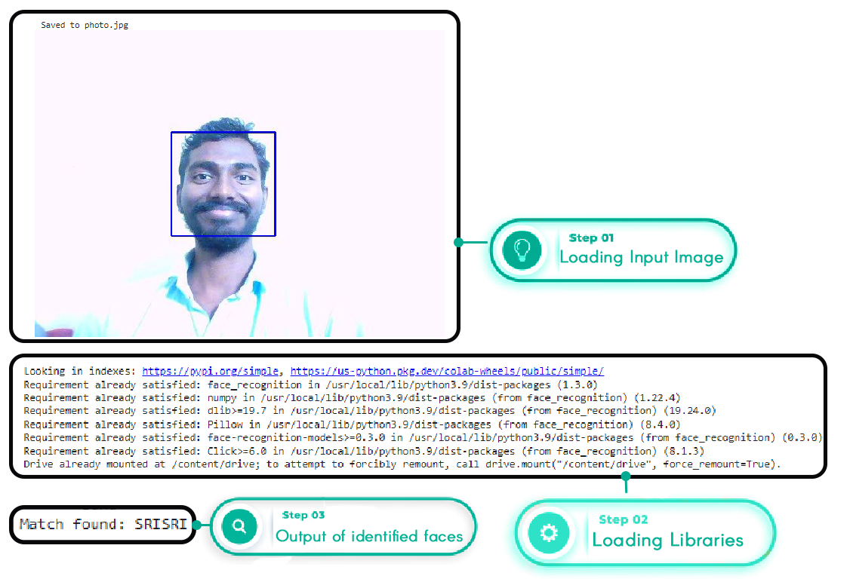
RESULTS CASE -1

Slide 19
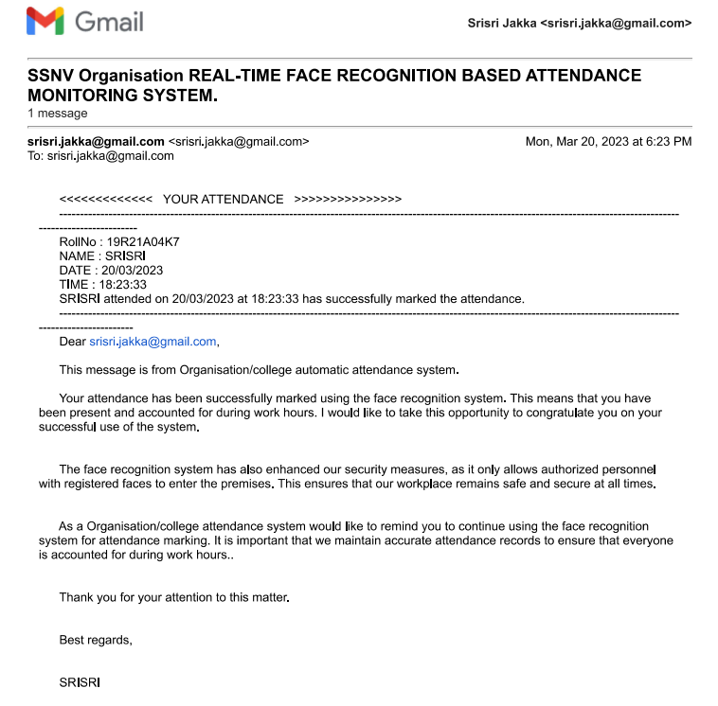
AUTO ACKNOWLEDGMENT MAIL

Slide 20
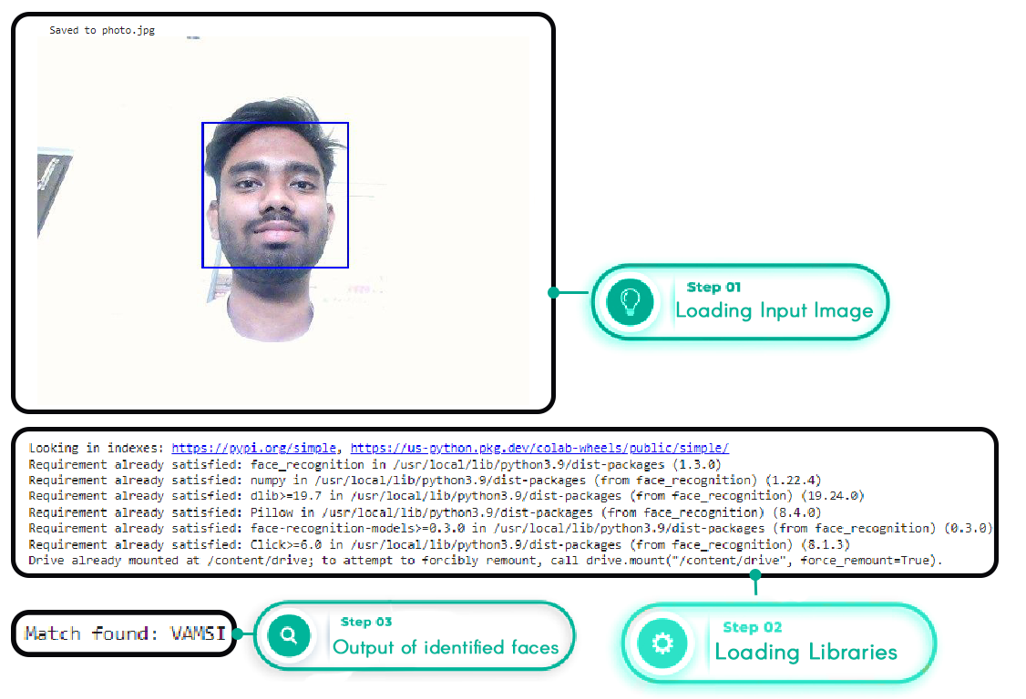
RESULTS CASE -2

Slide 21
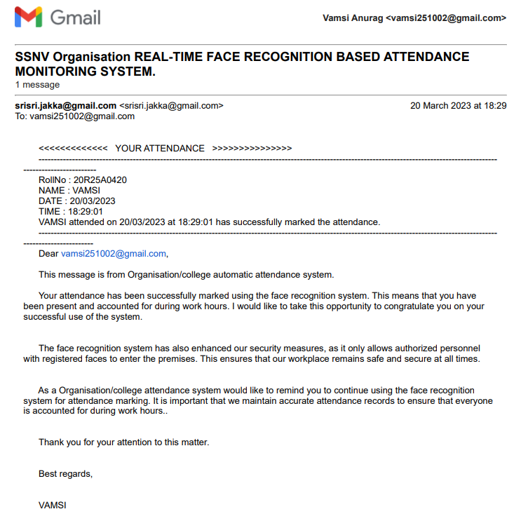
AUTO ACKNOWLEDGMENT MAIL

Slide 22
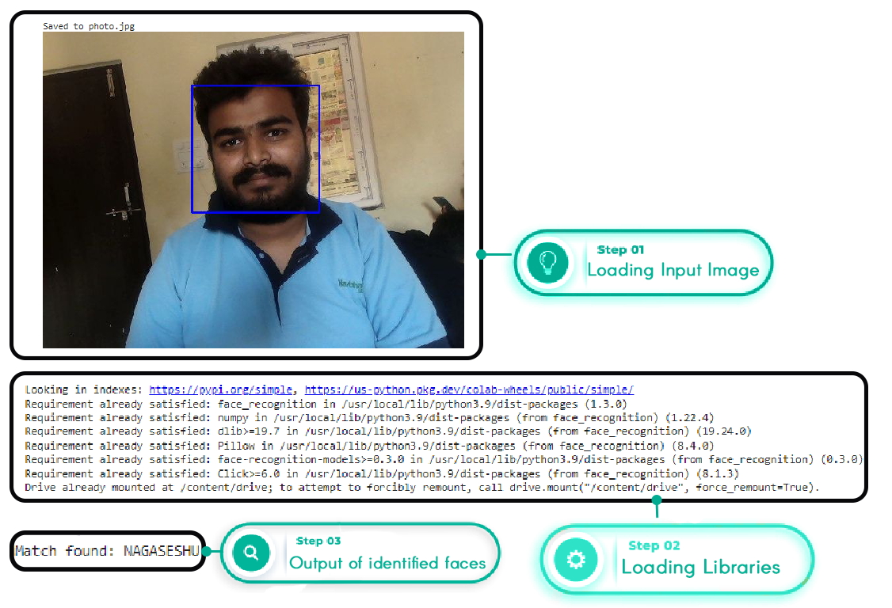
RESULTS CASE -3

Slide 23

AUTO ACKNOWLEDGMENT MAIL

Slide 24
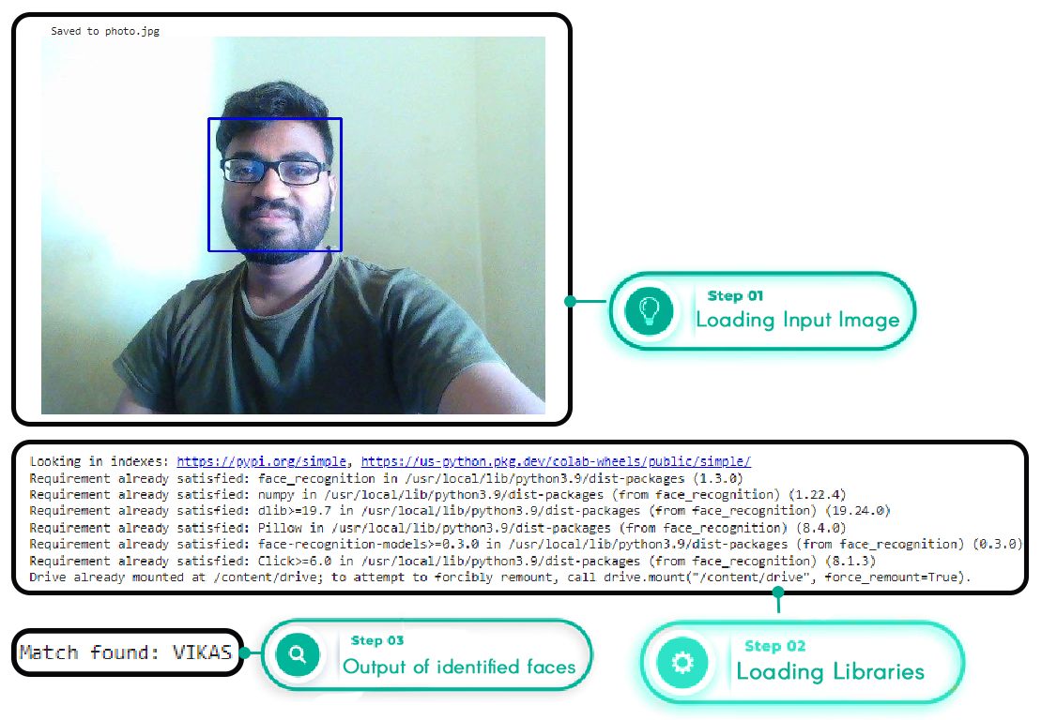
RESULTS CASE -4

Slide 25
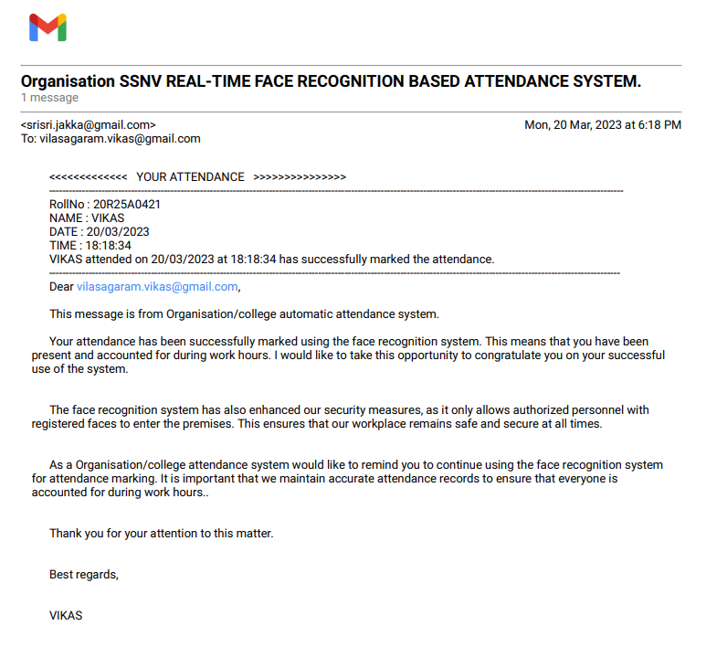
AUTO ACKNOWLEDGMENT MAIL

Slide 26
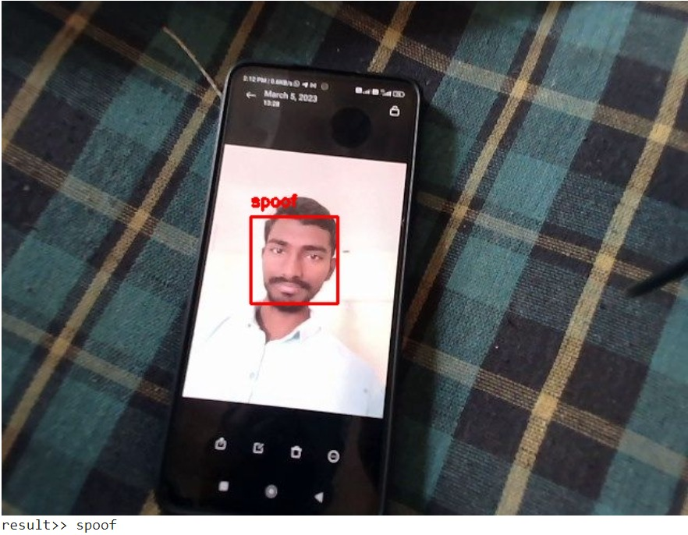
PROXY DETECTION

Slide 27

Working video of the project

Slide 28
Comparison Table
Parameters | Existing Model 1 | Existing Model 2 | Proposed Model
Face Detection model | Harr | HOG | CNN
Face Recognition model | LBP | LBP | face_encodings
Accuracy | 93.29 | 98.88 | 99.54
Proxy detection | Not available | Not available | Available
Acknowledgment model | Not available | Not available | Available
Storage | Local | Local | Cloud

Slide 29
APPLICATIONS
Biometrics : Using a face as a biometric is proved to be a successful approach since it is a way humans recognize each other. Some areas of applications are :Device Security , Computer Security.
Identification System : A face could be used to examine if a person exists or not in the list of individuals. Based on the information the system can allow respectively deny access. Example :Voting System.
Law Enforcement : Face recognition technology can be used to increase performance of surveillance and law enforcement. Example : Banking using ATM.

Slide 30
CONCLUSION
We propose a robust and efficient attendance marking system from a single image using face detection and recognition algorithms. The image is captured from a high-resolution camera mounted at a fixed location and the face images are extracted using a face_encodings followed by recognition using a convolutional neural network trained on the face database of students. Our experimental results show that the proposed framework outperforms other attendance marking systems in terms of efficiency and ease of use and implementation. The proposed system is an autonomous attendance system that requires less human-machine interaction, making it possible to easily incorporate in a smart classroom.

Slide 31
References
Design of Attendance System Based on Face Recognition andAndroidPlatform
Face Recognition based Attendance System using Haar Cascade and Local Binary Pattern HistogramAlgorithm.
A face sequence recognition method based on deep convolutional neural network Siwei Ma, Meng Cao, Jiadong Li, Quanyin Zhu*, Xiang Li, Yi Shen, Mengdi Wang Faculty of Computer & Software Engineering, Huaiyin Institute of Technology, Huaian, China
Smart Attendance Monitoring System (SAMS): A Face Recognition based Attendance System for Classroom Environment. Shubhobrata Bhattacharya, Gowtham Sandeep Nainala, Prosenjit Das and Aurobinda Routray
https://www.researchgate.net/publication/352775208_Feature_Extraction_Efficient_for_Face_Verification_Based_on_Residual_Network_Architecture

Slide 32
THANK YOU!!!

