Slide 1

Natural Language Processing and Network Analysis
Group Members: Sristi Kulung Rai
Riya Pokharel
Amisha Magar

Slide 2
  Research Question: Which political issues do EU speakers focus on, and how are different speakers shared topics?
Problem
Political debates are large, complex text collections.
It is difficult to understand:
Which speakers talk about which political topics
Manually reading thousands of speeches is impossible. So we use LLM-based topic extraction + network analysis to discover patterns automatically.

Slide 3
Dataset
We use the EU Debates dataset (HuggingFace), which includes:
Speeches from European Parliament sessions
Speaker names, parties, and full text
For our project, we selected a small subset of speeches (1000 ), cleaned the text, and extracted the main topic for each speech using an LLM.
Why EU Parliamentary Debates?
Large and real-world political text
Rich structure: speakers, parties, English speeches (2019–2021)
Perfect for LLM extraction, network building, and topic analysis
Gained insight on the topics which was mostly talked about.

Slide 4
Pipeline Overview
  Raw debates
  Sampling and Cleaning
  LLM-Based extraction
  Structured Data
  Knowledge Graph / Network construction
  Network Analysis
  Limitations of LLMs

Slide 5
Step 1 — LLM-Based Extraction
Model: We used LLaMA 3 model through Groq for topic extraction.
We pass each speech to an LLM and extract key structured elements such as:
Main topic
Keywords
Entities (people, issues, policies)
Output format: JSON schema
  Example :
  {"speaker": "Victor Negrescu",
  "party": "S&D",
  "topic": "Economy“}

Slide 6
Step 2 — Structured Data
  After extraction, we built a clean table with columns:
  • Speaker
  • Party
  • Topic
  This enables grouping and statistical summaries.

Slide 7
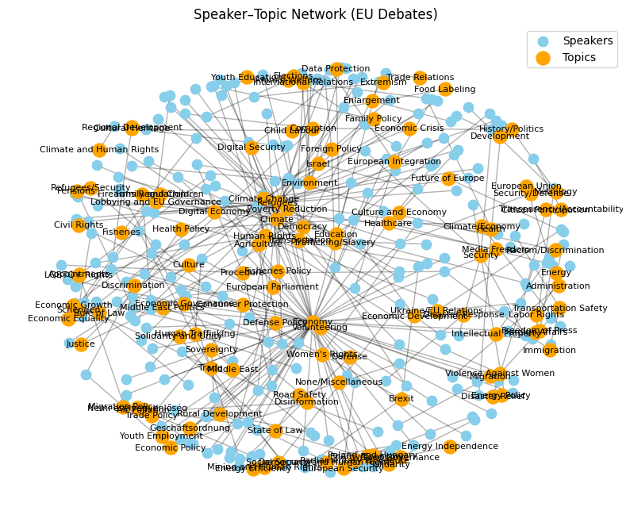
Step 3 — Knowledge Graph / Network
  • Bipartite graph: Speakers to Topics
  Nodes represent Speakers + Topics
  • Edges represent which speaker discusses which topic

Slide 8
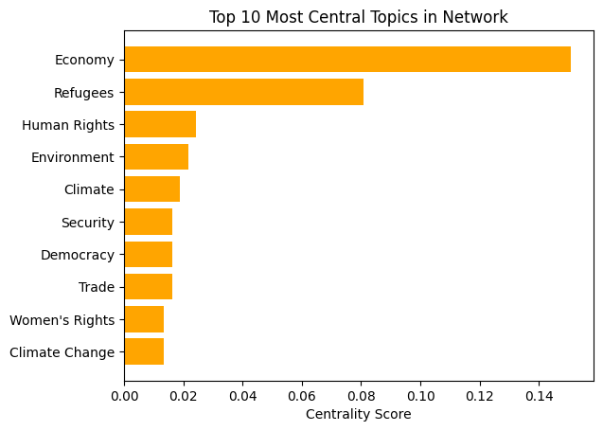
Step 4 — Network Analysis
  • Degree centrality on topics (It showed Topics mentioned by the most Speakers)
  Central Topic: Economy
  We used Networkx for calculation

Slide 9
Key insights:
Economy and Refugees dominate discussions; Human Rights and Environment also important
Network Visualization and Analysis
Visualization method using spring layout
Color coding: blue for speakers, orange for topics
Central topics identified: Economy and Refugees most central, discussed across parties

Slide 10
Conclusions & Open Questions
  LLMs extract structure well but was noisy
  Topics sometimes were overlapping
  Questions:
  How stable are these patterns across different LLM model?
  Would multi-label topics improve accuracy?
  How would the network look if we used more nodes types such as Parties, Years, Issues?

