Slide 1

Zomato Restaurant expansion
Presented by
Sristhi Kesarwani

Slide 2
Zomato Business Model
Customer Segment
Restaurants in the Neighbourhood
Users
Content Contributers
Zomato Provisions
Zomato Alliances
Value Propositions
Improving the quality of food
Improving customer Accessbility
Insure Affordability
Support in the range

Slide 3
Introduction And Objectives
As seen in the last slide, Zomato’s business model offers both delivery as well as dine-in services to cater a wide range of customers with different preferences.
Zomato gets 9 Crore visitors a month and covers 12000 restaurants across 100 cities in 23 nations.
It indicates that Zomato can provide us with a very good bulk of data to analyse for different purposes.
Today, we are going to analyse the Zomato data to open restaurants in countries/cities with following 2 key objectives-
Low competition
High food culture/interest

Slide 4

DATA OVERVIEW
Data Scale
Range of Information
Data Cleaning
Gives insights into restaurant rating, price range, cuisines, whether it has table booking, whether it facilitates online delivery, etc.
Helps in identifying competitors
India has highest number of restaurants
No duplicate rows present
Format of Datekey_opening can be corrected to standard date format, i.e. DD-MM-YYYY
Address missing values like filling the cuisines with the most common cuisine
Data of 9552 different restaurant outlets across different countries and cities

Slide 5

METHODOLOGY
Data visualisation using Pivot Charts and use those in creating a dashboard
Create Pivot tables for summarising various information and analysing the correlation between various parameters
Make use of functions like VLOOKUP, ARRAYFORMULA, etc.
Apply filters for simplicity
Data Cleaning and formatting

Slide 6
ABOUT THE DATA
2 tables – Raw Data and Country Description
Total no. of attributes is 21 (20 in Raw data table and 1 extra in country description)
13 Categorical columns are present
There are a total of 388 restaurants in India in the price range of 4.

Slide 7
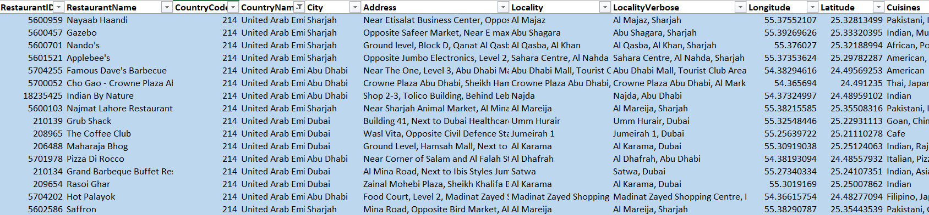
Customer Interest and Satisfaction
The average number of voters for the restaurants in each country according to the data is 637 (after rounding up)
Criteria used to filter the preferred countries: 1. Has a rating>=4 (suggests popularity of restaurants, i.e. indicating the interest of population as well), 2. Has_Online_delivery as “Yes” (Excluded India since it already has the highest number of restaurants)
The average rating for all the restaurants that have price_range < 4 and provide online delivery is 3.27381151
Formula used: =AVERAGEIFS('Raw Data'!T2:T9552,'Raw Data'!Q2:Q9552,"<4",'Raw Data'!N2:N9552,"Yes")

Slide 8
Year and Country-wise Count of Restaurants
A few countries where the team can open newer restaurants with lesser competition are as follows –
Canada 1 (4 restaurants)
Sri-Lanka (20 restaurants)
Singapore (20 restaurants)
Qatar (20 restaurants)
Indonesia (21 restaurants)
Philippines (22 restaurants)
Australia (24 restaurants)

Slide 10
Average Number of voters in each country
Indonesia has the highest count of voters and Turkey is the second highest with respect to the average count of voters.
The reason behind high number of votes in these countries could be high number of restaurants as well as mass interest in food and restaurants.
Countries that have very low number of voters are Singapore, Canada Brazil.
One of the reasons for low votes in these countries is low count of restaurants

Slide 11
Cities are opening restaurants based on low competition
Montville, Paynesville, Mayfield in Australia and Colombo in Sri Lanka are some good options for opening restaurants as they have only one restaurant, that too with rating less than 3 (suggesting low competition).

Slide 12
Price range and Rating
The average rating of restaurants opened in the selected countries ranges from 3 to 4.5.
Out of the selected countries, Brazil, Sri-Lanka and Australia seem to have average cost of two in restaurants as <= INR2000. The highest average cost of two can go up to INR 14000 in Singapore.
The correlation between rating and average cost of two in INR is 0.311070764. This shows that the rating is not really affected by the rates of cuisines.

Slide 13
The average rating of restaurants opened in the selected countries ranges from 3 to 4.5.

Slide 14
The count of restaurants in Price Range 4 is the highest.
Thus, it is suggestible to open restaurants in Price Range 4 and offer online delivery as well as table booking.

Slide 15
Also, the count of restaurants with online delivery and table booking is higher.

Slide 16
Expenditure Analysis
According to our data, the rates of cuisines and ratings are not correlated as the rating is almost constant over the range of cuisine price.
However, the team should not keep the rate of cuisines higher.

Slide 17
The correlation between rating and average cost of two in INR is 0.311070764.
This shows that the rating is not really affected by the rates of cuisines.

Slide 18

Market Leaders And The Ones Lagging Behind
5 Biggest competitors are:
5 Restaurants rated in lower brackets are:
Coco Bambu
Ministry of Crab
Simply Strawberries By Jagro
Taco Pep
Coco Bambu
Butter Boutique
Star Buffet
Pier 70
Queen's Cafe
Poets Cafe
Elite Indian Restaurant

Slide 19
Strategic recommendations
To open restaurants in the suggested countries, go for variety of cuisines as the rating is not significantly affected by the cuisine
Make sure the price range is in the range 3-4
Over 90% of restaurants in the suggested countries and cities do not offer table booking or online delivery. Hence, new restaurants with such facilities can be a game changer
Promote online ordering and table booking by making the customers realize the benefits of these facilities.
Conduct a survey to better understand the taste of common mass in the suggested countries/cities better as the given data might not enough for getting insight into tastes of people from different regions
Understand the strengths of your competitors (like Coco Bambu, Simply Strawberries by Jagro, Burger Point, etc.) and try to understand what makes them so popular among the common mass

Slide 20
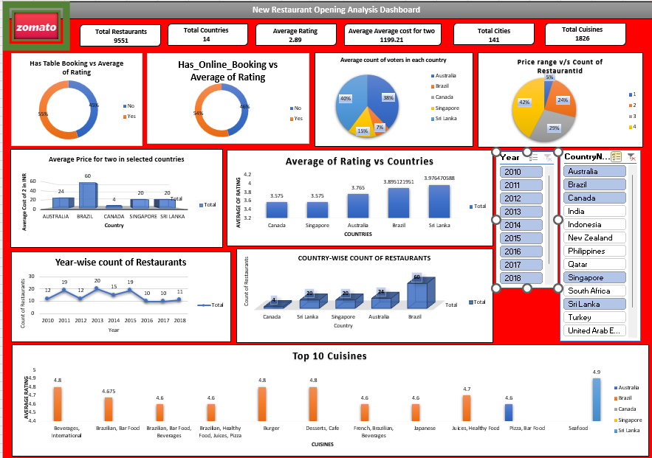
Dashboard And Visualizations

Slide 21
Conclusion
Zomato offers a vast and insightful dataset to analyse
The analysis of Zomato dataset helped in coming up with countries and cities which will be good for opening restaurants (offering low competition)
It helped in analysing ratings and votes indicating customer’s taste
It helped in analysing the average price range of restaurants to help cost saving and promote growth

Slide 22

Acknowledgement
Special thanks to Zomato for providing us with this dataset to analyse
Thanks to Newton School for this Project opportunity

