Slide 1
Unit-6
Spark ML Programming and Graph Analytics

Slide 2
MLlib
MLlib (Machine Learning Library) is Apache Spark’s scalable machine learning library. It provides tools for building machine learning pipelines that can handle large-scale data distributed across multiple machines.
In PySpark (the Python API for Apache Spark), MLlib helps you perform tasks such as:
ClassificationRegression
Clustering
Recommendation

Slide 3
Loading the dataset in Pyspark
from pyspark.sql import SparkSession
spark = SparkSession.builder.getOrCreate()
data=spark.read.csv("C:/Users/gurvi/OneDrive/Desktop/LPU/25261/INT315/Sampledata.csv", header=True, inferSchema=True)
data.show()

Slide 4
Install the packages
pip install numpy
pip install setuptools==58.0.4 ( use this as newer version of pythons doesn't contains distutils)

Slide 5
Linear Regression
Linear regression is a type of supervised machine-learning algorithm
It learns from the labelled datasets and maps the data points with most optimized linear functions which can be used for prediction on new datasets.
It assumes that there is a linear relationship between the input and output, meaning the output changes at a constant rate as the input changes. This relationship is represented by a straight line.

Slide 6
EXAMPLE
We want to predict a student's exam score based on how many hours they studied. We observe that as students study more hours, their scores go up. In the example of predicting exam scores based on hours studied. Here
Independent variable (input): Hours studied because it's the factor we control or observe.
Dependent variable (output): Exam score because it depends on how many hours were studied.

Slide 7
Implementation Data Importing
from pyspark.sql import SparkSession
spark = SparkSession.builder.getOrCreate()
data = spark.read.csv("C:/Users/ASUS/Downloads/boston_housing.csv", header = True,inferSchema = True)
data.show()
feature_columns = data.columns[:-1]
print(feature_columns)

Slide 8
Vector Assembler
VectorAssembler is a PySpark ML feature transformer that combines multiple columns (your numeric input features) into one vector column.
from pyspark.ml.feature import VectorAssembler
// features is the new column that will store the input in the form of array
assembler =VectorAssembler(inputCols=feature_columns,outputCol="features")
// It takes your DataFrame as input and adds new columns (or modifies existing ones) based on the operation.
data_2 = assembler.transform(data)
data_2.show()

Slide 9
Training and Testing of Data
train,test =data_2.randomSplit([0.7,0.3])
from pyspark.ml.regression import LinearRegression
algo = LinearRegression(featuresCol ="features",labelCol ="medv")
model = algo.fit(train)
evaluation_summary = model.evaluate(test)
evaluation_summary.meanAbsoluteError
predictions = model.transform(test)
predictions.select(predictions.columns[13:]).show()

Slide 10
Decision Tree
A Decision Tree helps us make decisions by showing different options and how they are related. It has a tree-like structure that starts with one main question called the root node which represents the entire dataset. From there, the tree branches out into different possibilities based on features in the data.
Root Node: Starting point representing the whole dataset.
Branches: Lines connecting nodes showing the flow from one decision to another.
Internal Nodes: Points where decisions are made based on data features.
Leaf Nodes: End points of the tree where the final decision or prediction is made.

Slide 11
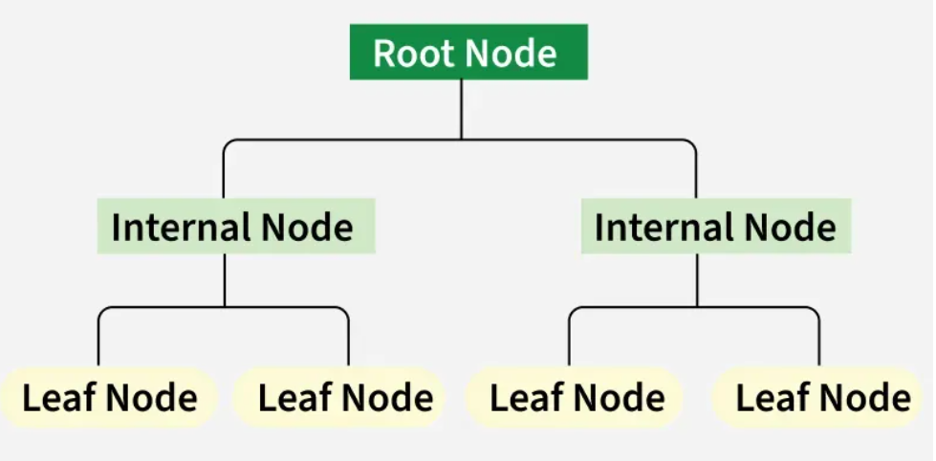

Slide 12
Decision Tree
from pyspark.sql import SparkSession
spark = SparkSession.builder.getOrCreate()
df = spark.read.csv('C:/Users/Dell/Desktop/iris.csv',header=True,inferSchema=True)
df.show()

Slide 13
Transformation of data
from pyspark.ml.feature import VectorAssembler
vector_assembler = VectorAssembler(inputCols=df.columns[:-1],outputCol="features")
df1 = vector_assembler.transform(df)
StringIndexer is a PySpark feature transformer that converts text (categorical) values into numeric labels.
Machine learning models in Spark can’t handle string labels, so we must turn them into numbers first.
from pyspark.ml.feature import StringIndexer
a_indexer = StringIndexer(inputCol="species", outputCol="labelIndex")

Slide 14
Training and Testing of Data
df1 = a_indexer.fit(df1).transform(df1)
(trainingData, testData) = df1.randomSplit([0.7, 0.3])

Slide 15
Applying DT
from pyspark.ml.classification import DecisionTreeClassifier
from pyspark.ml.evaluation import MulticlassClassificationEvaluator
dt = DecisionTreeClassifier(labelCol="labelIndex", featuresCol="features")
model = dt.fit(trainingData)
predictions = model.transform(testData)
predictions.select("prediction", "labelIndex").show(5)

Slide 16
Model Evaluation
evaluator = MulticlassClassificationEvaluator(labelCol="labelIndex", predictionCol="prediction",metricName="accuracy")
accuracy = evaluator.evaluate(predictions)
print(accuracy)
print("Test Error = %g " % (1.0 - accuracy))
print(model)

