Slide 1

Parkinson’s Disease Detection Using Machine Learning
MCKV Institute of Engineering
Dr.Poli Sil Sen
Computer Science and Engineering

Slide 2
Parkinson’s Disease Detection Using Machine Learning
MCKV Institute of Engineering
Dr.Poli Sil Sen
Computer Science and Engineering

Slide 3
Introduction
Parkinson’s Disease (PD) is a progressive neurologist disorder that affects Movement.
Early detection is important to begin treatment and slow disease progression.
Traditional Diagnosis is time-consuming and depends on expert neurologists.
Machine Learning can help detect Parkinson’s using patient voice or handwriting data more quickly and accurately.

Slide 4
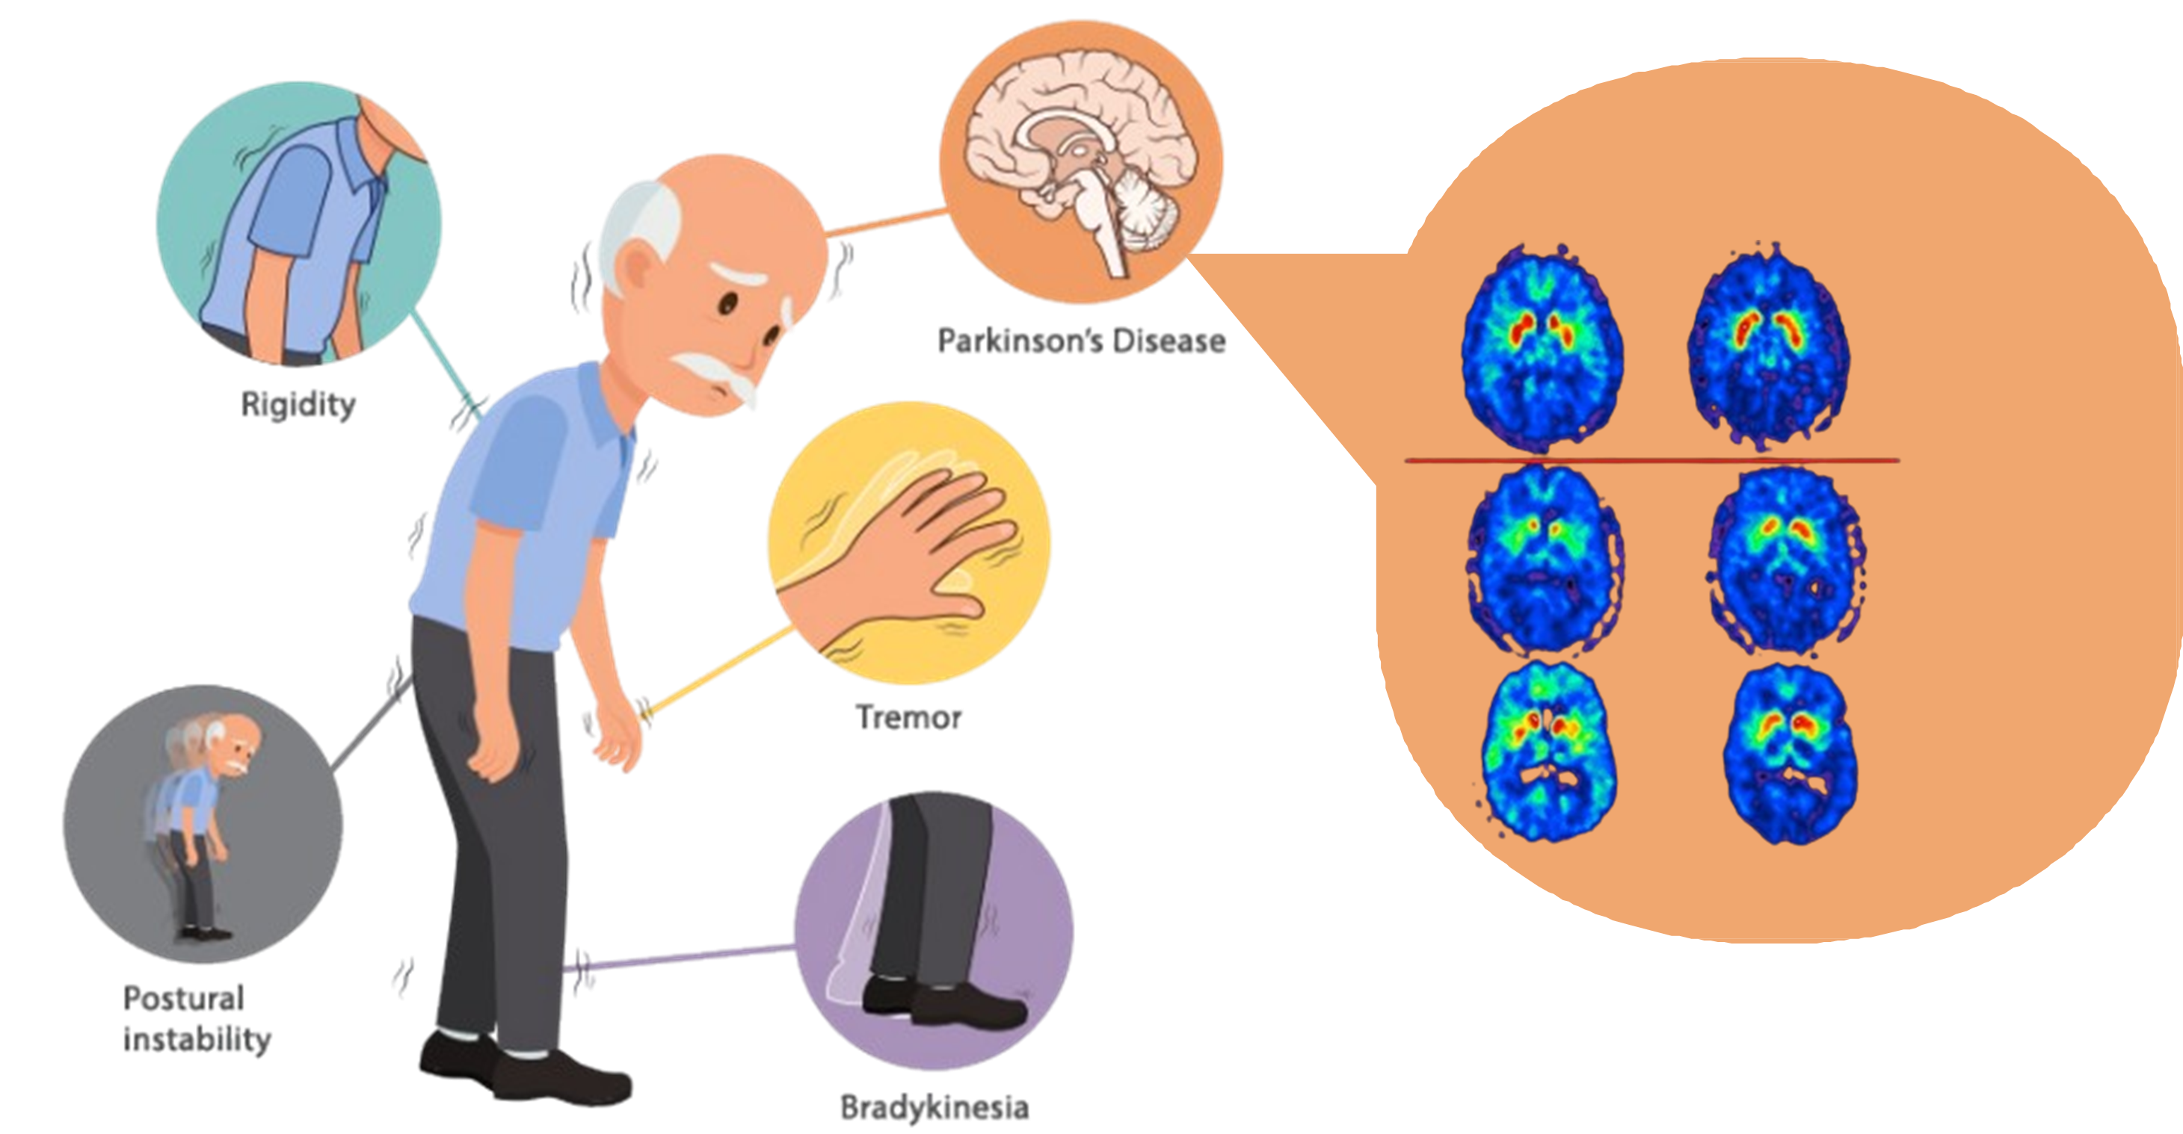
DatScan

Slide 5
Objective of the Project
To build a machine learning model that predicts Parkinson’s Disease.
To analyze patient data (spiral drawing) and identify key patterns.
To develop a simple system where patients can upload their img sample and get a test result.
To support doctors with faster and more screening.

Slide 6
Dataset Description
Dataset Used: UCI Parkinson’s Dataset/ Spiral Image Dataset
Include features such as:
* Scanned brain images
Total Sample : 550 – 600 img
Purpose : Provide labelled data for ML training and evalution.

Slide 7
Methodology
Data Collection: Obtain dataset from reliable sources.
Preprocessing: Noice removal, normalalization, resizing images, feature extraction.
Model Selection: Choose ML algorithm (CNN).
Training: Feed data into the model and adjust parameters.
Testing: Evaluate accuracy on unseen test data.
Deployment : Create a simple interface for patient testing.

Slide 8
Machine Learning Model
Model Used: CNN / Support Vector Machine
Reason for selection:
* High accuracy
* Working well for medical datasets
* Simple architecture and fast training
Tools/Technologies:
* Python
* TensorFlow / keras
* scikit – Learn
* Matplotlib, NumPy, Pandas

Slide 9
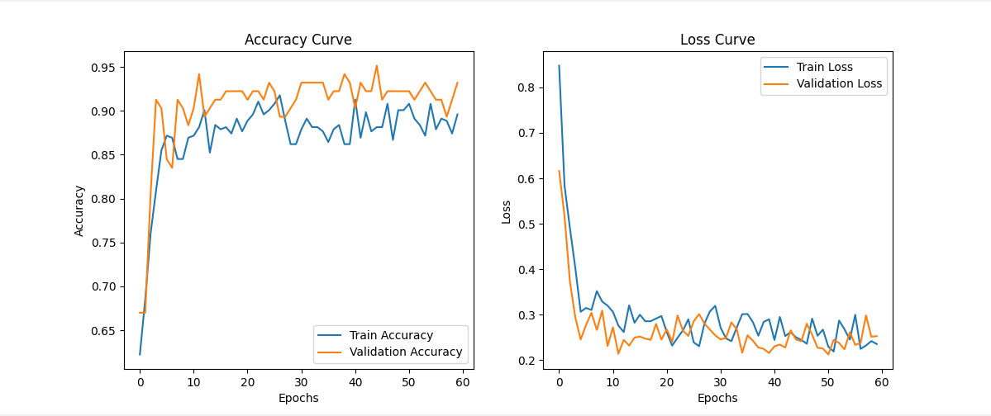
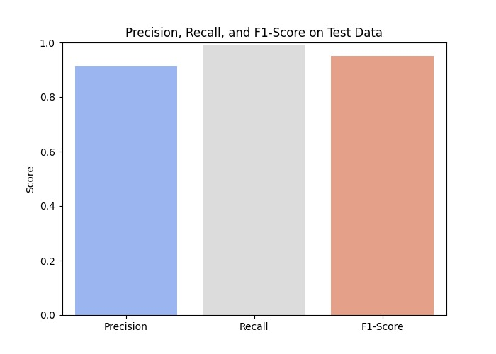
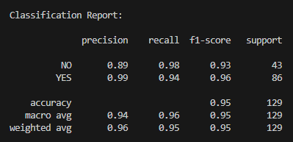
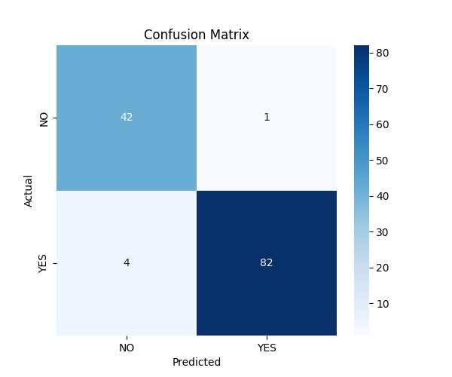
Results & Evaluation
Model Performance

Slide 10
Application / System Demo
The system allows users to upload a img report of brain scan.
The Ml model analyze the input and predicts Healthy Brain/ Parkinson Detected.
The interface also shows the probability score and report.
Designed to be easy for patients and healthcare workers to use.

Slide 11
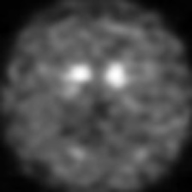
Working of the model
Parkinson Detected
PD_CNN_Model.h5
Healthy Brain
Patient Report

Slide 12
Conclusion
The machine learning model achieves good accuracy in detecting Parkinson’s Disease.
It can help in early screening before symptoms become severe.
This project shows the potential of ML in healthcare diagnosis.
Provide a fast, cost-effective, and reliable analysis tool.

Slide 13
Future Scope
Improve model with more diverse and real-world patient data.
Build a mobile app for quick testing.
Add real-time tremor detection using sensors or handwriting tablets.
Collaborate with hospitals for clinical validation of the system.

