Slide 1
TEMPERATURE CONTROL SYSTEM MATLAB ANALYSIS
Presented By: Syed Shaftain Ali Kazmi
Ali Zaman

Slide 2
Open loop system :
Code:
clc;
clear;
close all;
% Transfer Function
num = [1];
den = [10 1];
G = tf(num, den)
% Step Response
figure;
step(G);
grid on;
title('Open Loop Step Response');
% Poles and Zeros
figure;
pzmap(G);
grid on;
title('Poles and Zeros');
% System Information
info = stepinfo(G)
% Stability Check
poles = pole(G)

Slide 3
Output:
G = 1/ 10 s + 1
Continuous-time transfer function.
Model Properties
info = struct with fields:
RiseTime: 21.9701
TransientTime: 39.1207
SettlingTime: 39.1207
SettlingMin: 0.9045
SettlingMax: 0.9993
Overshoot: 0
Undershoot: 0
Peak: 0.9993
PeakTime: 73.2222
poles = -0.1000

Slide 4
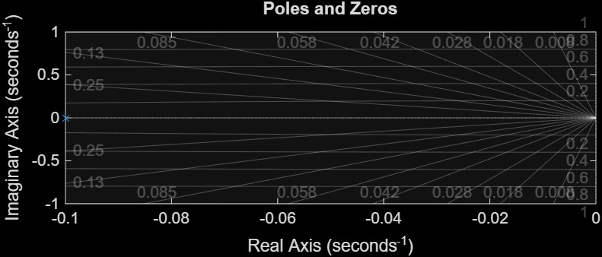
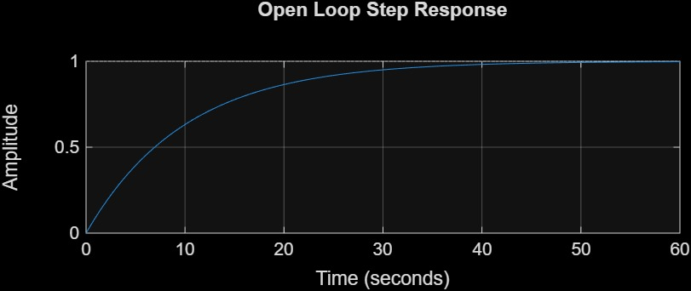

Slide 5
Closed loop system :
Code:
clc;
clear;
close all;
% Open Loop Transfer Function
G = tf([1],[10 1]);
% Closed Loop System with Unity Feedback
T = feedback(G,1);
% Display Closed Loop Transfer Function (T)
% Step Response
figure;
step(T);
grid on;
title('Closed Loop Step Response');
% Pole-Zero Map
figure;
pzmap(T);
grid on;
title('Closed Loop Poles and Zeros');
% Performance Analysis
info = stepinfo(T)
% Poles
poles = pole(T)

Slide 6
Output:
T = 1 / 10 s + 2
Continuous-time transfer
function.
Model Properties
info =
struct with fields:
RiseTime: 10.9850
TransientTime: 19.5604
SettlingTime: 19.5604
SettlingMin: 0.4523
SettlingMax: 0.4997
Overshoot: 0
Undershoot: 0
Peak: 0.4997
PeakTime: 36.6111
poles = -0.2000

Slide 7
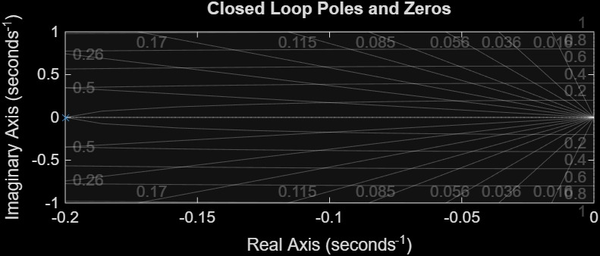
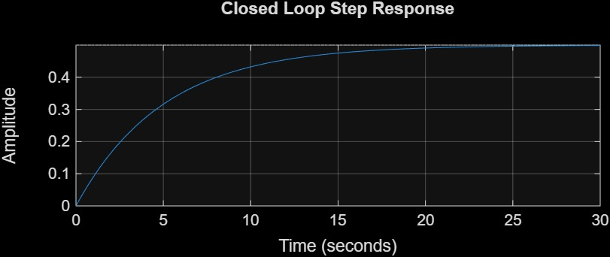

Slide 8
PI Controller:
Code:
clc;
clear;
close all;
% Open Loop System
G = tf([1],[10 1]);
% PID Controller
Kp = 5;
Ki = 1;
C = pid(Kp,Ki);
% Closed Loop System
T = feedback(C*G,1);
% Step Response
step(T);
grid on;
title('Closed Loop Step Response with PID');

Slide 9
PI Controller:
Code:
% Performance Information
info = stepinfo(T)
% Pole-Zero Map
figure;
pzmap(T);
grid on;
title('Closed Loop Poles and Zeros');
% Display Poles
poles = pole(T)

Slide 10
Output:
info = struct with fields:
RiseTime: 3.1860
TransientTime: 15.2749
SettlingTime: 15.2749
SettlingMin: 0.9144
SettlingMax: 1.0670
Overshoot: 6.7018
Undershoot: 0
Peak: 1.0670
PeakTime: 7.8288
poles = -0.3000 + 0.1000i
-0.3000 - 0.1000i

Slide 11
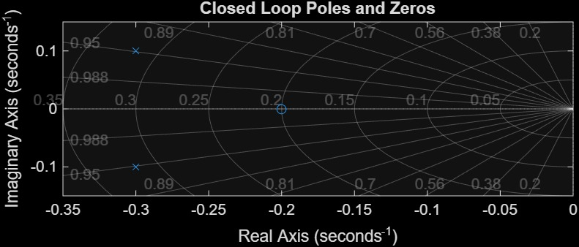
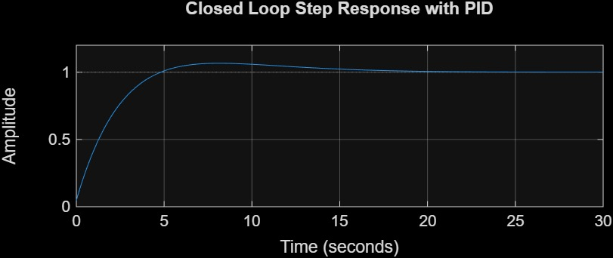

Slide 12
PD Controller:
Code:
clc;
clear;
close all;
% Open Loop System
G = tf([1],[10 1]);
% PID Controller
Kp = 5;
Kd = 0.5;
C = pid(Kp,Kd);
% Closed Loop System
T = feedback(C*G,1);
% Step Response
figure;
step(T);
grid on;
title('Closed Loop Step Response with PID');
% Performance Information
info = stepinfo(T)
% Pole-Zero Map

Slide 13
PD Controller:
figure;
pzmap(T);
grid on;
title('Closed Loop Poles and Zeros');
% Display Poles
poles = pole(T)

Slide 14
Output:
info = struct with fields:
RiseTime: 4.3940
TransientTime: 7.8241
SettlingTime: 7.8241
SettlingMin: 0.9045
SettlingMax: 0.9993
Overshoot: 0
Undershoot: Z
Peak: 0.9993
PeakTime: 14.6444
poles = -0.5000
-0.1000

Slide 15
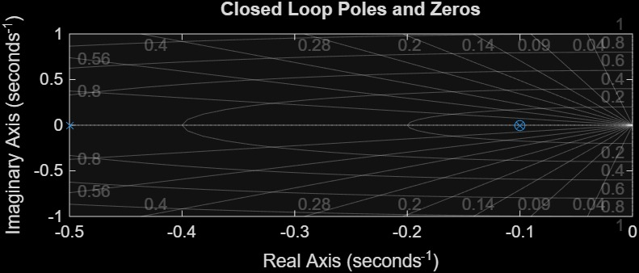
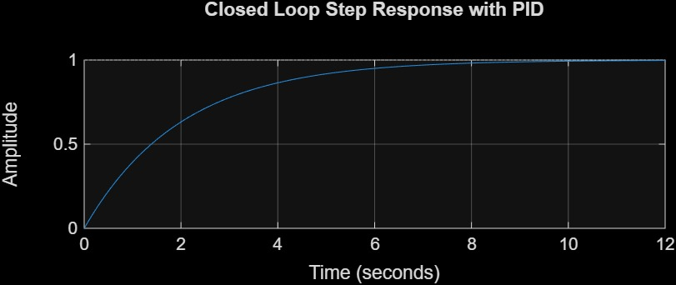

Slide 16
PID Controller:
Code;
clc;
clear;
close all;
% Open Loop System
G = tf([1],[10 1]);
% PID Controller
Kp = 5;
Ki = 1;
Kd = 0.5;
C = pid(Kp,Ki,Kd);
% Closed Loop System
T = feedback(C*G,1);
% Step Response
figure;
step(T);
grid on;
title('Closed Loop Step Response with PID');
% Performance Information
info = stepinfo(T)
% Pole-Zero Map

Slide 17
PID Controller:
figure;
pzmap(T);
grid on;
title('Closed Loop Poles and Zeros');
% Display Poles
poles = pole(T)

Slide 18
Output:
info = struct with fields:
RiseTime: 3.3821
TransientTime: 15.7480
SettlingTime: 15.5520
SettlingMin: 0.9046
SettlingMax: 1.0663
Overshoot: 6.6288
Undershoot: 0
Peak: 1.0663
PeakTime: 8.0590
poles =
-0.2857 + 0.1166i
-0.2857 - 0.1166i

Slide 19
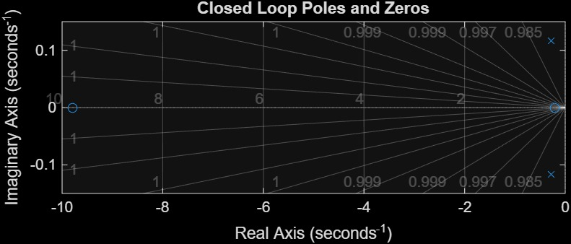

Slide 20
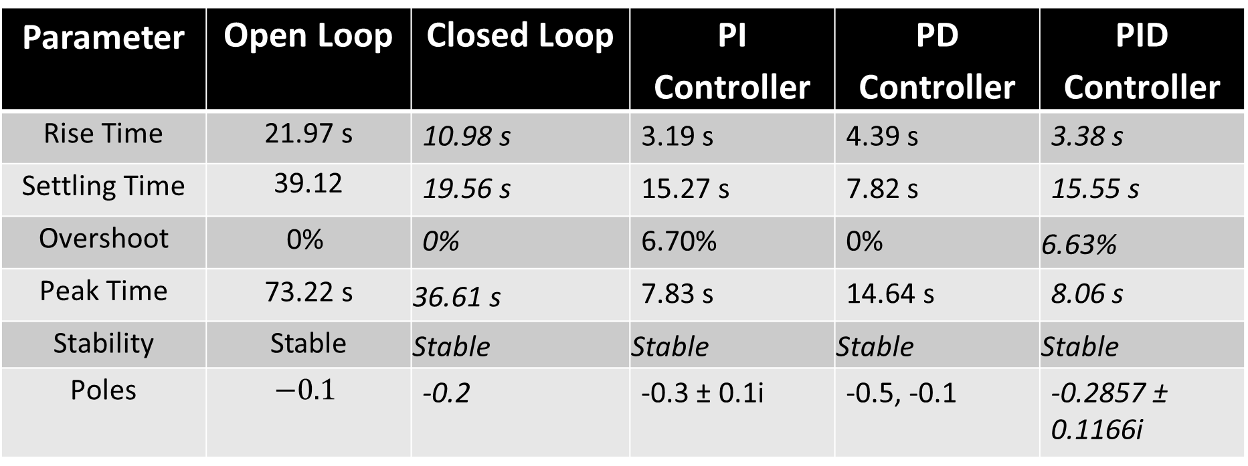
PERFORMANCE COMPARISON TABLE
Parameter | Open Loop | Closed Loop | PI Controller | PD Controller | PID Controller
Rise Time | 21.97 s | 10.98 s | 3.19 s | 4.39 s | 3.38 s
Settling Time | 39.12 | 19.56 s | 15.27 s | 7.82 s | 15.55 s
Overshoot | 0% | 0% | 6.70% | 0% | 6.63%
Peak Time | 73.22 s | 36.61 s | 7.83 s | 14.64 s | 8.06 s
Stability | Stable | Stable | Stable | Stable | Stable
Poles | $$−0.1$$ | -0.2 | -0.3 ± 0.1i | -0.5, -0.1 | -0.2857 ± 0.1166i

Slide 21
Open Loop System
Characteristics:
Very slow response
Large settling time
No control action
Observation:
Temperature changes slowly
Poor performance

Slide 22
Closed Loop System
Improvements:
Faster than open loop
Better stability
Reduced response time
Observation:
Feedback improved system behavior

Slide 23
PI Controller:
Improvements:
Very fast rise time
Reduced steady-state error
Problem:
Some overshoot introduced
Observation:
System becomes faster but slightly oscillatory

Slide 24
PD Controller:
Improvements:
Best settling time
No overshoot
Stable response
Observation:
PD gives smooth and stable behavior

Slide 25
PID Controller:
Improvements:
Fast response
Good accuracy
Balanced control
Problem:
Small overshoot still exists
Observation:
PID gives balanced overall performance

Slide 26
Performance Analysis:
The open-loop system showed slow response and large settling time. Introducing feedback in the closed-loop system improved stability and response speed. The PI controller significantly reduced rise time but introduced overshoot. The PD controller provided the best settling time with zero overshoot, making the system highly stable. The PID controller achieved balanced overall performance with improved speed and acceptable overshoot. Therefore, controller implementation greatly improved the temperature control system performance.

Slide 27
Conclusion:
The temperature control system was successfully analyzed using MATLAB. Open-loop and closed-loop systems were studied and different controllers were implemented. The controllers improved system response characteristics such as rise time, settling time, and stability. Among all controllers, the PD controller showed the best settling performance with zero overshoot, while the PID controller provided balanced overall control performance

