Slide 1
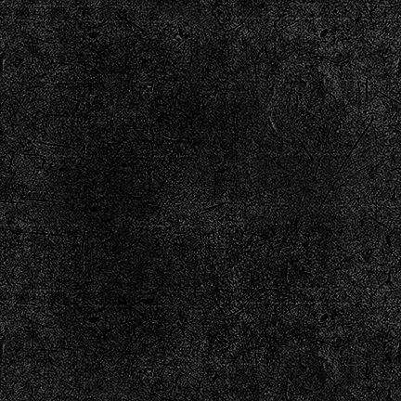
DEEPFAKE
Supervisor :Dr. Raghvendra Kumar
Class Teacher :Mr. Pritam Kumar Raul
GROUP NO:15
SRITAM MAHAPATRO
SUBHAM NAYAK
VIKRANT SINGH

Slide 2
AGENDA
Introduction
Objective
Key features
Modules and libraries
System Requirement
Data Flow Diagram
Conclusion

Slide 3
Introduction
A deepfake is a type of synthetic media that is created using deep learning techniques.
Deepfakes have become famous because they can trick and manipulate people, but they're also used for fun, like swapping faces for laughs or pretending to be famous folks.
However, they can be very harmful when people use them to lie, harm someone's reputation, or commit fraud.

Slide 4
Objective
Our objective of implementing deepfake video/image in social media can vary depending on the intention of the creator. Some possible objectives are:
To entertain, amuse, or something by swapping faces in a creative way.
To educate, inform, or demonstrate.

Slide 5
Key Features
Face Detection
Face Swapping
User Friendly UI
Versatile Use-case

Slide 6
Modules and Libraries Used
Modules:
Libraries:
OpenCV
Numpy
argparse
Streamlit
Pillow
Dlib
Scipy

Slide 7
System Requirements
Hardware Requirements:
Software Requirements:
CPU (i.e IntelCore i5 or equivalent)
RAM
Storage
Python
Python Libraries
Network Connectivity
Web Browser

Slide 8
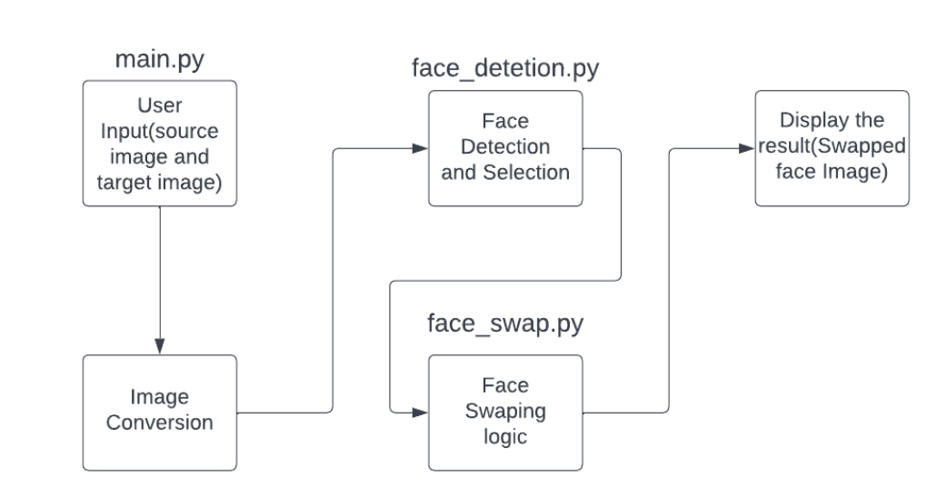
Dataflow Diagram
Using source image and target image and creating a Deepfake Image

Slide 9
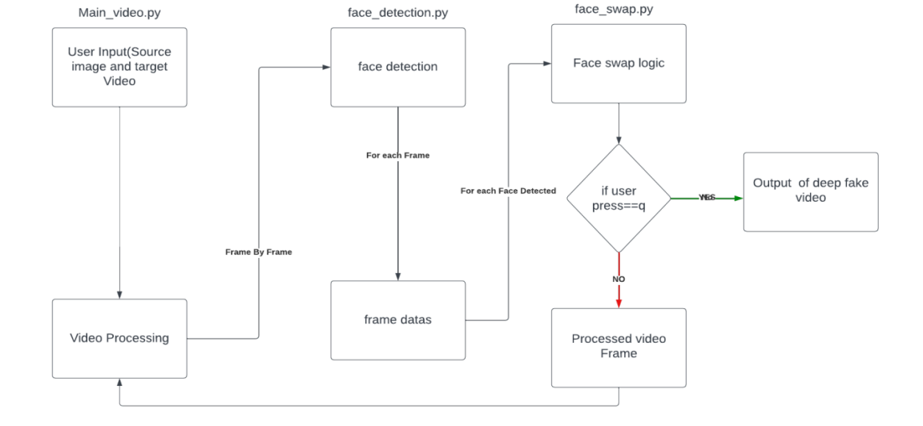
Dataflow Diagram
-
Using image and video and creating a Deepfake Video

Slide 10
Conclusion
Our project aims to build a platform for safe exploration of deepfake technology.
Our main goal is to show how ethical deepfake media can be used in social media.
We use DEEPFAKE Python for face detection and swapping, along with Streamlit for a user-friendly interface. We want to encourage responsible and creative use of deepfake tech while informing people about its capabilities and limitations.

