Slide 1
Project Title:- Predicting Treatment Outcomes from Patient Clinical data GitHub link : https://github.com/Sritejam/Capstone_TeamE
Prepared by- Team E
1. Ayushi Bhujade (ZG28331) 2. Nimit Tolia (YT29650) 3. Sriteja Madishetty (VT76695)

Slide 2
TABLE OF CONTENT
1. GitHub details
4. Exploratory Data Analysis
7. Future Work
2. Project Overview
3. Literature Survey
5. Predictive Classification Models
8. References
6. Evaluation Results

Slide 3
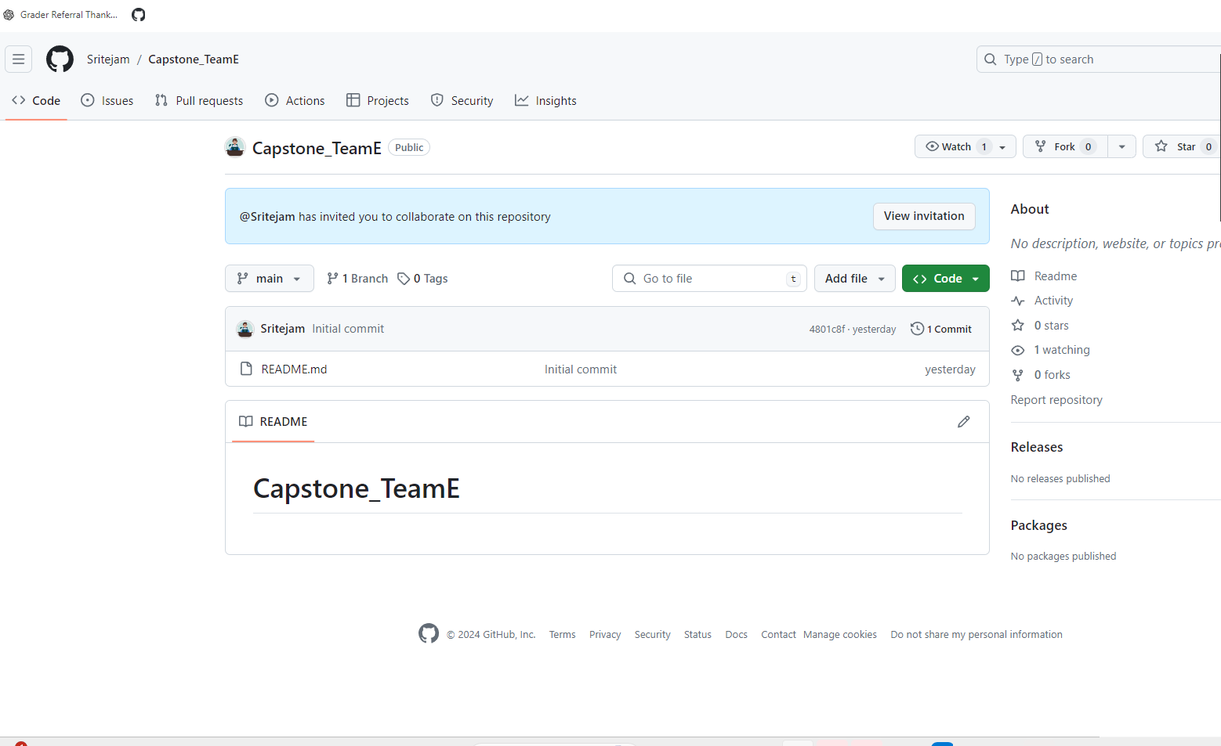
01. GITHUB DETAILS (to bee changed in the end)
GitHub link: https://github.com/Sritejam/Capstone_TeamE

Slide 4
02. PROJECT OVERVIEW (1)
Introduction
In the healthcare industry, the ability to accurately predict treatment outcomes based on patient clinical data can significantly enhance patient care and optimize medical resources.
Objective
The primary objective of this project is to develop a robust predictive model that can analyze extensive textual clinical data and accurately predict the appropriate treatment name.
Data Source
The dataset used in this project is sourced from Hugging Face, specifically the augmented clinical notes dataset ( AGBonnet/augmented-clinical-notes · Datasets at Hugging Face). This dataset comprises a wide array of textual and numerical clinical features of patients.
This project leverages advanced machine learning techniques - Natural Language Processing to predict the most suitable treatment for patients based on their comprehensive clinical history and current medical condition.
The predictive model is designed to process and interpret complex medical information like patient demographics, physiological context, visit motivation, diagnosis results, and related conditions.
The ultimate goal is to provide precise treatment recommendations based on data-driven insights.

Slide 5
02. PROJECT OVERVIEW - Methodology (2)
Data Selection
A subset of the original dataset was selected to ensure manageable data size and relevance.
Data Pre - processing
Given that the dataset is primarily textual, several preprocessing steps were undertaken
Feature Engineering
Creating relevant features using TF-IDF Vectorizer. This converts text data into numerical features and captures the importance of words in documents relative to the entire dataset.
Model Development
Training a Random Forest Classifier, a robust algorithm that handles datasets with high dimensionality.
Evaluation:
Splitting the dataset into an 80-20% train-test split to evaluate model performance on unseen data.
Performing cross-validation to ensure the model's robustness and reliability.
The selected subset consists of 17,000 records, 11 columns and 100 treatment classes.
Removing stop words, eliminating punctuation, and performing lemmatization to standardize the text.
Fine-tuning Model Parameters such as the number of trees, maximum depth, and feature selection.
Assessing the model's performance using accuracy, F1-score and AUC.

Slide 6
03. LITERATURE SURVEY (1)
Project/Study | Objective | Techniques Used | Key Contributions | References
MediNote | Generate clinical notes from dialogues | Fine-tuning large language models (LLMs) such as MediNote-7B and MediNote-13B | Automated clinical documentation to enhance efficiency and accuracy | Link
MediTron | Clinical LLM development | Pre-trained on PubMed articles and clinical guidelines, fine-tuned with the dataset | Improved generation of detailed and structured clinical notes | Link
Literature-Augmented Clinical Outcome Prediction | Enhance clinical outcome predictions | Sparse and dense retrieval models for integrating biomedical literature with clinical notes | Improved accuracy in outcome predictions by using both clinical notes and relevant literature | Link
NoteChat | Extend PMC-Patients with synthetic dialogues | Synthetic dialogues generated using ChatGPT and GPT-4 | Realistic training data mimicking real-world clinical interactions | Link
Structured Patient Information Extraction | Extract structured data from clinical notes | Using GPT-4 to extract structured patient information | Enhanced structured data extraction from unstructured text for better training of predictive models | Link

Slide 7
03. LITERATURE SURVEY (2)
Given below are the aspects of our approach and objectives that differs from the previous efforts utilized on Augmented Clinical Notes Dataset:
Aspect | Previous Work | Our Work
Objective | Generate clinical notes from dialogues (e.g., MediNote, MediTron) | Develop a predictive model specifically for predicting appropriate treatment names based on structured data
Data Utilization | Utilized Synthetic dialogues and structured patient information for note generation and structured data extraction | Leverage structured data from clinical notes summary for building a treatment prediction model
Modelling Techniques | NLP techniques and large language models (LLMs) for text generation and integration with literature | NLP techniques (vectorization) and ML statistical modeling techniques for predictive analytics (e.g., decision trees, random forests)
Feature Engineering | Text processing and synthesis of patient- doctor dialogues | Detailed feature engineering from structured data fields (e.g., patient demographics, diagnosis, medical history)
Enhanced Model Accuracy | Evaluated on the quality of generated notes and literature integration | Evaluated on classification and prediction accuracy for treatment names

Slide 8
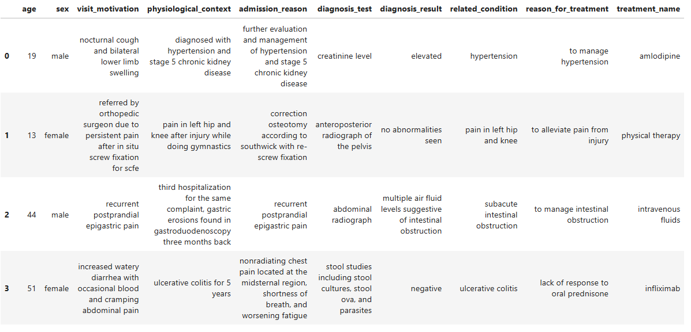
04. EXPLORATORY DATA ANALYSIS - Data Overview (1)
#Columns: 11 #Rows: 17,000 #Treatment Classes: 100

Slide 9
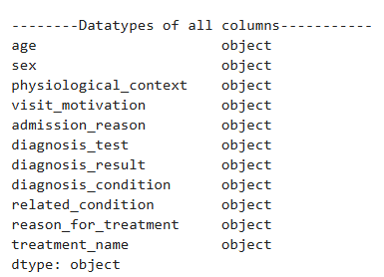
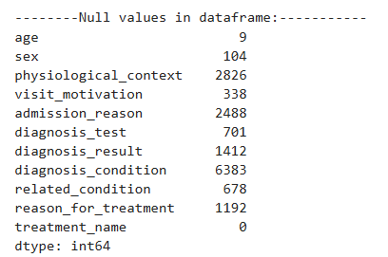
04. EXPLORATORY DATA ANALYSIS - Data Overview (2)
Fig (i)
Fig (ii)
Action: Handle missing values –
Drop column diagnosis_condition.
Delete records with null input
Result: The shape of the new data is : Rows - 10,093, Columns - 10

Slide 10
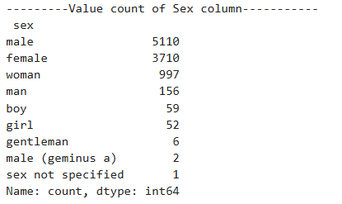
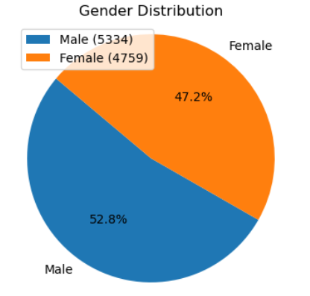
04. EXPLORATORY DATA ANALYSIS - Gender Distribution (3)
Fig (i)
Action: Normalize Gender Representation to two major categories: Male, Female
Fig (ii)

Slide 11
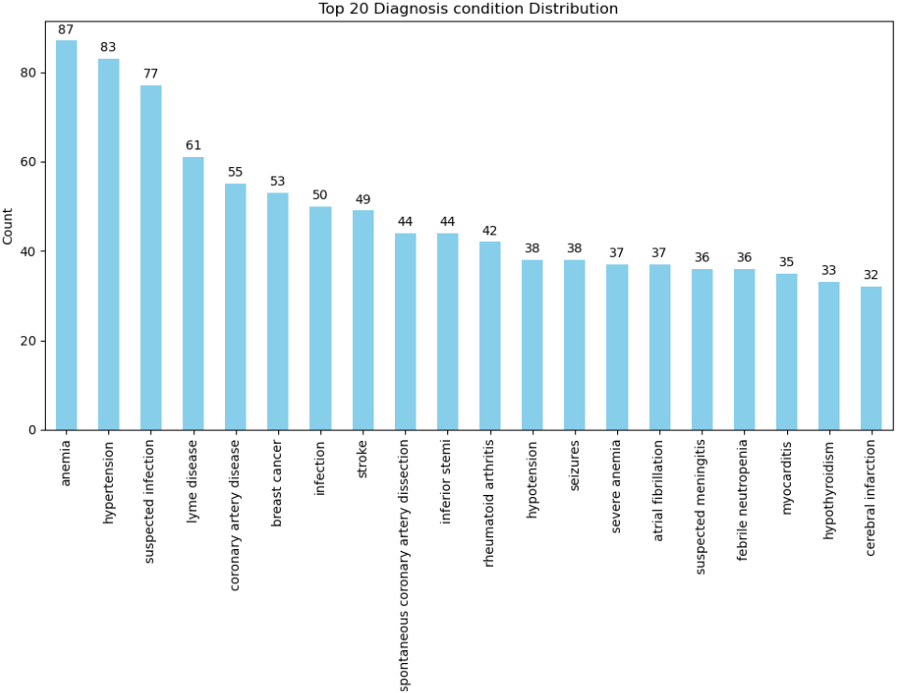
04. EXPLORATORY DATA ANALYSIS - Top Diagnosis Conditions (4)

Slide 12
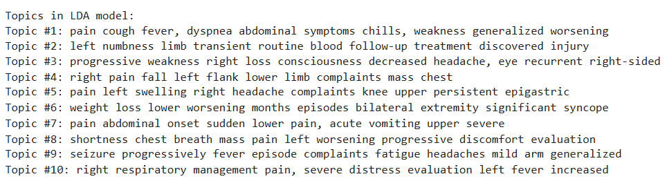
04. EXPLORATORY DATA ANALYSIS - Major visit motivations (5)
Topic Discovery: Applied Latent Dirichlet Allocation (LDA) to the "visit_motivation" column to uncover hidden topics or themes within the text data.
Insight Generation: LDA allows to gain insights into the common reasons behind medical visits, in understanding patterns and trends in patient concerns or clinical focuses
Fig (i)

Slide 13
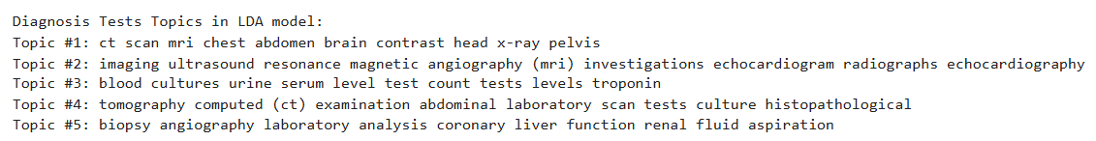
04. EXPLORATORY DATA ANALYSIS - Identify diagnosis tests (6)
Identifying Medical Topics: Applying LDA to diagnosis texts helps identify common themes or topics within medical diagnoses.
Insight Generation: LDA-generated topics helps to understand the distribution of diagnoses across patient populations.
Fig (i)

Slide 14
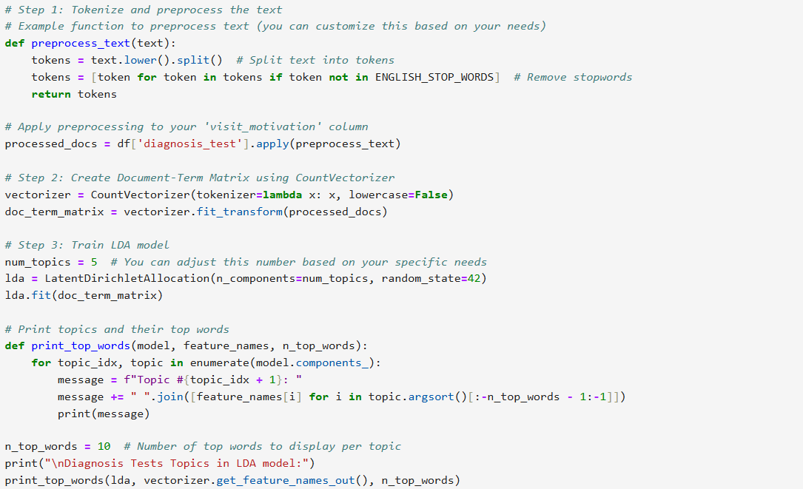
04. EXPLORATORY DATA ANALYSIS - Code for LDA (7)
Fig (i)

Slide 15
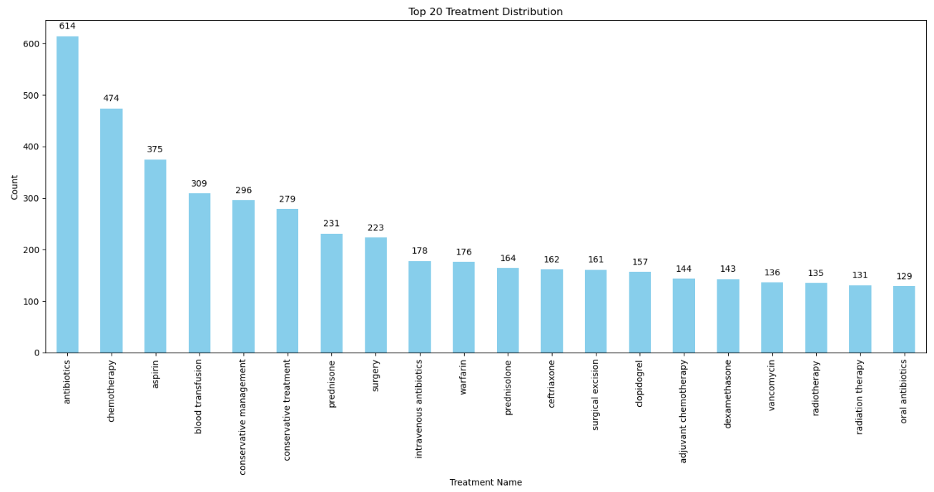
04. EXPLORATORY DATA ANALYSIS - Popular Treatments (8)

Slide 16
05. PREDICTIVE MODEL DEVELOPMENT (1)

Slide 17
05. PREDICTIVE MODEL DEVELOPMENT (2)

Slide 18
06. EVALUATION RESULTS

Slide 19
07. FUTURE WORK

Slide 20
08. REFERENCES
https://huggingface.co/datasets/AGBonnet/augmented-clinical-notes
https://arxiv.org/abs/2202.13876
https://arxiv.org/abs/2310.15959
https://huggingface.co/datasets/AGBonnet/augmented-clinical-notes/blob/main/report.pdf
https://www.cdc.gov/phlp/php/resources/health-insurance-portability-and-accountability-act-of-1996-hipaa.html?CDC_AAref_Val=https://www.cdc.gov/phlp/publications/topic/hipaa.html

Slide 21
THANK YOU

