Slide 1
Can an ARL Agent Outperform EGT Populations in a Simulated Market?
Rithwak Somepalli
Praneeth Rangarajan
Using Financial Markets to Test Deep Reinforcement Learning against Adaptive Adversaries

Slide 2
Research Question and Motivation
Research Question
  How does an Adaptive Reinforcement Learning (ARL) agent perform and adapt against an evolving population of heuristic traders governed by Evolutionary Game Theory (EGT)?
Motivation
  Markets are noisy, adversarial, and non-stationary - ideal for stress-testing AI.
  Safe environment for studying RL adaptation and robustness.
  EGT provides an adaptive adversary that changes over time, not a fixed opponent.
  Connects to AI themes: search, reasoning, planning, learning, and multi-agent interaction

Slide 3
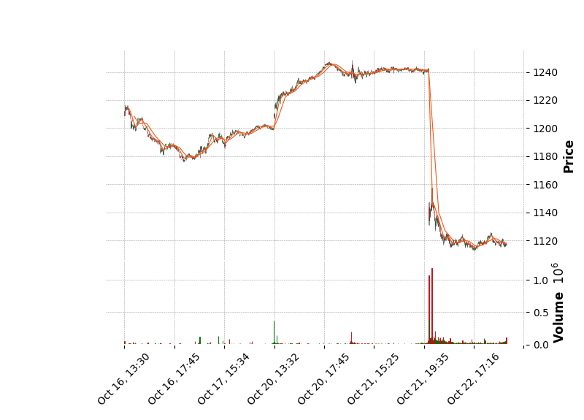
Tested Market Patterns
Why Multiple Patterns?
  We tested several market trajectories (trend, range, high volatility).
  ARL behavior remained consistent across patterns.
Presentation Note:
  For time, we show results for one representative market.

Slide 4
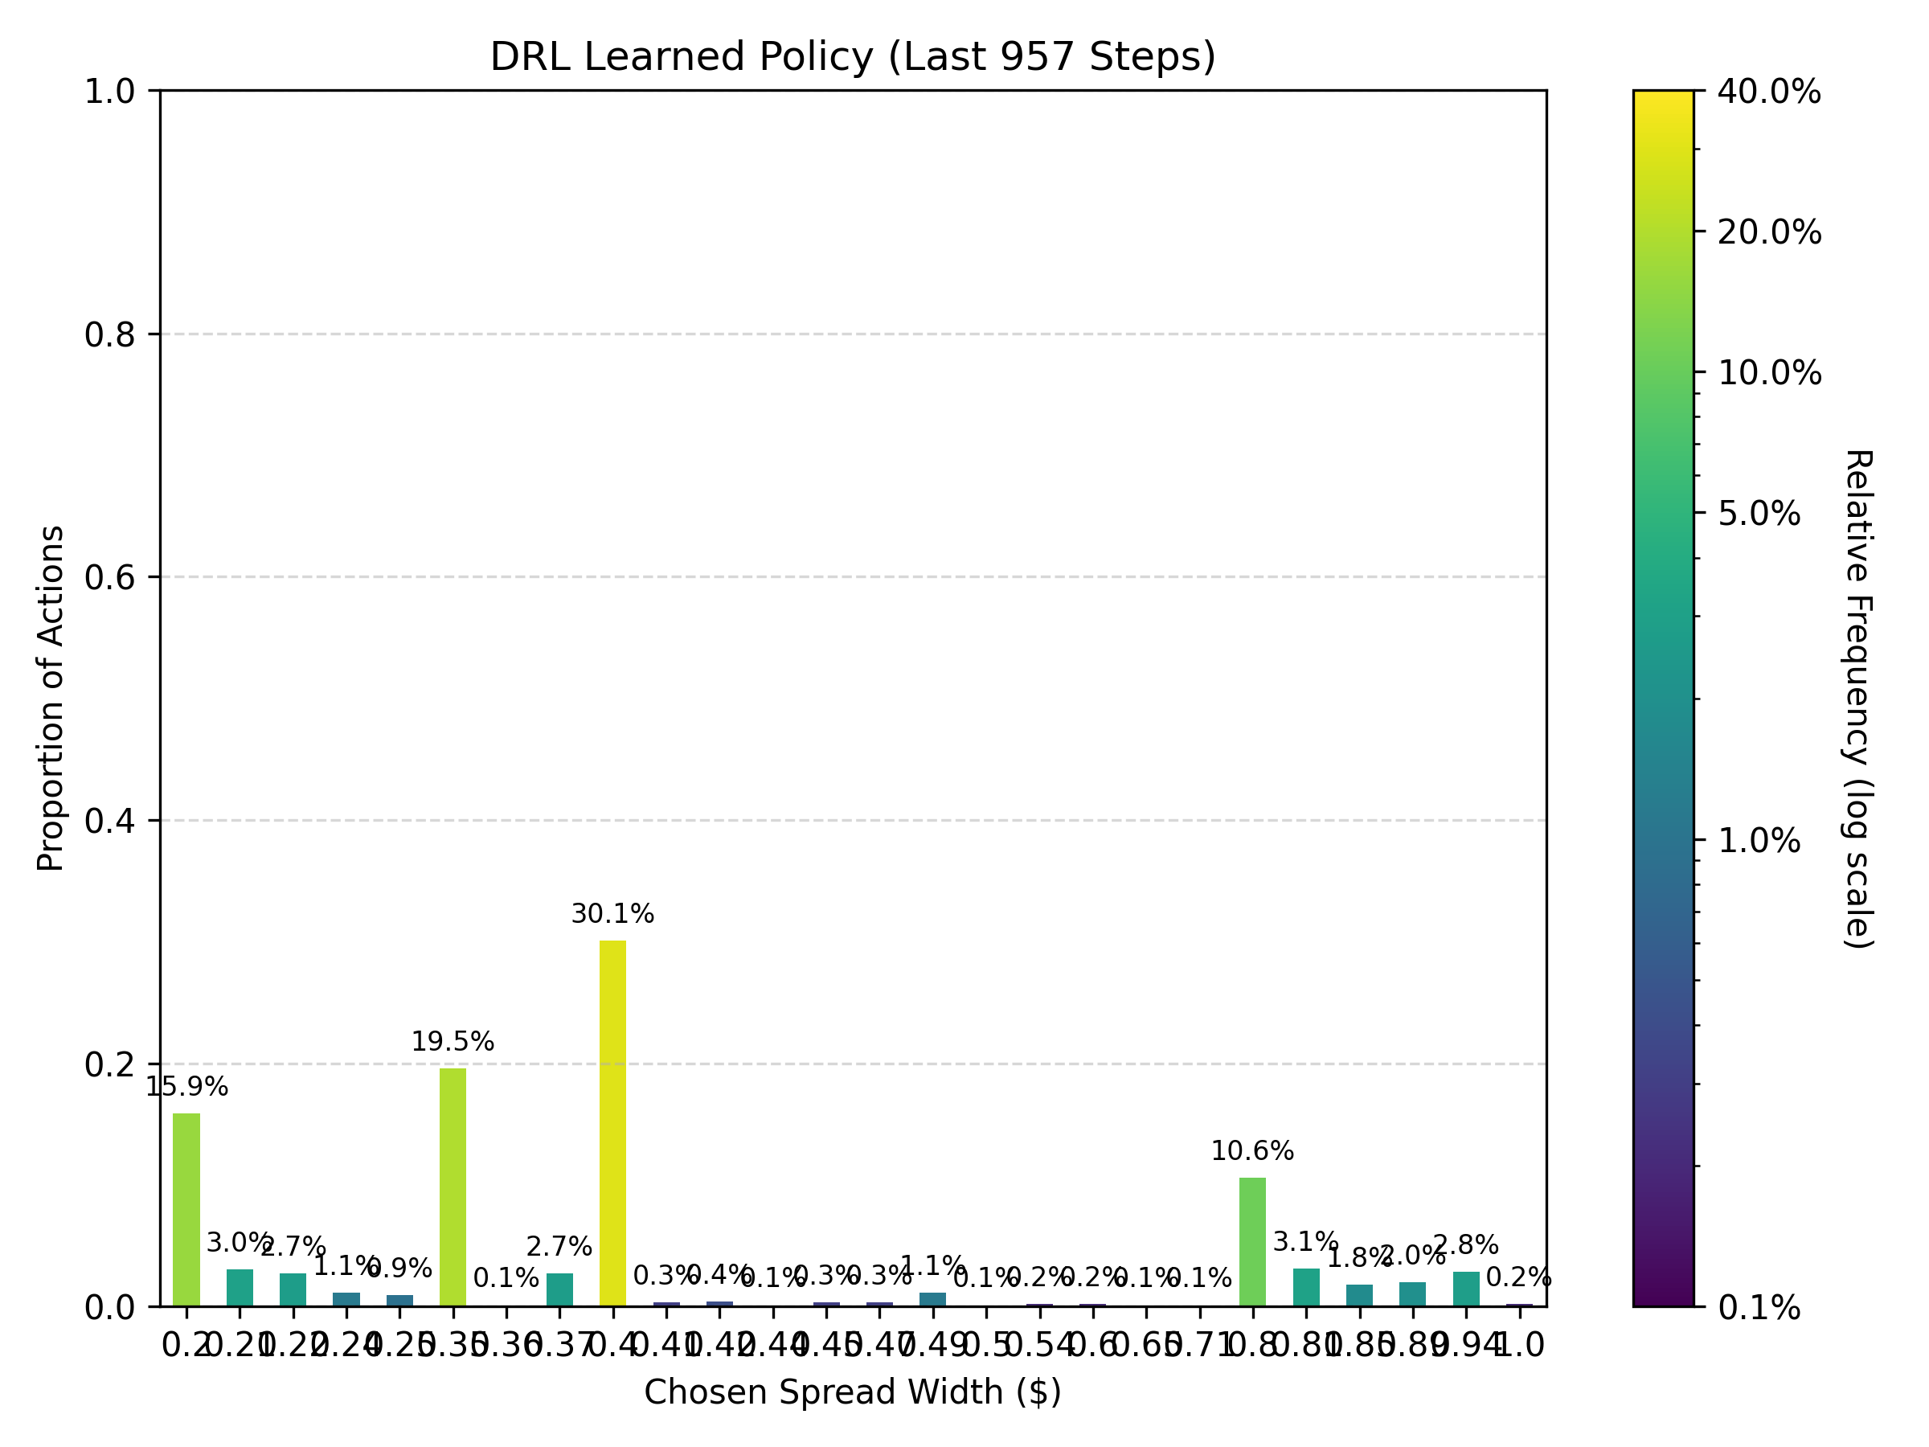
Simulation Environment / Market Setup
Mid-price evolves using stochastic volatility.
Agents interact via crossing quotes (order-book style).
ARL posts bid/ask spreads; EGT evaluates and trades.

Slide 5
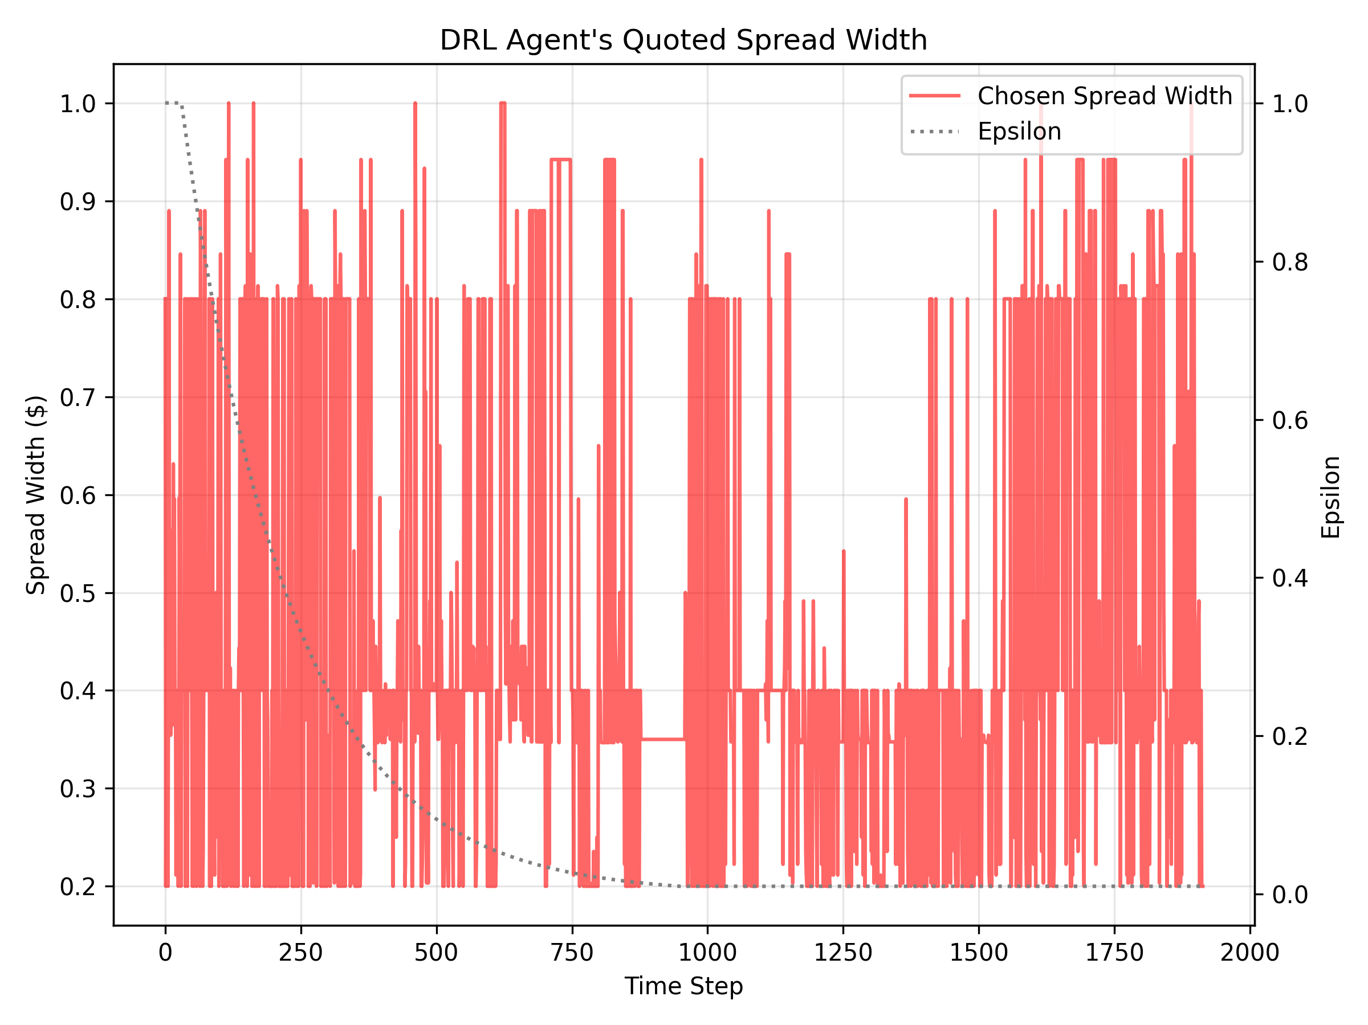
Methodology – ARL Agent
ARL Architecture
  Neural-Network based Q learning agent
  State includes: volatility, momentum, RSI, normalized volume, inventory, time-remaining
  Actions: discrete bid/ask spread pairs (tight - medium - wide)
Reward
  Profit, risk penalty, transaction cost + spread-capture bonus.
Exploitation / Safeguard Mechanisms
  Exploitation – When volatility is high and the EGT population is passive, the ARL tightens spreads to capture the spread profit.
  Safeguard – When inventory grows large or market volatility spikes, the ARL widens spreads or reduces quote frequency, limiting exposure and keeping the EGT population in check.

Slide 6
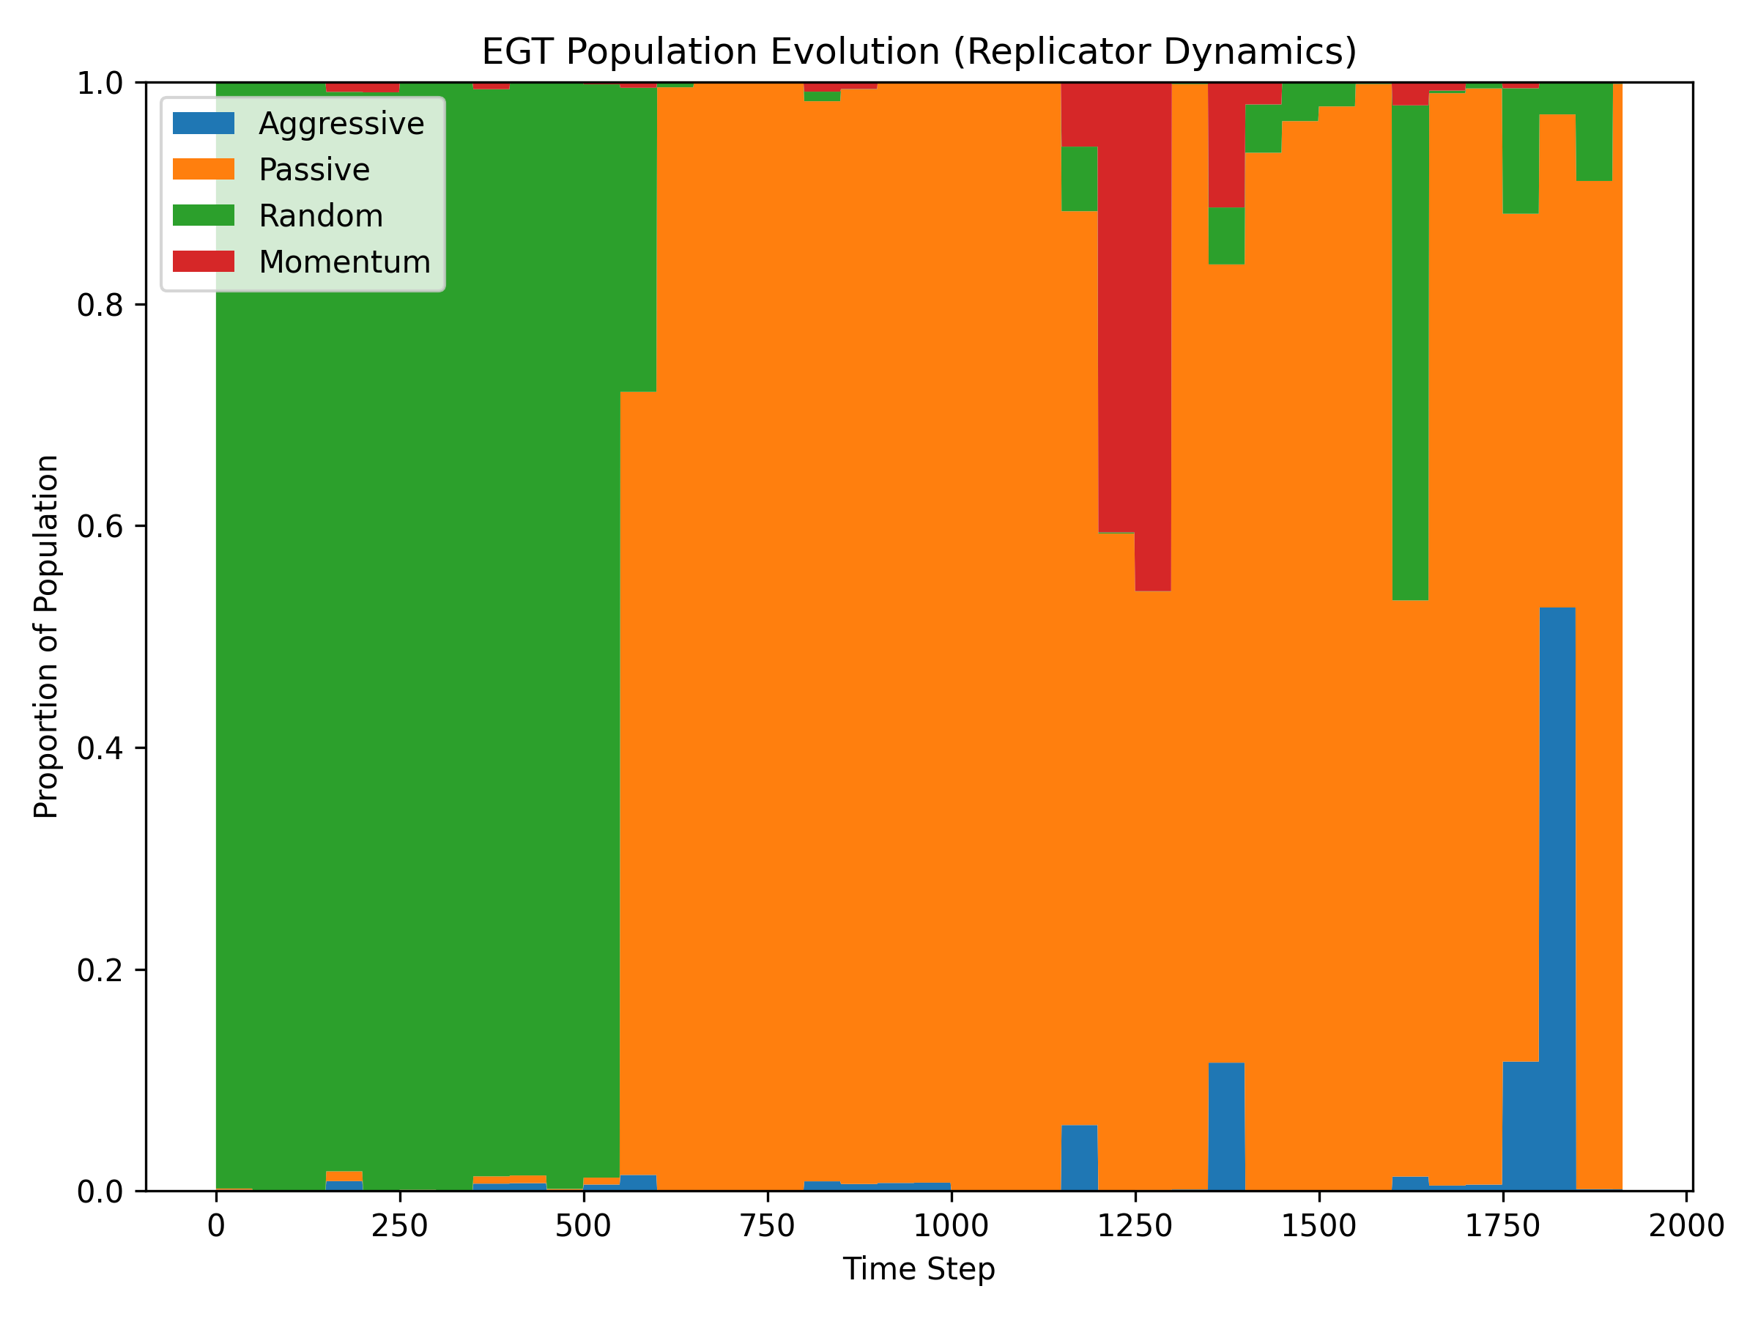
Methodology – EGT Population
Heuristic Strategies
  Aggressive, Passive, Momentum, Random.
Evolution Mechanism
  Trader fitness = rolling profitability
  Replicator dynamics adjust strategy frequencies
  Mutation (~2%) introduces fresh variants
Effect on ARL
  Changing population creates a non-stationary, adaptive environment.

Slide 7
Interaction Loop
ARL posts quotes
EGT agents decide to buy/sell using heuristics
Trades execute when quotes cross
ARL receives PnL, risk penalty, spread bonus
EGT strategies earn fitness
ARL updates via DDQN; EGT population evolves

Slide 8
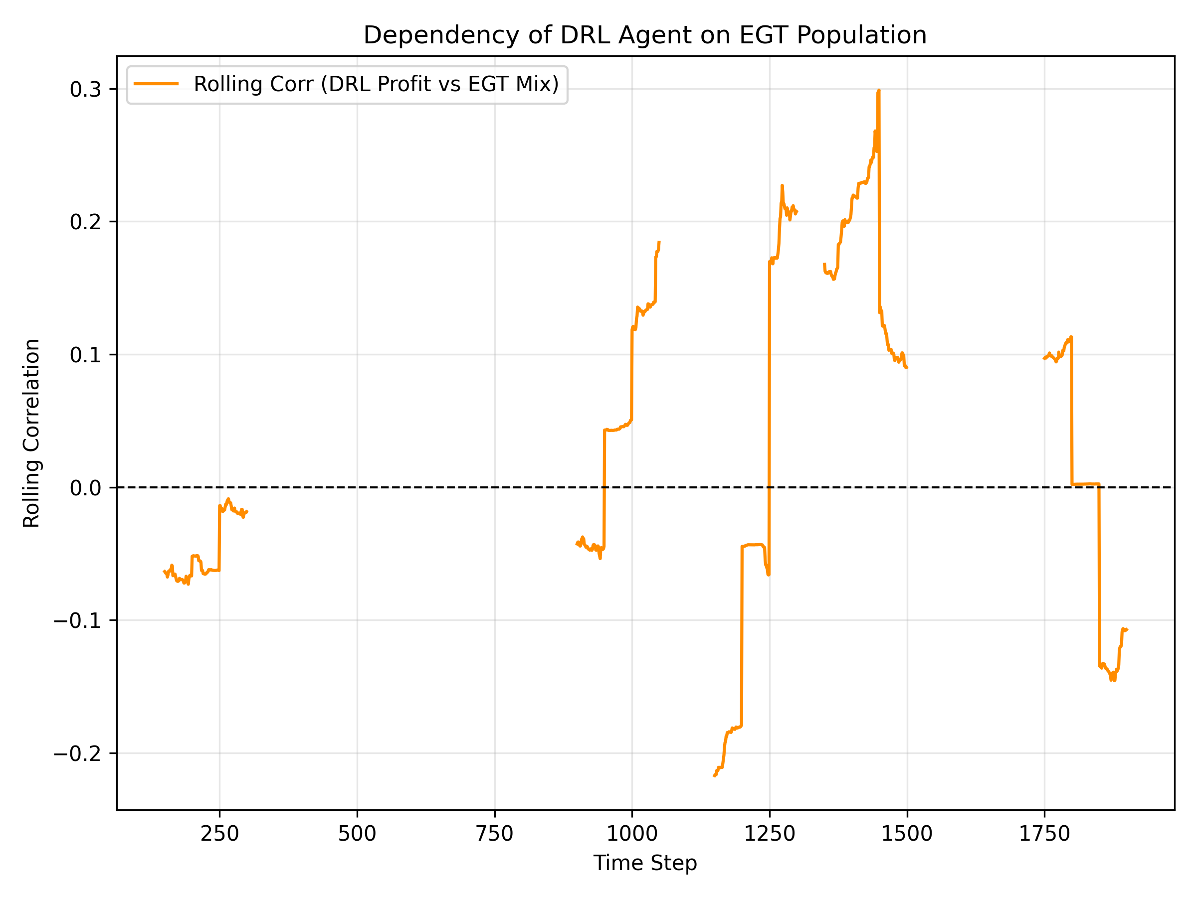
Detailed Influence Between ARL & EGT
ARL → EGT: Tight spreads temporarily boost Aggressive strategy fitness.
EGT → ARL: When Aggressive dominates, ARL widens spreads to reduce risk.
Passive traders eventually dominate (>99%) due to ARL pressure.
Clear feedback loop emerges: each agent type shapes the other’s behavior.

Slide 9
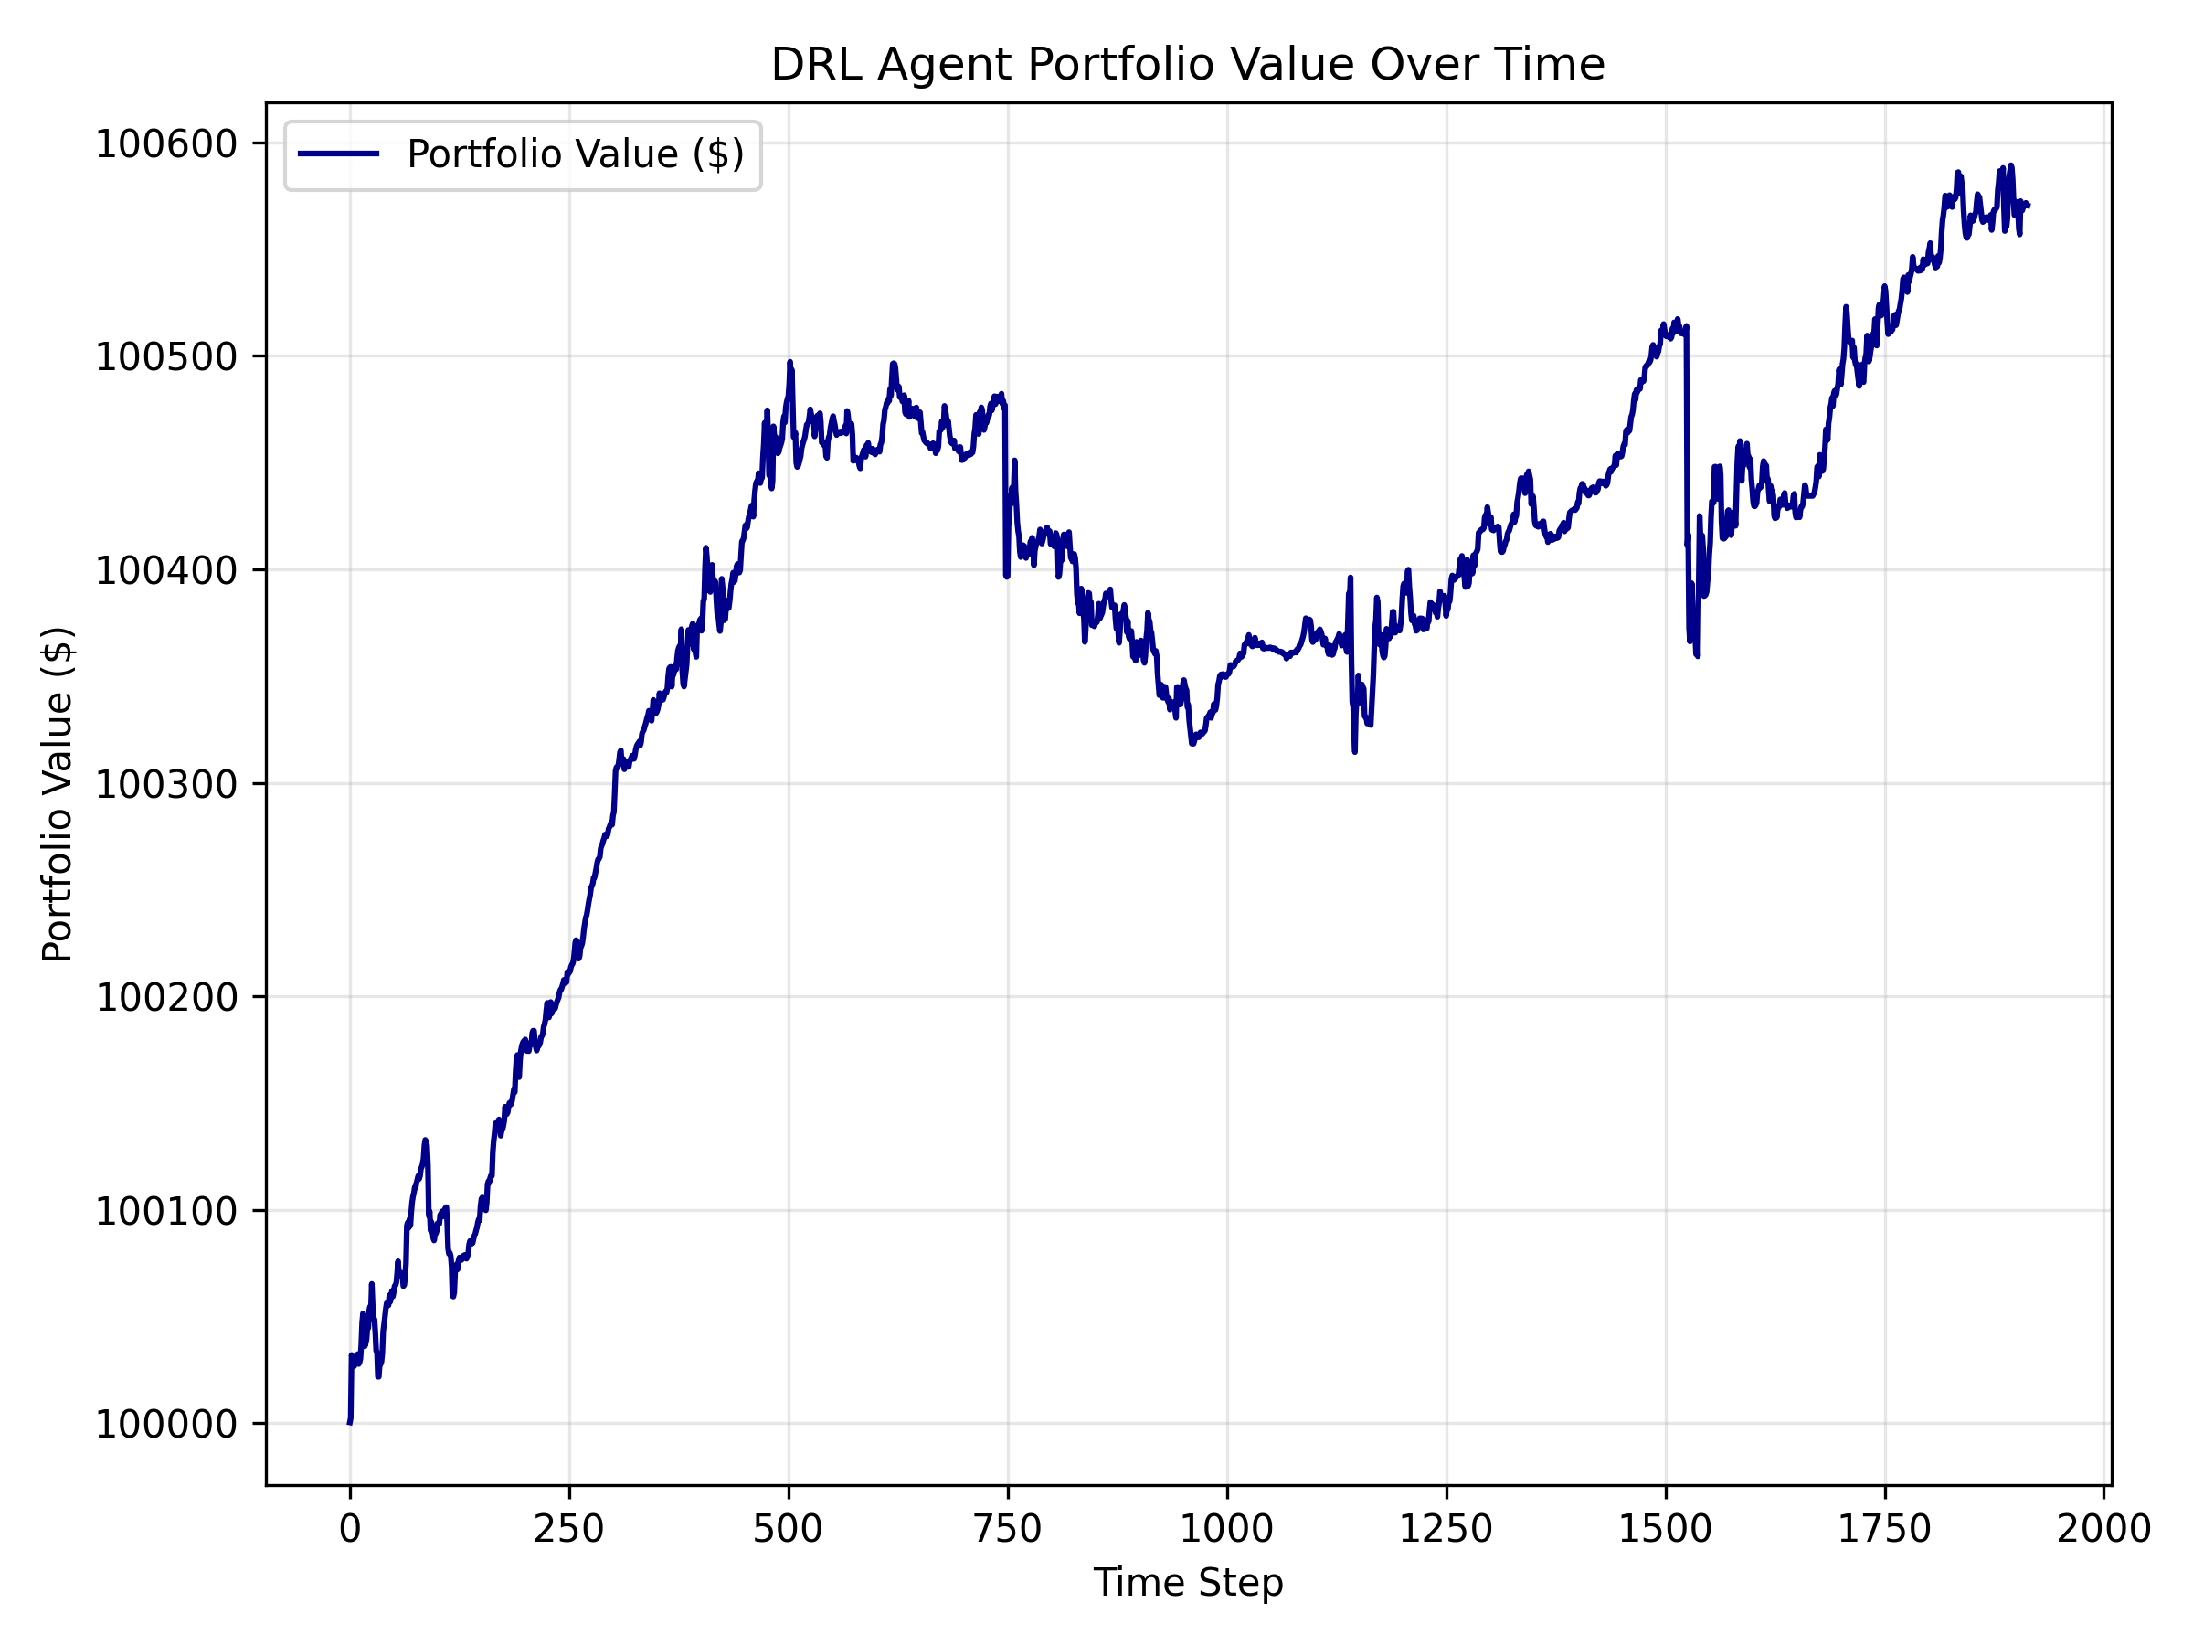
Overall Portfolio Performance
ARL achieved positive total returns (~1.5%).
Performance stayed consistent across calm and volatile regimes.
ARL remained stable even as the EGT population evolved.

Slide 10
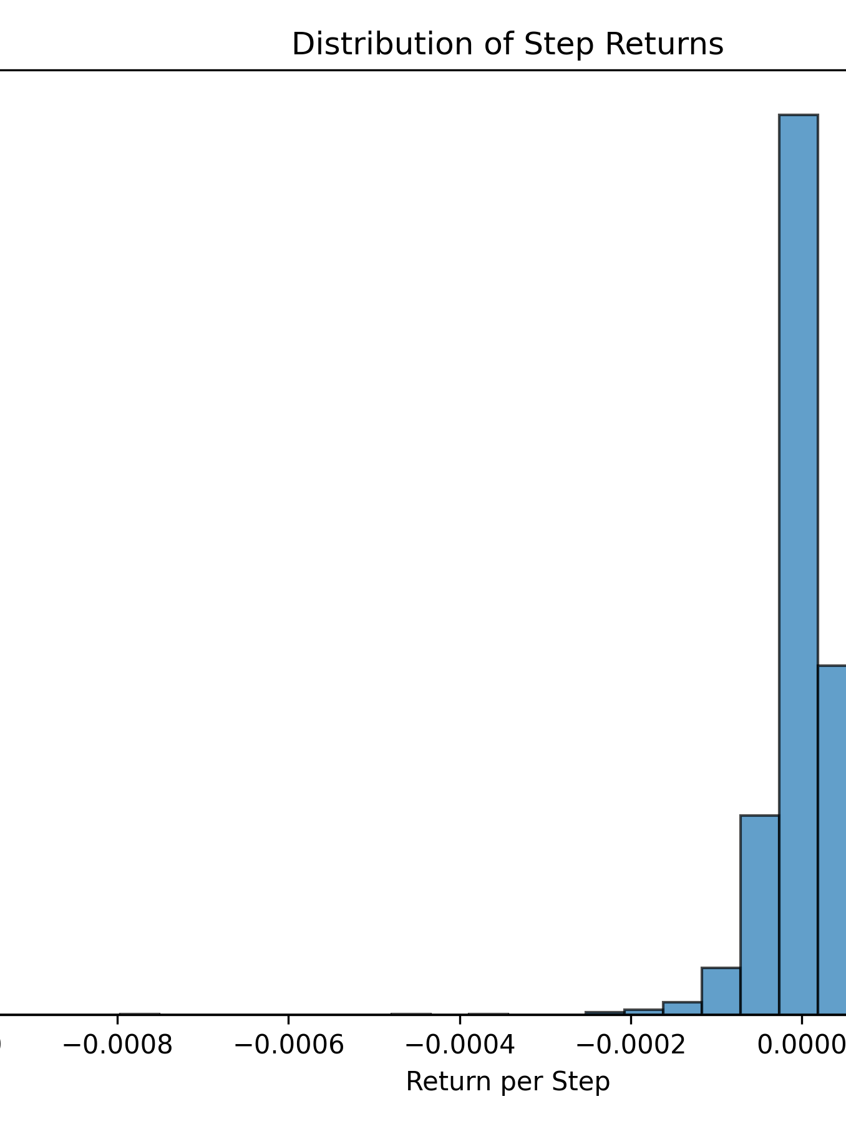
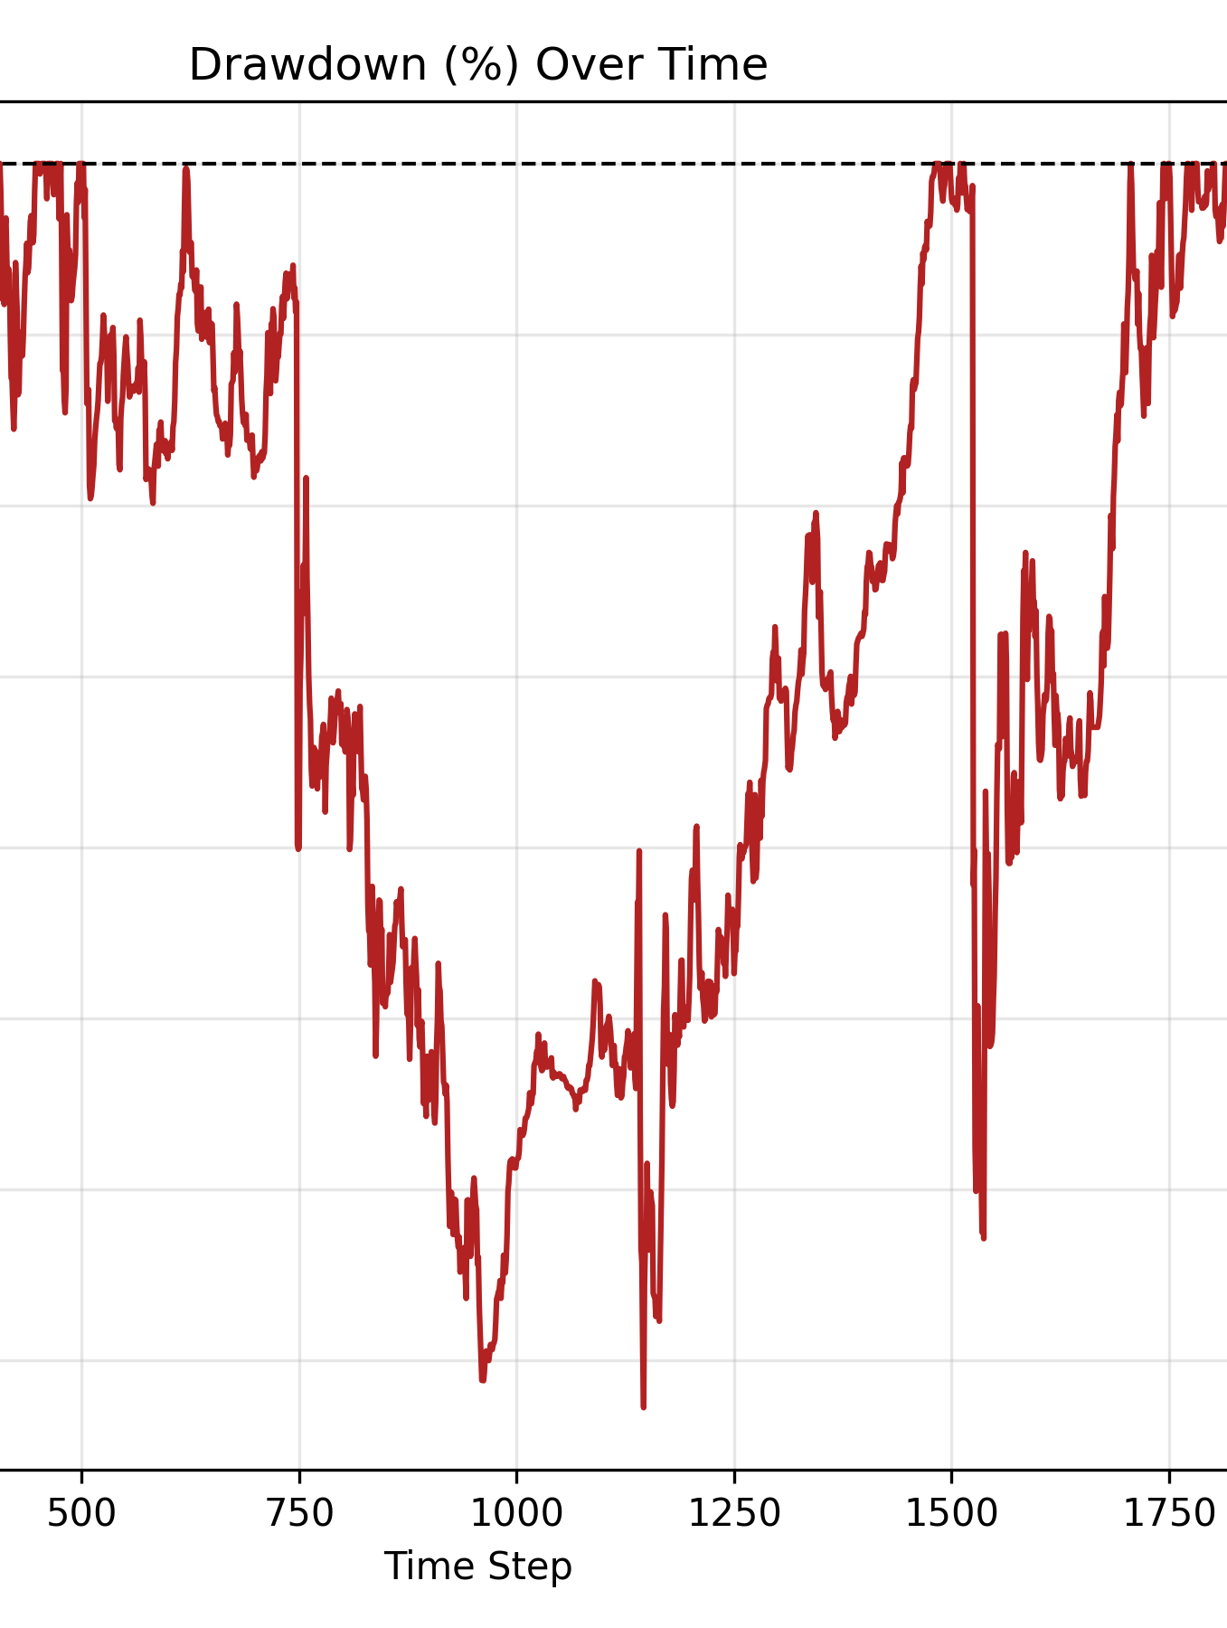
Risk Profile & Return Distribution
Maximum drawdown remained low due to inventory-aware safeguards.
Return distribution is positively skewed; tail risks are suppressed.

Slide 11
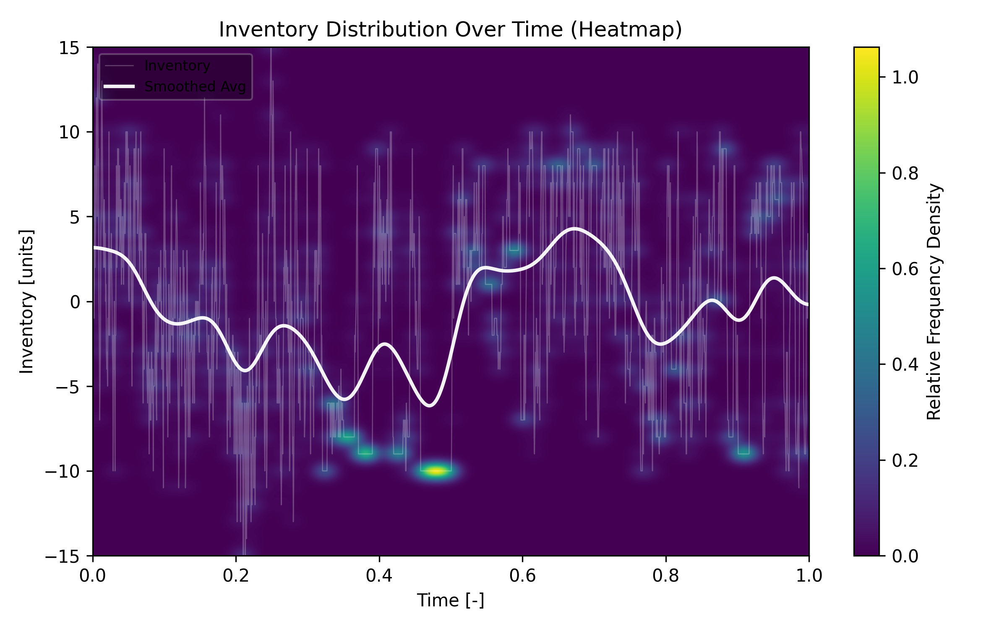
Inventory Stability
ARL learned to keep inventory tightly controlled.
Spread widening during high volatility prevented runaway exposure.
Inventory variance < 0.02.

Slide 12
Policy Behavior & Learned Strategy
Observed Behavioral Patterns
Tight spreads when volatility is low and inventory is near zero
Wider spreads when EGT becomes aggressive
Stable quoting during passive EGT regimes
Reinforces that ARL learned context-dependent microstructure tactics.

Slide 13
Novelty and Contribution
Why This Work Is Novel
  Combines Deep RL + Evolutionary Game Theory inside a dynamic market microstructure.
  Studies co-evolution, not just performance — rare in RL finance research.
  Uses inventory-aware DDQN with spread-capture incentives.
  Creates an evolving adversarial environment rather than a static backtest.
Community Contribution
  Open-source simulation for studying AI robustness & adaptation.
  Useful for education in RL, multi-agent systems, and market simulation.
  Seeds a benchmark for testing RL agents under evolving adversaries.
  Enables safe experimentation on multi-agent strategic behavior.

Slide 14
Conclusion
What We Accomplished
  Built a multi-agent market environment combining RL and EGT.
  Showed the ARL agent can learn stable, risk-aware, profitable policies.
  Observed clear co-adaptation between ARL and EGT populations.
  Demonstrated that agent behavior and population dynamics shape each other.
Why It Matters
  Helps researchers understand RL robustness in adversarial, adaptive settings.
  Provides a platform for exploring multi-agent learning, AI safety, and market microstructure.
  Lays groundwork for richer future experiments with smarter EGT agents or multi-ARL ecosystems.

