Slide 1
Operating Systems Unit_1_Chapter_1
Introduction

Slide 2
Syllabus
UNIT I
Introduction:
What Operating Systems Do, Operating-System Operations, Resource Management, Security and Protection, Virtualization, Distributed Systems, Kernel Data Structures.
Operating System Structures:
Operating-System Services, User and Operating-System Interface, System Calls, Operating-System Structure.
Processes:
Process Concept, Process Scheduling, Operations on Processes, inter process Communication, IPC in shared-memory Systems, IPC in Message-passing Systems.

Slide 3
Syllabus
UNIT II
Threads and Concurrency:
Overview, Multicore Programming, Multithreading Models, Implicit Threading, Threading Issues.
CPU Scheduling:
Basic Concepts, Scheduling Criteria, Scheduling Algorithms, Thread Scheduling, Multiple-Processor Scheduling, Real-Time CPU Scheduling.
Synchronization:
Background, The Critical-Section Problem, Peterson ‘solution, Hardware support for Synchronization, Mutex Locks, Semaphores, Monitors. Classic Problems of Synchronization.

Slide 4
Syllabus
UNIT III
Dead Locks:
System Model, Deadlock Characterization, Methods for Handling Deadlocks, Deadlock Prevention, Deadlock Avoidance, Deadlock Detection, Recovery from Deadlock.
Main Memory:
Background, Contiguous Memory Allocation, Paging, Structure of the Page Table, Swapping.
Virtual-Memory:
Background, Demand Paging, Page Replacement, allocation of frames, Thrashing - Memory Compression, Other considerations

Slide 5
Syllabus
UNIT IV
Mass-Storage Structure:
Overview of Mass-Storage Structure, HDD Scheduling.
Files System Interface:
File Concept, Access Methods, Directory Structure, Protection, Memory mapped files.
File-Systems Implementation:
File-System Structure, File-System operations, Directory Implementation, Allocation Methods, and Free-Space Management.

Slide 6
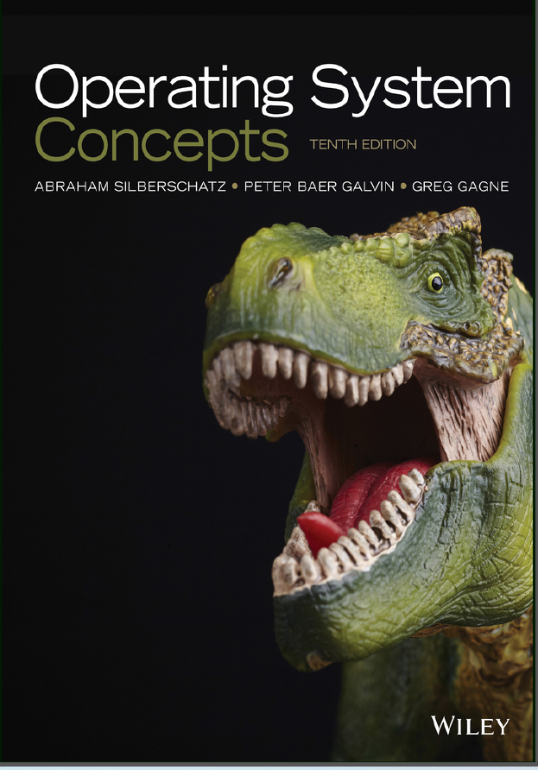

Slide 7
Introduction
OPERATING SYSTEMS(OS)
DEFINITION:
An operating system is software that manages a computer’s hardware.
OR
An operating system is a program that acts as an interface between the user and the computer hardware and controls the execution of all kinds of programs

Slide 8
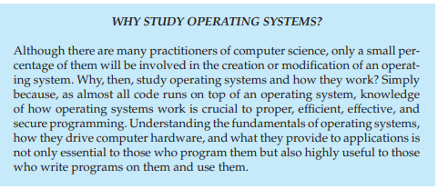

Slide 9
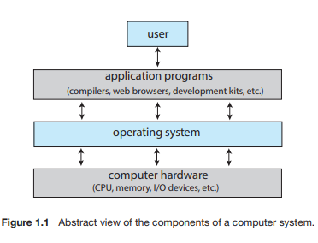
What operating system do

Slide 10
A computer system can be divided roughly into four components:
the hardware
the operating system
the application programs
a user
The hardware— the central processing unit (CPU), the memory, and the input/output (I/O) devices—provides the basic computing resources for the system.
The application programs -- word processors, spreadsheets, compilers, and web browsers—define the ways in which these resources are used to solve users’ computing problems.
The operating system controls the hardware and coordinates its use among the various application programs for the various users
User: one who uses the system

Slide 11
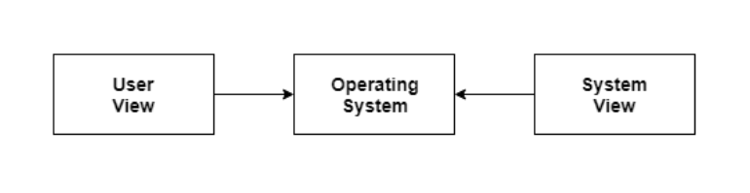
The operating system provides the means for proper use of these resources in the operation of the computer system.
It simply provides an environment within which other programs can do useful work.
To understand more fully the operating system’s role, we explore operating systems from two viewpoints: that of the user and that of the system.

Slide 12
User View:
The user’s view of the computer varies according to the interface being used.
If the user is using a personal computer, the operating system is largely designed to make the interaction easy. Some attention is also paid to the performance of the system, but there is no need for the operating system to worry about resource utilization. This is because the personal computer uses all the resources available and there is no sharing.
Many computer users sit with a laptop or in front of a PC consisting of a monitor, keyboard, and mouse. Such a system is designed for one user to monopolize its resources. (Single user)
The goal is to maximize the work (or play) that the user is performing. In this case, the operating system is designed mostly for ease of use, with some attention paid to performance and security and none paid to resource utilization—how various hardware and software resources are shared(multiple users)
Some computers have little or no user view. For example, embedded computers in home devices and automobiles may have numeric keypads and may turn indicator lights on or off to show status, but they and their operating systems and applications are designed primarily to run without user intervention

Slide 13
System View:
From the computer’s point of view, the operating system is the program most intimately involved with the hardware.
In this context, we can view an operating system as a resource allocator.
A computer system has many resources that may be required to solve a problem: CPU time, memory space, storage space, I/O devices, and so on.
The operating system acts as the manager of these resources.
Facing numerous and possibly conflicting requests for resources, the operating system must decide how to allocate them to specific programs and users so that it can operate the computer system efficiently and fairly.
A slightly different view of an operating system emphasizes the need to control the various I/O devices and user programs.
An operating system is a control program.
A control program manages the execution of user programs to prevent errors and improper use of the computer. It is especially concerned with the operation and control of I/O devices

Slide 14
Operating systems can also be viewed as a way to make using hardware easier.
Computers were required to easily solve user problems. However it is not easy to work directly with the computer hardware. So, operating systems were developed to easily communicate with the hardware.
An operating system can also be considered as a program running at all times in the background of a computer system (known as the kernel) and handling all the application programs. This is the definition of the operating system that is generally followed.

Slide 15
Operating-System Operations
Multiprogramming and Multitasking
Dual-Mode and Multimode Operation
Timer

Slide 16
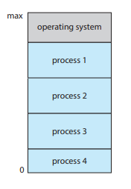
Multiprogramming and Multitasking
One of the most important aspects of operating systems is the ability to run multiple programs, as a single program cannot, in general, keep either the CPU or the I/O devices busy at all times.
Furthermore, users typically want to run more than one program at a time as well. Multiprogramming increases CPU utilization, as well as keeping users satisfied, by organizing programs so that the CPU always has one to execute. In a multiprogrammed system, a program in execution is termed a process
The idea is as follows: The operating system
keeps several processes in memory simultaneously

Slide 17
The operating system picks and begins to execute one of these processes. Eventually, the process may have to wait for some task, such as an I/O operation, to complete.
In a non-multiprogrammed system, the CPU would sit idle.
In a multiprogrammed system, the operating system simply switches to, and executes, another process. When that process needs to wait, the CPU switches to another process, and so on. Eventually, the first process finishes waiting and gets the CPU back. As long as at least one process needs to execute, the CPU is never idle.

Slide 18
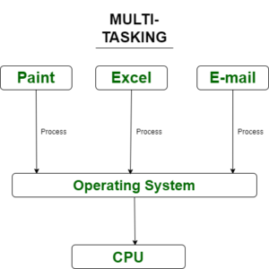
Multitasking is a logical extension of multiprogramming. In multitasking systems, the CPU executes multiple processes by switching among them, but the switches occur frequently, providing the user with a fast response time. Consider that when a process executes, it typically executes for only a short time before it either finishes or needs to perform I/O

Slide 19
In a multitasking system, the operating system must ensure reasonable response time. A common method for doing so is virtual memory, a technique that allows the execution of a process that is not completely in memory .The main advantage of this scheme is that it enables users to run programs that are larger than actual physical memory.
Further, it abstracts main memory into a large, uniform array of storage, separating logical memory as viewed by the user from physical memory. This arrangement frees programmers from concern over memory-storage limitations.

Slide 20
Having several processes in memory at the same time requires some form of memory management
if several processes are ready to run at the same time, the system must choose which process will run next. Making this decision is CPU scheduling
Multiprogramming and multitasking systems must also provide a file system .The file system resides on a secondary storage; hence, storage management must be provided
To ensure orderly execution, the system must also provide mechanisms for process synchronization and communication

Slide 21
Dual-Mode and Multimode Operation
Since the operating system and its users share the hardware and software resources of the computer system, a properly designed operating system must ensure that an incorrect (or malicious) program cannot cause other programs — or the operating system itself—to execute incorrectly.
In order to ensure the proper execution of the system, we must be able to distinguish between the execution of operating-system code and user-defined code. The approach taken by most computer systems is to provide hardware support that allows differentiation among various modes of execution.

Slide 22
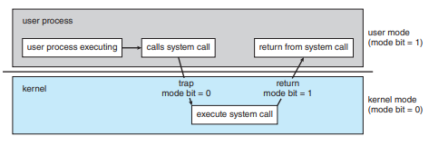
At the very least, we need two separate modes of operation:
user mode
kernel mode (also called supervisor mode, system mode, or privileged mode).
A bit, called the mode bit, is added to the hardware of the computer to indicate the current mode: kernel (0) or user (1).
With the mode bit, we can distinguish between a task that is executed on behalf of the operating system and one that is executed on behalf of the user

Slide 23
At system boot time, the hardware starts in kernel mode.
The operating system is then loaded and starts user applications in user mode.
Whenever a trap or interrupt occurs, the hardware switches from user mode to kernel mode (that is, changes the state of the mode bit to 0).
Thus, whenever the operating system gains control of the computer, it is in kernel mode.
The system always switches to user mode (by setting the mode bit to 1) before passing control to a user program.

Slide 24
The dual mode of operation provides us with the means for protecting the operating system from errant users—and errant users from one another.
We accomplish this protection by designating some of the machine instructions that may cause harm as privileged instructions
The hardware allows privileged instructions to be executed only in kernel mode.
If an attempt is made to execute a privileged instruction in user mode, the hardware does not execute the instruction but rather treats it as illegal and traps it to the operating system

Slide 25
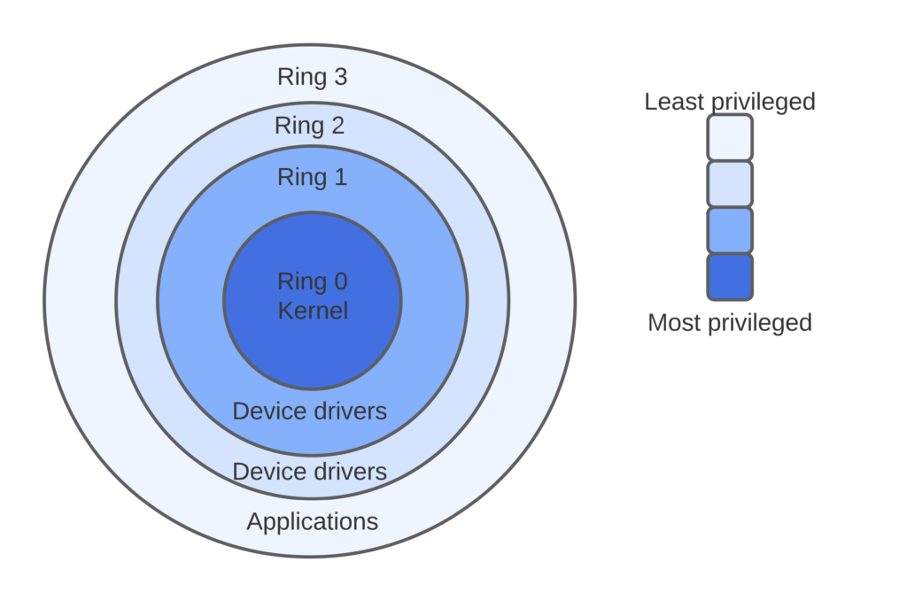
The concept of modes can be extended beyond two modes.
For example, Intel processors have four separate protection rings, where ring 0 is kernel mode and ring 3 is user mode. (Although rings 1 and 2 could be used for various operating-system services, in practice they are rarely used.

Slide 26
Once hardware protection is in place, it detects errors that violate modes.
These errors are normally handled by the operating system.
If a user program fails in some way—such as by making an attempt either to execute an illegal instruction or to access memory that is not in the user’s address space—then the hardware traps to the operating system.
The trap transfers control through the interrupt vector to the operating system, just as an interrupt does.
When a program error occurs, the operating system must terminate the program abnormally.
This situation is handled by the same code as a user-requested abnormal termination.
An appropriate error message is given, and the memory of the program may be dumped. The memory dump is usually written to a file so that the user or programmer can examine it and perhaps correct it and restart the program.

Slide 27
TIMER
We must ensure that the operating system maintains control over the CPU.
We cannot allow a user program to get stuck in an infinite loop or to fail to call system services and never return control to the operating system.
To accomplish this goal, we can use a timer.
A timer can be set to interrupt the computer after a specified period.
The period may be fixed (for example, 1/60 second) or variable (for example, from 1 millisecond to 1 second).

Slide 28
A variable timer is generally implemented by a fixed-rate clock and a counter.
The operating system sets the counter. Every time the clock ticks, the counter is decremented. When the counter reaches 0, an interrupt occurs.
Before turning over control to the user, the operating system ensures that the timer is set to interrupt.
If the timer interrupts, control transfers automatically to the operating system, which may treat the interrupt as a fatal error or may give the program more time

Slide 29
Resource Management(RM)
An operating system is a resource manager.
System’s CPU(Process Management)
memory space(Memory management)
file-storage space (File System management)
I/O devices (I/O System management)
are among the resources that the operating system must manage.
Apart from these we do have
Secondary storage(Mass storage management )
Faster Storage(cache management)

Slide 30
RM-Process Management
A program can do nothing unless its instructions are executed by a CPU.
A program in execution, as mentioned, is a process
A program such as a compiler is a process
a word-processing program being run by an individual user on a PC is a process.
Similarly, a social media app on a mobile device is a process.

Slide 31
A process needs certain resources—including CPU time, memory, files, and I/O devices—to accomplish its task.
These resources are typically allocated to the process while it is running.
In addition to the various physical and logical resources that a process obtains when it is created, various initialization data(input) may be passed along.
For example, consider a process running a web browser whose function is to display the contents of a web page on a screen.
The process will be given the URL as an input and will execute the appropriate instructions and system calls to obtain and display the desired information on the screen.

Slide 32
We emphasize that a program by itself is not a process. A program is a passive entity, like the contents of a file stored on disk, whereas a process is an active entity.
A single-threaded process has one program counter specifying the next instruction to execute. The execution of such a process must be sequential. The CPU executes one instruction of the process after another, until the process completes.
Further, at any time, one instruction at most is executed on behalf of the process. Thus, although two processes may be associated with the same program, they are nevertheless considered two separate execution sequences. A multithreaded process has multiple program counters, each pointing to the next instruction to execute for a given thread.

Slide 33
A process is the unit of work in a system.
A system consists of a collection of processes, some of which are operating-system processes (those that execute system code) and the rest of which are user processes (those that execute user code).
All these processes can potentially execute concurrently—by multiplexing on a single CPU core—or in parallel across multiple CPU cores.
The operating system is responsible for the following activities in connection with process management:
Creating and deleting both user and system processes
Scheduling processes and threads on the CPUs
Suspending and resuming processes
Providing mechanisms for process synchronization
Providing mechanisms for process communication

Slide 34
RM-Memory Management
The main memory is central to the operation of a modern computer system.
Main memory is a large array of bytes, ranging in size from hundreds of thousands to billions.
Each byte has its own address.
Main memory is a repository of quickly accessible data shared by the CPU and I/O devices.
The CPU reads instructions from main memory during the instruction-fetch cycle and both reads and writes data from main memory during the data-fetch cycle (on a von Neumann architecture).
As noted earlier, the main memory is generally the only large storage device that the CPU is able to address and access directly

Slide 35
For a program to be executed, it must be mapped to absolute addresses and loaded into memory.
As the program executes, it accesses program instructions and data from memory by generating these absolute addresses.
Eventually, the program terminates, its memory space is declared available, and the next program can be loaded and executed.
To improve both the utilization of the CPU and the speed of the computer’s response to its users, general-purpose computers must keep several programs in memory, creating a need for memory management.
Many different memory management schemes are used.
These schemes reflect various approaches, and the effectiveness of any given algorithm depends on the situation.
In selecting a memory-management scheme for a specific system, we must take into account many factors—especially the hardware design of the system. Each algorithm requires its own hardware support

Slide 36
The operating system is responsible for the following activities in connection with memory management:
Keeping track of which parts of memory are currently being used and which process is using them
Allocating and deallocating memory space as needed
Deciding which processes (or parts of processes) and data to move into and out of memory

Slide 37
RM-File System Management
A file is a collection of related information defined by its creator. Commonly, files represent programs (both source and object forms) and data. Data files may be numeric, alphabetic, alphanumeric, or binary.
File management is one of the most visible components of an operating system.
Computers can store information on several different types of physical media. Secondary storage is the most common, but tertiary storage is also possible.
Each of these media has its own characteristics and physical organization.
Most are controlled by a device, such as a disk drive, that also has its own unique characteristics. These properties include access speed, capacity, data-transfer rate, and access method (sequential or random).

Slide 38
The operating system implements the abstract concept of a file by managing mass storage media and the devices that control them. In addition, files are normally organized into directories to make them easier to use.
Finally, when multiple users have access to files, it may be desirable to control which user may access a file and how that user may access it (for example, read, write, append).
The operating system is responsible for the following activities in connection with file management:
• Creating and deleting files
• Creating and deleting directories to organize files
• Supporting primitives for manipulating files and directories
• Mapping files onto mass storage
• Backing up files on stable (nonvolatile) storage media

Slide 39
RM-I/O system management
One of the purposes of an operating system is to hide the peculiarities of specific hardware devices from the user. For example, in UNIX, the peculiarities of I/O devices are hidden from the bulk of the operating system itself by the I/O subsystem.
The I/O subsystem consists of several components:
A memory-management component that includes buffering, caching, and spooling
A general device-driver interface
Drivers for specific hardware devices

Slide 40
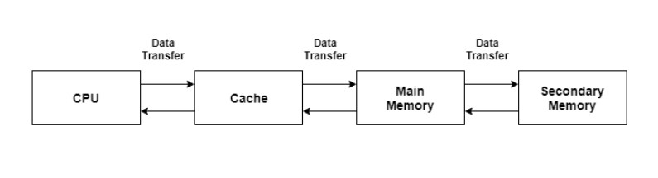
RM-Cache Management
Cache is a type of memory that is used to increase the speed of data access. Normally, the data required for any process resides in the main memory. However, it is transferred to the cache memory temporarily if it is used frequently enough.
A diagram to better understand the data transfer in cache management is as follows −
Because caches have limited size, cache management is an important design problem. Careful selection of the cache size and of a replacement policy can result in greatly increased performance

Slide 41
RM-Mass Storage Management
The computer system must provide secondary storage to back up main memory.
Because secondary storage is used frequently and extensively, it must be used efficiently. The entire speed of operation of a computer may hinge on the speeds of the secondary storage subsystem and the algorithms that manipulate that subsystem.
The operating system is responsible for the following activities in connection with secondary storage management:
Mounting and unmounting
Free-space management
Storage allocation
Disk scheduling
Partitioning
Protection

Slide 42
Security and Protection
If a computer system has multiple users and allows the concurrent execution of multiple processes, then access to data must be regulated.
For that purpose, mechanisms ensure that files, memory segments, CPU, and other resources can be operated on by only those processes that have gained proper authorization from the operating system.
Protection, then, is any mechanism for controlling the access of processes or users to the resources defined by a computer system. This mechanism must provide means to specify the controls to be imposed and to enforce the controls.
A system can have adequate protection but still be prone to failure and allow inappropriate access. Consider a user whose authentication information (her means of identifying herself to the system) is stolen. Her data could be copied or deleted, even though file and memory protection are working. It is the job of security to defend a system from external and internal attacks.

Slide 43
Protection and security require the system to be able to distinguish among all its users.
Most operating systems maintain a list of user names and associated user identifier (user IDs)
Sometimes selected set of users may be allowed only to read the file. To accomplish this, we need to define a group name and the set of users belonging to that group. Group functionality can be implemented as a system-wide list of group names and group identifier .
In the course of normal system use, the user ID and group ID for a user are sufficient. However, a user sometimes needs to escalate privileges to gain extra permissions for an activity so we have effective UID.

Slide 44
Virtualization
Virtualization is a technology that allows us to abstract the hardware of a single computer (the CPU, memory, disk drives, network interface cards, and so forth) into several different execution environments, thereby creating the illusion that each separate environment is running on its own private computer
A single physical system is divided into many "virtual" servers by virtualization. Virtual machines (VMs) run on dedicated hardware without relying on each other. We split a single physical device into separate independent worlds, known as virtual machines, through virtualization. It allows us to create several computer simulations from the host hardware with dedicated resources
Broadly speaking, virtualization software is one member of a class that also includes emulation. In computing, the emulator is a hardware or software that enables one device (named Host) to function like other systems (named Guest).

Slide 45
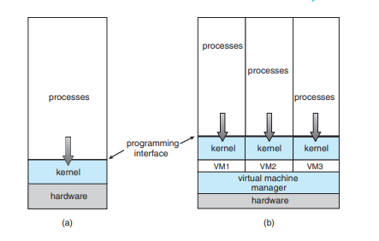

In this virtualization, a user installs the virtualization software in the operating system of his system like any other program and utilizes this application to operate and generate various virtual machines. Here, the virtualization software allows direct access to any of the created virtual machines to the user.

Slide 46
Distributed Systems
A distributed system is a collection of physically separate, possibly heterogeneous computer systems that are networked to provide users with access to the various resources that the system maintains.
Access to a shared resource increases
computation speed
functionality
data availability
Reliability
Some operating systems generalize network access as a form of file access, with the details of networking contained in the network interface’s device driver
Others make users specifically invoke network functions.
Generally, systems contain a mix of the two modes—for example FTP and NFS

Slide 47
A network, in the simplest terms, is a communication path between two or more systems.
Distributed systems depend on networking for their functionality.
Networks vary by the protocols used, the distances between nodes, and the transport media.
TCP/IP is the most common network protocol, and it provides the fundamental architecture of the Internet.
Networks are characterized based on the distances between their nodes.
A local-area network (LAN)
A wide-area network (WAN)
A metropolitan-area network (MAN)
a personal-area network(PAN)

Slide 48
A local-area network (LAN) connects computers within a room, a building,or a campus.
A wide-area network (WAN) usually links buildings, cities, or countries.
For example, a metropolitan-area network (MAN) could link buildings within a city.
BlueTooth and 802.11 devices use wireless technology to communicate over a distance of several feet, in essence creating a personal-area network (PAN) between a phone and a headset or a smartphone and a desktop computer

Slide 49
The media to carry networks are equally varied. They include
Copper wires,
fiber strands
wireless transmissions between satellites, microwave dishes, and radios.
When computing devices are connected to cellular phones, they create a network.
Even very short-range infrared communication can be used for networking.
At a rudimentary level, whenever computers communicate, they use or create a network.
These networks also vary in their performance and reliability.

Slide 50
Some operating systems have taken the concept of networks and distributed systems further than the notion of providing network connectivity.
A network operating system is an operating system that provides features such as file sharing across the network, along with a communication scheme that allows different processes on different computers to exchange messages.
A computer running a network operating system acts autonomously from all other computers on the network, although it is aware of the network and is able to communicate with other networked computers.
A distributed operating system provides a less autonomous environment. The different computers communicate closely enough to provide the illusion that only a single operating system controls the network.

Slide 51
Kernel Data Structures
We turn next to a topic central to operating-system implementation: the way data are structured in the system.
we briefly describe several fundamental data structures used extensively in operating systems.
Lists, Stacks, and Queues
Trees
Hash functions and maps
An array is a simple data structure in which each element can be accessed directly. For example, main memory is constructed as an array. If the data item being stored is larger than one byte, then multiple bytes can be allocated to the item, and the item is addressed as “item number × item size.” But what about storing an item whose size may vary? And what about removing an item if the relative positions of the remaining items must be preserved? In such situations, arrays give way to other data structures.

Slide 52
After arrays, lists are perhaps the most fundamental data structures in computer science. Whereas each item in an array can be accessed directly, the items in a list must be accessed in a particular order. That is, a list represents a collection of data values as a sequence. The most common method for implementing this structure is a linked list, in which items are linked to one another.
Linked lists are of several types:
In a singly linked list, each item points to its successor
In a doubly linked list, a given item can refer either to its predecessor or to its successor.
In a circularly linked list, the last element in the list refers to the first element, rather than to null.
Linked lists accommodate items of varying sizes and allow easy insertion and deletion of items.
One potential disadvantage of using a list is that performance for retrieving a specified item in a list of size n is linear—O(n), as it requires potentially traversing all n elements in the worst case.

Slide 53
A stack is a sequentially ordered data structure that uses the last in, first out (LIFO) principle for adding and removing items, meaning that the last item
placed onto a stack is the first item removed. The operations for inserting and removing items from a stack are known as push and pop, respectively.
An operating system often uses a stack when invoking function calls.
Parameters, local variables, and the return address are pushed onto the stack when a function is called;
returning from the function call pops those items off the stack.

Slide 54
A queue, in contrast, is a sequentially ordered data structure that uses the first in, first out (FIFO) principle: items are removed from a queue in the order in which they were inserted.
There are many everyday examples of queues, including shoppers waiting in a checkout line at a store and cars waiting in line at a traffic signal. Queues are also quite common in operating systems—jobs that are sent to a printer are typically printed in the order in which they were submitted

Slide 55
A tree is a data structure that can be used to represent data hierarchically.
Data values in a tree structure are linked through parent–child relationships.
In a general tree, a parent may have an unlimited number of children.
In a binary tree, a parent may have at most two children, which we term the left child and the right child.
A binary search tree additionally requires an ordering between the parent’s two children in which left child <= right child.
When we search for an item in a binary search tree, the worst-case performance is O(n) (consider how this can occur). To remedy this situation, we can use an algorithm to create a balanced binary search tree. Here, a tree containing n items has at most lg n levels, thus ensuring worst-case performance of O(lg n).
Linux uses a balanced binary search tree (known as a red-black tree) as part its CPU-scheduling algorithm.

Slide 56
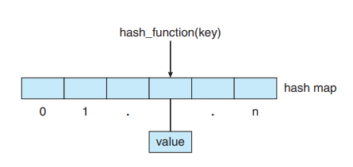
Hash Functions
A hash function takes data as its input, performs a numeric operation on the data, and returns a numeric value. This numeric value can then be used as an index into a table (typically an array) to quickly retrieve the data. Whereas searching for a data item through a list of size n can require up to O(n) comparisons, using a hash function for retrieving data from a table can be as good as O(1), depending on implementation details. Because of this performance, hash functions are used extensively in operating systems.
One potential difficulty with hash functions is that two unique inputs can result in the same output value— that is, they can link to the same table location. We can accommodate this hash collision by having a linked list at the table location that contains all of the items with the same hash value. Of course, the more collisions there are, the less efficient the hash function is
Tne use of a hash function is to implement a hash map, which associates (or maps) [key:value] pairs using a hash function. Once the mapping is established, we can apply the hash function to the key to obtain the value from the hash map

Slide 57
Bit Maps
A bitmap is a string of n binary digits that can be used to represent the status of n items. For example, suppose we have several resources, and the availability of each resource is indicated by the value of a binary digit: 0 means that the resource is available, while 1 indicates that it is unavailable (or vice versa).
The value of the i th position in the bitmap is associated with the i th resource. As an example, consider the bitmap shown below: 001011101 Resources 2, 4, 5, 6, and 8 are unavailable; resources 0, 1, 3, and 7 are available.

