Slide 1
IBM University Engagement Project Submission
“Exploring the Power of Agentic AI with IBM Granite and LangFlow”

Slide 2

Project Tile – Travel Planner Agent
Domain of Project – TravelTech
Student Name | Recent Passport Photo | Email ID | Mobile number [WhatsApp]
Nakka Srivalli |  | rhs.srivalli@gmail.com | 7036177294

Slide 3
Problem Statement -
Problem Statement : Travel Planner Agent
The Challenge
Travel planning today is fragmented, time-consuming, and overwhelming. Travellers must juggle multiple platforms to research destinations, build itineraries, compare transport options, find accommodation, check weather, and estimate costs. Without a unified, intelligent assistant, most travellers waste hours across 5–10 different websites and still end up with a suboptimal, stress-filled plan. There is no single AI-powered solution that delivers personalised, real-time travel guidance that adapts to user preferences, budgets, and constraints.
The Objective
Build an AI-powered Travel Planner Agent that delivers personalised itineraries and end-to-end travel guidance for individuals, families, and groups. The solution should:
Destination Suggester – Recommend destinations based on travel style, budget tier, and user preferences
Itinerary Builder – Generate detailed day-by-day schedules with activities, restaurants, and estimated costs
Live Weather Integration – Fetch real-time forecasts via OpenWeatherMap API
Transport Advisor – Recommend transport modes based on journey distance and budget
Accommodation Finder – Suggest hostels, hotels, resorts, Airbnb with price benchmarks
Budget Estimator – Calculate per-person total cost broken down by category
Packing List Generator – Tailored checklists by trip type
Multi-Agent Orchestration –
  Travel Research Agent
  Itinerary Planning Agent
  Budget & Logistics Agent
  Conversational Assistant Agent (IBM Granite)
Interactive Dashboard – Live weather, budget breakdown, chat interface in one place

Slide 4
Proposed Solution -
AI-Powered Travel Planner Agent : The proposed solution is a multi-agent AI-powered Travel Planner Agent built using Flask, IBM watsonx.ai, and Granite Models to provide personalised, real-time travel planning guidance. The system addresses challenges in destination discovery, itinerary building, budget estimation, and travel logistics through an intelligent, modular architecture. At its core, the solution uses a conversational AI pipeline powered by IBM Granite (ibm/granite-3-8b-instruct) to process natural language travel queries, understand user preferences, budget constraints, and trip duration, and respond with structured, actionable travel plans. Live weather data is fetched in real time via the OpenWeatherMap API, enabling climate-aware recommendations and seasonal planning. The system consists of four key agents: Travel Research Agent retrieves destination suggestions, weather forecasts, and travel advisories based on the user's travel style, budget tier, and region of interest. Itinerary Planning Agent generates detailed day-by-day schedules with morning, afternoon, and evening activities, restaurant recommendations, estimated travel times, and costs in USD. Budget & Logistics Agent calculates per-person total trip costs broken down by accommodation, food, transport, and activities, and recommends suitable transport modes and accommodation options across budget, mid-range, and luxury tiers. Conversational Assistant Agent maintains multi-turn session memory to handle follow-up questions, itinerary refinements, packing queries, and visa information through a natural, flowing conversation powered by IBM Granite. The solution includes a user-friendly interactive dashboard (built with HTML, CSS, and JavaScript) that displays a live weather widget, a real-time budget estimator, quick-action prompts, and a full conversational chat interface — all in a single-page application. Flask is used to orchestrate agent workflows and expose REST API endpoints, while watsonx.ai ensures scalable model deployment and AI governance. Granite models power reasoning, summarisation, and personalisation. Overall, this solution delivers an end-to-end intelligent travel assistant that transforms complex, multi-platform trip planning into a single seamless conversation — saving time, reducing cost, and delivering personalised travel experiences.

Slide 5
Technology Used
Flask platform — For designing and orchestrating the multi-agent travel planning workflows and exposing REST API endpoints to the frontend.
IBM Granite model — for eg – ibm/granite-3-8b-instruct – For natural language understanding, reasoning, and personalisation in travel itinerary generation and conversational planning.
IBM Cloud – It provides the infrastructure to build, deploy, and scale the Travel Planner Agent efficiently. IBM Cloud enables a reliable, secure, and scalable environment for deploying the Travel Planner Agent.
IBM watsonx.ai – For model deployment, LLM inference, and AI governance — enabling the Granite model to process travel queries, generate itineraries, and deliver personalised recommendations at scale.
OpenWeatherMap API – For real-time weather data retrieval, allowing the agent to fetch live forecasts first, then generate climate-aware travel recommendations, making the Travel Planner Agent more accurate and trustworthy.
Python (Flask 3) — For backend logic, intent detection, session memory management, and tool orchestration across all four travel planning agents.
HTML / CSS / JavaScript — For the interactive single-page chat dashboard with a live weather widget, budget estimator, quick-action prompts, and full conversational UI.

Slide 6
Langflow component Used -
1) Chat Input – Interface where users enter their travel queries, preferences, destination choices, trip duration, and budget details (text-based conversational input).
2) IBM watsonx AI Agent - Processes user input using IBM Granite models to generate personalised travel itineraries, destination recommendations, transport suggestions, and accommodation options.
3) Name of IBM Granite model - ibm/granite-3-8b-instruct → Fast, efficient for real-time travel planning, itinerary generation, and multi-turn conversational reasoning.
4) Chat output - Displays AI-generated responses such as day-by-day itineraries, destination suggestions, budget breakdowns, packing lists, and travel advisories.
5) File component - Stores and retrieves user session data, travel preferences, conversation history, and trip details for continuous multi-turn planning and itinerary refinement.
6) URL / API component - Connects to the OpenWeatherMap API to fetch live weather forecasts for the destination city and inject real-time climate data into the Granite model's travel recommendations.

Slide 7
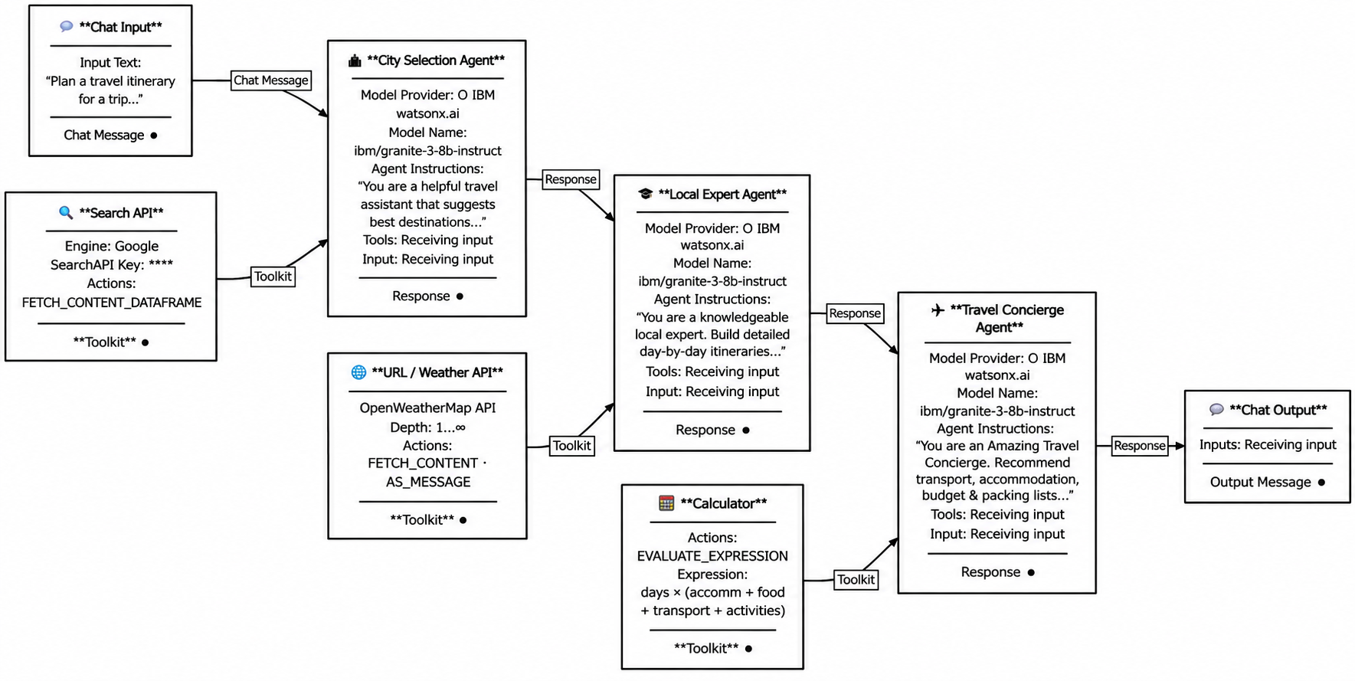
Langflow workflow -

Slide 8
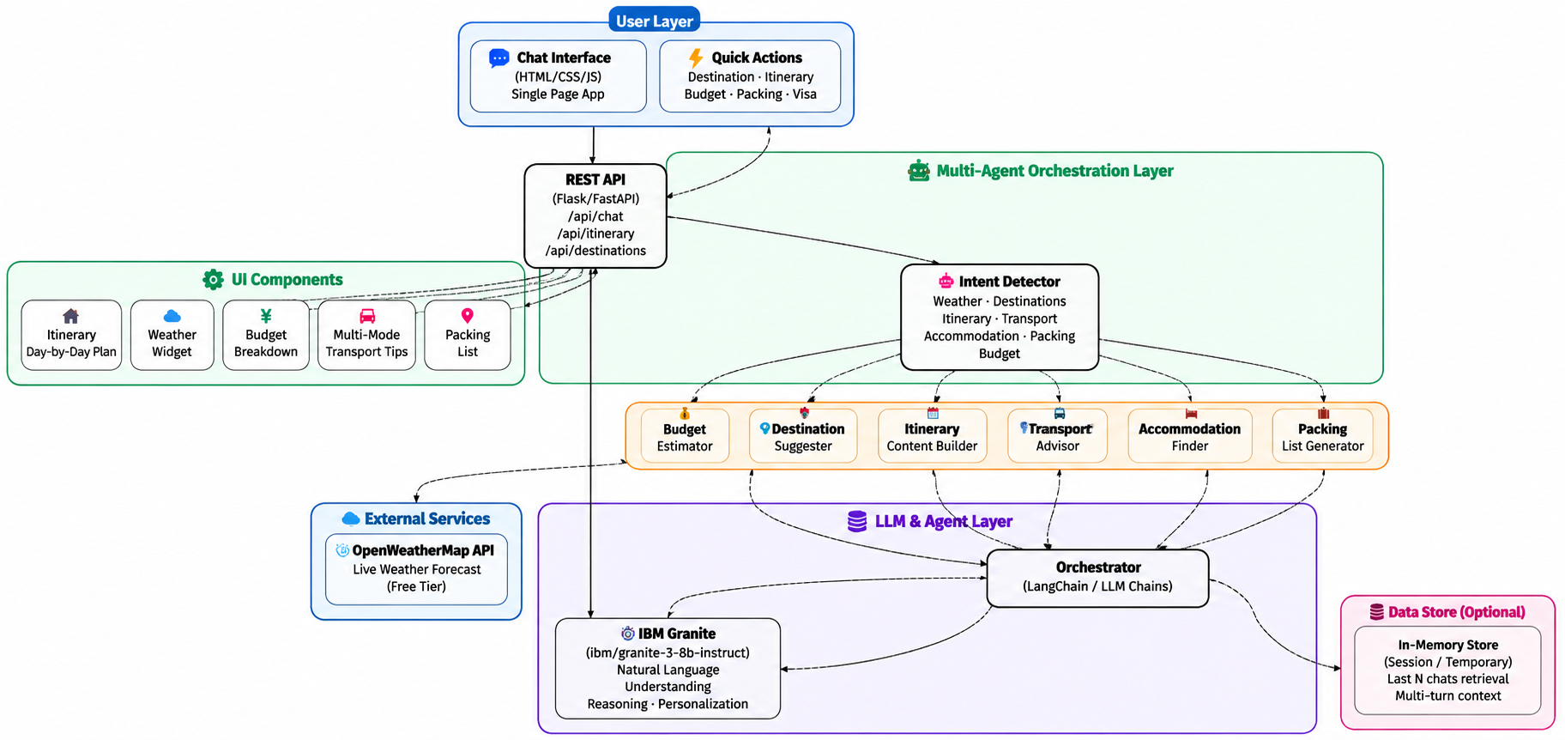
Architecture blueprint

Slide 9

Role of Agentic AI in the solution
Role of Agentic AI in Travel Planner Agent:
Agentic AI enables the Travel Planner Agent to function as an intelligent, autonomous system rather than a simple chatbot. Using IBM watsonx.ai and IBM Granite models, it coordinates multiple specialised agents to deliver personalised, end-to-end travel planning guidance.
Each agent performs a specific role — such as researching destinations, building day-by-day itineraries, recommending transport and accommodation, and estimating budgets — while working collaboratively in a pipeline. This multi-agent approach ensures efficient task execution, accurate recommendations, and a seamless planning experience for the traveller.
Agentic AI also brings context awareness, understanding user details like travel style, budget tier, trip duration, group size, and personal interests to generate tailored itineraries and destination suggestions. It supports real-time adaptation, continuously enriching its responses with live weather data, current transport options, and up-to-date accommodation pricing based on user inputs.
Additionally, agents communicate with each other through a shared session memory — the City Selection Agent passes destination context to the Local Expert Agent, which passes the itinerary to the Travel Concierge Agent — enabling better decision-making, coherent multi-turn conversations, and improved travel outcomes across the entire planning journey.
Overall, Agentic AI makes the Travel Planner system proactive, personalised, and goal-driven, acting like a smart digital travel concierge that helps users plan their perfect trip — from destination discovery to packing lists — in a single, intelligent conversation.

Slide 10
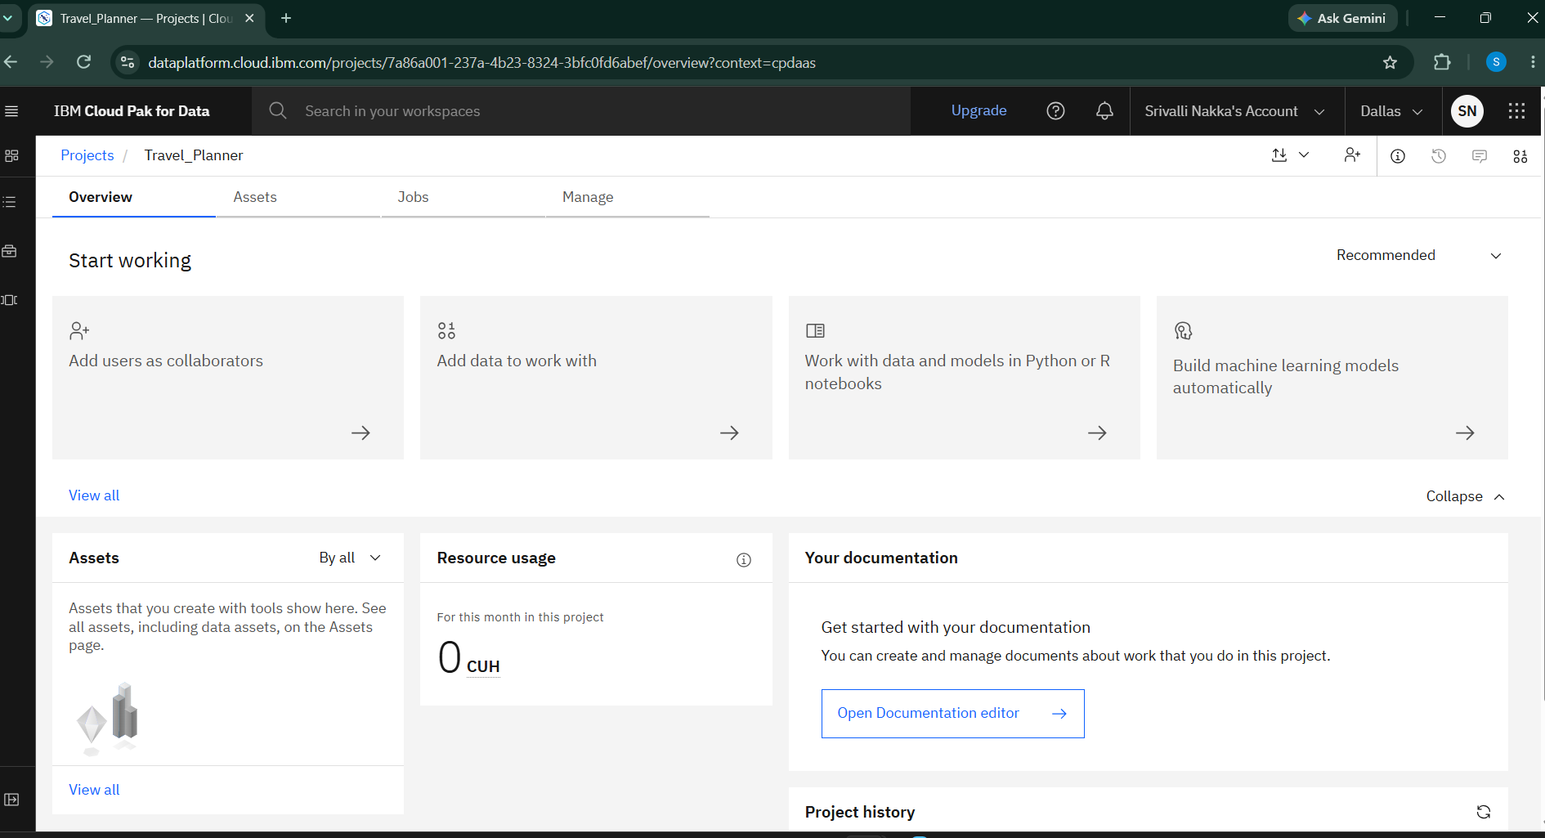
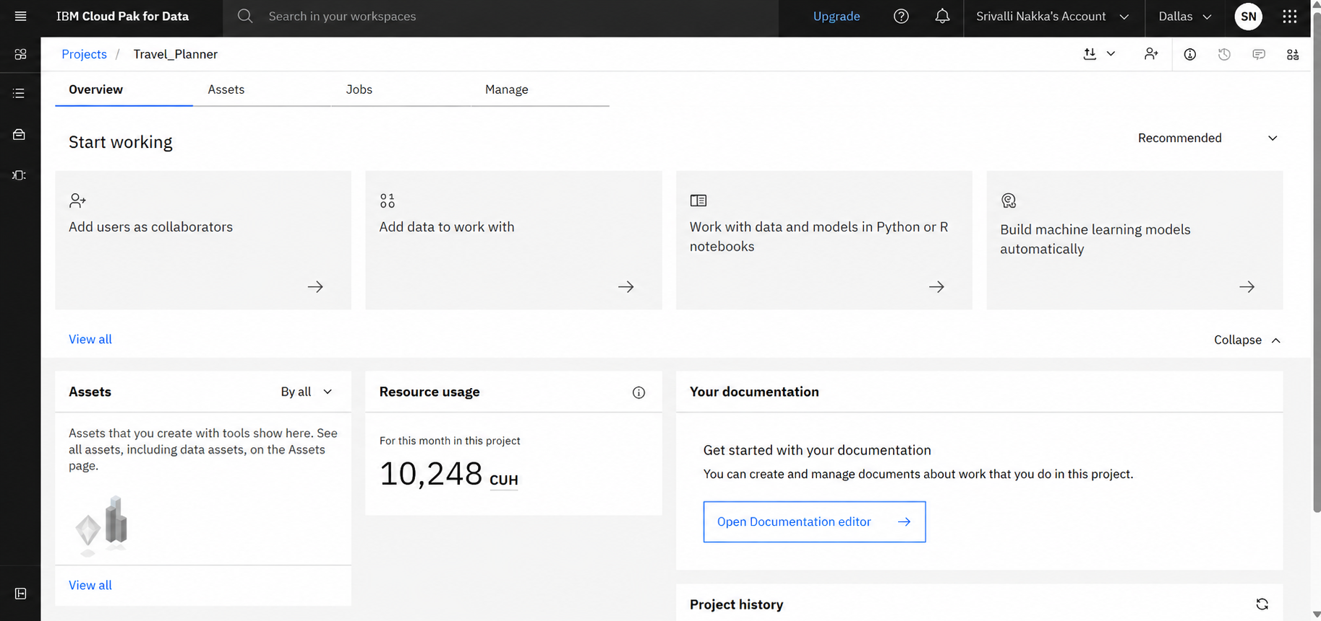
Token Usage
11,761 token are used
Before Prompt
After the Prompt
·
·
·

Slide 11
Novelty and Uniqueness
The proposed Travel Planner Agent stands out by combining Agentic AI, real-time data integration, and hyper-personalisation into a single intelligent travel planning system.
Multi-Agent Intelligence – Instead of a single chatbot, multiple specialised agents collaborate — City Selection, Local Expert, Budget & Logistics, and Travel Concierge — to deliver accurate, context-aware, and end-to-end travel guidance.
Real-Time Data Enrichment – Integrates live weather forecasts from OpenWeatherMap directly into itinerary generation, ensuring climate-aware and seasonally accurate travel recommendations.
Hyper-Personalisation – Tailors destinations, itineraries, accommodation, and transport options based on travel style, budget tier, group size, trip duration, and personal interests.
Real-Time Feedback Loop – Continuously adapts travel plans based on follow-up user inputs such as budget changes, additional days, or new destination preferences within the same conversation session.
Multi-Tool Orchestration – Simultaneously invokes six specialised travel tools — destination suggester, itinerary builder, budget estimator, transport advisor, accommodation finder, and packing list generator — within a single agent pipeline.
Unified Single-Platform Experience – Goes beyond simple Q&A to provide a complete travel planning dashboard with live weather, budget breakdown, quick-action prompts, and conversational AI in one interface — eliminating the need for 5–10 separate travel websites.
Scalable & Enterprise-Ready – Built on IBM watsonx.ai with IBM Granite models, ensuring reliability, AI governance, and seamless scalability on IBM Cloud Lite infrastructure.
This makes the solution a smart, adaptive, and proactive digital travel concierge, not just a static trip recommendation tool.

Slide 12
Git Hub Link
https://github.com/Srivalli0612/IBM_Travel_Planner
The complete source code for the AI-powered Travel Planner Agent is hosted on GitHub.
The repository contains the Flask backend, IBM Granite LLM client, and all travel planning tools.
It integrates IBM watsonx.ai using the ibm-watsonx-ai SDK with the ibm/granite-3-8b-instruct model.
The granite_client.py file handles all communication with IBM watsonx.ai using a singleton model inference client.
The travel_tools.py file implements six specialised tools — destination suggester, itinerary builder, budget estimator, transport advisor, accommodation finder, and packing list generator.
The app.py file orchestrates the multi-agent pipeline with intent detection, tool enrichment, and session memory management.
The static/index.html delivers a fully responsive, dark-mode chat dashboard with a live weather widget and budget estimator — built with zero external frontend dependencies.
The env.example file provides a ready-to-use credential template for IBM API Key, Project ID, watsonx.ai URL, and OpenWeatherMap API Key.
The .env file is excluded from the repository via .gitignore to ensure IBM credentials remain secure and are never exposed publicly.
The repository includes a detailed README.md with setup instructions, API documentation, project structure, and IBM Cloud Lite onboarding steps to help anyone run the project locally in under 5 minutes.
·
·
·

Slide 13
Future Scope
Integration with Live Flight & Hotel Booking APIs — The system can be integrated with real-time booking platforms such as Skyscanner, Booking.com, Expedia, and MakeMyTrip APIs to enable direct flight searches, hotel availability checks, and live pricing — allowing the Travel Planner Agent to move beyond recommendations into actual booking assistance within the same conversational interface.
AI-Powered Voice Assistant & Multilingual Support — Enhancing the system with a voice-enabled assistant and support for multiple languages will significantly improve accessibility. Travellers can interact naturally in their preferred language — Hindi, Spanish, French, Arabic, Japanese, and more — making the solution more inclusive and suitable for diverse global populations, especially first-time international travellers from non-English-speaking regions.
Personalised Travel Profile & User History — Integrating a persistent user profile database will allow the agent to remember past trips, preferred destinations, travel styles, dietary restrictions, and budget preferences across sessions. This long-term memory will enable increasingly personalised recommendations with every trip the user plans, evolving from a one-time assistant into a lifelong travel companion.
Real-Time Travel Alert & Disruption Management — The agent can be enhanced with real-time travel alert systems that monitor flight delays, cancellations, political advisories, natural disasters, and health warnings. When a disruption is detected, the agent autonomously re-optimises the itinerary, suggests alternative routes, and notifies the traveller — transforming it from a planning tool into an active travel management system.
·
·
·

Slide 14
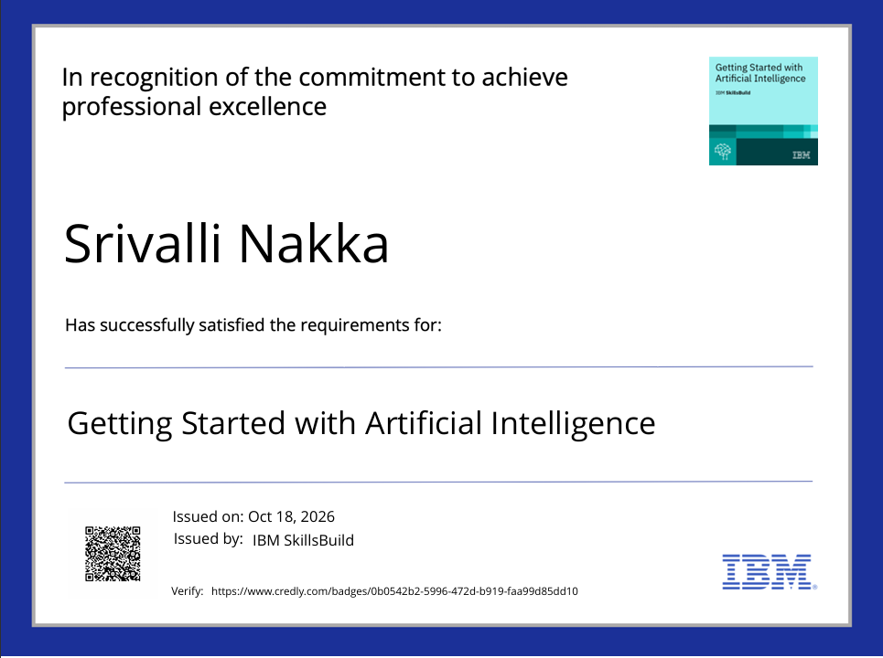
Certificates Earned:

Slide 15
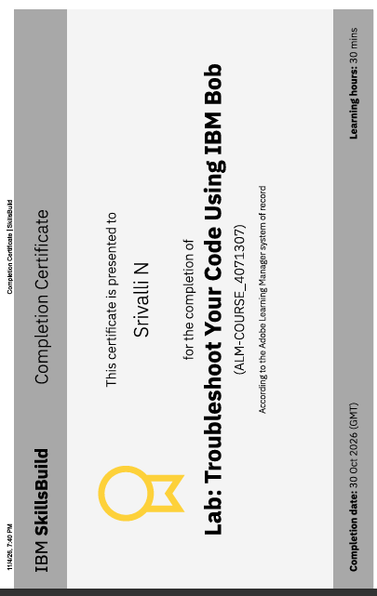
Certificates Earned:​
IBM BOB Certificate

Slide 16


