Slide 1
E-commerce Chatbot Project
Case Study Presentation
E-Commerce Sales Chatbot Project
Presentation to the Recruitment Panel

Slide 2
1. Project Overview
This project presents a fully functional E-Commerce Sales Chatbot designed to improve customer interaction and product discovery on a simulated e-commerce platform. The chatbot facilitates product search, query resolution, and a smooth browsing experience for end-users.

Slide 3
2. Objective
To develop a responsive, interactive chatbot interface backed by a Django-powered backend system and mock inventory data. The chatbot aims to enhance customer experience through intelligent query handling and product recommendation.

Slide 4
3. Technology Stack
Frontend: HTML5, CSS3, JavaScript
Backend: Python (Django, Django REST Framework)
Database: SQLite (for mock inventory)
Authentication: Django Auth, JWT (SimpleJWT)

Slide 5
4. Key Features
Chatbot UI with responsive design
JWT Authentication and session handling
Real-time product recommendations based on user queries
Admin panel for product and user management

Slide 6
5. Architecture
The system is divided into frontend and backend layers. The chatbot frontend captures user input and sends it via REST API to the Django backend. The backend processes the query, filters product data, and sends responses which are dynamically rendered on the frontend.

Slide 7
6. Sample Queries
User: I want to buy headphones Bot: Found 3 products matching 'headphones'. 🛍️ Sony WH-1000XM4 - ₹25,000

Slide 8
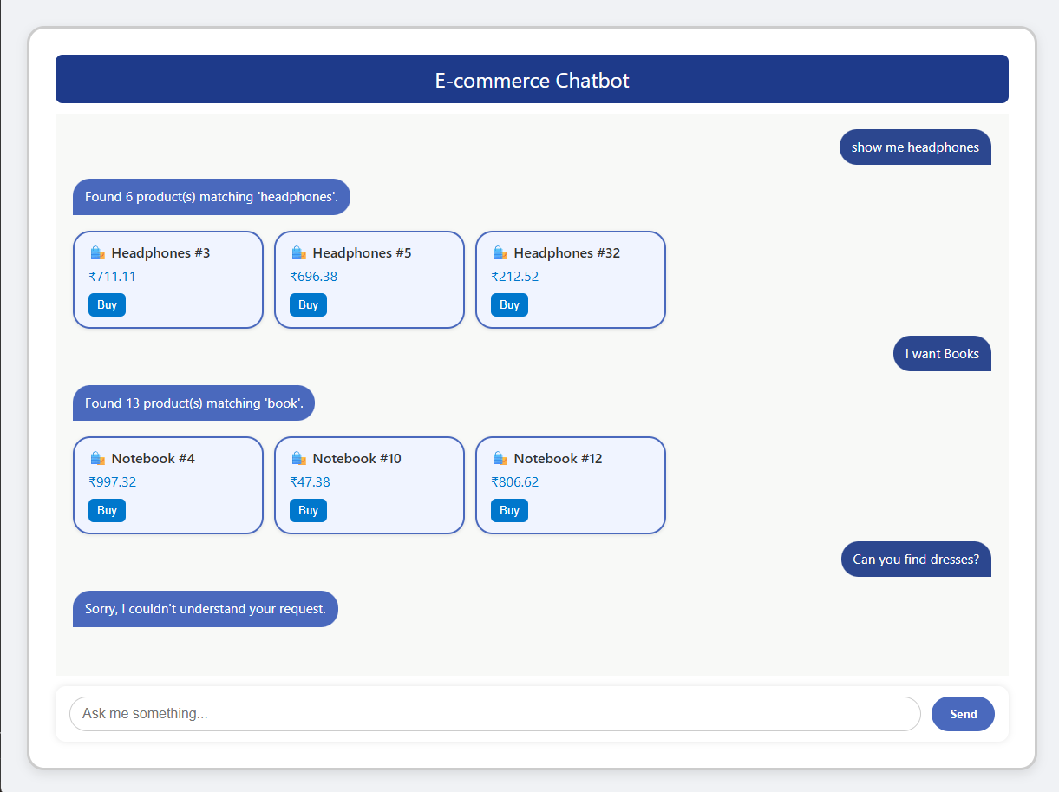
E-commerce Chatbot

Slide 9
7. Challenges & Solutions
Ensuring responsiveness on all screen sizes – resolved with CSS Flexbox and media queries.
Query understanding and keyword matching – implemented keyword matching logic with fallback response.

Slide 10
8. Key Learnings
Full-stack application development with Django and REST API integration
JWT token-based authentication
Importance of UI/UX for chatbot experiences

Slide 11
9. Conclusion
This project showcases the integration of full-stack development practices and chatbot logic to build a professional e-commerce support tool.

