Slide 1
Modelling Viral Genome Compression in Viruses
Srivarma Battini

Slide 2
Introduction
What is Genome Compression?
Viral genomes are naturally small and highly optimized.
Genome compression explores how information is densely encoded.
We aim to mimic this natural efficiency using compression algorithms entropy analysis.

Slide 3
Motivation
Why this project?
The amount of genomic data is increasing rapidly due to advancements in DNA sequencing technologies.
Efficient storage and transmission of genome sequences is a growing challenge in bioinformatics.
Viral genomes are commonly studied in medical research, epidemiology, and vaccine development.
Standard compression tools are not optimized for DNA data, which has a limited alphabet and specific patterns.
Effective genome compression can reduce storage costs and improve data transfer efficiency.
Lossless compression is essential to preserve the integrity of biological data during processing and sharing.

Slide 4
Modelling Genome Compression in Viruses: Implementation of Context Modelling & Compression
Pipeline of the Project:
→ →
↓
← ←
↓
→ →
FASTA File (Input)
Read & Clean DNA Sequence
Train 2-gram and 4-gram Models
Arithmetic Decoding → Reconstructed Sequence
Arithmetic Encoding → Decimal Value
Context Mixing (get_mixed_probs(i))
Mismatch Check (Lossless Validation
Bit Estimation (Entropy based compression)
Save Output Files + Evaluate Compression Ratio

Slide 5
Function: NGramModel
➤ Purpose:
To model the probability of the next nucleotide (A, C, G, T) based on a context of previous n bases.
➤ Input:
n (context length)
DNA sequence (e.g., ACGTAC...)
➤ Output:
Dictionary of probabilities for each nucleotide given a context
➤ Use:
Used to estimate how likely each base is to follow a given pattern, which helps in compression via prediction.

Slide 6
Function: ContextMixer
➤ Purpose:
To combine multiple N-gram model predictions into one final probability distribution.
➤ Input:
List of trained models (e.g., 2-gram and 4-gram)
Contexts extracted for each model at position I
➤ Output:
Mixed probability distribution for A, C, G, T at position I
➤ Use:
Improves prediction by balancing general (2-gram) and specific (4-gram) context strengths.

Slide 7
Function: get_mixed_probs(i)
➤ Purpose:
To return the final prediction probabilities for position i using the context mixer.
➤ Input:
Position i in the DNA sequence
Sequence itself
➤ Output:
Dictionary of probabilities for A, C, G, T at that position
➤ Use:
Called during encoding and decoding to fetch dynamic, context-aware probabilities.

Slide 8
Function: Arithmetic Encoding
➤ Purpose:
To compress the entire DNA sequence into a single decimal value using dynamic probability ranges.
➤ Input:
Full DNA sequence
get_mixed_probs(i) for probability guidance at each step
➤ Output:
Single decimal number representing the whole sequence
➤ Use:
Core compression logic — uses predicted probabilities to encode sequence efficiently.

Slide 9
Function: Arithmetic Decoding
➤ Purpose:
To reconstruct the original sequence from the encoded decimal value.
➤ Input:
Encoded value
Length of original sequence
get_mixed_probs(i) to guide decoding
➤ Output:
Fully reconstructed DNA sequence
➤ Use:
Ensures lossless recovery — validates the compression by reproducing the exact input.

Slide 10
Function: Compression Evaluation
➤ Purpose:
To measure the effectiveness of compression.
➤ Input:
Original sequence
Decoded sequence
Probability predictions
➤ Output:
Number of mismatches
Theoretical compressed size (bits)
Physical file size (bytes)
Compression ratios
➤ Use:
Confirms compression accuracy and performance both mathematically and practically.

Slide 11
Results & Observations
Dataset | Length | Mismatches | Theoretical Ratio | Physical Ratio
SARS-CoV-2.fasta | 29,903 | 0 | 0.2537 | 0.2494
HIV.fasta | 9,181 | 0 | 0.2473 | 0.2416
Dengue_virus.fasta | 10,735 | 0 | 0.2523 | 0.2477
Observations:
All outputs were lossless (no mismatches)
Compression ratios consistent across datasets
Shows generalizability and reliability of context modeling

Slide 12
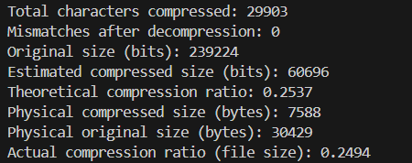
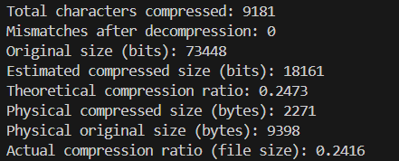
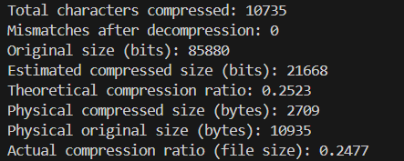
Results
sars_cov2.fasta Dataset: HIV.fasta Dataset:
Dengue_virus.fasta Dataset:

Slide 13

THANK YOU

