Slide 1
INC250422

Slide 2
INC250311
IR team presented their findings
Impacted hosts isolated and rebuilt
MFA implemented for employees
Security controls implemented for phishing
Security awareness training is provided to all employees
Lessons learned were conducted
Business back to normal

Slide 3
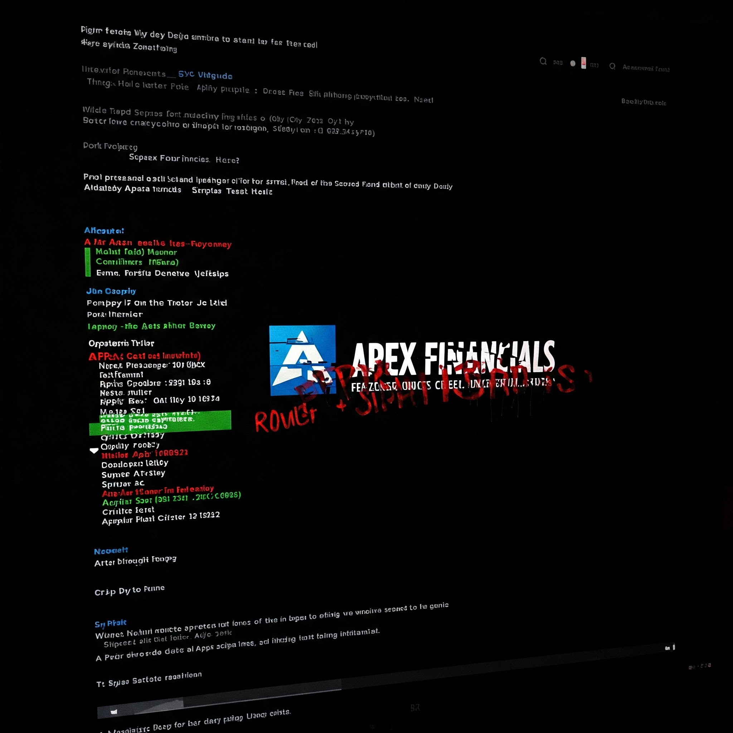
4/22/2025 – Post on darkweb

Slide 4
Currently what’s happening
Discussion regarding the data in blogs and social media
Calls from clients
Executive management looking for answers
Every team is blaming the other
You are in charge

Slide 5
Your task
Provided data sources
Firewall logs
Web server access logs for public website www.apexfinancials.com
Resource document
Analyze provided log files
Identify the rootcause, and data exfiltration activities.
Determine the scope and impact of the incident.

Slide 6
Deliverables
Develop and Document a containment strategy to isolate affected systems and prevent further data loss.
Develop and Document a recovery plan to restore affected systems and services.
Conduct a thorough post-incident review and root cause analysis.
Collaboration and effective communication are essential for a successful response
To all the stakeholders including your executive management, business/data/system owners, customers/clients, press

Slide 7
Bonus points
Any enumeration on the C2 server ,
any information about the data which was exfiltrated,
Research the capabilities of the backdoor, if any

Slide 8
Please ask questions

