Slide 1

ML Project
Team Name - Gryffindor
Team Members -
Aakanksha Rani (MT2022001)
Akanksha Shukla (MT2022008)

Slide 2
Problem No.-01
YAHOO-TROLL-QUESTION-DETECTION
Problem Statement - As a last-ditch attempt to give Yahoo Answers some legitimacy in the era of Quora and Reddit, Yahoo's CEO Merissa Meyer has tasked you with creating a machine learning model to detect spam and troll questions so that they can be removed. To this end, you are given a hand-labeled dataset consisting of questions with unique IDs and whether they are troll questions or not.

Slide 3
Natural Language Processing
NLP is the technology used to help machines to understand and learn text and language . It is done to teach machines to understand and make sense of human language. It is a discipline that focuses on the interaction between data science and human language, and is scaling to lots of industries.
Use Cases of NLP :
1-Sentiment Analysis
2-Spam Classification
3-Troll Question Detection
4-Text Classification
5-Speech Recognition

Slide 4
*NLP has two aspects-
1-Natural Language Understanding or Natural Language Interpretation (human to machine)
2-Natural Language Generation (machine to human)
*Natural Language Processing tasks are primarily achieved by syntactic analysis (syntax refers the grammatical structure of the text) and semantic analysis (semantics refers to the meaning of the sentence).

Slide 5

But Why we Need NLP?
1. Our goal is to create a machine learning model to screen questions and classify them as troll and non troll .
2. NLP helps us with this by analysing the text.
3. NLP analyzes text and understands the sentiments behind it.

Slide 6
In Python we have several libraries for NLP:
Scikit-learn, Keras, TensorFlow — has some text processing capabilities
NLTK — Natural language toolkit(Highly used Python library for Text Processing)
SpaCy — is an industrial strength NLP package with many practical tools in a nice API.

Slide 7
Preprocessing Of Data Set
1.Data Cleaning
2.Exploratory Data Analysis(EDA)
3.Data Preprocessing
Regularization
Lower Case
Tokenization
Removing Stopwords
Stemming
Lemmatization

Slide 8
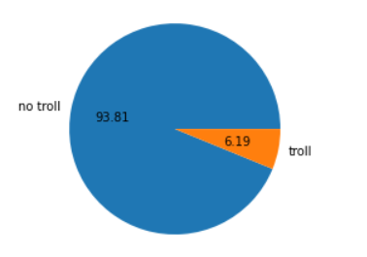
EDA
In our training dataset we have
Number of rows: 1000000
Number of Columns :3
Number of non troll questions : 938130
Number of troll questions : 61870

Slide 9
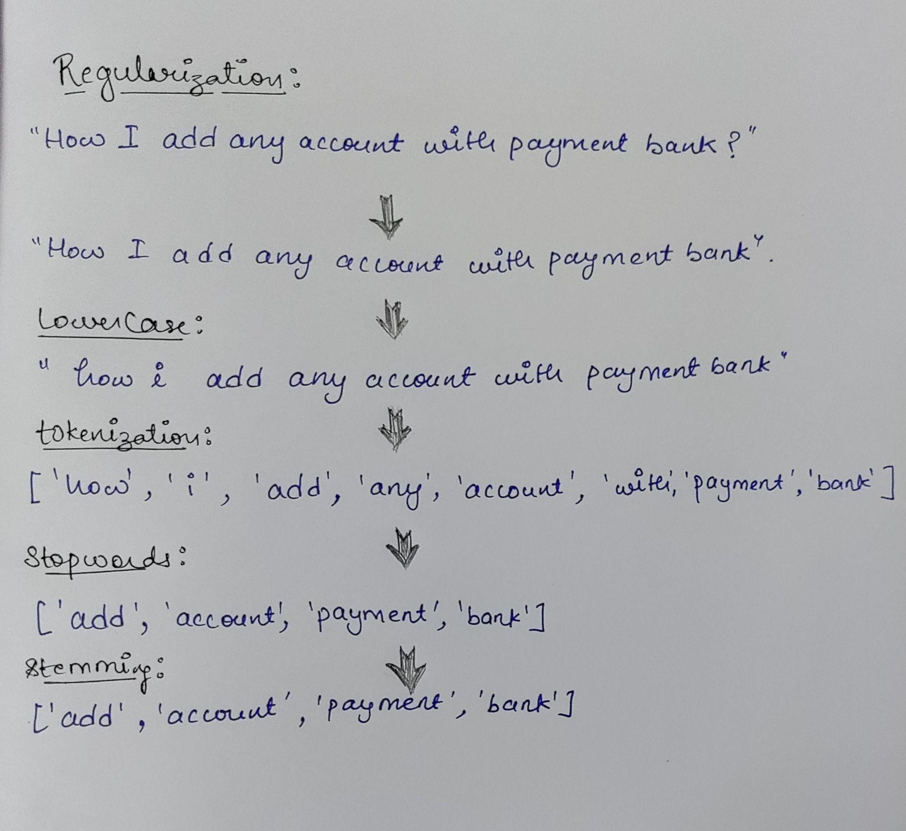
Preprocessing of Text
Ex- “How I add any account with payment bank?”

Slide 10
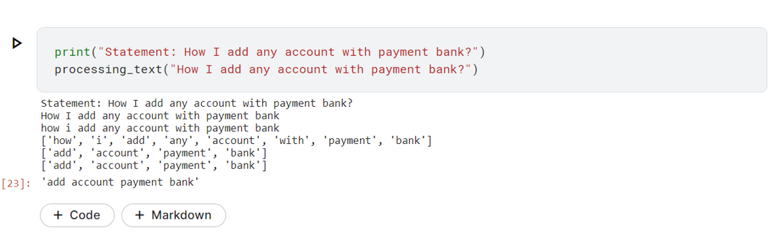

Slide 11
Bag of Words and TF-IDF
Words → Numbers or vectors
Bag of Words - Converting words to numbers with no semantic information.
TF-IDF - Converting the words to numbers or vectors with some weighted information.

Slide 12
Vectorizers
Countvectorizer - It uses the bag of word model to convert arbitrary text into fixed length vectors by counting how many times each word appears.
TF-IDF Vectorizer - The TF-IDF score for each word is calculated as given below to generate the feature vectors for each sample questions.
The TF-IDF technique is good as it gives importance to
rarely occurring words.

Slide 13
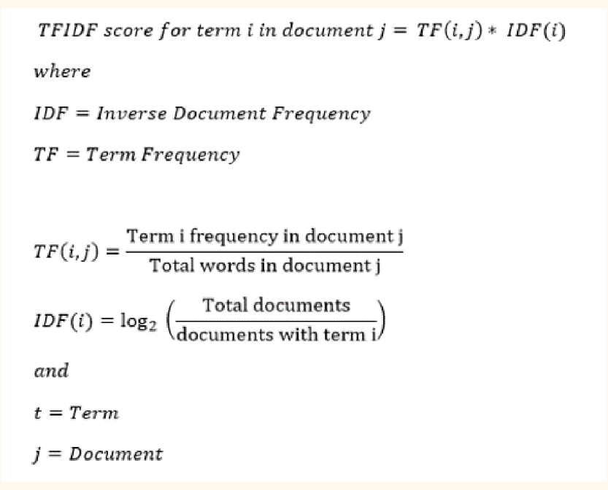

Slide 14
Little more about what we have done till now
We have separately preprocessed both training and test data set.
Then pickled the preprocessed data and save them into files.
Now merging the preprocessed data set instead of raw dataset .
TF-IDF is used for vectorizations of words.
Words → → Vectors
TF-IDF

Slide 15
Continue…….
5. We have limited our features upto 4000 unique words (feature
columns).
6. Again splitting of merged preprocessed dataset as training and
Testing dataset.
Train Data - 1000000 x 4000
Test Data - 306122 x 4000

Slide 16
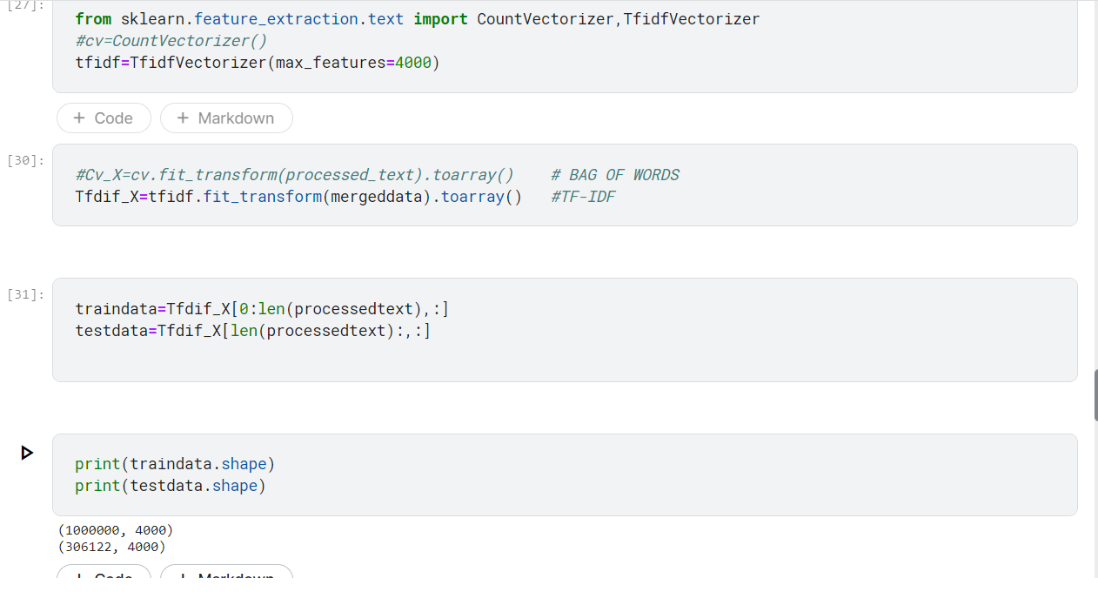

Slide 17
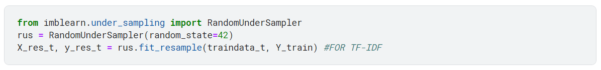
Balancing The Dataset
The random undersampler provided by imblearn was used to balance the dataset as a majority of the samples were of the non troll category.
We can also use oversampling but since data is too much we preferred undersampling.

Slide 18
Model Training (Top 3 Approaches)
Model Name | Description | Kaggle Score
Logistic Regression (undersampled) | LR with no preprocessing + using bag of words with hyper parameter tuning (max features 500000) | 0.54752
Logistic Regression | LR with pre preprocessing (stemming)+ TF-IDF (max features 7000) | 0.48677
Logistic Regression | LR with pre preprocessing (stemming +lemmatizing)+ TF-IDF | 0.47799

Slide 19
Some Other Approaches
Model Name | Description | Kaggle Score
Naive Bayes | Multinomial NB (Preprocessed +Undersampled) + using TF-IDF | 0.35487
Logistic Regression with grid search | LR with pre preprocessing (stemming)+ TF-IDF | 0.45994
Random Forest (still working on it) | RF with pre processed + undersampled data | 0.38528
Decision Tree (still working on it) | DT with pre processed + undersampled (countvectorizer) | 0

Slide 20
Future Models we are planning to implement
SVM
Perceptron
XGBoost
Ada Boost

