Slide 1
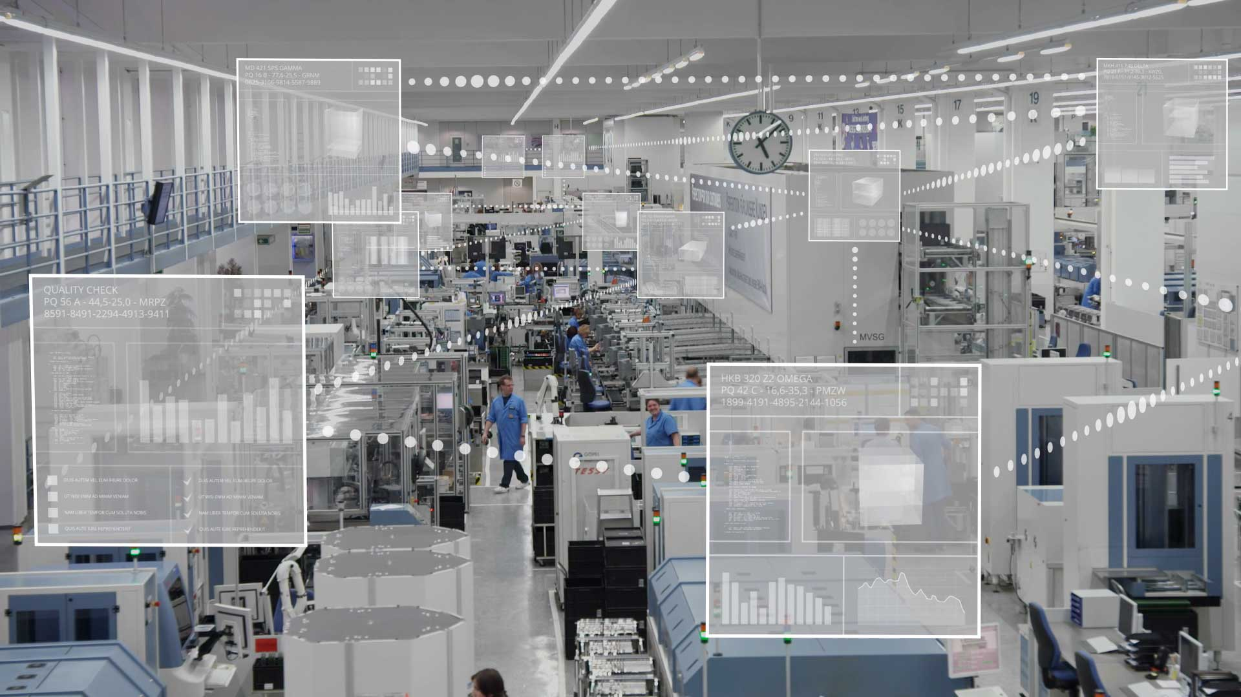
ER∏IOT
REAL TIME DATA. REALER.
“TRUE INNOVATION IS COMING UP WITH THE PRODUCT THAT THE CUSTOMER DIDN’T EVEN KNOW THEY NEEDED”
- J. PAUL GETTY

Slide 3
WHY?

Slide 4

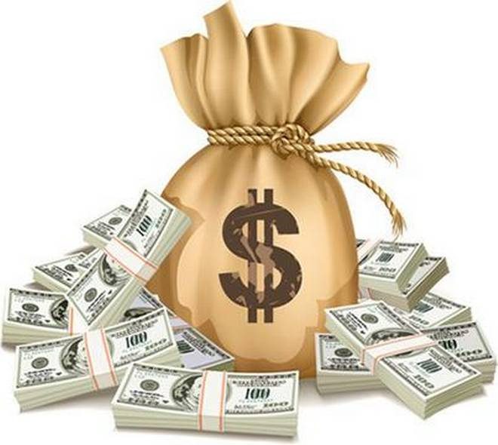


Man
Machine
Material
Measurement
Method
Environment
DISINTEGRATION
MISMANAGEMENT
"Alone we can do so little, together we can do so much"

Slide 5
WITH WHAT?

Slide 6







GPS
Logistics
ER∏IOT
Cloud Solutions with ERP software
Machines
Sensors
Customers
Human Resource
RFID
“A Satisfied Customer is the Best Business Strategy of All”

Slide 7
HOW?

Slide 8
Enterprise Internet of Things
Connect
Collect
Correct
Correlate
Network components
Sensors
Cleansing and transforming the data
1.Data display
2. Closed loop analysis
Wired Connectivity
[Ethernet, CC link etc.]
Wireless Connectivity
1. Machine performance measurement
2.Part tracking
3.Part Identification
Hardware
Software
Gathering Server
Edge analytics
In house data analytics and prediction
Master/Standby DB Server
Master data processing [Cloud]/Local]
“Creativity is Just Connecting Things” – Steve Jobs

Slide 9
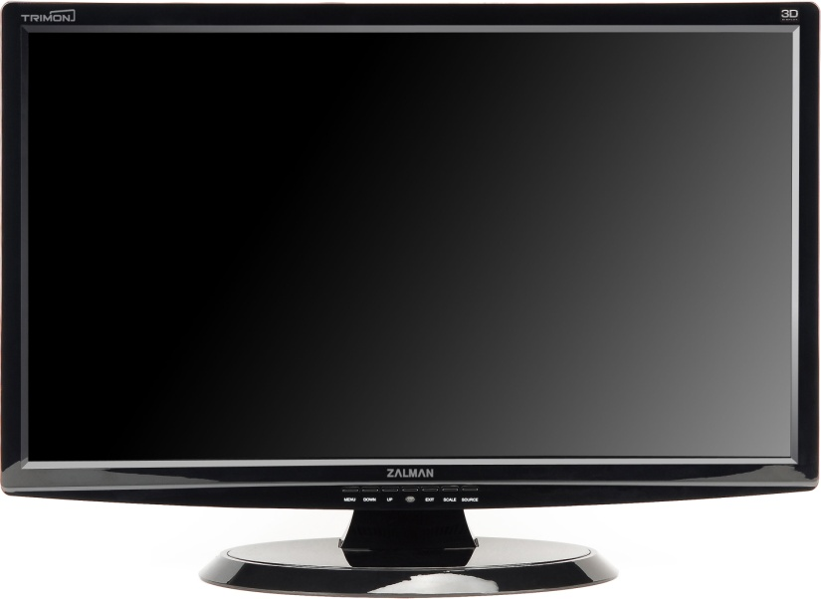
ENTERPRISE INTERNET OF THINGS FOR MANUFACTURING SECTOR
Tools
Manufacturing Master
Software Phase
M1
M2
M3
M4
M5
HTML , CSS , PHP, JS, Adobe Air and MySQL
M6
M7
M8
M9
Machine M1 MALFUNCTIONS
STOP
Controller
Arduino /Raspberry Pi [any custom requirement]
Production Real time data monitoring
Key parameter determination
Real time data analysis
Offline data analysis
Part tracking and traceability
Accounting
Hardwares
Network[Server, Switch]
Machine [Sensors]
“IF WE DONT AUTOMATE THE PROCESS THEN WE ARE WASTING OUR TIME”

Slide 10
WITH HOW MUCH?

Slide 11
6 month budget:
PROVISIONS | COST/ PER MONTH (INR) | TOTAL COST (INR)
TEAM EXPANSION | 90,000 | 5,40,000
LEGAL (COPYRIGHTS,INCORPORATION)* | - | 30,000
MARKETING – GOOGLE ADS+LINKEDIN | 32,500 + 15,000 | 2,85,000
OFFICE RENT | 20000 | 1,20,000
BROADBAND | 1500 | 7500
CLOUD SERVICES | 20000 | 1,20,000
ACCESSORIES (PC’S+TABLES+CHAIRS+FANS+LIGHT) | - | 1,90,000
OTHERS (ELECTRICITY+WATER) | 4000+1000 | 30,000
13,22,500
“ GIVE US IN NUMBERS, WE WILL DO WONDERS”

Slide 12
EXPECTED EBITDA (6 months)– 4,41,000 (INR)
21000*(6+5+4+3+2+1) 30 users 21000 per month 1 org/month

Slide 13
WHY WE?

Slide 14
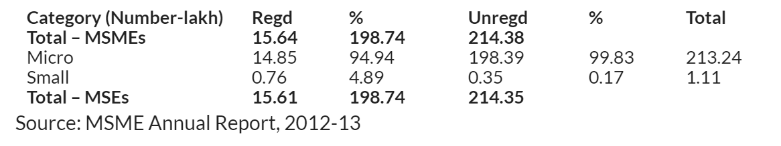

Source: www.g2crowd.com
ER$π$IOT
Oracle Netsuite
SAP
Microsoft Dynamics 365
Financial Force
Infor cloudsuite
QAD
BizAutomation
Root stock
Odoo
“100 times 10 is better than 1 times 1000.”

Slide 15


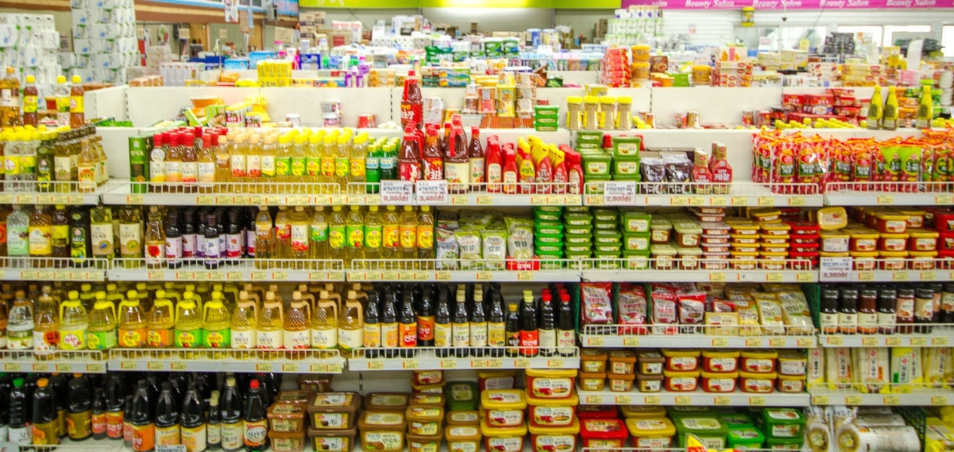


“Vision is the art of the invisible.”

Slide 16
100 CRORE RETURNS IN
10 YEARS

Slide 17
WHAT IF?
They compete – Will innovate indefinitely and infinitely
Fear of job loss – Will provide Skill Development Plans
System collapses – Backup cloud storage for important data
Data gets leaked – Use third party security services
“Treatment without prevention is simply unsustainable “– Bill gates

Slide 18

WHO?
3 Issues 1 Vision 4Er$π$ioteers
Endless Service
∏ - 3.14159265 …

Slide 19
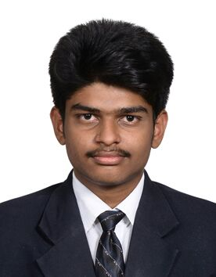
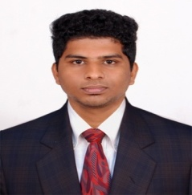
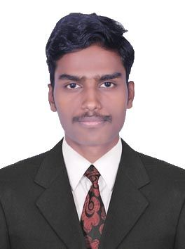
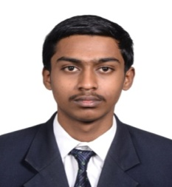
“We will Work Until We Don’t Need to Introduce Ourselves”
ABOUT US |  | WE GOOD AT
SRIVASTHAN R |  | Software Programming, Sensor Interface and Leadership
AKILAN V |  | Sensor Interface , Controller Programming and Managing People
KAVIYARASU E |  | Out of the box thinking, Digital marketing, Web development
TAMILALAGAN K |  | Financial and Accounting plans, Human Resource Management.
THANK YOU FOR HEARING US OUT

