Slide 1
CGB1201 – JAVA PROGRAMMING
Department of Artificial Intelligence and Data Science
Academic Year: 2024 – 2025 (Odd Semester)
Register Number : 2303811724321108
Name : SRIVATHSAN S
Year : II
Semester : III
Section : B
Date : 3/12/24

Slide 2
TITLE OF THE PROJECT
ATM SIMULATION SYSTEM

Slide 3
PROBLEM IDENTIFICATION
1)Authentication Issues:
Card Reader Failures: The system may face problems reading card information .
PIN Verification Errors: Incorrect handling of PIN inputs could lead to user lockout or unauthorized access.
2)Transaction Handling:
Inconsistent Balance Updates: Balance might not get updated correctly after transactions (e.g., withdrawal, deposit).
Multiple Transactions at Once: Concurrent access or multiple transactions in a networked environment can lead to inconsistencies.
Insufficient Funds Handling: Correct feedback mechanisms when balance is insufficient must be ensured.
3)Security Concerns:
Data Encryption Failures: Improper encryption of sensitive data (card details, PINs) during transmission.
Unauthorized Access: Simulated attacks may reveal weaknesses in access controls or firewalls.

Slide 4
OBJECTIVE
1)Testing and Development:
System Testing: To allow developers to test different components of ATM software, including authentication, transaction handling, and error recovery, without using physical hardware.
Error Handling Simulation: To simulate real-world scenarios like network failure, insufficient funds, incorrect PIN entries, etc., and ensure the ATM system handles these gracefully.
2)Training and Learning:
User Training: To familiarize users with the operation of ATMs in a risk-free, virtual environment, reducing errors in real-world use.
Operator Training: To train bank employees or technical staff on handling operational issues, such as troubleshooting, system crashes, or cash refill processes, through realistic simulations.
3) Error and Risk Mitigation:
Detecting Flaws Early: To identify potential design flaws, errors, and vulnerabilities in the ATM system during the development phase, avoiding costly errors in the final product.
Simulating Failure Scenarios: To simulate system crashes, card jams, or dispenser malfunctions and measure the system’s resilience in terms of recovery and user experience.

Slide 5
JAVA PROGRAMMING - CONCEPTS USED
1.Variables and Data Types: For storing account details and managing financial data.
2. Control Statements: If-Else for validations , Switch-Case for menu options.
3. Loops: While loop for repeatedly displaying the ATM menu.
4.Input Handling: Scanner class for user inputs.
5. Arithmetic Operations: For updating balances during transactions.
6.Conditionals: Validates sufficient balance and input correctness.
7. System Class: System.out for messages.System.exit() to terminate the program.
8. Exception Handling (Implicit): Handles invalid input types during runtime.

Slide 6
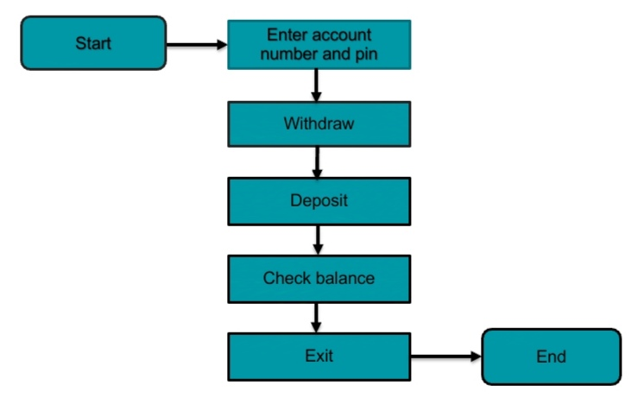
PROPOSED ARCHITECTURE

Slide 7
MODULE DESCRIPTION
Authentication : User inputs account number and PIN for verification. Only authorized users can proceed to the next step.
ATM Menu : After successful login, a menu offers options: Withdraw, Deposit, Check Balance, and Exit.
Withdraw : Checks if the balance is sufficient for withdrawal. If sufficient, balance is updated, and cash is dispensed. If insufficient, an error message is displayed.
Deposit : Adds the deposited amount to the balance. Confirms successful deposit.
Check Balance : Displays the current account balance to the user.
Exit : The user can exit the program, ending the session.

Slide 8

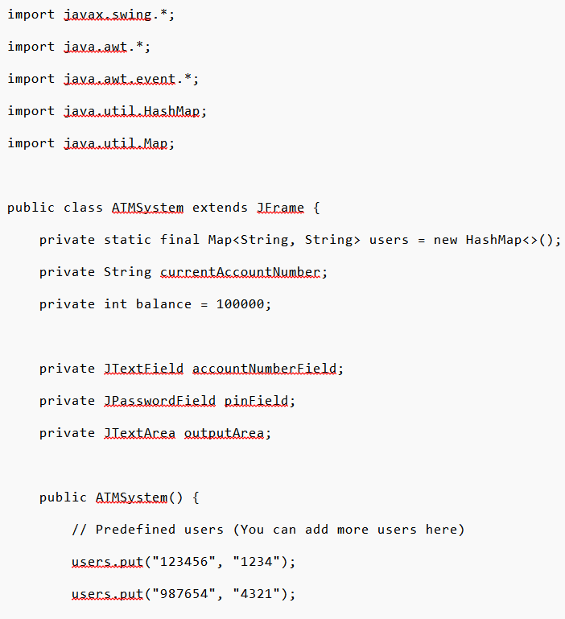
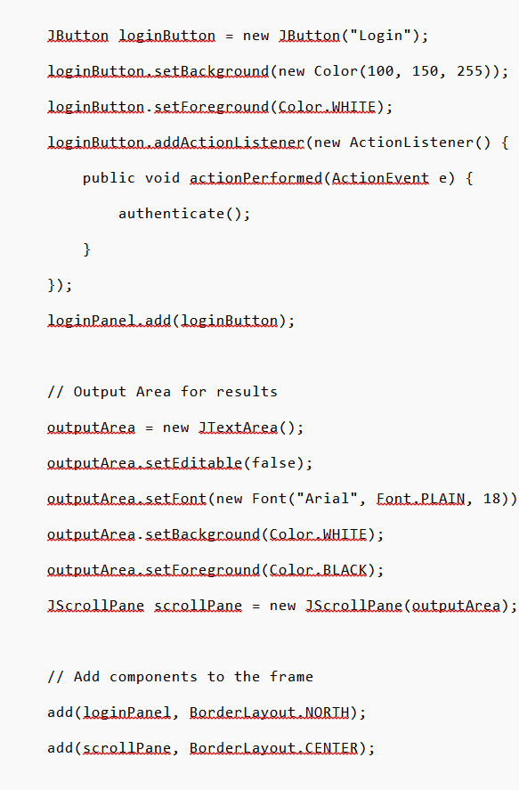
SOURCE CODE

Slide 9
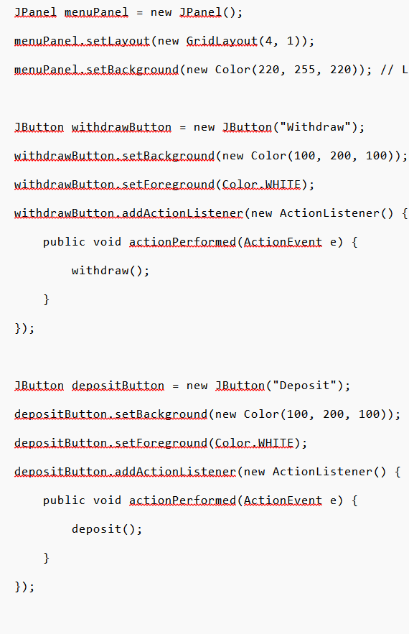
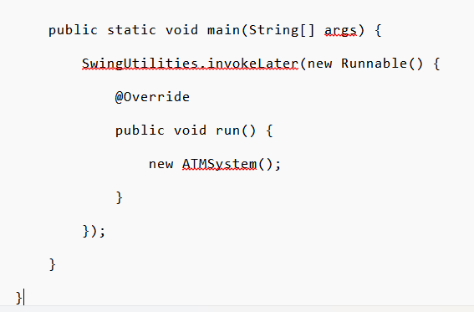
SOURCE CODE

Slide 10
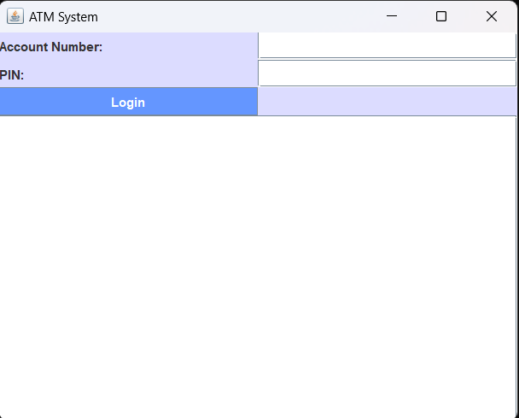
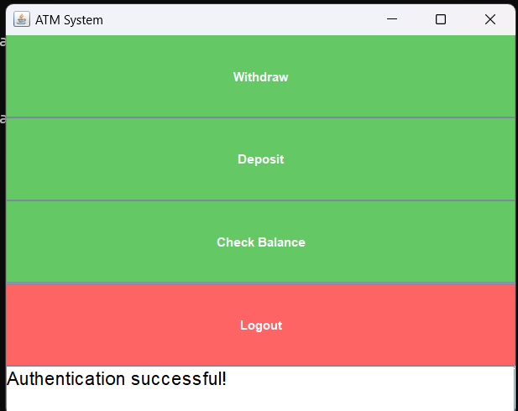
RESULTS AND DISCUSSION

Slide 11
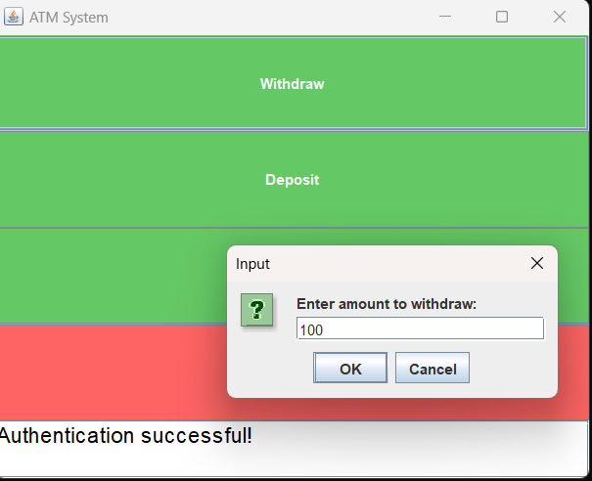
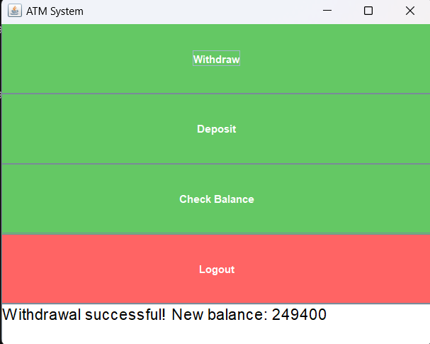
RESULTS AND DISCUSSION

Slide 12
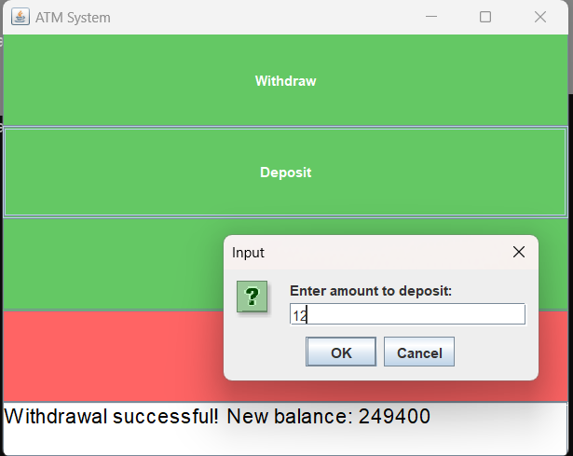
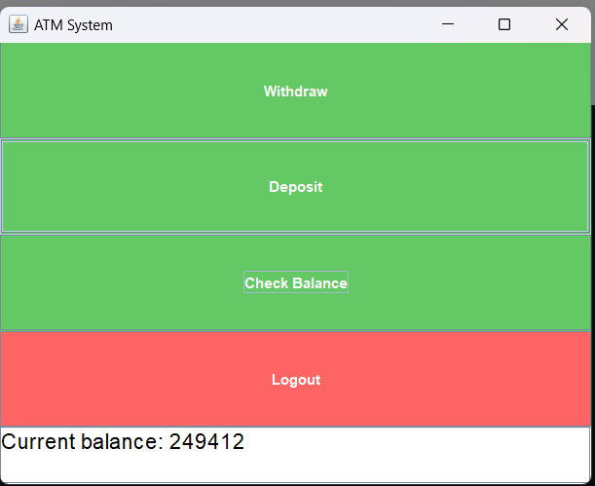
RESULTS AND DISCUSSION

Slide 13
CONCLUSION
This project effectively simulates a basic ATM system, providing users with essential banking functionalities in a secure and straightforward manner. Through the use of Java programming concepts such as conditionals, loops, and modular design, the project achieves its objectives while serving as an educational tool for understanding real-world banking processes. While the current implementation is functional, it offers potential for future enhancements, such as integrating additional features or improving usability through advanced interfaces. This project demonstrates the importance of structured programming in building reliable and user-friendly applications.

Slide 14
THANK YOU

