Slide 1
MDTE11 BATCH
I’m Srivathsan , currently in my final year pursuing B.Tech Cse at SRM UNIVERSITY , RAMAPURAM . Now I’m Currently learning DataScience At Guvi and have done a project Titled – DATASPARK – ILLUMINATING INSIGHTS FOR EDA (EXPLORATORY DATA ANALYSIS)

Slide 2
Exploratory Data Analysis (EDA) Insights for Global Electronics
Project Problem Statement
Global Electronics, a leading retailer, aims to enhance customer satisfaction and optimize operations through a comprehensive Exploratory Data Analysis (EDA). This analysis uncovers key insights from sales, customer demographics, and product data, offering actionable recommendations to drive growth and operational efficiency.

Slide 3
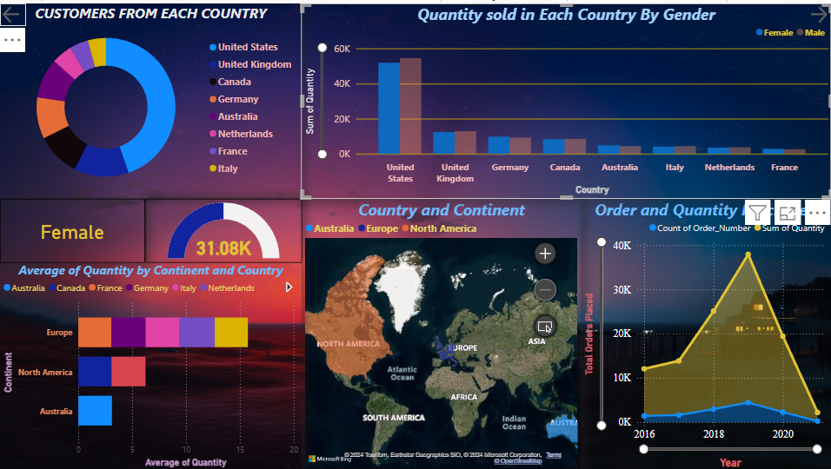
Sales Distribution Across Countries
United States has the highest sales, dominated by male customers.
Germany and the UK are also key markets with balanced gender sales.
The Netherlands and France have the lowest sales.

Slide 4
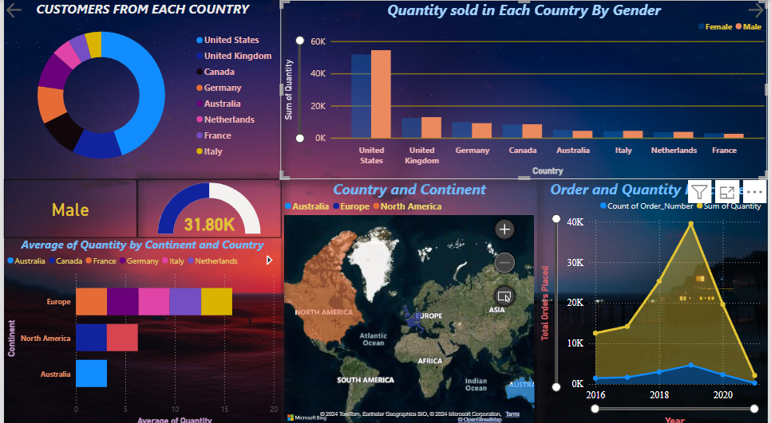
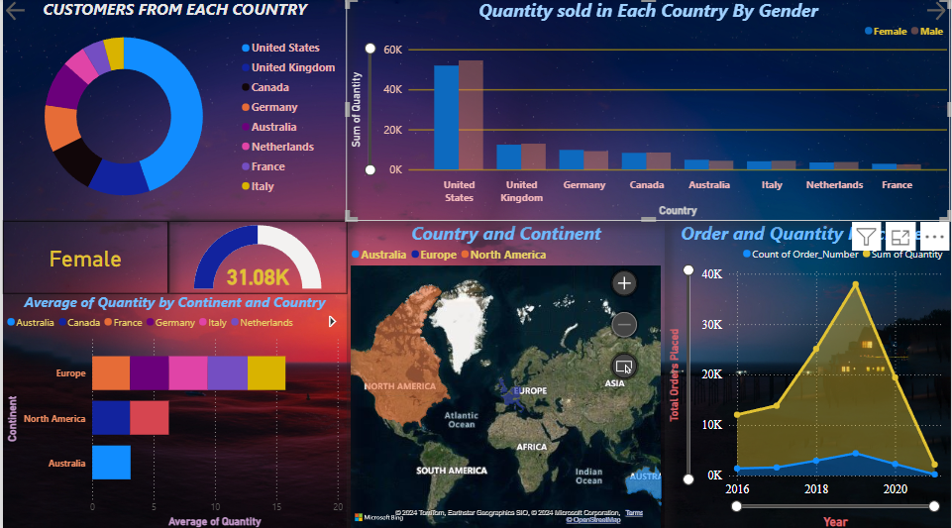
Customer Segmentation by Gender and Age
Female customers dominate purchases in North America.
Most purchases are made by customers between the ages of 25-45.
July and August are the peak months for customer birthdays, indicating seasonal trends.

Slide 5
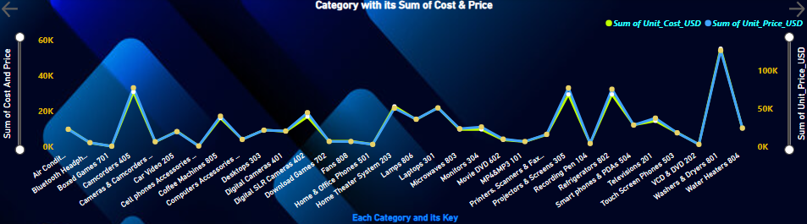
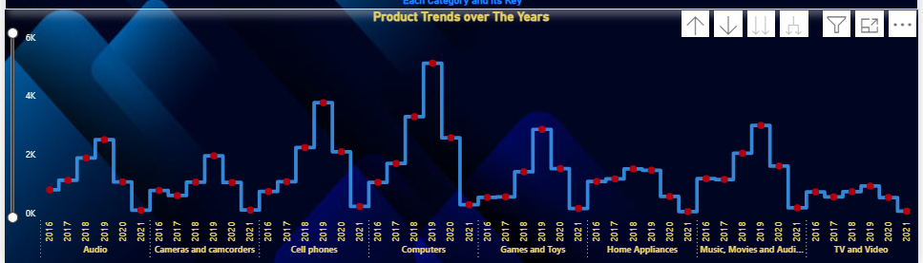
Key Product Categories Driving Revenue
Cell phones and Computers lead the revenue with the highest margins.
Home appliances and televisions are high-volume but lower-margin categories.
Smartphones and cameras show consistent demand year over year.

Slide 6
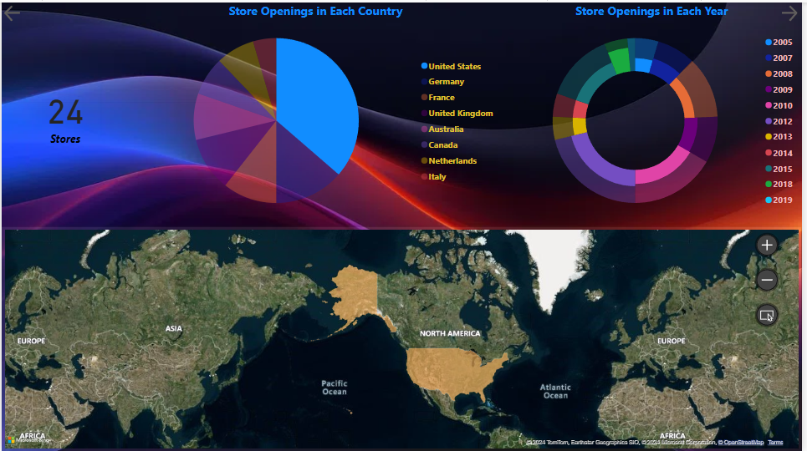
Store Expansion and Performance Analysis
The US has the highest number of store openings, contributing significantly to revenue growth.
Australia and Germany show moderate expansion with promising performance.
France and the Netherlands have fewer stores, showing room for growth.

Slide 7
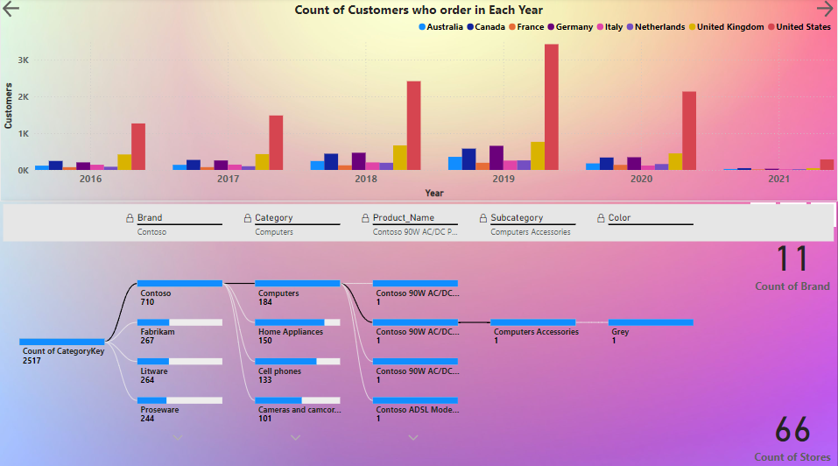
Strategic Recommendations
Expand store presence in underperforming markets like France and the Netherlands.
Focus marketing on female customers, especially in North America.
Increase product diversity in high-margin categories like smartphones and cameras.
Optimize inventory for seasonal trends, especially around July-August.

