Slide 1
CUSTOMER SENTIMENT ANALYSIS
PAVAN KUMAR THATHA
SIVARAJ
SRIVASTHAV

Slide 2
Sentiment Analysis Using Analytical Approach
Business Problem Definition
Customer Sentiment Analysis.
Data Sources
Social Media – Twitter, Facebook.
Tech Reviews– CNN, Engadget, Amazon.
Basic Process and Algorithm
Opinion Mining/Sentiment Polarity.
Machine Learning/Reinforcement Learning.
Data Metrics/Visualization
Tableau/Kibana, Elastic search.
Challenges/Limitations, Alternate Approaches, Tools used
Conclusion
Future Enhancements/Recommendations

Slide 3
Business Problem
“How to Analyse/Evaluate Customer Sentiments about TiVo products/features.”
Top features picked:
TiVo BOLT VOX.
Hydra UI.
Personalized Content Predictions.
Apps (Netflix/Youtube) watching experience.
Commercials Skip Mode.
TiVO BOLT.

Slide 4
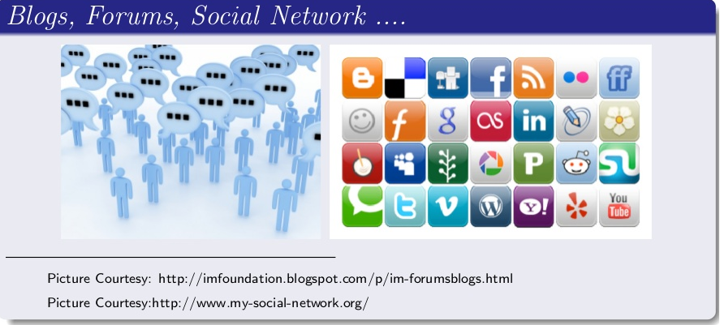
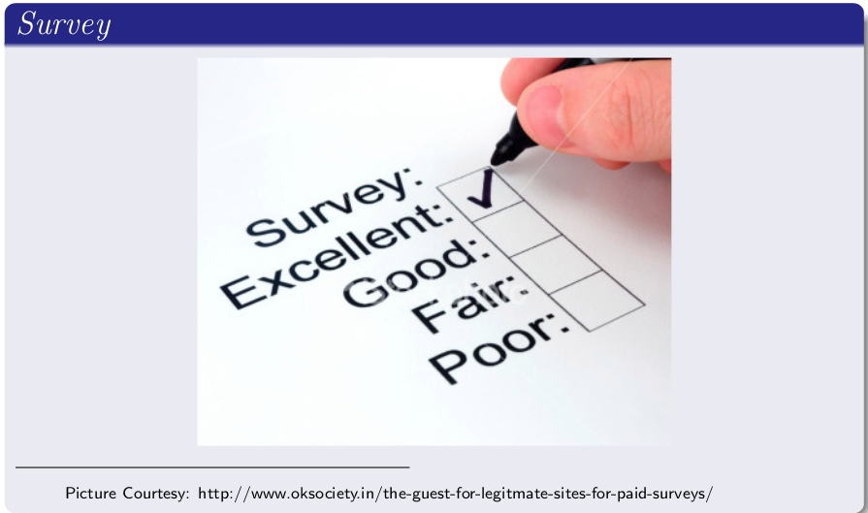

Data Sources
Tech Reviews

Slide 5
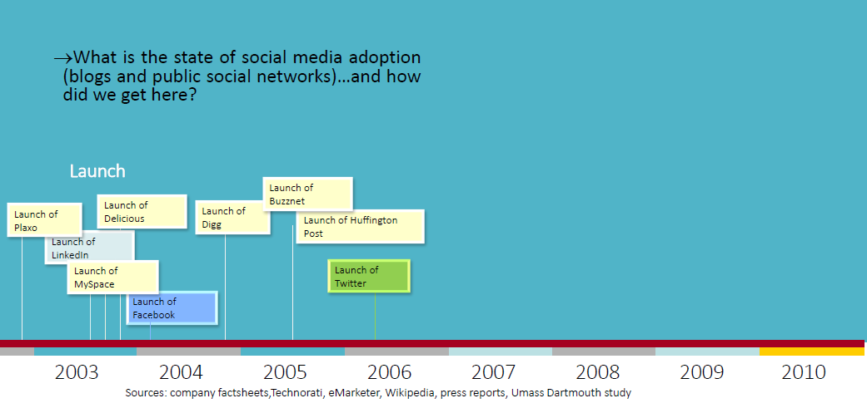
Social Media Adoption

Slide 6
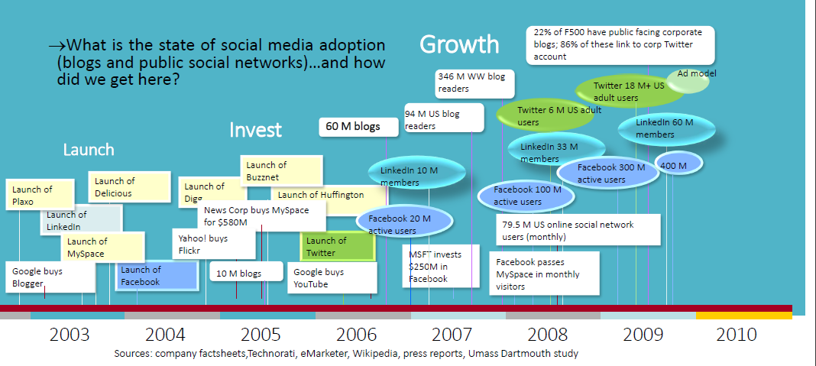
Social Media Adoption

Slide 7
Data Collection Metrics
S.No | Feature | Twitter | Amazon | Blogs /Tech Reviews | TOTAL
1 | BOLT VOX | 32 | 126 | 400 | 526
2 | HYDRA UI | 3 | 222 | 165 | 390
3 | PREDICTIONS | 67 | 320 | 305 | 692
4 | COMMERCIAL-SKIP | 132 | 356 | 322 | 810
5 | NETFLIX/YOUTUBE | 88 | 406 | 562 | 1056
6 | BOLT | 168 | 594 | 296 | 1058
 | TOTAL | 458 | 2024 | 2050

Slide 8
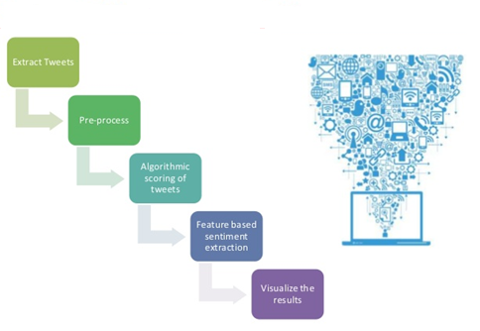
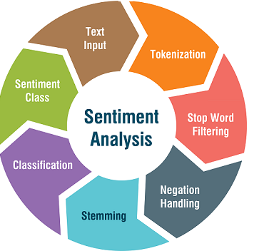
Process and Sentiment Polarity

Slide 9
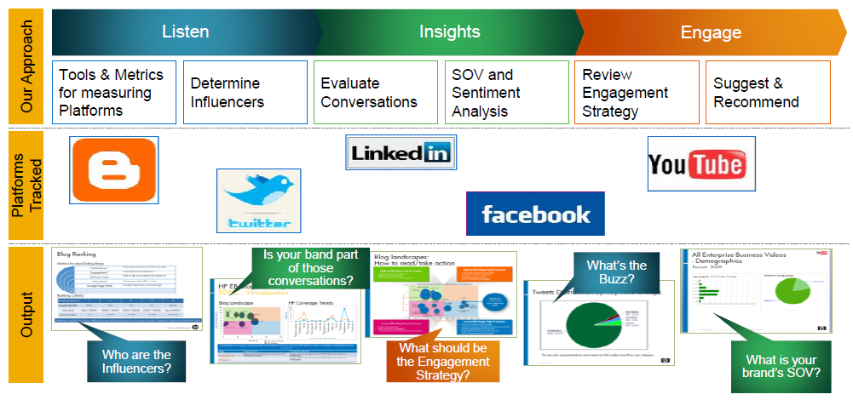
Measurement Framework

Slide 10
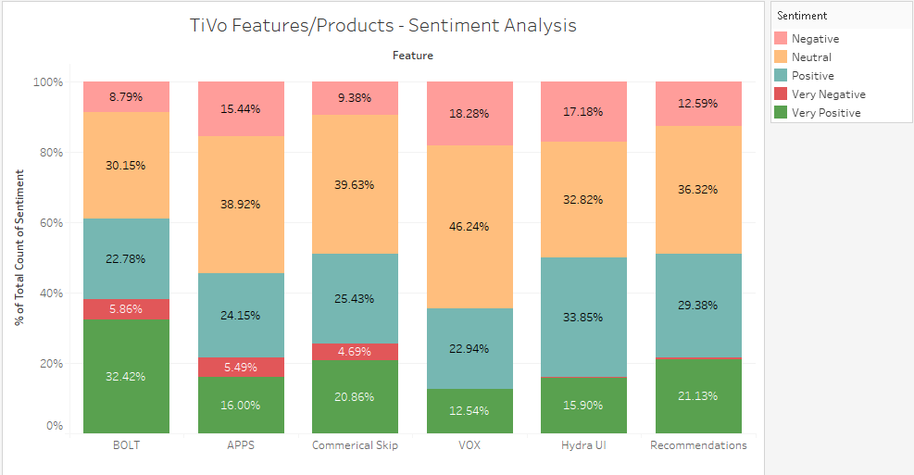
Sentiment Analysis Results

Slide 11
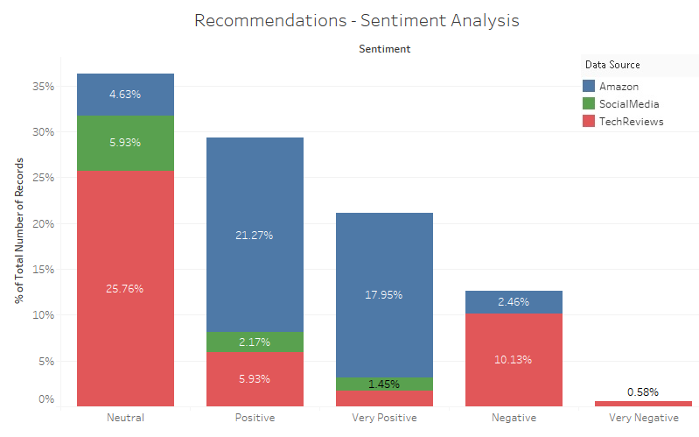
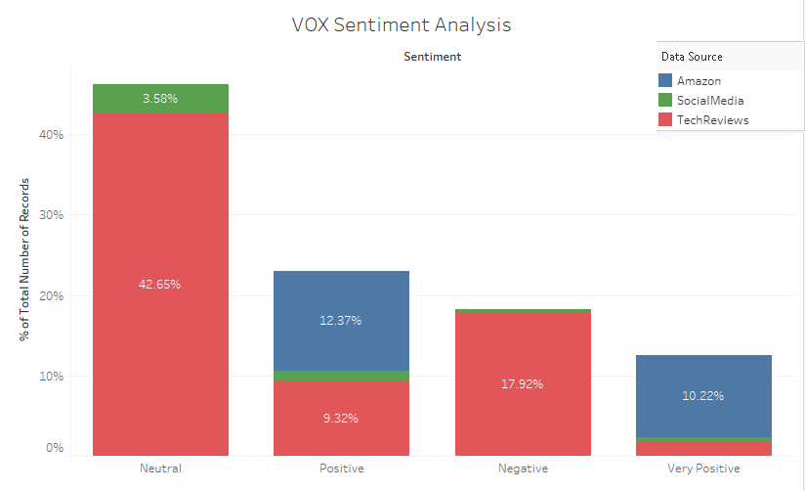
Sentiment Analysis Results

Slide 12
Sentiment Logs
Very Positive
02-12-2017 “Verified Purchase” - Finally something I can talk to that doesn’t talk back
20-11-2017 “Verified Purchase” - Upgraded my Bolt to the new software, love the voice control!!!
14-11-2017 17:15 b"What's your favorite way to #TalkToTheVOX? Get inspired but some of our fans' favorite searches!
11-10-2017 TiVo Bolt VOX dramatically improved my TV experience, Excellent!
Positive
28-10-2017 VR maker TiVo announced its first devices that can be controlled with voice commands Tuesday: The new TiVo BOLT VOX DVR and the TiVo VOX mini companion box both come with a remote control with integrated microphone. The company is considering adding support for third-party voice assistants and hardware as well,
Neutral
29-10-2017 The TiVo VOX Remote can be purchased separately by existing TiVo BOLT, TiVo Roamio and first-generation TiVo Mini customers for $40 in either black or white. The VOX Remote for Roamio products (OTA, Pro and Plus) and first-generation TiVo Mini will be available in black only and will cost approximately $45, including Bluetooth adapter.
Negative
29-10-2017 I am a loyal TiVo user for the past 10+ years, so I was looking forward to this new VOX remote. Unfortunately, The VOX remote is a step backwards. My old slide pro remote was a learning remote and I was able to program it to turn ON/OFF BOTH the TV and the AV receiver. I CAN\'T DO THATt with the VOX remote at the same time. Also, to skip the Ads (which is a GREAT feature), on the old slide remote pro, I push on the D button and it skips. You can do that on a VOX remote, but to use your voice, you have to push Voice and then speak "Skip", so two steps on the new VOX remote- push button and speak, while one step on the old slide remote- push D.

Slide 13
Challenges/Limitations
Data Specific Limitations
Infrastructure issues specially to download Twitter in continuous time were seen, for example any Twitter handle provides latest 3200 tweets for free.
Noisy Data from Blogs/Review websites, for example lots of invalid fields.
Missing fields, for example – facebook data miss the date info of like/comments.
Sentiment very likely changes over time according to a person’s mood, world events, and so forth, it’s usually important to look at data from the standpoint of time.
Technological Limitations
Entity level vs Article level sentiment.
Can’t identify the root cause of the review.
Language Specific Limitations
Words have different meaning, for example spanish, however python packages available for language specific Text means.
Context matters, for example sarcasm“Oh, yeah, Fast Food Restaurant. I just LOVE the 30 minute wait for my food.”, however can be addressed by sentiment solver.s

Slide 14
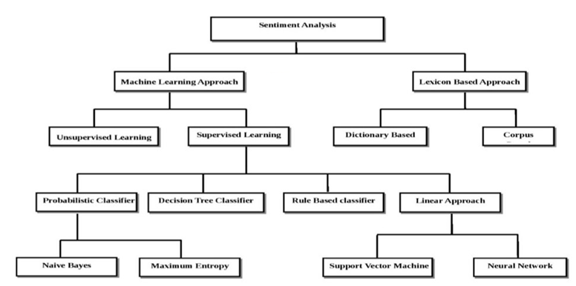
Alternate Approaches and Algorithms

Slide 15
Tools and Techniques
Data Collection
Google scraper for URLs.
Web scraping for website Text extraction.
Tweepy for Tweets, Graphlib for Facebook.
Data Clean up
Identification of invalid strings/fields.
Removal of unnecessary visible text.
Text Mining
Preprocessing steps.
Sentiment Scoring
Textblob for calculating Sentiment polarity.
Visualization
Kibana, Elastic Search.
**** All codes are developed in Python.

Slide 16
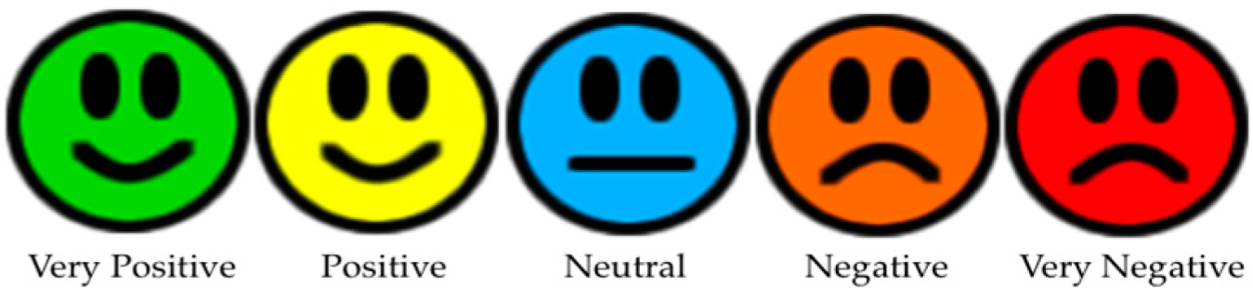
Conclusion
While we couldn’t cover all of the limitations, however Developed a Sentiment Analysis tool that can judge the type of sentiment present in Social media/Technical reviews/Blogs/Community Data. Sentiment levels like these can be achieved.
Social Media Campaign to be improved, for example reviews can be engaged in Twitter, Facebook, Youtube ..etc.

Slide 17
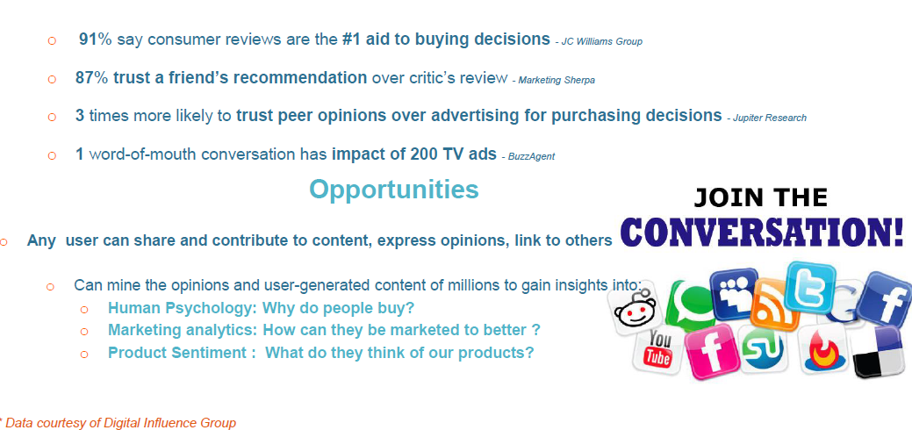
Recommendation - Social Media Influences People

Slide 18
Recommendations/ Future Enhancements
As a business solution following decisions are viable
Revenue Growth
Customer Churn Analysis - Converting Neutral or Negative customers to Elite customers.
Take data driven decisions using customer wishlist features/products.
Create and review Interactive Dash Boards – Manager/ Sales/ Product Life cycle.
Spot industry trends: Track social media mentions to identify news and events in industries of interest.
Gather competitive intelligence: Track social media mentions for top competitors by simply adding competitors brands in the keywords – “Skip Mode vs AutoHop”.
Identify own brand's influencers and promoters: by tracking those on social media who are usually associated with a positive sentiment for your brand.
Predict Customer Sentiments – Pre/Post Sw updates/New features/Products.

Slide 19

THANK YOU for Your Time and Attention

