Slide 1

Sentiment Analysis on “The Godfather” movie reviews
Shanmukha Srivathsav Satujoda
NetID : ss3203
Data Wrangling and Husbandry, Spring 2019

Slide 2
Presentation Layout
Introduction
Data gathering
Data preparation
Visualizations
Sentiment Analysis
Comparison
Conclusion

Slide 3
Introduction and Objective
The theme of this project is to come up with a sentiment analysis on the user reviews of the very famous “The Godfather” movie.
Showcase various wrangling techniques with focus on scraping, preprocessing and sentiment analysis.

Slide 4
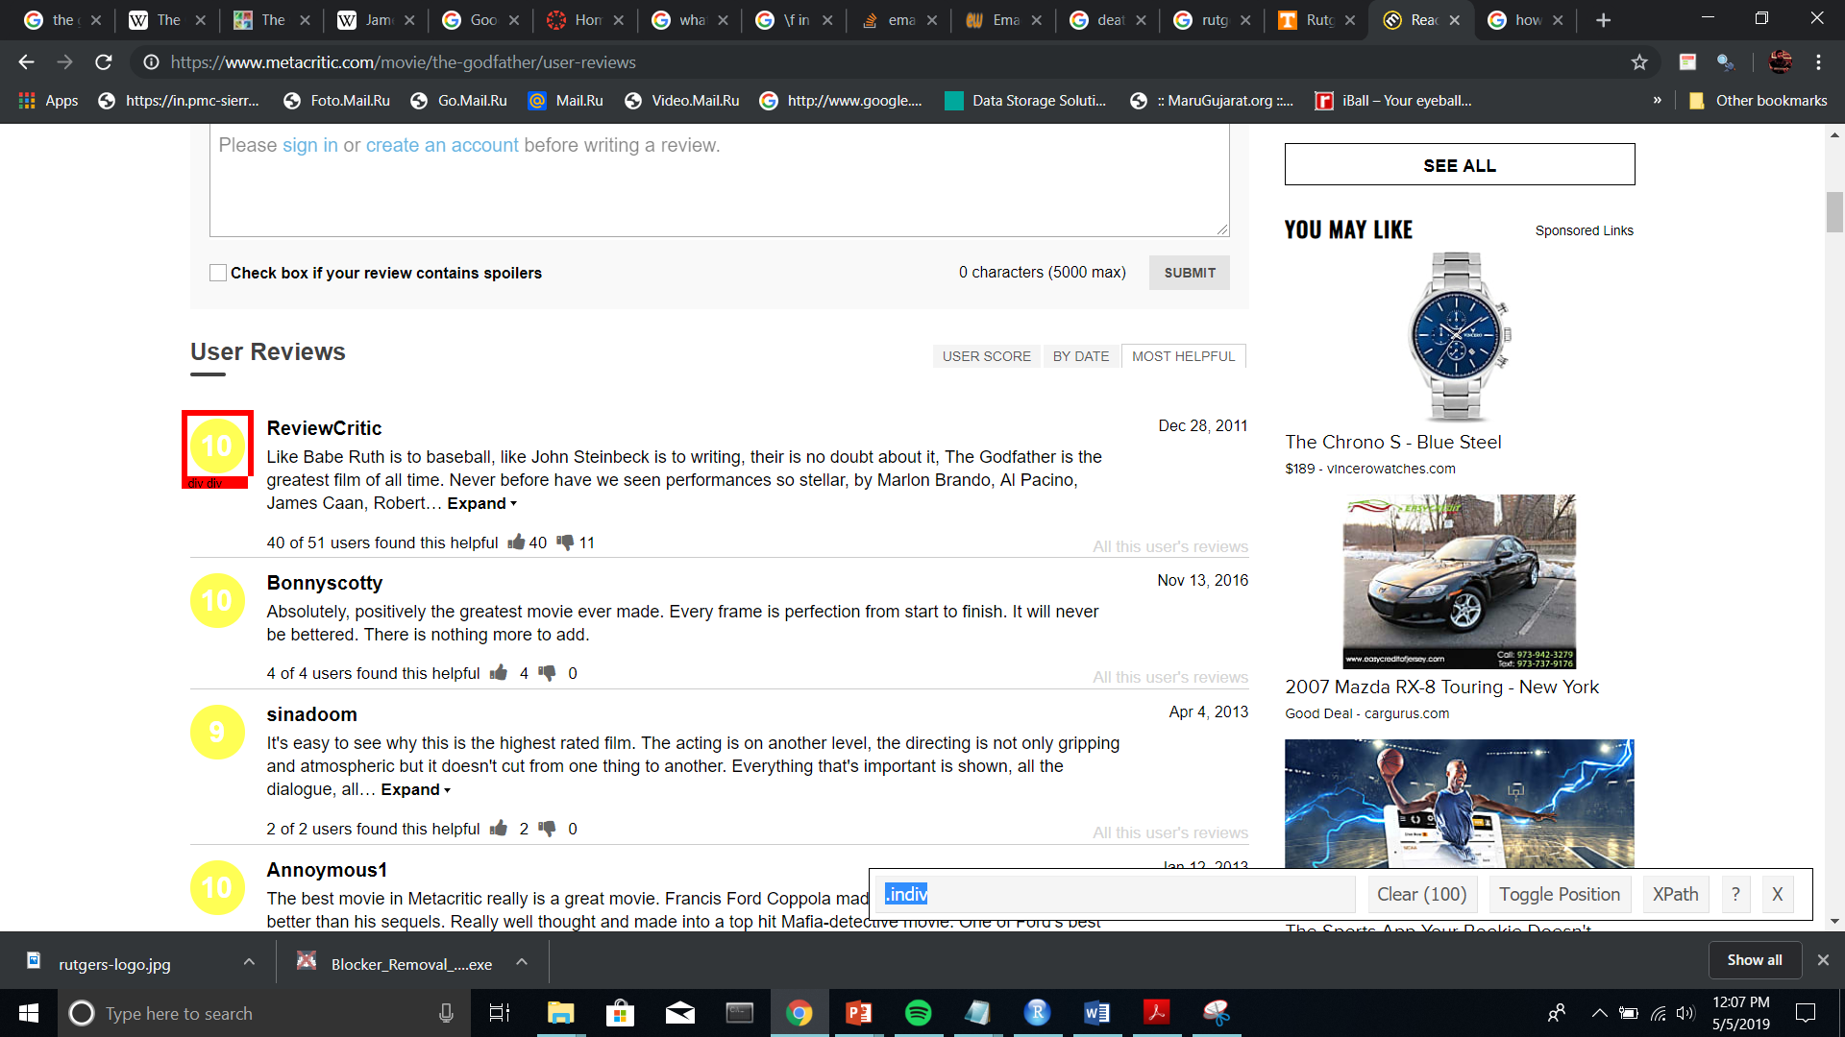
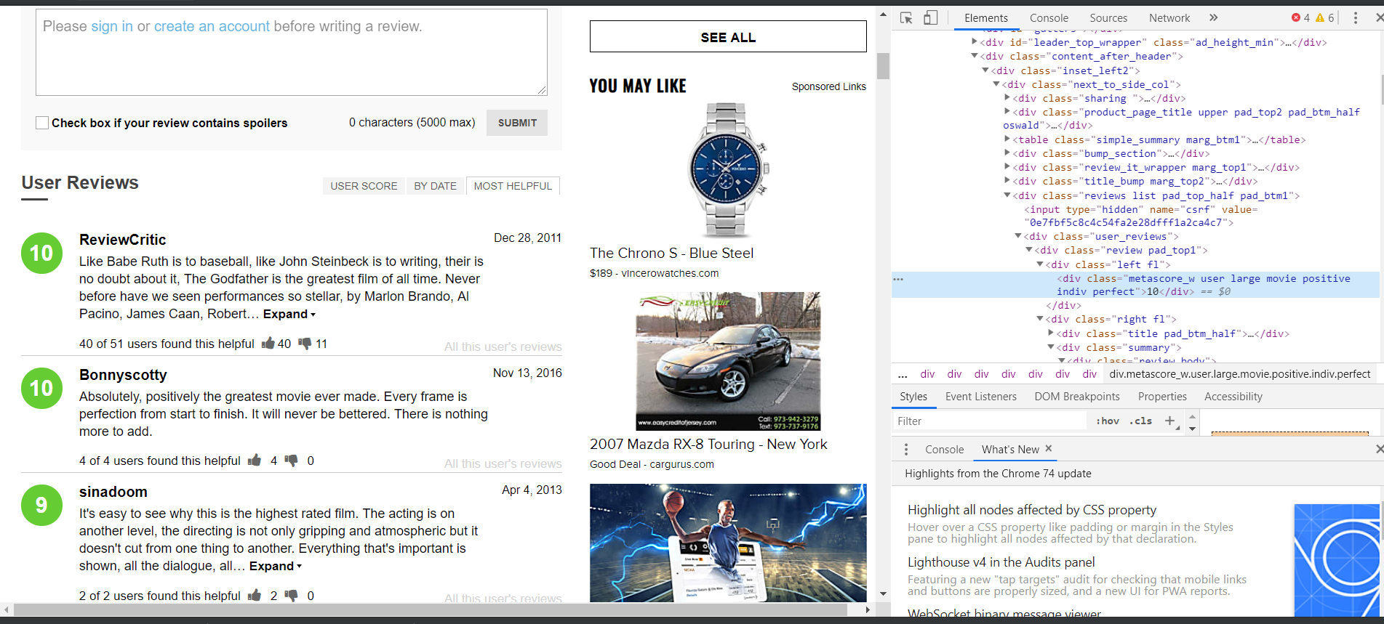
Data Gathering

Slide 5
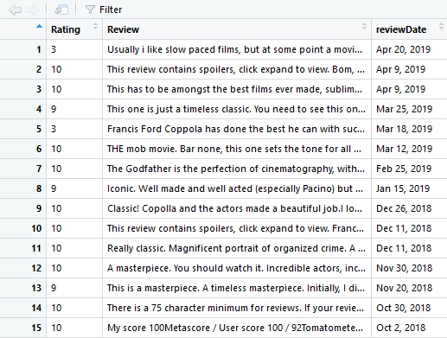
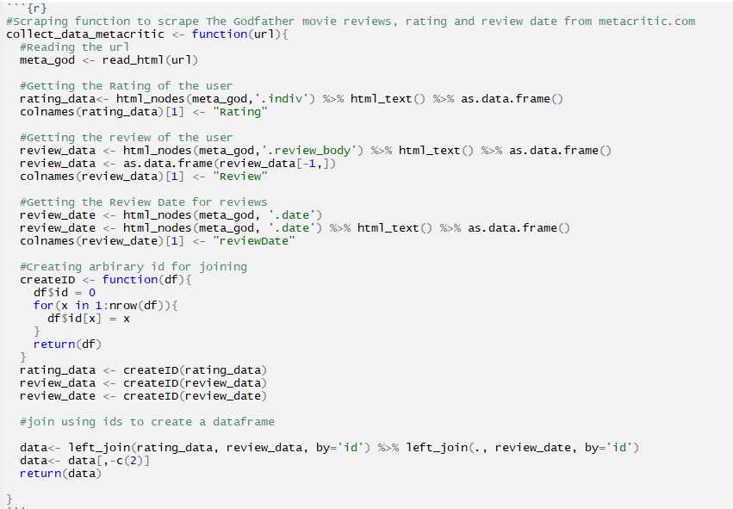
Data Gathering Cntd.

Slide 6
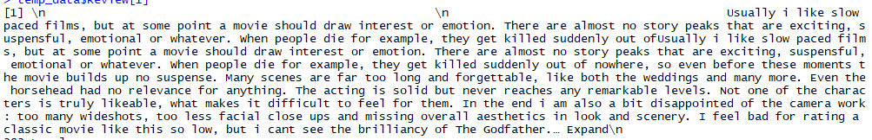
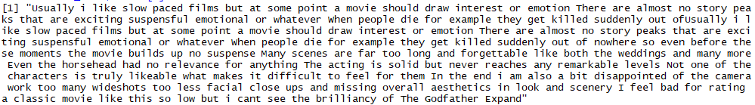
Data Preparation

Slide 7
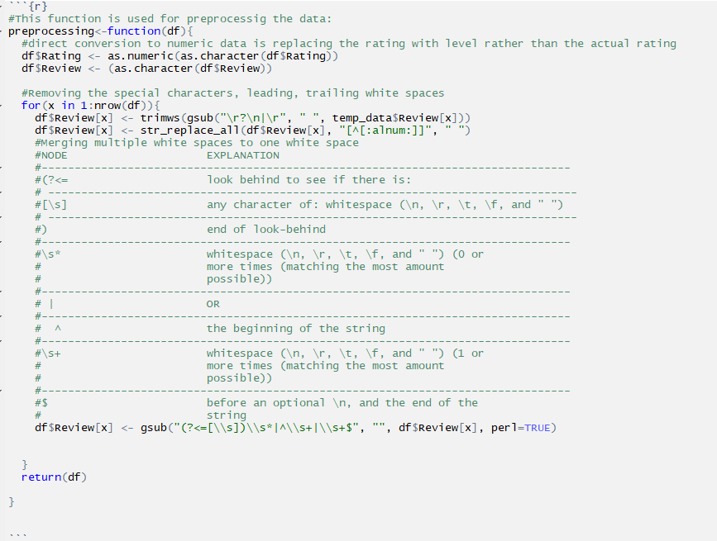
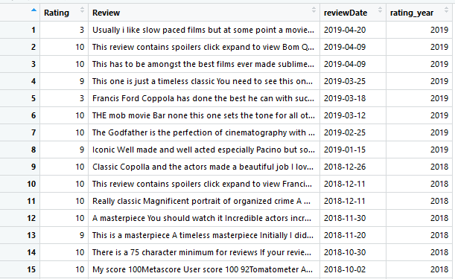
Data Preparation Cntd.

Slide 8
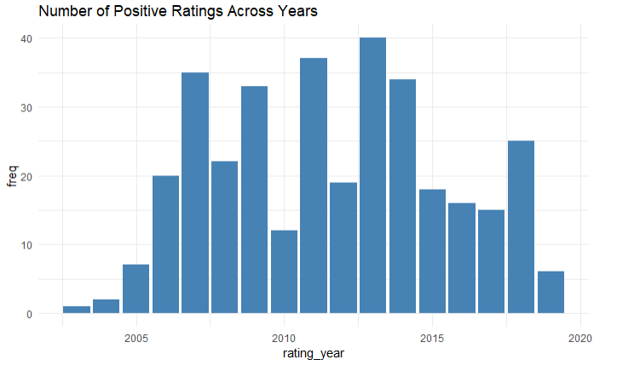
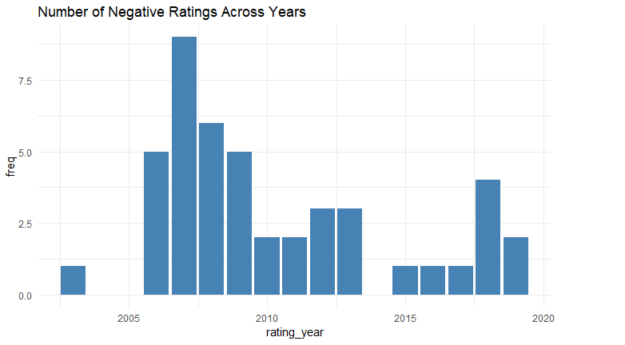
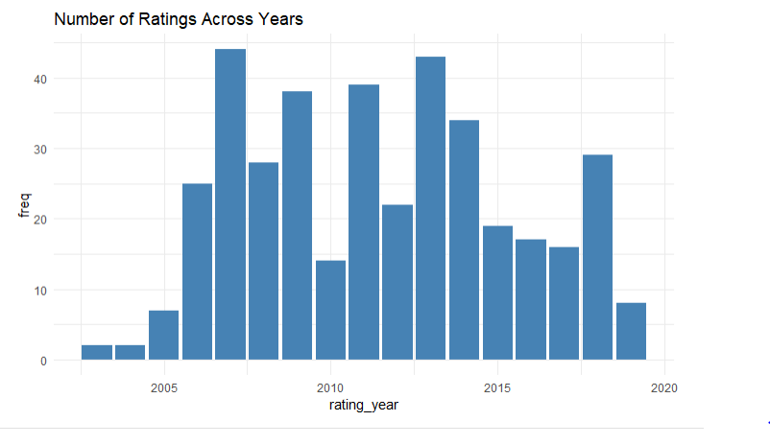
Visualizations
Grouping by year
Summarizing by frequency

Slide 9

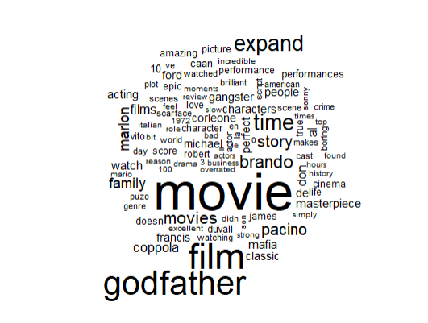
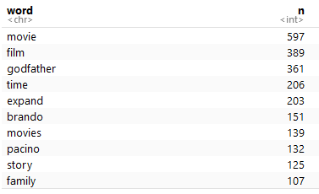
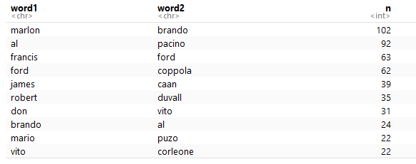
Visualizations Cntd.
Word Cloud
Monograms
Bigrams

Slide 10
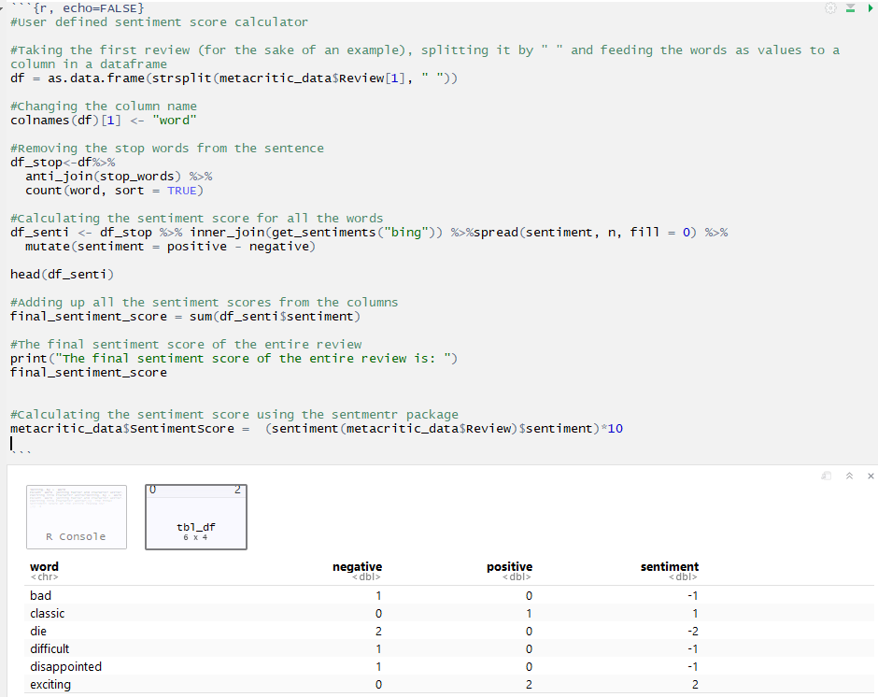
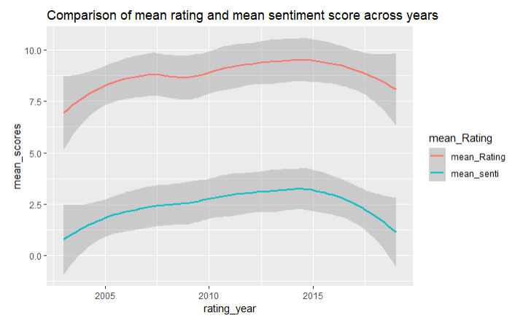
Sentiment Analysis

Slide 11
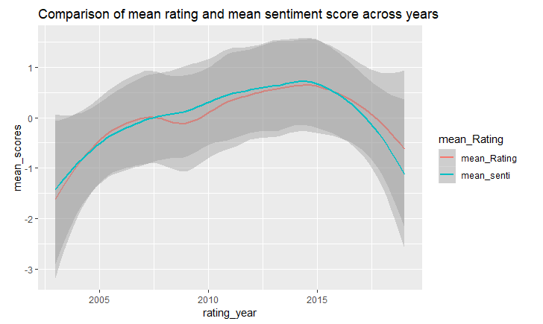
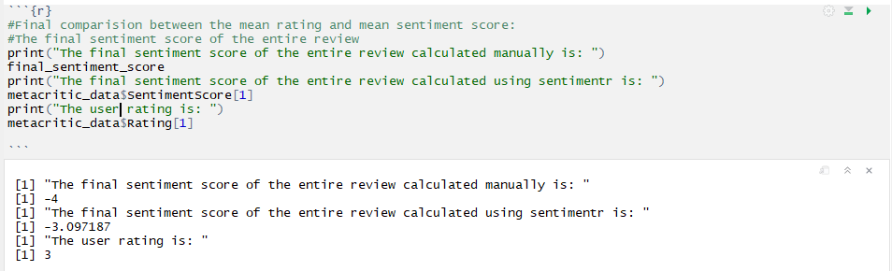
Sentiment Analysis Cntd.

Slide 12
List of concepts used
Pipes
Creating functions for reusability
Scraping
Regular expressions
Joins & Bindings
Grouping by
Summarizing & Aggregating
Tidyverse-unnesting
Tokenizing
Mutates
Gather
Visualizations using ggplot
Word clouds
Monograms & Bigrams
Getting sentiment scores
Sentiment analysis

Slide 13

Thank You

