Slide 1
Dual Tree Complex Wavelet Transform
By
Srivatsa Sarang
140907606
43

Slide 2
Introduction
This algorithm is used in image compression as it has two important characteristics.They are
Shift invariance
Directional selectivity

Slide 3
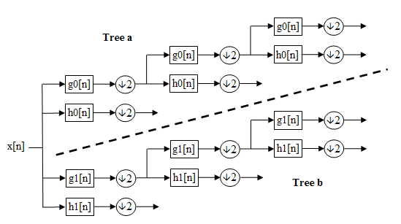

Filter tree structure
The six sub-bands produced after filtering are

Slide 4
Filter tree structure
The image is passed through low pass and high pass filter.Then the image is downsampled by 2 .Then the downsampled image undergoes the same process 2 more times.
The rows are initially filtered.Then they are downsampled by 2 which means that rows are divided into 2 halves.Then the columns are filtered through the filters.After that,they are downsampled.
We obtain 4 different sub images of the original image having 4 different frequency ranges.

Slide 5
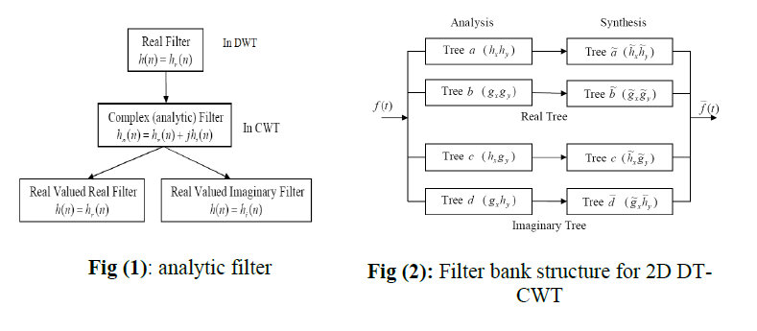
Filter
Hilbert transform pairs are used.

Slide 6
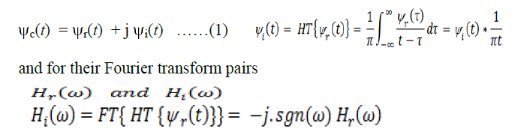
Filter

Slide 7
Image compression
Wavelet transform is used.
Provides information about the signal which allows the data to be compressed by standard entropy coding techniques such as Huffman coding.

Slide 8
Huffman coding
Used for lossless data compression .
Higher probability symbols are assigned with short strings of bits and lower probability symbols are assigned with long strings of bits.

Slide 9
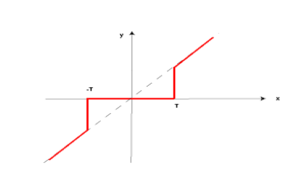
Thresholding
Hard threshold function is used.
Thresholding function
Removes noise by thresholding the wavelet coefficients into the detailed sub band only while keeping low resolution coefficients unaltered.

Slide 10
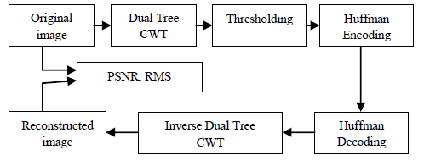
Compression algorithm
Block diagram of compression algorithm using DT-CWT.

Slide 11
Compression algorithm
Steps
Read the source image
Decompose the image into wavelet coefficients using DT-CWT.
Modify the coefficients using thresholding.
Apply Huffman encoding to compress.

Slide 12
Application
Image Denoising
Volume Denoising.
Directional Selectivity in 3D.

