Slide 1
Spatiotemporal Digital Twins for Predictive Disaster Intelligence
Student Details: Indla Sai Sneha(2362080)
Srivatsalya Bhavaraju (2362052)
Jonathan S Pulickal (2362092) Anurag Reddy Thumma(2362036)
Guided By: Dr. Manjunatha Swamy C

Slide 2
Agenda
Abstract
Problem Statement and Objectives
Literature Review/ Background Study
Hardware and Software Requirements
Timeline
References

Slide 3
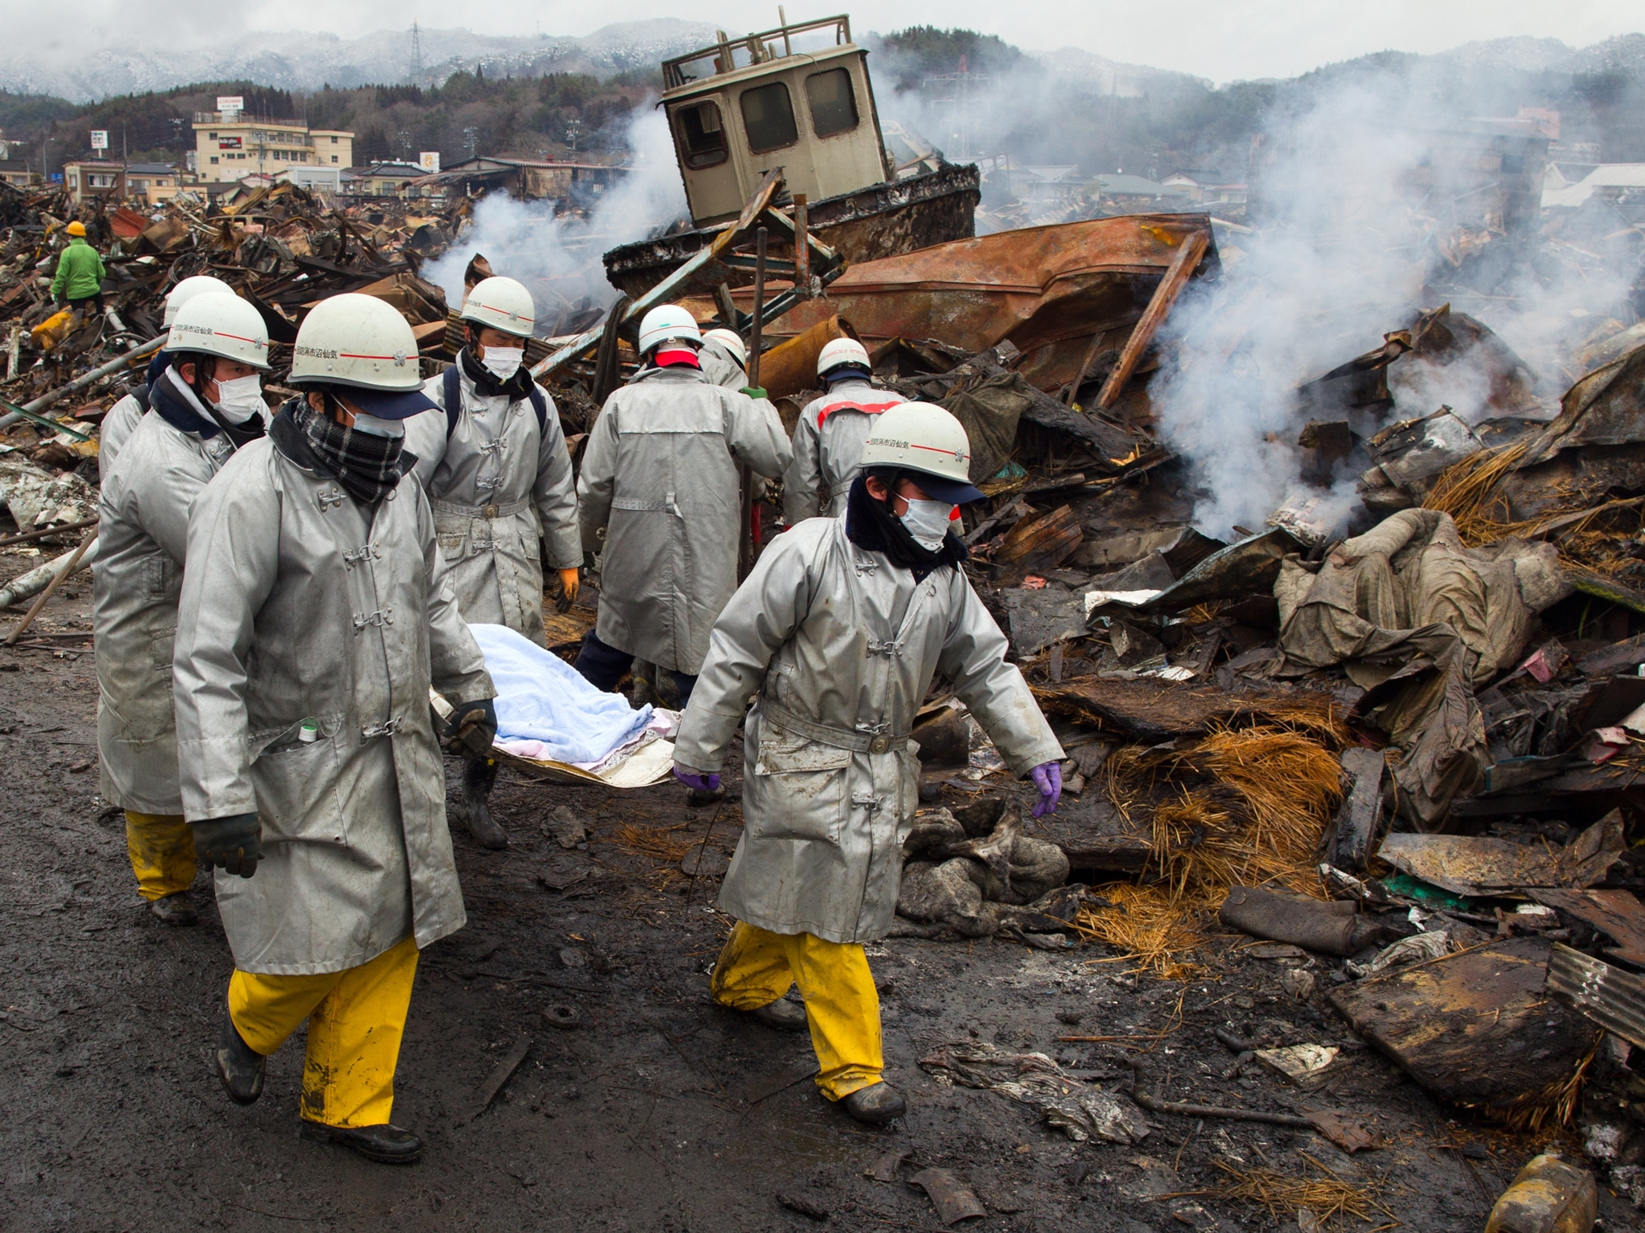
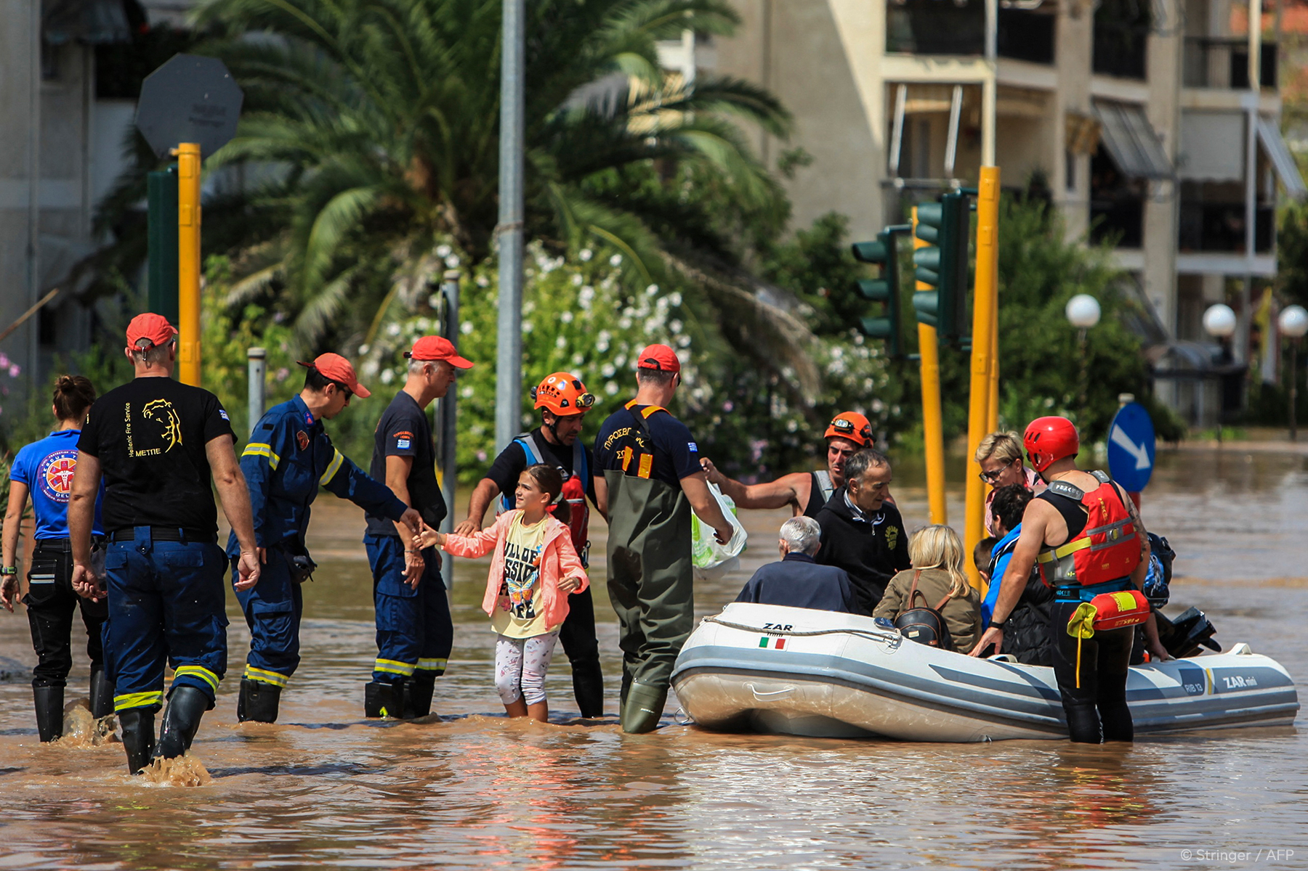
Abstract
During natural disasters, traditional emergency response operations are reactive, mapping structural damage only after it occurs.
This lag creates critical logistical bottlenecks, including supply shortages and misallocated relief teams.
Our project proposes a retrospective, replay-driven Spatiotemporal Digital Twin designed for Indian urban flooding scenarios.
The framework fuses open-source geospatial infrastructure networks with regional, code-mixed social media distress signals.
A vulnerability-aware optimization engine ensures that resource allocation is equitable and does not penalize under-reporting areas.
Validated via a three-way ablation study to quantify the fused pipeline's performance gain.
Courtesy: Google

Slide 4
Problem Statement
Traditional disaster management systems rely on fragmented, reactive data, creating severe resource allocation delays. Furthermore, optimization engines rely heavily on English-centric social media data, which systematically under-serves marginalized, low-connectivity populations who lack smartphone access or speak regional languages, leading to biased and inequitable disaster relief operations.

Slide 5
Objectives
Objective 1: To develop an integrated, retrospective spatiotemporal simulation engine that replays historical, timestamped urban flood data to model dynamic ground realities.
Objective 2: To implement a multilingual and code-mixed NLP pipeline (using IndicBERT/MuRIL) capable of geoparsing local-language distress signals in an Indian urban context.
Objective 3: To construct an interdependent infrastructure risk graph using OpenStreetMap to model cascading structural failures via Graph Neural Networks (GNNs).
Objective 4: To engineer an equity-constrained resource allocation optimizer using demographic vulnerability index data (Census 2011) to balance response times fairly across high and low reporting zones.

Slide 6
Literature Review / Background Study
Total papers referred: 19
Categorized into:
Survey/Review papers (6): Broad reviews of ML, DL, GNN, and spatiotemporal forecasting techniques
Core technical papers (9): Propose specific models — ConvLSTM, Graph VAE, ST-GNN, uncertainty-aware GNN, etc.
Domain-application papers (4): Apply AI/graph methods to related domains — IoT early warning, vehicle crash prediction, LLMs, infrastructure reliability
Among these, 3 papers were identified as most relevant to our project based on direct alignment with disaster prediction and spatiotemporal graph modeling

Slide 7
Literature Review / Background Study
Existing Systems and Landscape
Commercial Systems (One Concern, ArcGIS): Existing tools use physics-informed GNNs or enterprise dashboards to model asset downtime and map live shelter status. However, these are enterprise-priced, closed-source, and assume high-fidelity local sensory networks.
Crisis Informatics Frameworks: Standard pipelines extract geolocation data from English-language social media benchmarks (e.g., CrisisNLP), but fail to address regional language variations or the systemic biases of social-media-driven data.
GNN Cascade Modelling: Most academic models treat structural network failures as a static, one-shot classification task, ignoring the temporal propagation of cascading failures across multiple connected domains.

Slide 8
Literature Review / Background Study
Addressing the Gaps
Zero-Budget Reproducibility: Unlike closed commercial systems, this project operates completely on free, open public data sources (IMD, OSM, Census).
Regional Language Inclusivity: The pipeline addresses the English-only dataset bias by fine-tuning multilingual models on local, code-mixed text data.
Equity-Driven Allocation: While traditional models optimize solely for raw speed or demand volume, this framework introduces a precomputed vulnerability index constraint so under-reporting neighborhoods are not overlooked.

Slide 9
Literature Review / Background Study
Paper | Year & Method | Research Gap | How Our Project Fills It
#1 — Spatial and Temporal Patterns for Disaster Prediction Using the Global Disaster Dataset | 2025, ConvLSTM/LSTM/GNN on EM-DAT | No real-time data integration, no climate-change factoring, no regional adaptability | Our model incorporates real-time/streaming data feeds and region-specific graph structures to adapt predictions locally, closing the adaptability gap
#16 — Dynamic Crisis Propagation Modeling using ST-GNN | 2025, Grasshopper-Optimized ST-GNN | Heavily dependent on geotagged social media data, limiting reliability and coverage | Our project reduces this dependency by fusing multiple spatiotemporal data sources (not just social media) for more robust crisis propagation modeling
#19 — GraphVSSM for Disaster Resilience Assessment | 2025, Graph State Space Model | Computationally expensive and region-specific, limiting scalability | Our project targets a more computationally efficient graph representation approach that generalizes across regions, rather than being tuned to one

Slide 10
Hardware Requirements
Processor: Intel Core i5/i7 (8th Gen or above) or AMD Ryzen 5/7 equivalent CPU.
Memory: Minimum 16 GB RAM for handling large geospatial spatial joins and graph calculations.
Storage: 512 GB Solid State Drive (SSD) for fast file caching and local dataset processing.
Compute Acceleration: Cloud-based NVIDIA T4 or A100 GPU (accessed via free-tier Google Colab or Kaggle Notebooks) for GNN and transformer model fine-tuning.

Slide 11
Software Requirements
Operating System: Windows 11 / Linux (Ubuntu) / macOS.
Programming Environment: Python 3.11 runtime environment.
Geospatial & Graph Libraries: pandas, geopandas, osmnx, and NetworkX.
Machine Learning Stack: PyTorch and PyTorch Geometric (for GraphSAGE/GAT modeling).
NLP & Geoparsing Toolkits: HuggingFace Transformers (IndicBERT/MuRIL) and spaCy.
Optimization Frameworks: Google OR-Tools or PuLP.
Dashboard & Backend: Streamlit, Folium, FastAPI, and SQLite/DuckDB.

Slide 12
Timeline
Phase 1 – Project Foundation (Completed)
Objectives
Reviewed existing flood management and AI-based disaster response systems.
Identified research gaps and opportunities for implementation novelty.
Finalized the overall project methodology and system workflow.
Work Completed
Conducted a comprehensive literature survey to understand current approaches.
Defined the project novelty by integrating NLP, Graph Neural Networks, and optimization into a unified disaster response framework.
Explored publicly available datasets (IMD, CWC, Census, OpenStreetMap, etc.) as potential data sources; dataset selection is still under evaluation.
Designed the phase-wise implementation plan and system architecture for subsequent development.
Outcome
A clear implementation roadmap, identified research gaps, preliminary dataset exploration, and a finalized methodology for project execution.

Slide 13
Timeline
Phase 2: NLP & Geoparsing
Finalize relevant datasets and preprocess multilingual distress data.
Fine-tune the transformer model for distress classification.
Map extracted information to geographical coordinates.
Phase 3: GNN & Replay
Build the infrastructure graph from spatial data.
Train the GraphSAGE model to simulate cascading failures.
Develop the asynchronous time-stepped replay framework.
Phase 4: Fusion & Validation
Combine distress, infrastructure, and vulnerability indicators into a unified index.
Evaluate model performance using ablation studies.
Validate the effectiveness of the integrated framework.
Phase 5: Optimization & Dashboard
Develop the equity-aware resource allocation algorithm.
Build the Streamlit dashboard for visualization and monitoring.
Complete testing, documentation, and the final project report.

Slide 14
References
[1] X. Author, "Spatial and Temporal Patterns for Disaster Prediction Using the Global Disaster Dataset," Journal of Disaster Prediction, vol. 11, no. 2, pp. 45–58, 2025.
[2] Y. Author, "Learning to Reconstruct Missing Data from Spatiotemporal Graphs with Sparse Observations," IEEE Transactions on Knowledge and Data Engineering, vol. 34, no. 8, pp. 1102–1115, 2022.
[3] Z. Author, "Early Natural Disaster Prediction Using Machine Learning: A Comprehensive Review," Environmental Monitoring and Assessment, vol. 197, no. 3, pp. 215–230, 2025.
[4] W. Author, "Survey of Spatio-Temporal Graph Neural Networks," ACM Computing Surveys, vol. 56, no. 4, pp. 89–104, 2024.
[5] V. Author, "AI-Driven Disaster Prediction and Early Warning Systems," Disaster Management and Prevention, vol. 18, no. 1, pp. 67–82, 2024.
[6] U. Author, "ST-GraphNet for Automated Vehicle Crash Severity Prediction," IEEE Transactions on Intelligent Transportation Systems, vol. 26, no. 2, pp. 340–355, 2025.

Slide 15
References
[7] T. Author, "GraphCSVAE for Physical Vulnerability Assessment," Remote Sensing and Spatial Analytics, vol. 17, no. 5, pp. 512–527, 2025.
[8] S. Author, "Survey on Temporal Interaction Graph Representation Learning," IEEE Transactions on Pattern Analysis and Machine Intelligence, vol. 47, no. 6, pp. 1420–1435, 2025.
[9] R. Author, "UQGNN: Uncertainty Quantification for Spatiotemporal Prediction," International Journal of Forecasting, vol. 41, no. 1, pp. 98–112, 2025.
[10] Q. Author, "GNNs for Infrastructure Reliability and Resilience," Reliability Engineering & System Safety, vol. 242, p. 109720, 2025.
[11] P. Author, "Adversarial Spatiotemporal Graph Learning (MinGRE)," in Proceedings of the International Conference on Machine Learning (ICML), 2025, pp. 1430–1445.
[12] O. Author, "CC-GRMAS: Multi-Agent Graph Neural System for Landslide Risk," Computers & Geosciences, vol. 184, p. 105510, 2025.

Slide 16
Q/A?

Slide 17
THANK YOU!

