Slide 1

TEAM 9
Patrick Moy (1841305) | Siddharth Sheth (2076180) | Srivatsav Gopalakrishnan (2075414)
Notes:
Hi everyone, this is Patrick, Siddharth, and Srivatsav, and we are Team 9. And our incredibly original, not-derivative-in-any-way app is called Mapbook.

Slide 2
What is mapbook?
Social network-esque map webapp
Where to eat? Where to go?
Mark and categorize places of interest
Network users can view places
Notes:
In the process of deciding on a database project, we got a bit of an idea inspired from current events. As the pandemic continues in the US, I’m sure a lot of us want to go out and see things and do things — kind of getting tired of being inside. It occurred to us that quite a few of us are not from the Washington area, and so, some of us may not necessarily know what are good spots to visit.
Obviously, things like Yelp exist, or Google Maps reviews. But we figured it’d be cooler if you could use ratings of people you know, people who are your friends. And so the idea of mapbook was born.
It’s basically a social network map app, where you can mark places that are interesting to visit and categorize them.
Mapbook is a web application that helps users find places of interest and other people using the application.

Slide 3
Functionalities
1
Authentication
Register / Sign Up
Sign In
2
Search
Find places of interest based on distance/type
3
View Locations and Users
View map markers of locations of interest
View list of info of other users
4
Add place of interest
Add a new place of interest by location
Add info about the new place
5
View profile
View user’s profile and information
6
Edit profile
Edit user’s profile and information
7
Add friend
Add another user as one’s friend
Notes:
So, as we said, the application incorporates the functionalities of a social media platform on a map interface. Like any similar platform, users can register and sign in. Users can then search for user generated places of interest. They can filter these search results by how far a place of interest is from them. The users can further filter places based on type.
So you can look for restaurants near you, parks, banks, gas stations - we have a bunch of basic types.
Users can also add new places of interest - and that’s where the network concept really happens.
Users can also view their own profile and edit attributes like their first name, last name, email, etc.
Users can also add other users as friends. We were thinking that it would be good to view only places of interest for your friends, as a good feature to add down the line.

Slide 4
Languages, Frameworks and Database used
React.js & Google maps API
Node.js & Express
PostgreSQL on AWS RDS.
Notes:
Our frontend is implemented using React.js. We used Node and Express to develop our backend server and communicate with our database. Our database is a PostgreSQL instance running on Amazon Web Services on their RDS (Relational Database Service).

Slide 5
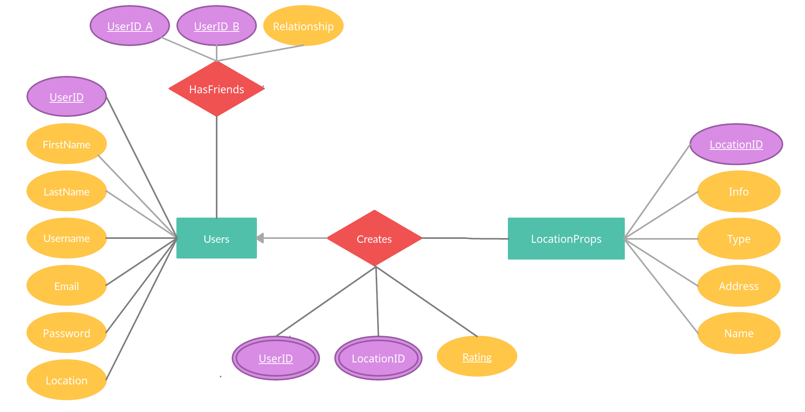
Backend design - 1 : ER Diagram
Notes:
Here is our basic ER diagram.
As you can see, Users have several attributes, such as name, username, etc. Users can have friends - this is a relationship between two Users, in which we keep track of user A and user B, as well as their relationship type. We have incorporated the concept of a “friend” at the moment. However, this can be further extended to other relationships such as spouse, parent, etc or even the ability to block a user.
Users can create places of interest which is stored in the LocationProperties table by providing type, info, address, name, latitude and longitude,etc. These locations are then visible to all other users on the app.
Once a place of interest is added,it is linked to the user in a many to one relationship. The relationship between a user and their places of interest is stored in the Locations table.

Slide 6
Backend design - 2 : Schema
USERS
FirstName | VARCHAR(255) NOT NULL
LastName | VARCHAR(255) NOT NULL
Username | VARCHAR(255) NOT NULL UNIQUE
Email | VARCHAR(255) NOT NULL UNIQUE
Password | VARCHAR(255) NOT NULL
Location | POINT
LOCATIONPROPS
LocationID | SERIAL PRIMARY KEY
Name | VARCHAR(255) NOT NULL
Address | VARCHAR(255)
Location | POINT
Type | VARCHAR(255)
Info | VARCHAR(255)
FRIEND
UserID_A | INTEGER NOT NULL
UserID_B | INTEGER NOT NULL
Relationship | VARCHAR(255) NOT NULL, CHECK (UserID_A < UserID_B),
LOCATIONS
UserID | INTEGER NOT NULL
LocationID | INTEGER NOT NULL
Rating | INTEGER NOT NULL, CHECK (Rating >= 0 AND Rating <= 5),
Notes:
This is a snapshot of our schema. We have 4 tables -
Users to store information on the users
LocationProps Stores information on places of interests
Locations Links a user to the places of interest they have added
And Friend Links a user to another user with their relationship
As you can see, we have some arbitrary constraints. For example, We ensure that email and username are unique, we also ensure that ratings for places of interest go from 0 to 5 only.

Slide 7
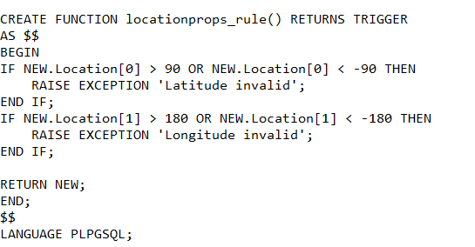
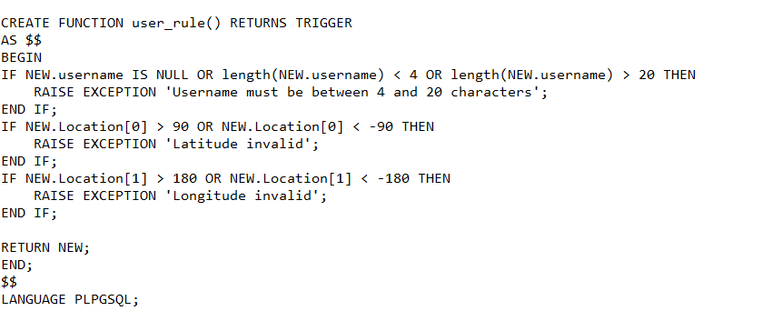
Backend design - 3 : Triggers (PL/SQL)
Notes:
We’ve also added a few triggers to the users table and the locationprops table. These triggers ensure that the fields are valid on an insert. For example, locations are points representing a latitude and longitude and there latitudes can only go from -90 to 90 and longitude from -180 to 180 — if we insert any Location point value that doesn’t fit this rule, the trigger will catch it and raise an exception.

Slide 8
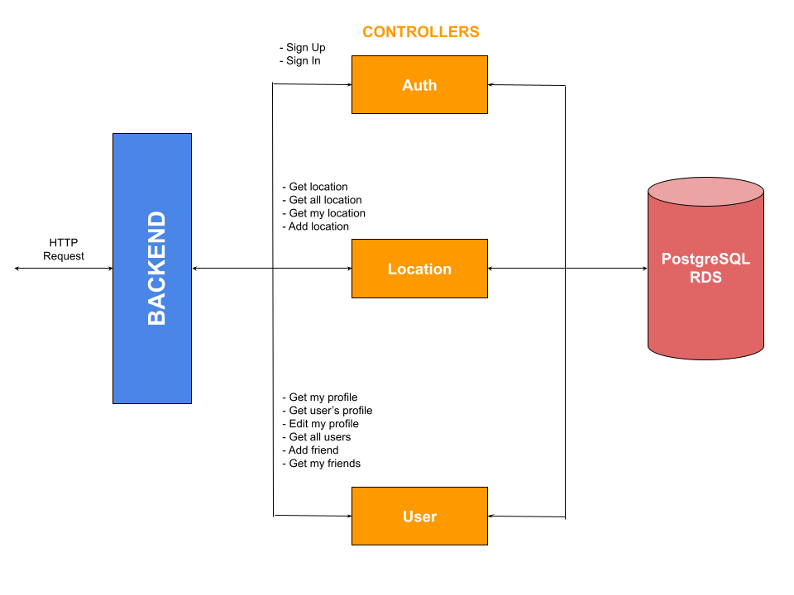
Backend design - 4 : Architecture
Notes:
This is a view of how our backend is designed.
The frontend using React just runs on a browser and sends HTTP requests to the backend.
The backend routes the request to the appropriate controller which then makes a query to our cloud database
We have designed 3 controllers to ensure separation of concerns
The auth controller deals with authentication requests like SignUp and Sign In and primarily deals with the Users table in the database
The Location controller is concerned with requests like getting locations, getting a user’s location, adding a location and getting information about a location. It mostly uses the LocationProps and the locations table.
The third controller is the user controller. It deals with functionalities related to user information and friend. And therefore uses the Users and Friends table.
Finally, the results of the query are returned to the backend, and sent as a response back to the frontend and then interpreted for display.

Slide 9
Demo
Notes:
At this point, my teammate, Siddharth would briefly demonstrate how our app works.

Slide 10
Conclusion
AWS RDS with a SQL DB meshes well with an application like this
Facebook also uses MySQL
Monolithic full stack app
4NF
Notes:
In conclusion, we think that a cloud database with a SQL DB instance works pretty well for an application like this. Fun fact: Facebook uses MySQL for their database.
We have implemented a full stack application with a monolithic architecture that uses React and Node for the frontend and the backend respectively and PostgreSQL as the database.
The 4 relations are normalized to the 4th Normal form

Slide 11
References
Class recordings and slides by Professor
https://docs.aws.amazon.com/elasticbeanstalk/latest/dg/create-deploy-nodejs.rds.html
https://isitoktocode.com/post/display-locations-from-a-database-on-a-map-using-google-maps-javascript-api-and-php
https://developers.google.com/maps/documentation/javascript/mysql-to-maps
https://developers.google.com/maps/documentation/javascript/custom-markers
https://stackoverflow.com/questions/379236/database-design-best-table-structure-for-capturing-the-user-friend-relationship

Slide 12
Q&A

