Slide 1
Multimedia Processing
Mp3 Player using Python
5th Semester Project
Presented By:
Subhadip Maity : 18cse002 : Sec- B
V V Srivatsha : 18cse189 : Sec-A
Satyam Kumar : 18cse025 : Sec-A

Slide 2

Need of this Project:
Audio is an important source of communication and is as important as text in today’s time.
We know that the audio files are digital files.
Therefore, there is a need of a tool to run the digital files or in other words, play the files.
Without this tool or player, we’ll never be able to listen to music, movies or the contents of any audio file.
Thus, we need MP3 players.

Slide 3
It is a device using to play MP3s and other digital audio files.
We can build this by ourselves without have to download and install premium music players.
The Mp3 player GUI project idea attempts to emulate the physical MP3 Player.
This program will allow you to play songs, music, and all MP3 files on your desktop or laptops.
MP3 player using Python is a basic programming application built using the programming language Python.
It is a GUI program built by the means of Python libraries Tkinter, Pygame.

Slide 4
INTRODUCTION:
We need an application that will allow us to play or listen to digital audio files.
The main objective of this project is to allow users to play MP3 and digital audio files.
To be engaging for users, the application has to have a simple but beautiful user interface.
The GUI aspect of the application is built using the Tkinter library of Python.
The interactive part of the application that handles the MP3 files uses the Pygame library.
You can have an interface for listing the available MP3 files.

Slide 5
Problem Description:
To build an MP3 player using Python programming language to be able to play and listen to songs, MP3 files.
Determine the functionalities of the MP3 player.
The player should be have a simple and easy to use GUI with options for various functions, display screen to display the entire playlist and buttons to shut down the player.
The player should be able to play any song. It should be capable of playing MP3 files.
The player should allow the user to browse through the contents of the computer drive to choose song/s to be played or queued.

Slide 6
Problem Description:
It should provide the user with option to pause or resume the song.
The user should be able to play the previous or the next song in the playlist.
The user should be able to increase and decrease the volume.
The user should be able to on and off the Shuffle.
The user should be able to search any song in the playlist.
Lastly, the user should get basic details about the current song.

Slide 7
ALGORITHM
Import the libraries.
Create an object of the tkinter and Pygame libraries.
Create a window using Tkinter object and create a Frame.
Add buttons that provide different functionalities:
Add a song
Play/pause the song
Stop the song
Play previous song
Play next song
Turn on Shuffle
Vol Up & Down

Slide 8
ALGORITHM
Add a song button when pressed should open a dialog box to browse and choose the directory.
Add label to display the song’s information
Display screen will display the details of the entire playlist.
Add a search bar where user can search for the songs in the playlist.
Stop button will stop playing the song.
Close button will automatically clear the song list and will exit.

Slide 9

System analysis:
User Requirements :
User have to open the mp3 player and have to understand the buttons.
First of all add Songs in the mp3 player and automatically songs will start playing.
User have to use different types of buttons to activate and
deactivate functionalities like shuffle, play/pause, stop.
According to the user requirement it must be able to play mp3 files.

Slide 10
System analysis:
Hardware Requirements :
Processor : Intel core (i3,i5,i7,i9)
Display : LCD
Accessories : Mouse
Software Requirements :
Operating System : Microsoft Windows 7 or higher
Application : Jupyter notebook / Spyder
Programming language : python
Framework and Libraries : Tkinter, pygame, PIL, OS.

Slide 11
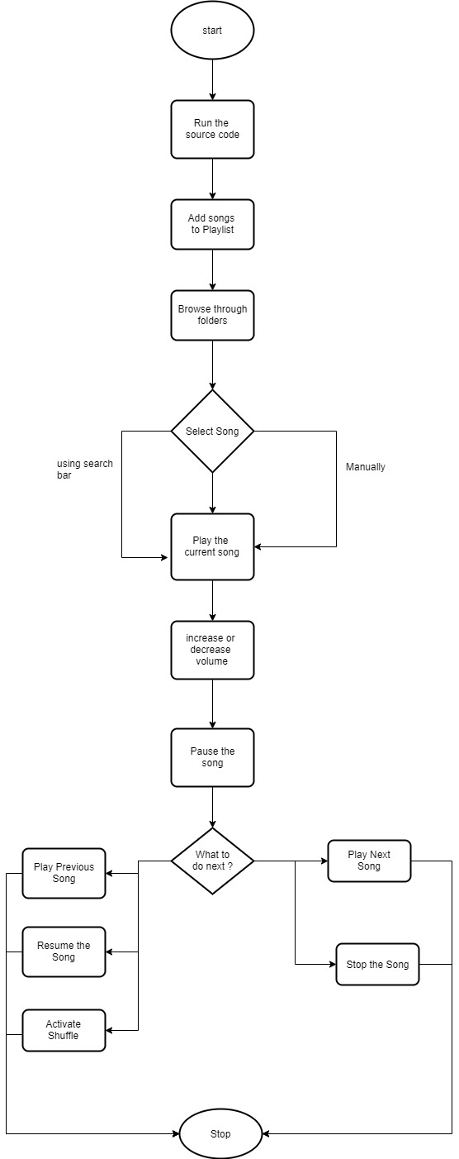
System Design:
HIGH LEVEL DESIGN(HLD) :
Structure Chart:

Slide 12
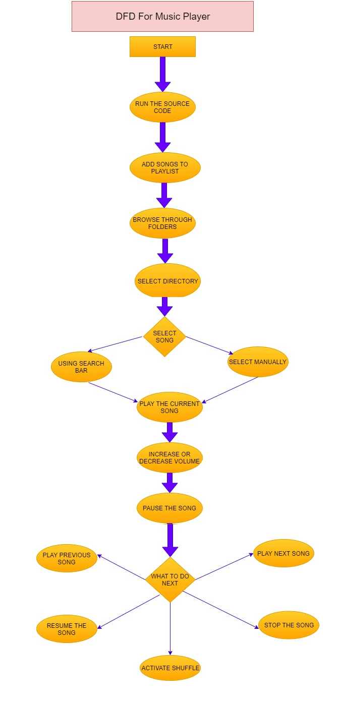
Data Flow Diagram (DFD):

Slide 13
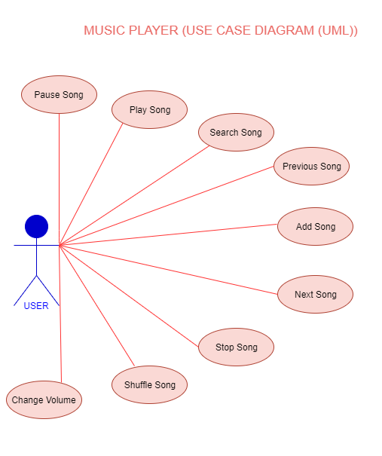
UML (Use Case):

Slide 14
Low level design (hld):
Pseudocode:
Library Required:
Tkinter
Pygame
PIL
OS
Install and Import the required libraries.
Upload songs directory:
dir=askdirectory()
Initialize the operation:
pygame.mixer.init()
Load song :
pygame.mixer.music.load(songslist[index])

Slide 15
Pseudocode:
Play Song :
pygame.mixer.music.play(0)
Pause Song :
pygame.mixer.music.pause()
Unpause Song
pygame.mixer.music.unpause()
Stop Song :
pygame.mixer.music.stop()
Volume change :
pygame.mixer.music.set_volume(vol)

Slide 16

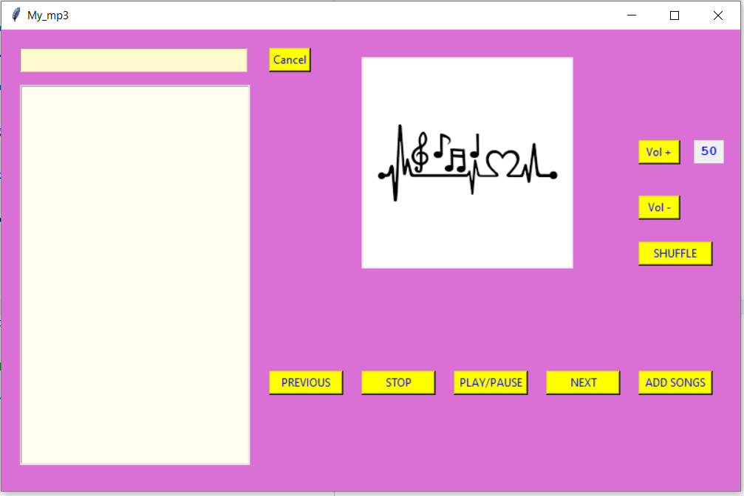
Screenshots:
Home page :

Slide 17
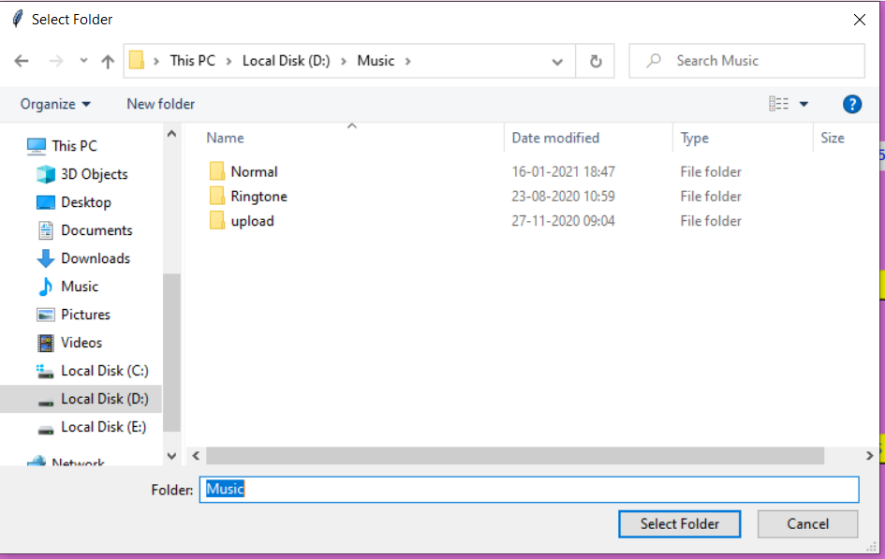
Adding Songs Directory:

Slide 18
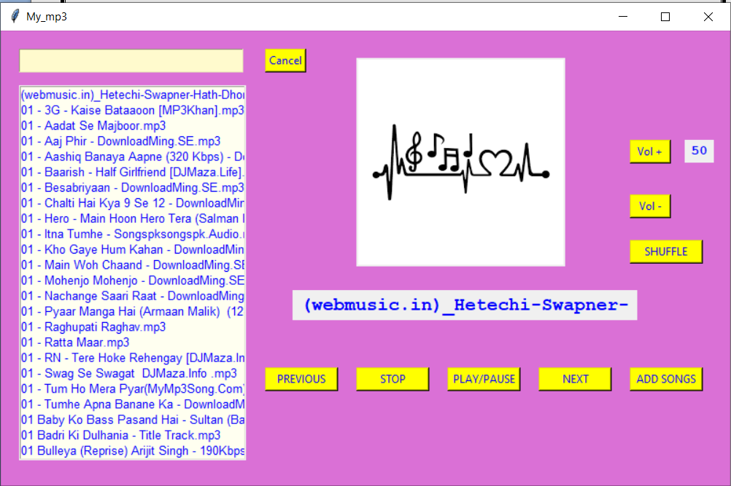
Songs Added and playing:

Slide 19
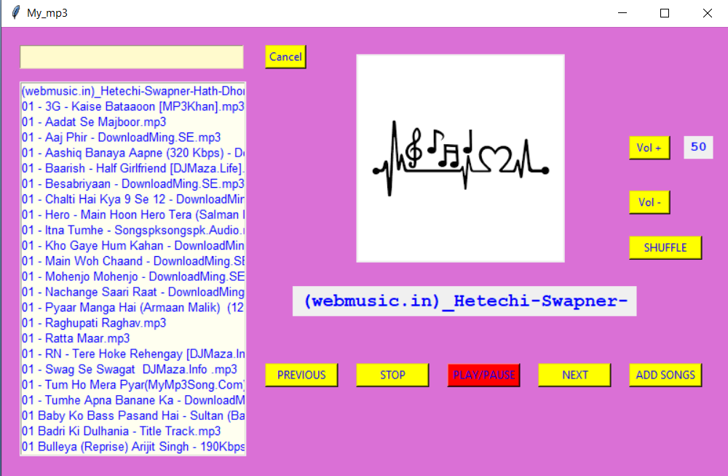
Paused the song:

Slide 20
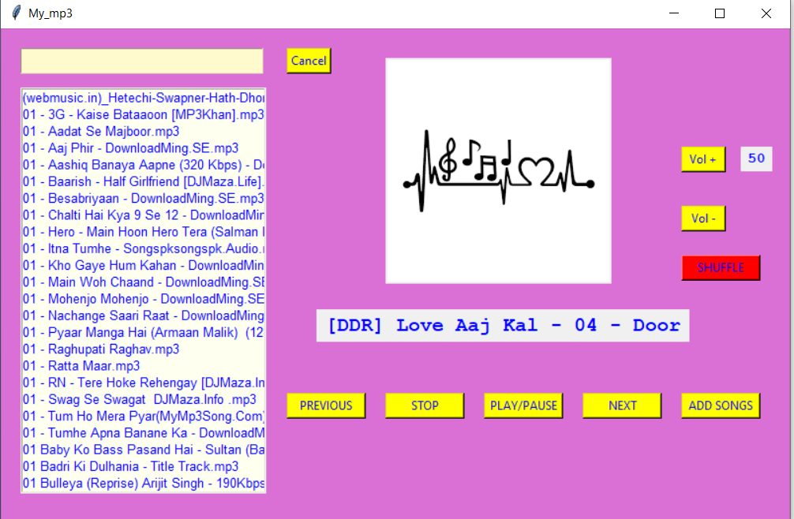
Shuffle On:

Slide 21
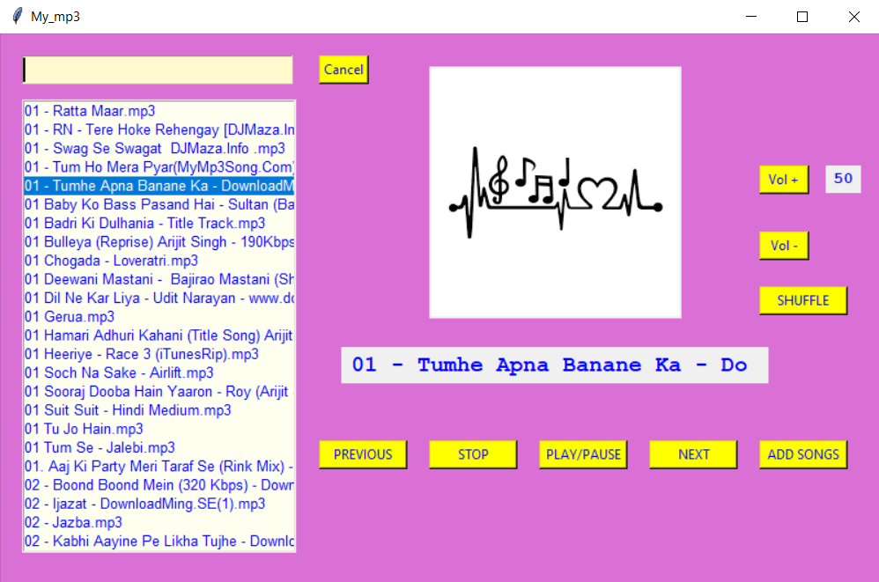
Click on songs to play:

Slide 22
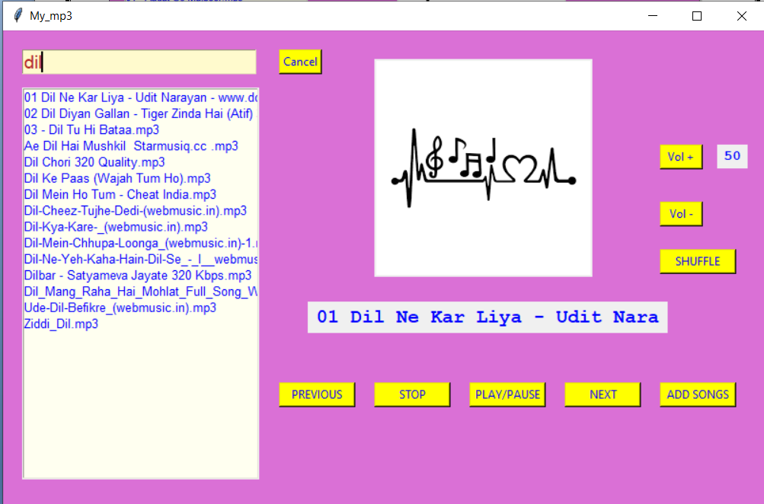
Searching Songs:

Slide 23
Conclusion
MP3 player is a device built to play and listen to digital audio files. These can be either MP3 files or some other audio files. The player was built using Python language. A GUI implementation of the application was developed that is simple and easy to use.
The application provides the user with many options like — to add song to a playlist, to play the song, to pause or resume the song, to play the previous song and to play the next song, shuffle and volume up down and search songs in the search bar.
The player also has the capability to add multiple songs to theplaylist at the same time. It has a large display area where the playlist is visible.

Slide 24
Conclusion
The Tkinter library of Python was used to create the GUI of the project. It was used to create the option buttons, the label and the display area.
The Pygame library is used to add songs, play the songs, provide pause and resume and other options.
In conclusion, a successful project was built in which songs willplay one after the other automatically and the entire playlist will play all over again once concluded.

