Slide 1
SRIVIDYA R
Final Project

Slide 2
FACIAL EMOTION RECOGNITION USING CONVOLUTION NEURAL NETWORKS
04/05/2024 Annual Review

Slide 3


AGENDA
Problem Statement
Project Overview
Who are the end users?
Your Solutions and its value proposition
The wow in your solution
Modelling
Results
3/21/2024 Annual Review

Slide 4

PROBLEM STATEMENT
Facial emotion recognition using CNN aims to develop a system that can accurately identify emotions such as happiness, sadness, anger, and others from images of human faces. This involves training a convolutional neural network (CNN) to learn patterns and features in facial expressions, enabling it to classify emotions correctly. The goal is to create a robust and reliable model that can interpret facial cues and provide accurate emotion labels in real-time applications like virtual assistants, customer service bots, and psychological research.

Slide 5

PROJECT OVERVIEW
In this project, we aim to create a system that can recognize human emotions accurately from facial expressions using Convolutional Neural Networks (CNNs).
The system will analyze images or video frames containing human faces and determine the corresponding emotions such as happiness, sadness, anger, surprise, fear, disgust, or neutrality.
To achieve this, we will train a CNN model using a large dataset of labeled facial images, where each image is tagged with the emotion it represents.
The CNN model will learn to automatically extract relevant features from facial expressions, enabling it to classify emotions with high accuracy.
Once trained, the system can be deployed in various applications such as human-computer interaction, market research, healthcare, and security to enhance user experience, understand customer sentiments, provide personalized services.

Slide 6

WHO ARE THE END USERS?
Social media users who want to add fun filters or emojis to their photos based on their facial expressions.
Video game players interested in enhancing gaming experiences through more responsive avatars that react to their emotions.
Security personnel employing facial emotion recognition for surveillance purposes, identifying potential threats or suspicious behavior.
Healthcare professionals using the technology to assist in diagnosing and monitoring mental health conditions.
Customer service representatives aiming to improve interactions by gauging customer emotions and adjusting their approach accordingly.
Educational institutions utilizing facial emotion recognition for student engagement analysis and personalized learning experiences.
Market researchers studying consumer reactions to advertisements or products through facial expressions.
Automotive companies implementing the technology for driver monitoring systems to enhance safety by detecting signs of drowsiness or distraction.

Slide 7

YOUR SOLUTION AND ITS VALUE PROPOSITION
Solution: Our solution utilizes Convolutional Neural Networks (CNNs) for facial emotion recognition.
Value Proposition: Our facial emotion recognition system offers accurate and efficient identification of emotions from facial expressions using CNN technology.

Slide 8

THE WOW IN YOUR SOLUTION
In our facial emotion recognition solution using CNN (Convolutional Neural Network), the unique "wow" factor lies in its ability to understand emotions from facial expressions with remarkable accuracy. Instead of relying solely on traditional methods, our CNN model learns directly from images, recognizing subtle facial cues that indicate different emotions. This enables it to detect emotions more effectively, providing a more nuanced understanding of human expressions.
3/21/2024 Annual Review
8

Slide 9
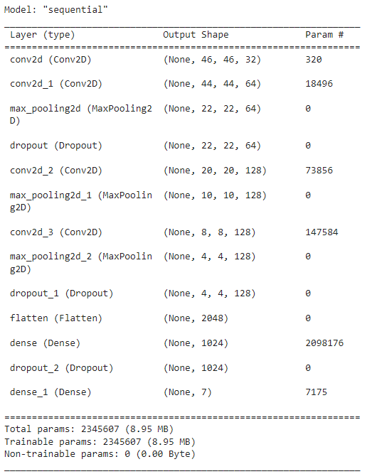
MODELLING
9

Slide 10
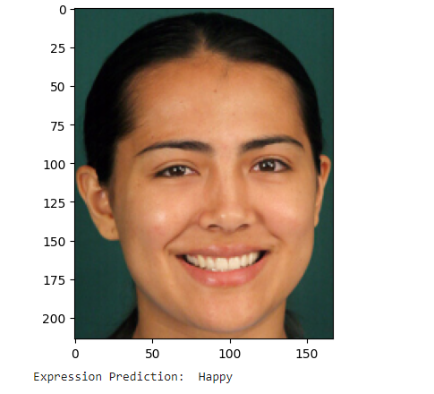
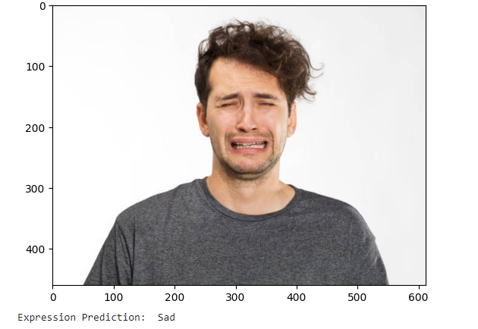
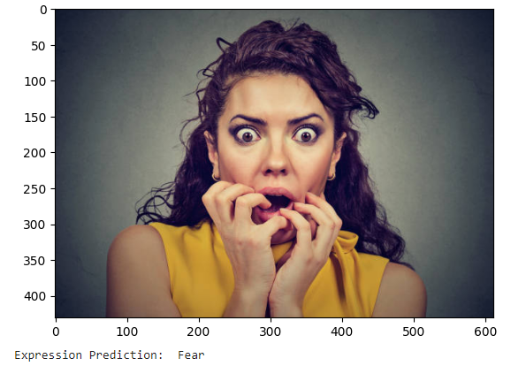
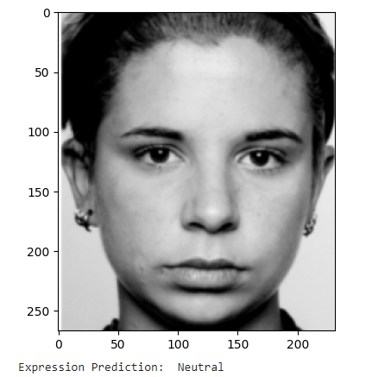
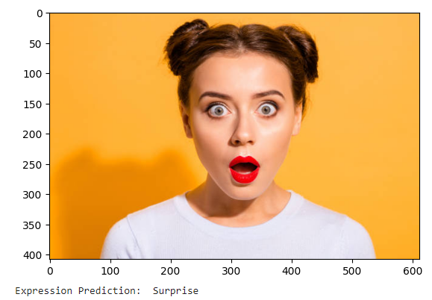
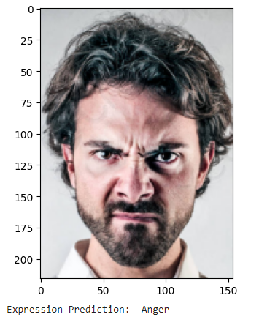
RESULTS
Demo link
10

