Slide 1
Generative Dog Images using GANs
Srividya Kirthivasan, Shambhavi Gupta

Slide 2
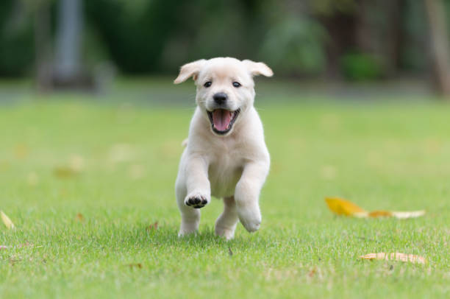
Goal:
Generate synthetic images of dogs using Generative Adversarial Networks
Have fun with GANs and explore how the training process works.

Slide 3
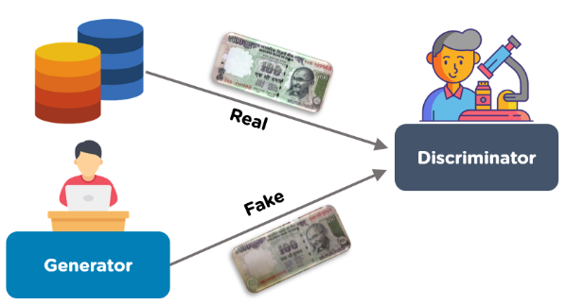
What are GANs?
GANs or Generative adversarial networks train on real-world examples to create realistic fakes.
Discriminator: Model that is used to classify examples as real or fake.
Generator: Model that is used to generate synthetic images by learning from real-world examples.

Slide 4
Process
Used Stanford dogs dataset
Apply transformations on the data - Color jitter, Random rotations
Define Generator and Discriminator
Define hyper-parameters - Kernel size, stride
Train the model
Define the metric of evaluation - Inception score

Slide 5
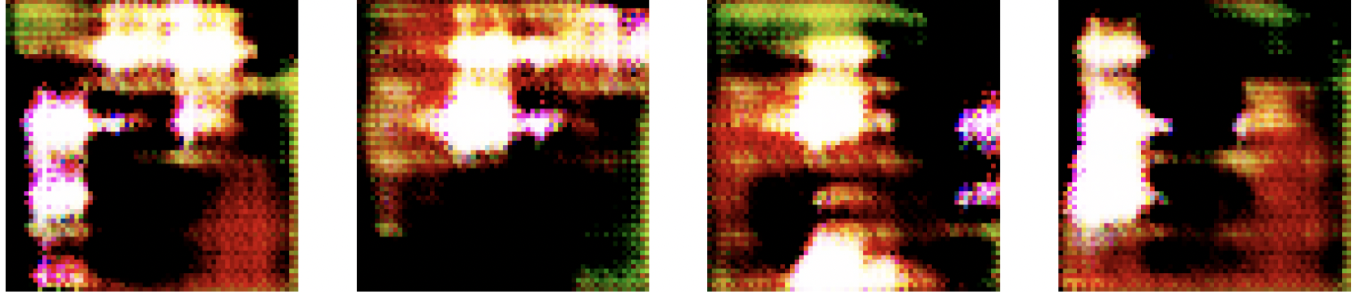
Epoch 1

Slide 6
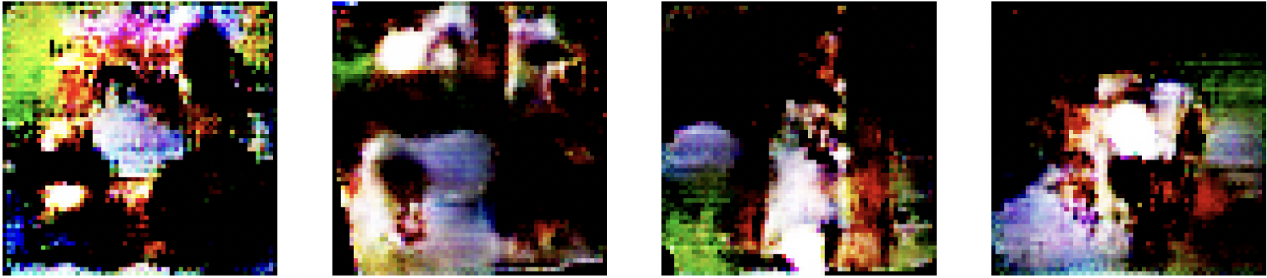
Epoch 10

Slide 7
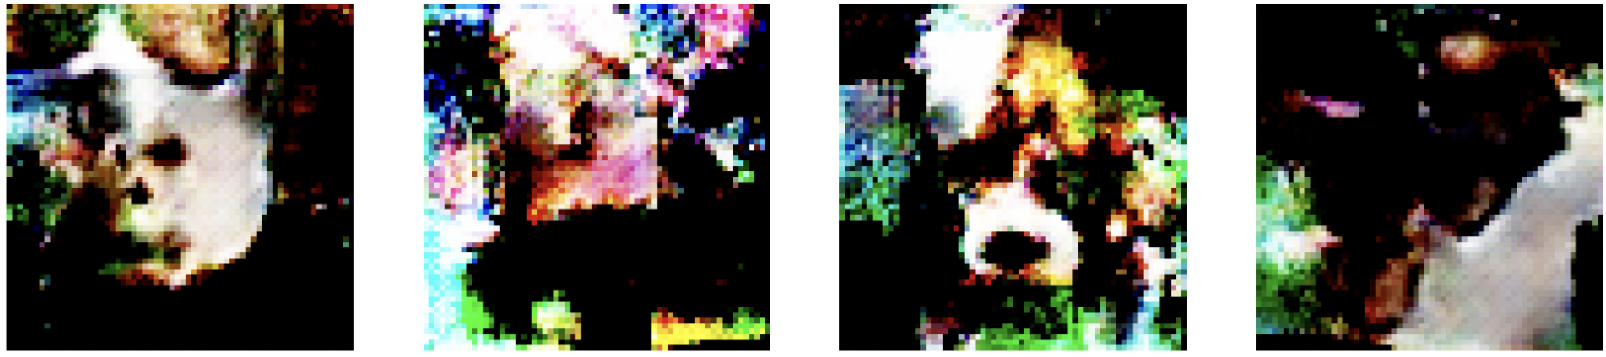
Epoch 20

Slide 8
What went well
We were able to dip our toes in GANs.
Built a working pipeline to train GANs on images.

Slide 9
What didn’t go well
If wrong hyperparameters are picked then the discriminator trains well, with the loss reducing to close to 0, however the generator loss is high.
Needs large amount of data to make reasonable images.
Training is slow
High compute power required

Slide 10
Thank you!

