Slide 1
Achieving Immunity
An attempted analysis on
COVID-19 vaccination till date
Srividya N Suresh
Done for Rising Ahead
March 2021

Slide 2
Objective
Project immunity timeline for India as well as the world at large.
Assumptions
Vaccines are performing with 100% efficiency.
Approach
Build a time series model to predict the timeline for herd immunity.
Response to the vaccines (public and government) will remain constant through time.
Clean the data and perform preliminary exploratory data analysis.
Consider herd immunity to be achieved at a lower limit of 50% of population.
Test the data for its efficiency and sufficiency.

Slide 3
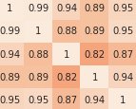
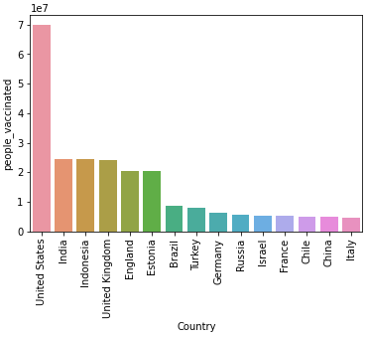
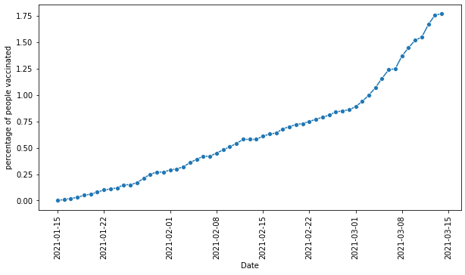
Analysis
Data Preprocesing
1. High multi collinearity. Columns like total_vaccinated were dropped.
2. Null values forward filled. Date converted to datetime object
Exploratory Data Analysis
1. Countries with most vaccinated people, with most percentage of vaccinated people graphed.
Time Series Analysis
1. ADF test performed on Indian data. Data stationary after 3rd differencing,
so cannot be considered reliable.
2. ADF test performed on World data. Data stationary after 1st differencing.
But ACF and PACF graphs are unclear. Cannot be considered reliable.
Kindly find the notebook here.

Slide 4
Findings
India, while having the second largest population of people vaccinated, lags behind other countries when we consider our population.
We have 59 data points available for India. India vaccinated is 1.75%. Even if we consider the lower limit of herd immunity to be 50%, we still have a long way to go.
Data collected until now is insufficient. Especially with time series, it is considered wrong to predict into such far futures.
This is further verified when the data became stationary after 3rd differencing, at which point, it is considered unreliable.
The story goes on similar lines for world immunity.
We might be able to predict a few days into the future with a few more data points, but predicting immunity at 50% might not lead a reliable result as of now.
Kindly find the notebook here.

Slide 5
Future scope of Action
Train the model on countries that have higher vaccination rates (per hundred) and test it against countries having similar distribution of data.
Make use of all the variables under different objectives like Vaccination brand study and probability of a second vaccination shot.
Consider the sentiments of the public and the government towards social distancing measures and vaccinations (with time). Dwell into the relationship between the two.
Collect more data for better trained models. Automate the model with a UI to display the ever-changing yet updated timelines.

Slide 6
Thank you for the opportunity!

