Slide 1


Digital Music Store data analysis using SQL
01

Slide 2
OBJECTIVE
We will analyze the dataset music store database with SQL and help the store to understand the business growth by answering Question’s
SQL Server: Microsoft sql database Managemnet studio 19
02

Slide 3
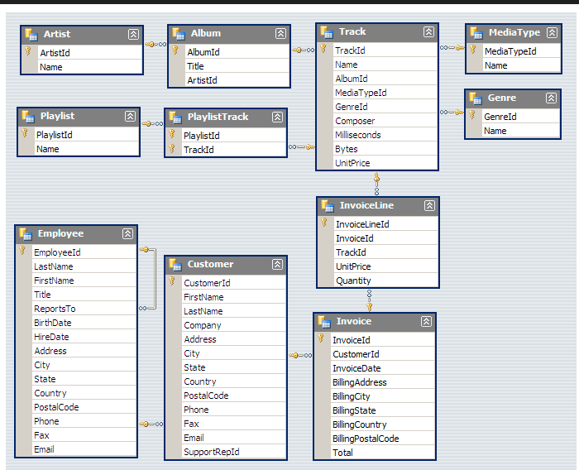
DATABASE SCHEMA
A database schema is essentially a blueprint for how a database is structured. It defines the organization of data and how different pieces of data relate to each other. In simple terms, it's a plan that shows how data is stored and organized within a database.
02

Slide 4
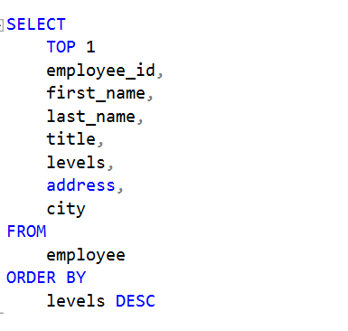
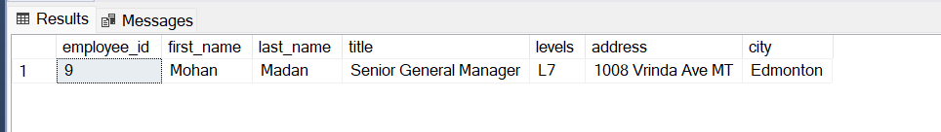
1. Who is the senior most employee based on job title?
03

Slide 5
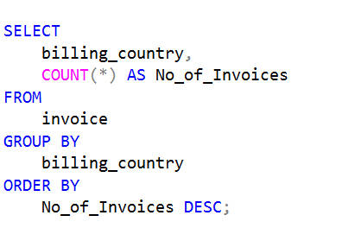
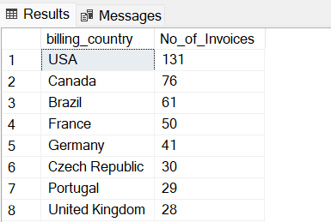
2. Which countries have the most Invoices?
04

Slide 6
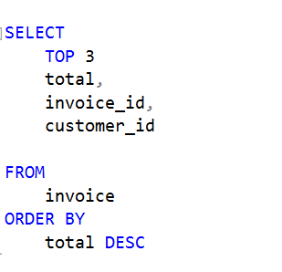
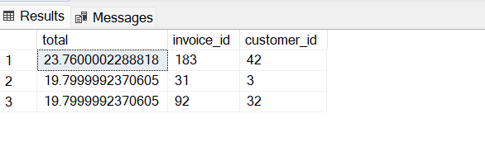
3. What are top 3 values of total invoice?
05

Slide 7
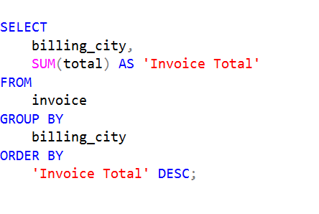
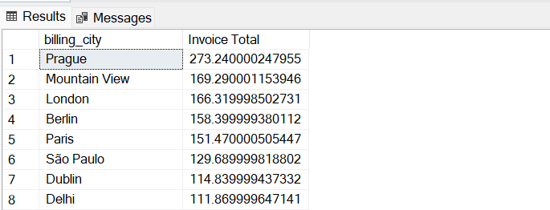
4. Which city has the best customers? We would like to throw a promotional Music Festival in the city we made the most money. Write a query that returns one city that has the highest sum of invoice totals. Return both the city name & sum of all invoice totals
06

Slide 8
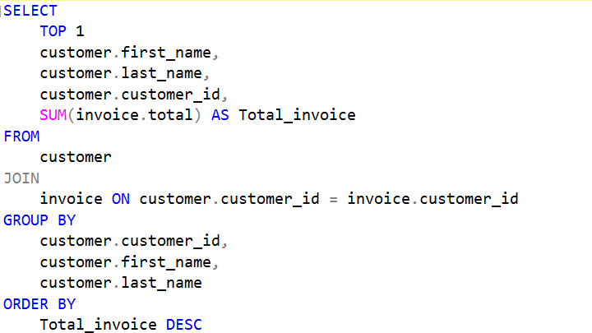

5. Who is the best customer? The customer who has spent the most money will be declared the best customer. Write a query that returns the person who has spent the most money
07

Slide 9
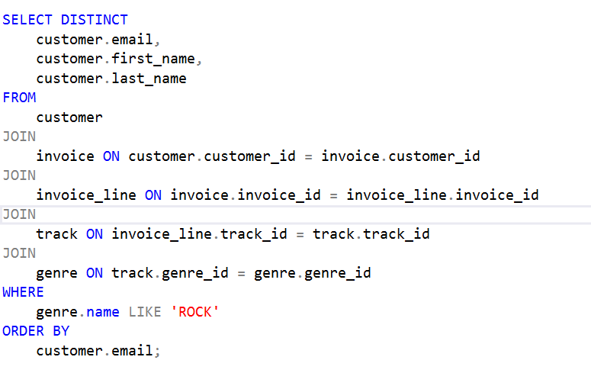
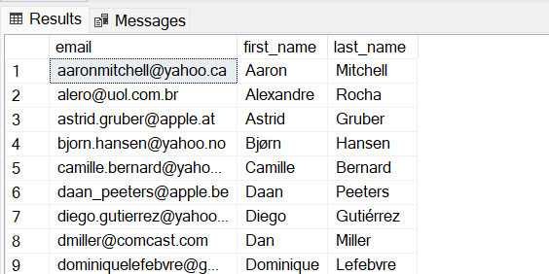
6. Write query to return the email, first name, last name, & Genre of all Rock Music listeners. Return your list ordered alphabetically by email starting with A
08

Slide 10
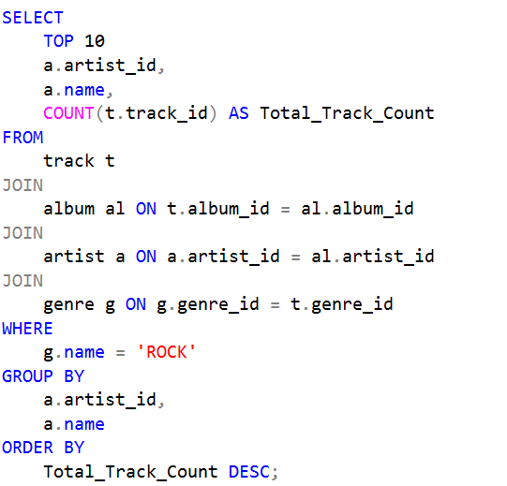
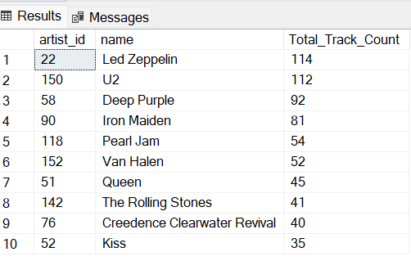
7. Let's invite the artists who have written the most rock music in our dataset. Write a query that returns the Artist name and total track count of the top 10 rock bands
09

Slide 11
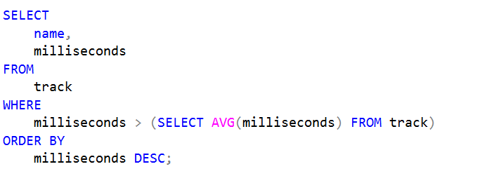
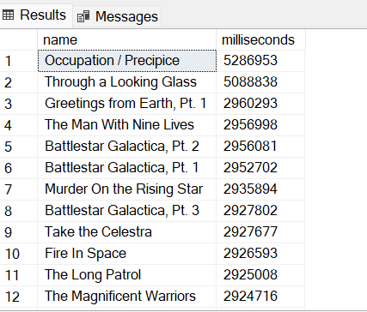
8. Return all the track names that have a song length longer than the average song length. Return the Name and Milliseconds for each track. Order by the song length with the longest songs listed first
10

Slide 12
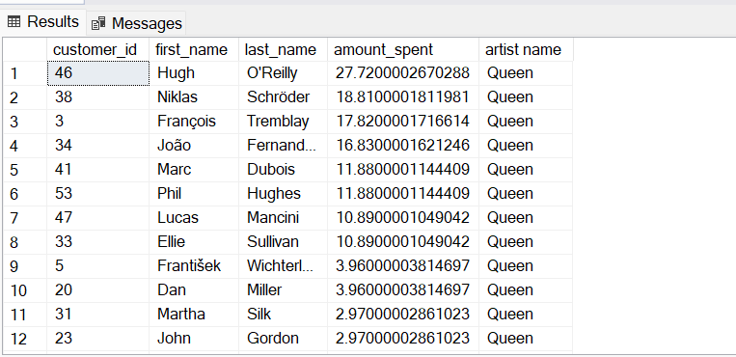
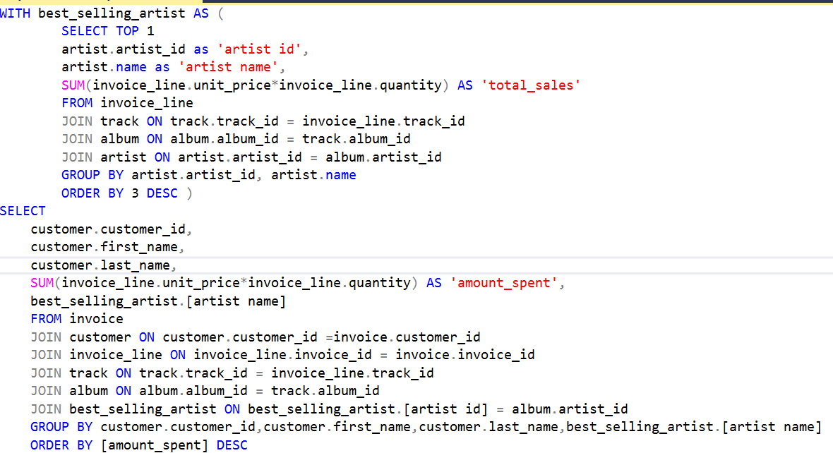
9. Find how much amount spent by each customer on artists? Write a query to return customer name, artist name and total spent
11

Slide 13
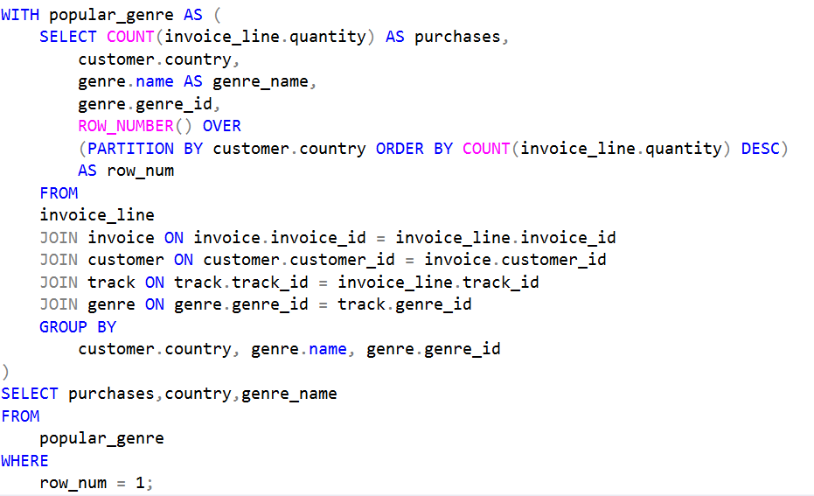
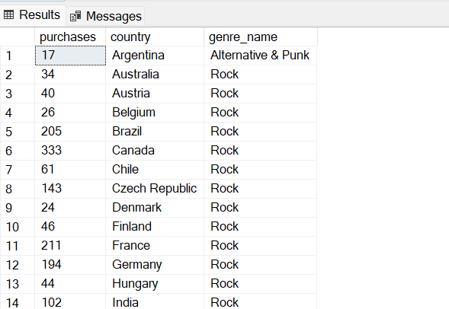
10. We want to find out the most popular music Genre for each country. We determine the most popular genre as the genre with the highest amount of purchases. Write a query that returns each country along with the top Genre. For countries where the maximum number of purchases is shared return all Genres
12

Slide 14
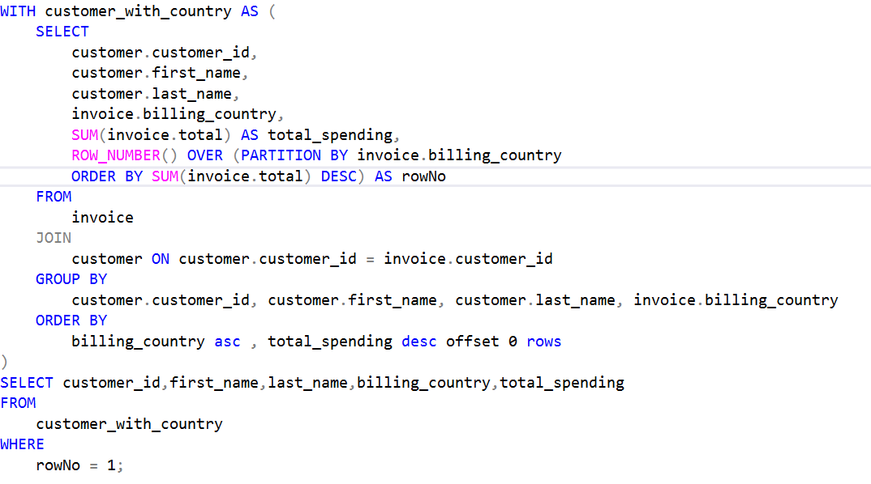
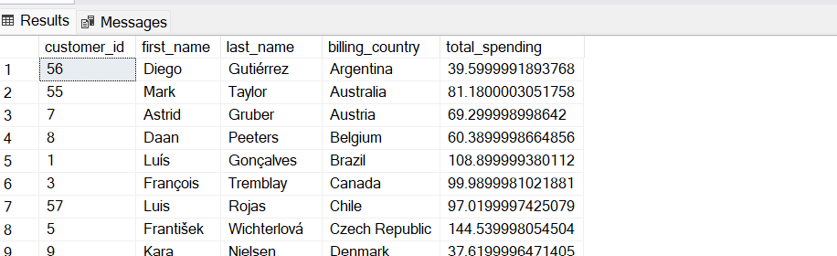
11. Write a query that determines the customer that has spent the most on music for each country. Write a query that returns the country along with the top customer and how much they spent. For countries where the top amount spent is shared, provide all customers who spent this amount
13

Slide 15
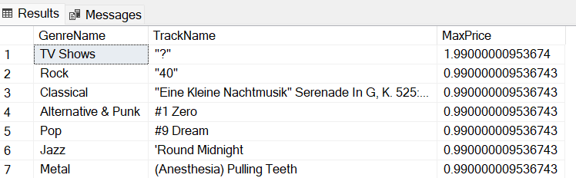

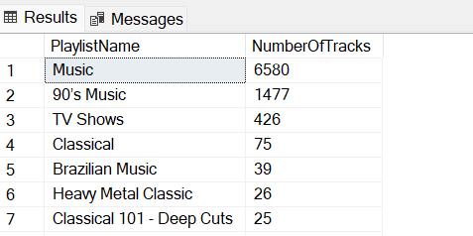
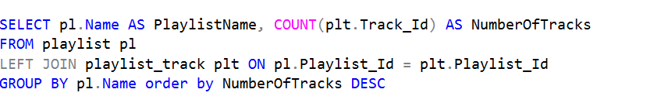
12. Retrieve the most expensive track for each genre
13. List all playlists and the number of tracks in each playlist
13

Slide 16
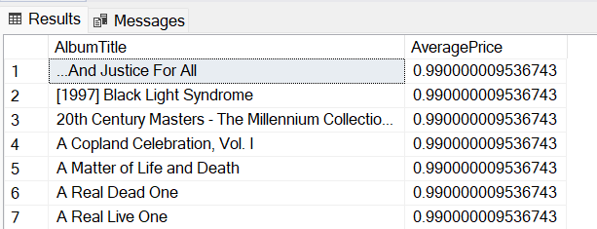
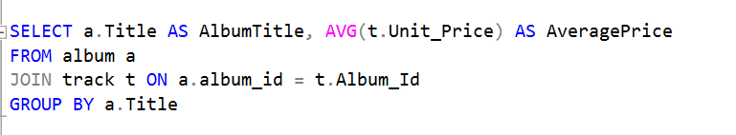
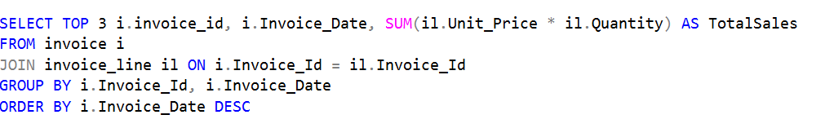
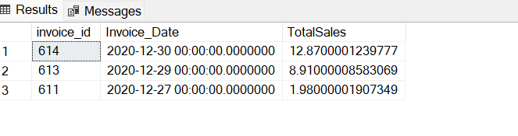
14. Find the average price of tracks in each album
15. Find the top 3 most recent invoices and their total sales
13

Slide 17
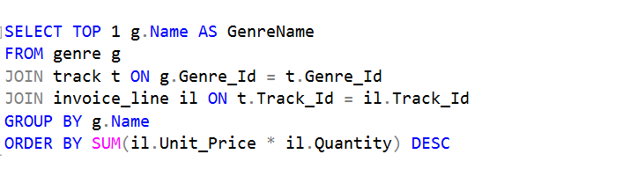
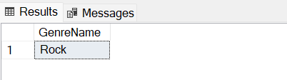
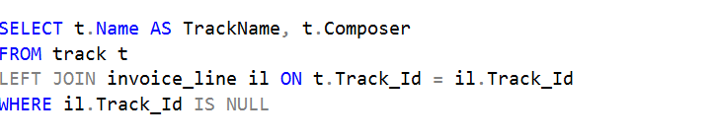
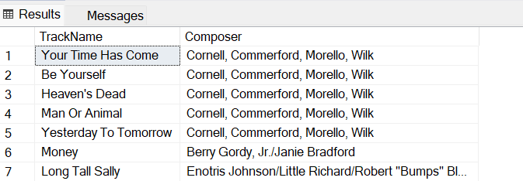
16. Get the genre with the highest total sales
17 Retrieve the list of tracks and their composers with no sales
13

Slide 18
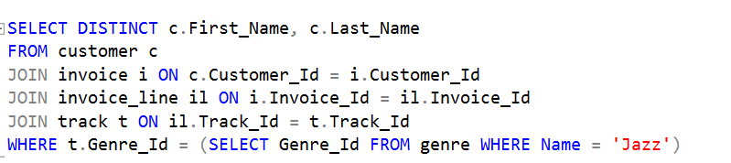
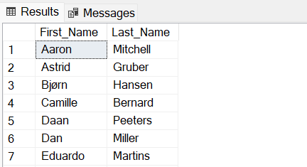
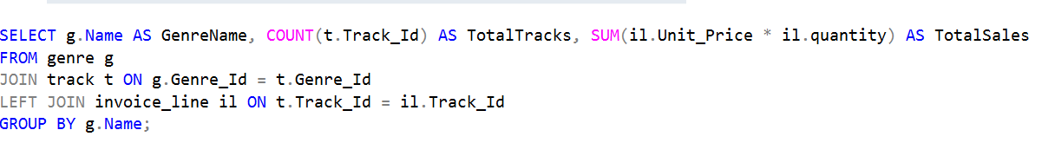
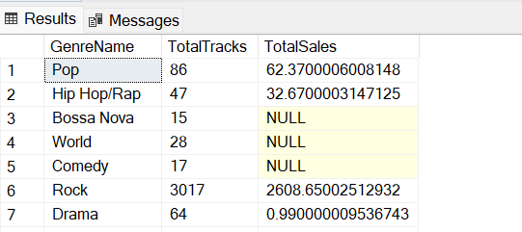
18 .Find all customers who have purchased tracks from a specific genre
19. Show the total number of tracks and their total sales in each genre
13

Slide 19
Business Findings
Top Customers: Identify high-value customers to target for loyalty programs and personalized offers.
Customer Retention: Track repeat purchases to assess and improve customer loyalty.
Popular Music Tracks: Highlight best-selling tracks to boost inventory management and promotions.
Sales Trends: Analyze sales patterns over time to identify seasonal trends and peak periods.
Revenue by Genre: Focus on profitable genres to tailor marketing strategies and manage inventory.
Top Artists: Promote high-revenue artists to enhance visibility and sales.
Artist Popularity Trends: Adjust marketing and inventory based on artist popularity shifts.
13

Slide 20
Stock Levels: Monitor inventory to prevent stockouts and overstock situations.
Order Fulfillment Efficiency: Improve fulfillment processes to enhance customer satisfaction.
Promotion Effectiveness: Evaluate promotional impact to refine future marketing campaigns.
Customer Demographics: Tailor marketing efforts based on customer demographics for better targeting.
Overall Revenue Analysis: Assess total revenue to gauge business performance and growth.
Customer Acquisition Costs: Evaluate acquisition costs against customer lifetime value for marketing efficiency.
13

Slide 21
SUMMARY
By leveraging these insights, a digital music store can make informed decisions regarding marketing strategies, inventory management, customer engagement, and overall business strategy. These insights support optimizing operations, enhancing customer satisfaction, and driving revenue growth.
13

Slide 22

Thank You
14

