Slide 1

Team Members:
Srividya Chekuri
Sai Venkata Ajay Varma Alluri

Slide 2
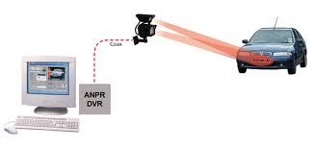
Project Topic
Vehicle Number Plate Detection

Slide 3
Statement of Project Objectives
With the increase in the number of vehicles, vehicle tracking has become an important research area for efficient traffic control, surveillance, and finding stolen cars.
For this purpose, efficient real-time license plate detection and recognition are of great importance. Due to the variation in the background and font color, font style, size of the license plate, and non-standard characters, license plate recognition is a great challenge in developing countries.

Slide 4

Statement of Value
Vehicle number plate detection strengthens security in areas like law enforcement, parking management, and access control. It aids in identifying and tracking vehicles related to criminal activities, deterring unlawful actions, and improving public safety.
In smart cities and transportation systems, number plate detection streamlines traffic, reduces congestion, and improves transportation. It enables real-time monitoring, intelligent traffic light control, and data-driven decision-making.
Vehicle number plate detection automates toll collection, parking access, and entry/exit at secured facilities, resulting in streamlined operations, shorter wait times, and increased user convenience

Slide 5
Review of state of Art
Deep learning, particularly Convolutional Neural Networks (CNNs), has emerged as the dominant approach for vehicle license plate detection, encompassing both localization and character recognition tasks. State-of-the-art architectures such as Faster R-CNN, SSD (Single Shot Multi Box Detector), and EfficientDet have proven effective in efficiently locating number plates in images, emphasizing speed and accuracy.
Noteworthy advancements include the application of region-based CNNs and single-stage detectors like YOLO (You Only Look Once) to enhance the precision of number plate localization. These models leverage the latest techniques to efficiently identify and extract license plate regions within images.

Slide 6
Review of state of Art
For character recognition, contemporary models like CRNN (Convolutional Recurrent Neural Network) and attention-based mechanisms have significantly improved accuracy in reading and recognizing text on license plates. These models have demonstrated superior performance compared to earlier approaches.
Recent vehicle license plate recognition advancements prioritize domain adaptation techniques, mitigating challenges from training on synthetic or regional datasets. State-of-the-art methods employ adversarial training or self-supervised learning to enhance model generalization across diverse environments, ensuring robust performance in practical applications.

Slide 7

Relevant Works
“Car License Plate Detection and Recognition Using Modified U-Net Deep Learning Model” by Ruben Jose Tom, Awanit kumar , Syed Basha Shaik, Lydia D Isaac, Vikas Tripathi, Prakash Pareek (2022)
“Application of License Plate Number Recognition Based on Deep Learning Method in Intelligent Building Security System” by Shenghui wang, Jin Xu (2021)
“Reading Vehicle License Plates in unconstrained conditions” by Yann LeCun, Léon Bottou, Yoshua Bengio, and Patrick Haffner (1997):
This paper introduced a pioneering approach to vehicle license plate detection and character recognition using neural networks

Slide 8
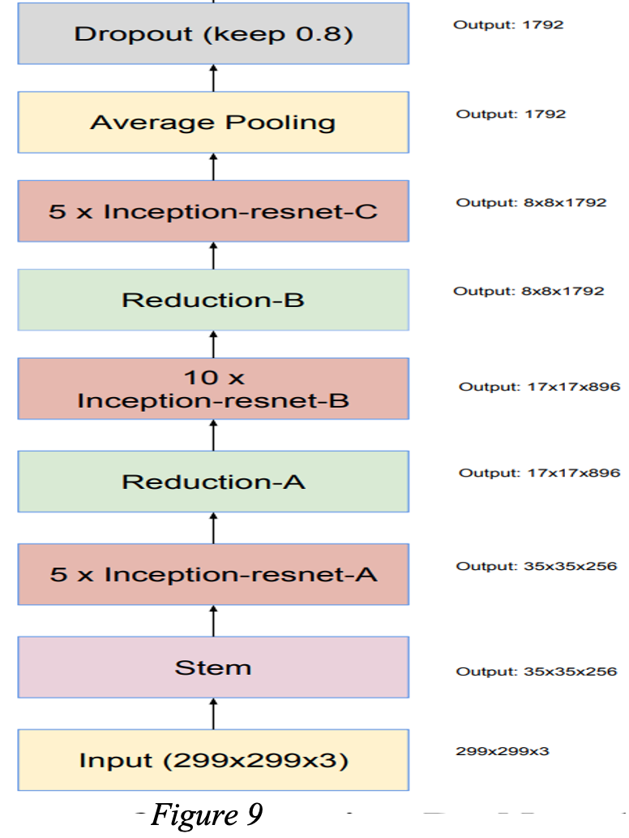
Approach
Inception-ResNet-v2 is a convolutional neural network that is trained on more than a million images from the ImageNet database. The network is 164 layers deep and can classify images into 1000 object categories, such as keyboard, mouse, pencil, and many animals. As a result, the network has learned rich feature representations for a wide range of images. The Inception-ResNet-v2 was used for the classification task.
Inception-Resnet-v2 is formulated based on a combination of the Inception structure and the Residual connection. In the Inception-Resnet block multiple sized convolutional filters are combined by residual connections. The usage of residual connections not only avoids the degradation problem caused by deep structures but also reduces the training time.
We are ready to train a deep learning model for object detection. Here we will use the Inception-ResNet-v2 model with pre-trained weights and train this to our data.
We used Stanford cars dataset from Kaggle.

Slide 9
Deliverables
Project presentation(PPT)
Project Demo Video
Working project files(ipynb)

Slide 10

Evaluation Methodology
Accuracy Metrics:
Precision: Precision measures the accuracy of positive predictions (correctly detected number plates). It is calculated as the number of true positives divided by the sum of true positives and false positives.
Recall (Sensitivity): Recall measures the ability of the system to identify all actual positive cases (number plates). It is calculated as the number of true positives divided by the sum of true positives and false negatives.
F1 Score: The F1 score is the harmonic mean of precision and recall and provides a balanced evaluation of a system's performance.

