Slide 1
Chocolate Sales Dashboard
Data Analytics Internship Project

Slide 2
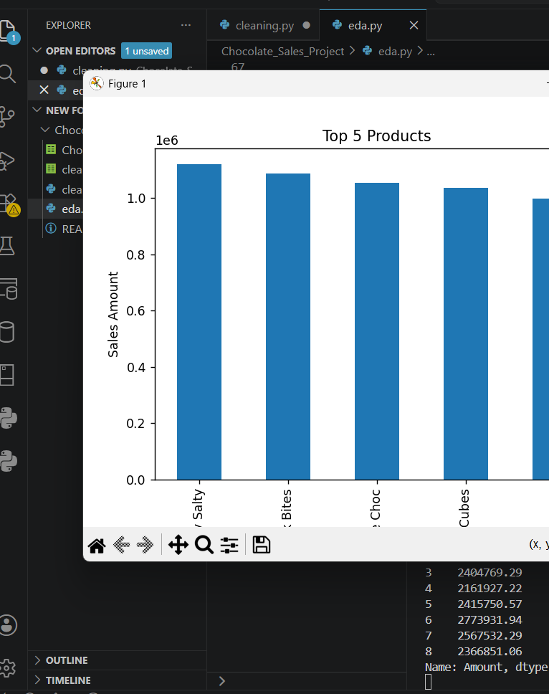
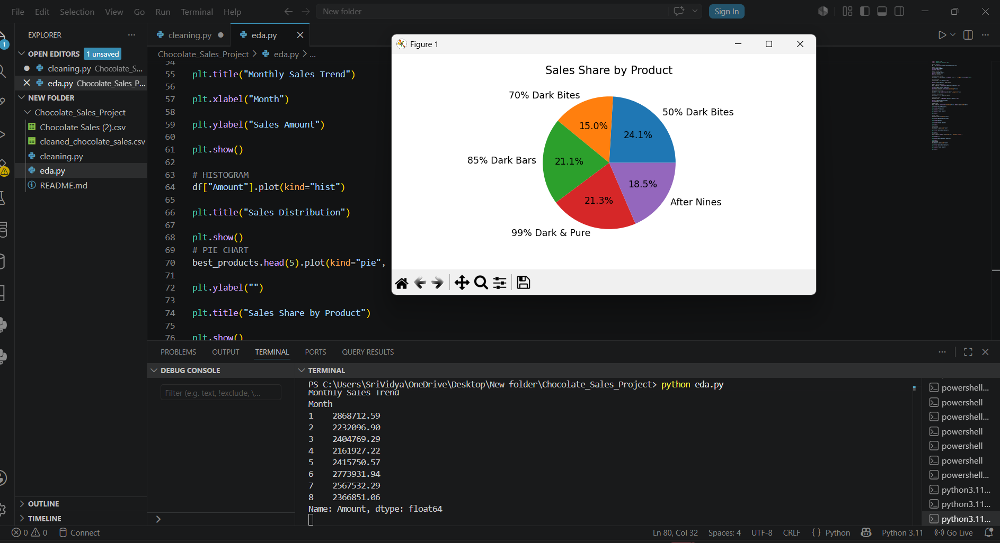
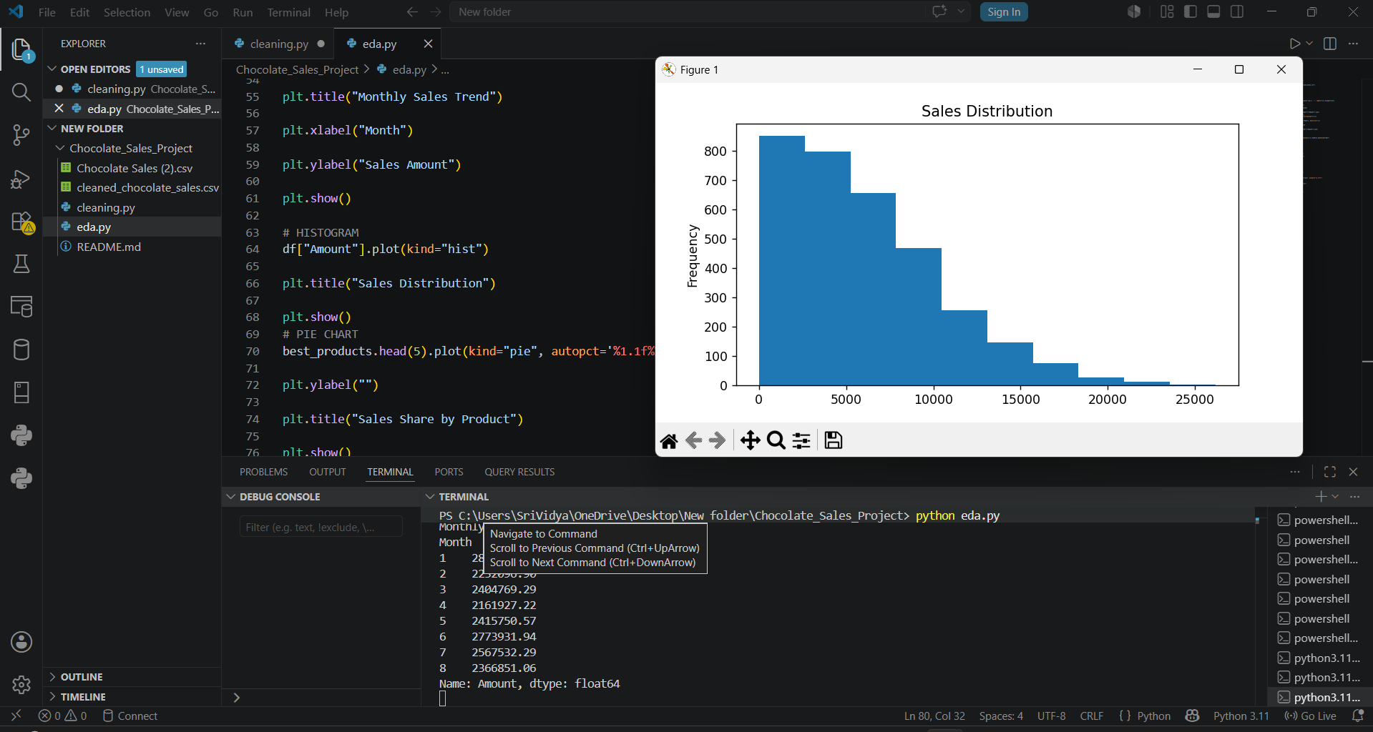
Charts & Insights
PIE CHART
BAR GRAPH
HISTOGRAM

Slide 3
Business Insights:
• Top-selling products generated the highest revenue. • Product sales varied across categories. • Data analysis revealed business trends. • High-performing products can be prioritized for future sales growth. • Sales distribution analysis helped identify differences in transaction values. • Data-driven insights can support better business decision-making a

Slide 4
Tools & Conclusion
Tools Used: Python, Pandas, Matplotlib, SQL, GitHub, VS Code
The project cleaned, analyzed and visualized chocolate sales data to derive business insights.

