Slide 1

RAGHU ENGINEERING COLLEGE Multi-Document Question Answering System using Retrieval Augmented Generation (RAG)
PRESENTED BY UMMIDI SRI VYSHNAVI 22981A44I6
UGGINA NOOKESWARA SATYANARAYANA 22981A44I6
TALAGANA TARUN 22981A44I6
SABBAVARAPU SAI MADHU 22981A44I6
Under the guidance
Mr. V. VIDHYA SAGAR
CSE(DATA SCIENCE)

Slide 2
TABLE OF CONTENTS
•Abstract •Introduction •Existing System •Proposed System •Methodology •Architecture •Results •Conclusion

Slide 3
INTRODUCTION
Large documents such as research papers, legal files, and technical manuals are difficult to manually analyze. Traditional keyword-based search fails to provide contextual answers.
RAG combines:
Information Retrieval
Vector Embeddings
Large Language Models
This enables accurate, context-aware responses from user-uploaded documents.

Slide 4
ABSTRACT
This project presents a Retrieval-Augmented Generation (RAG) based system for multi-document question answering. The system allows users to upload multiple PDF documents and ask contextual questions. Instead of relying solely on a language model’s internal knowledge, the system retrieves relevant document chunks using vector embeddings and generates accurate responses.
The solution integrates PDF processing, semantic search, vector databases, and LLM-based answer generation to improve accuracy and reduce hallucination.

Slide 5
PROBLEM STATMENT
Large volumes of unstructured documents such as research papers, reports, and legal files are difficult to analyze manually. Traditional keyword-based search systems fail to understand context and often return irrelevant results. Although Large Language Models (LLMs) can generate fluent answers, they may produce hallucinated or inaccurate information when not grounded in specific documents.

Slide 6
EXSISTING SYSTEM
• Traditional Large Language Models (LLMs) store knowledge only in model parameters (parametric memory). • They cannot dynamically access external or user-specific documents. • May generate hallucinated or outdated information.
RAG Framework (Lewis et al., 2020): • Uses Dense Passage Retriever (DPR) to fetch relevant documents. • Retrieved passages are passed to a generator model (e.g., BART). • Improves factual accuracy compared to standalone LLMs.
Limitations: • Designed mainly for large static datasets (e.g., Wikipedia). • Does not directly support user-uploaded multi-document PDFs. • No structured extraction of tables or images. • Computationally expensive for real-time applications.

Slide 7
PROPOSED SYSTEM
• Developed a web-based interface using Flask to enable user interaction. • Enabled support for user-uploaded PDF documents instead of static datasets. • Implemented text extraction and chunking for efficient document processing. • Integrated local embedding generation using MiniLM for semantic representation. • Used FAISS for vector storage and similarity search. • Implemented local LLM-based answer generation without relying entirely on external APIs. • Built a fully functional end-to-end RAG pipeline from document upload to answer generation.

Slide 8
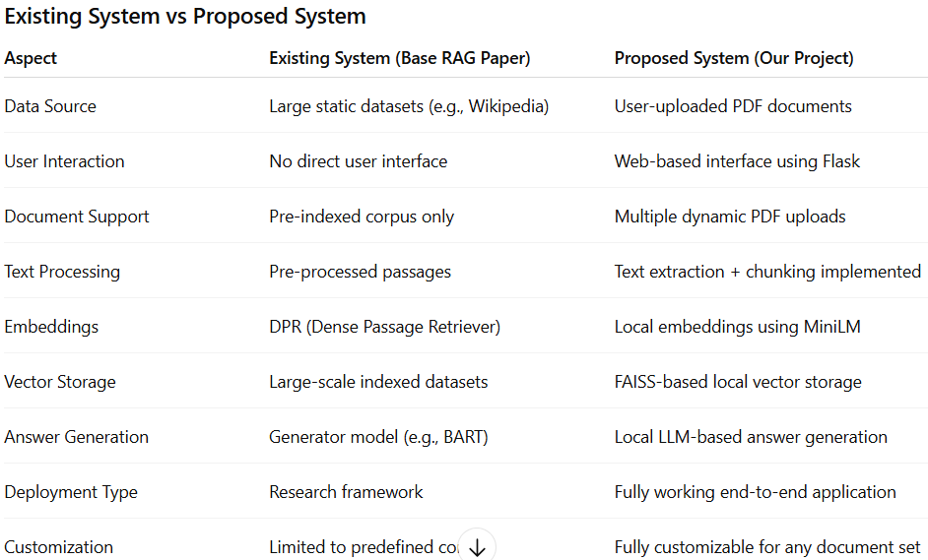
EXISTING VS PROPOSED

Slide 9
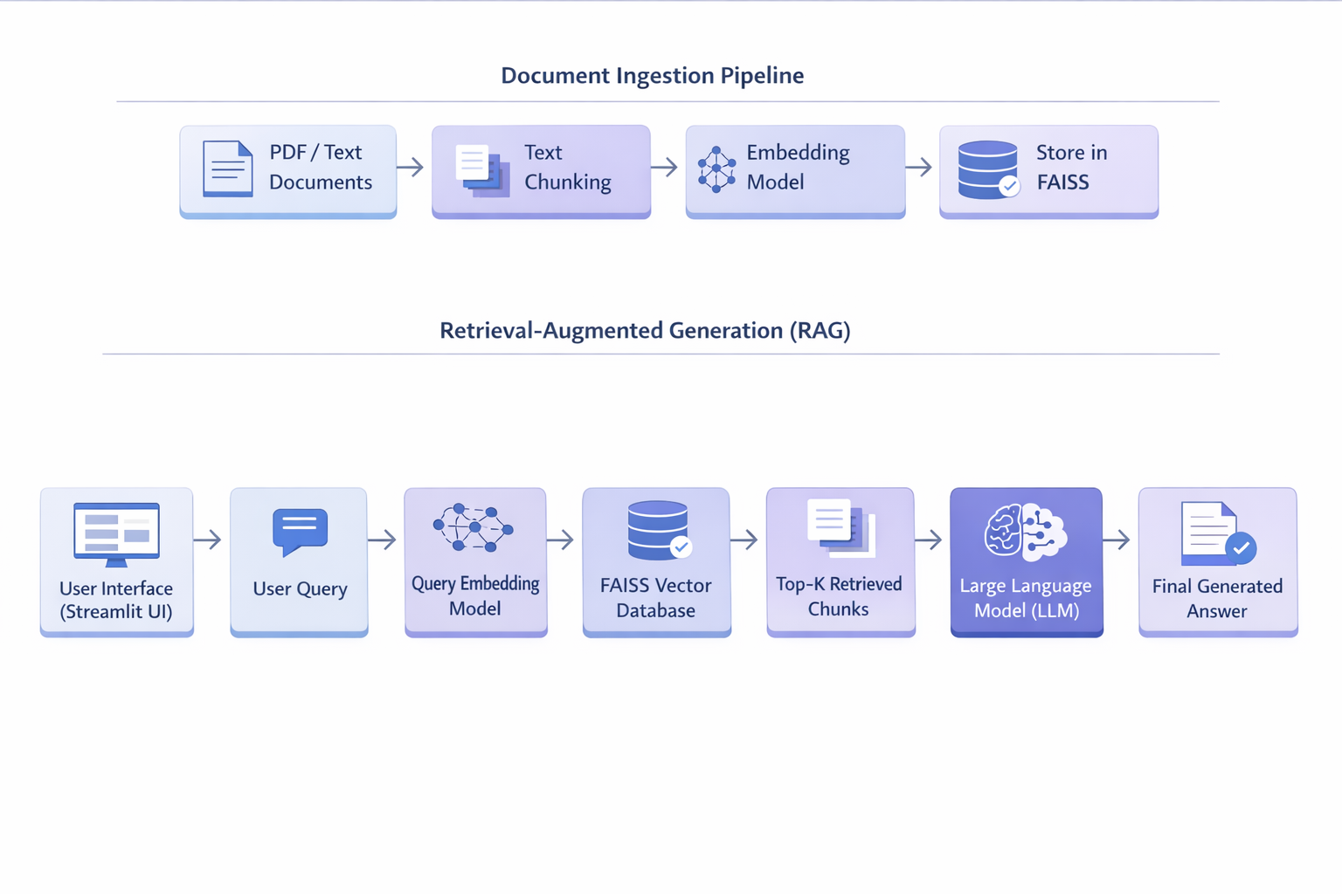
ARCHITECTURE

Slide 10
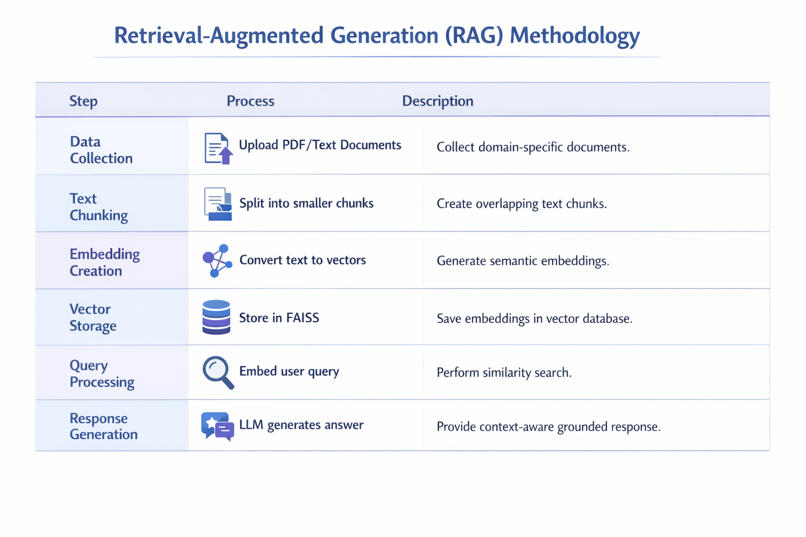
METHODOLOGY

Slide 11
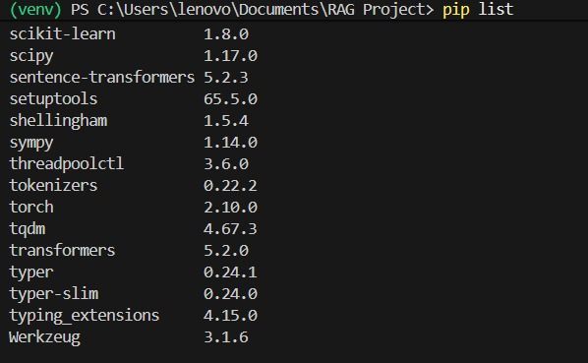
Download required libraries:
LIBRARIES
In our project, we used modules such as langchain for managing the RAG pipeline, faiss-cpu for vector similarity search, transformers for embeddings and response generation, and PyPDFLoader for loading PDF documents. We also used text splitters from LangChain to divide documents into chunks before creating embeddings.

Slide 12
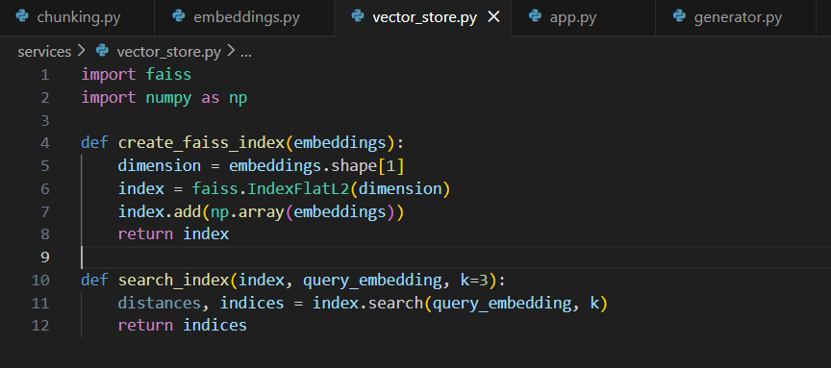
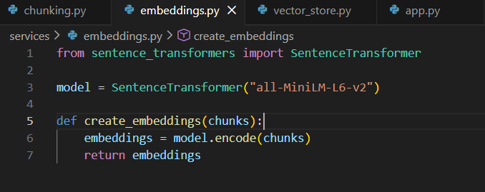
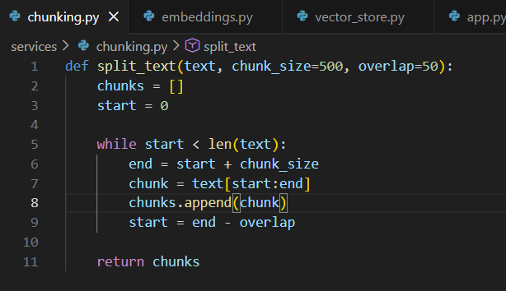
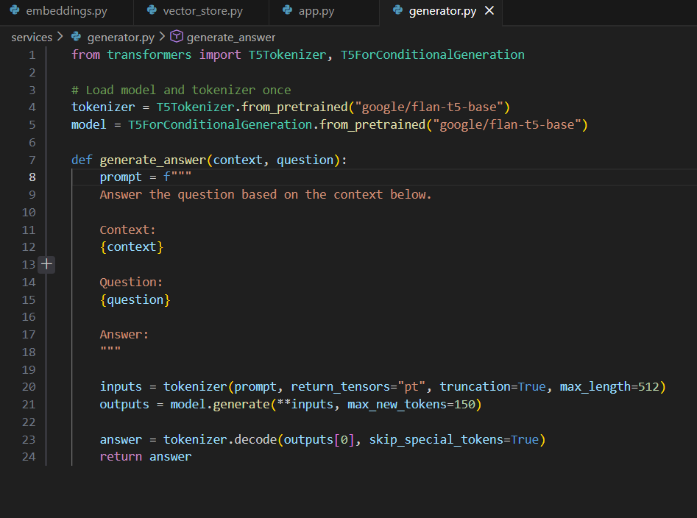
CODE SNIPPETS

Slide 13
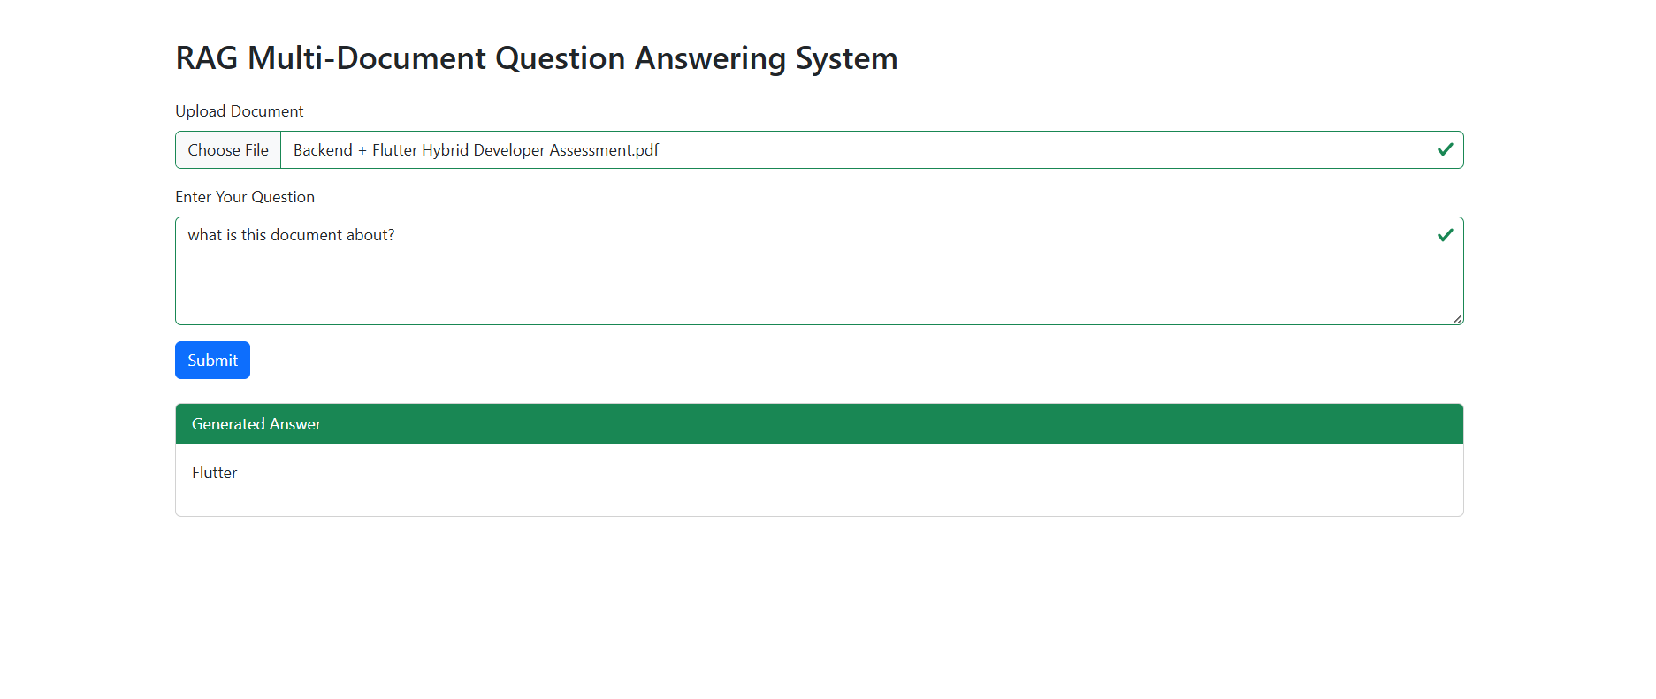
OUTPUT

Slide 14
CONCLUSION
In this project, we successfully developed a Retrieval-Augmented Generation (RAG) based Question Answering system that combines semantic retrieval with Large Language Model generation. By integrating document embeddings, FAISS vector search, and contextual response generation, our system provides accurate, relevant, and document-grounded answers. This approach reduces hallucination and demonstrates how modern NLP techniques can be applied to build intelligent and reliable real-world applications.

Slide 15
THANK YOU

