Slide 1
Software Engineering Presentation
Title : Music Recommendation System

Slide 2

Groove: A Music Recommendation Engine
A web application that recommends music based on song similarity and user mood, built using Machine Learning and Web Technologies

Slide 3
The Music Discovery Challenge
The Problem
Our Solution
With millions of songs available across streaming platforms, users face an overwhelming choice. Manual searching is time-consuming and often fails to capture the specific mood or moment they're in. Traditional search methods don't understand context or emotional state.
Groove addresses this challenge through intelligent recommendation systems that understand both song characteristics and user emotions. By combining audio feature analysis with mood detection, the system surfaces relevant music without requiring extensive searching.
Millions of Songs
Mood Matching
Smart Recommendations
Spotify alone hosts over 100 million tracks
Understands emotional context
ML-powered suggestions

Slide 4

Project Overview
01
Web-Based Engine
Built as a responsive web application accessible from any device
02
Two Recommendation Methods
Song-based similarity matching and mood-driven playlist generation
03
ML-Powered Analysis
Uses cosine similarity and hybrid scoring algorithms
04
User-Friendly Interface
Simple, intuitive design that requires no technical knowledge

Slide 5
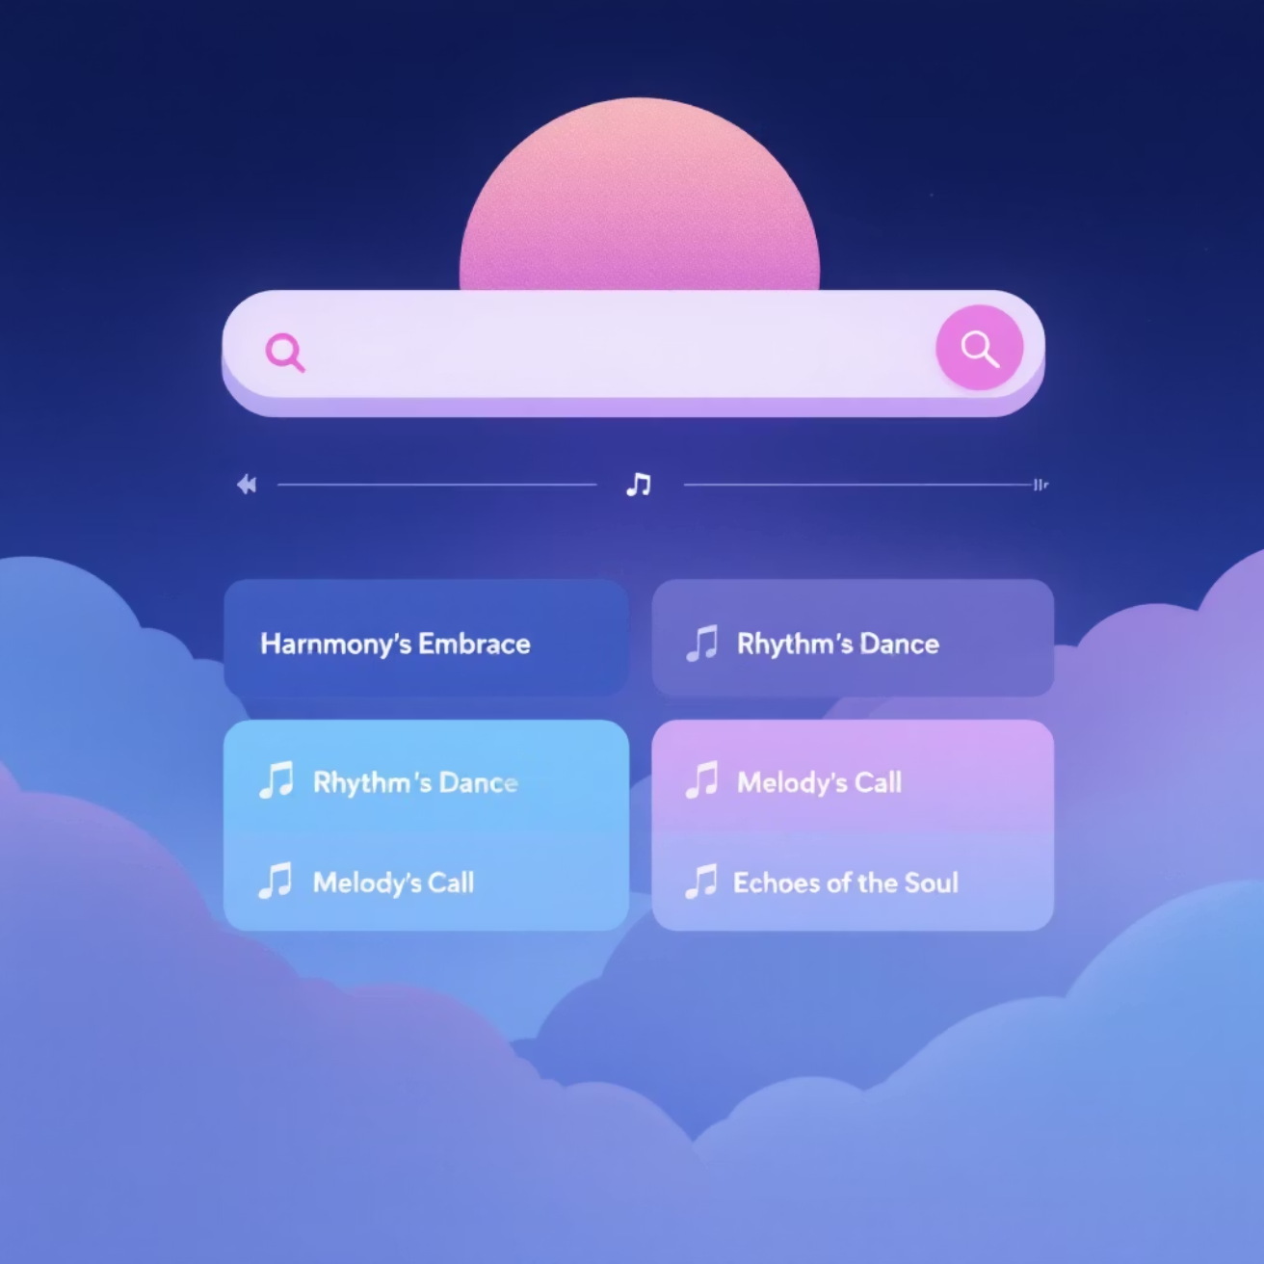
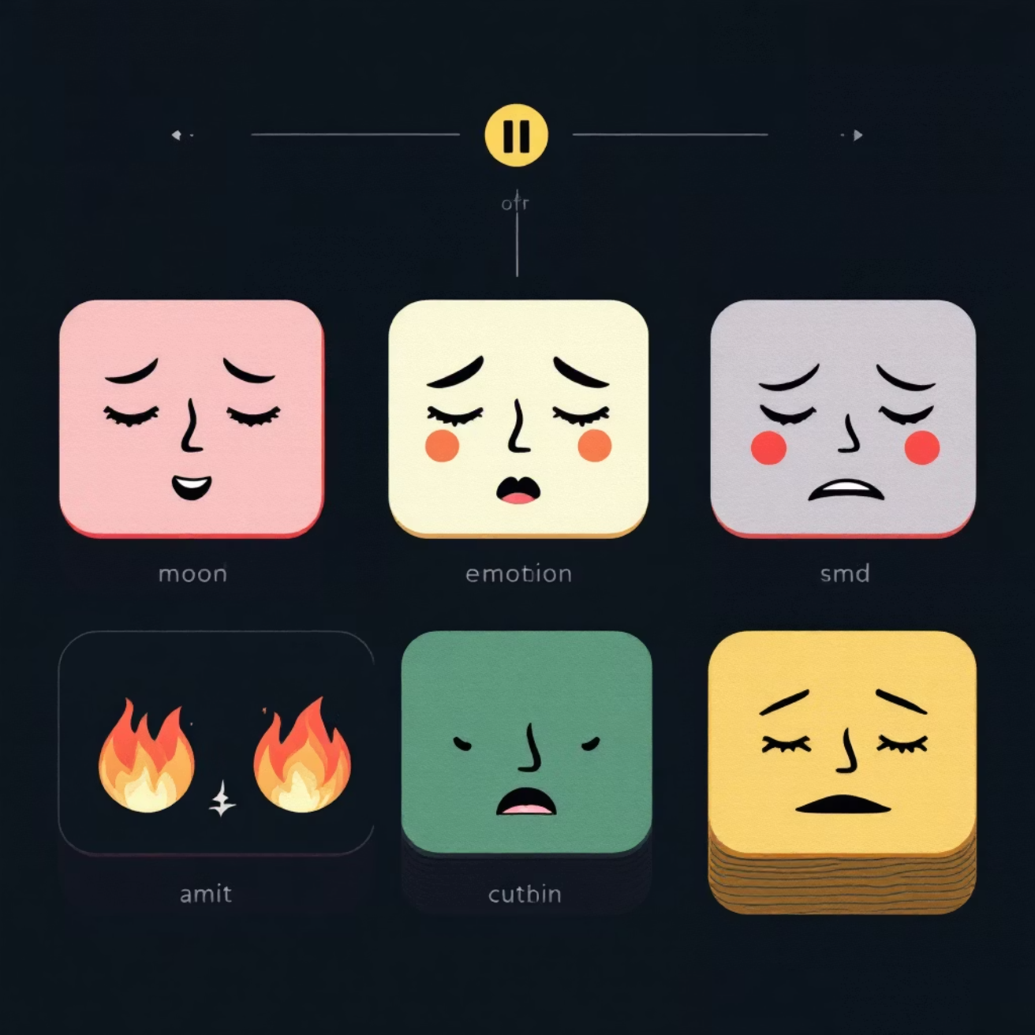
Key Features
Song-Based Recommendation
Mood-Based Playlist
Users can search for any song in the dataset by title. The system analyzes the audio characteristics of the input song and finds the 10 most similar tracks using machine learning similarity techniques.
Users select their current mood from four options: Happy 😊, Sad 😢, Chill 🧘, or Energetic ⚡. The system filters songs matching the emotional profile and generates a 15-song playlist.
Enter song title in search field
System validates song exists
Extracts audio features automatically
Returns 10 similar recommendations
Choose from four mood categories
Valence and energy filters applied
Popularity-based sorting
15-song playlist generated

Slide 6



Hybrid Recommendation Model
The system combines audio feature analysis with popularity metrics to improve recommendation accuracy and relevance.
Audio Features (60%)
Popularity Score (40%)
Weighted calculation based on:
Factors in song popularity to balance discovery with quality:
Danceability
Energy levels
Acousticness
Tempo analysis
Track popularity metrics
Hybrid scoring formula
Balanced recommendations
Why Hybrid? Combining similarity with popularity ensures users discover both relevant songs and quality tracks that others enjoy, improving overall recommendation quality.

Slide 7
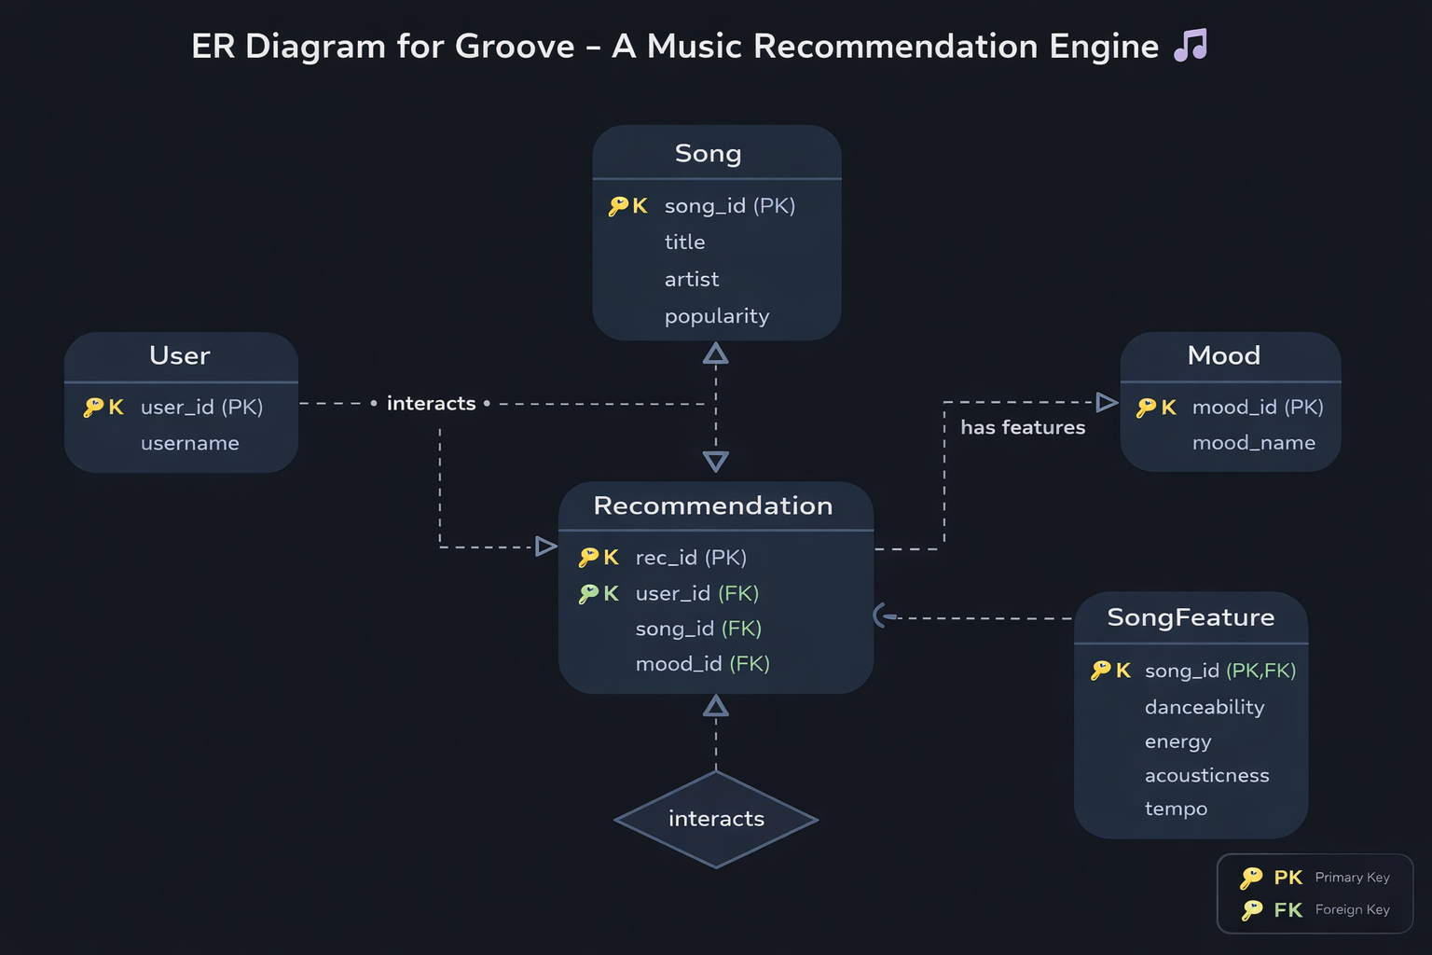

Slide 8

Technology Stack
Backend Framework
Frontend Technologies
Flask for web server
Pandas for data manipulation
Scikit-learn for ML algorithms
NumPy for numerical computing
HTML5 for structure
CSS3 for styling
JavaScript Fetch API
Responsive design
Dataset
Modified Spotify Tracks Dataset
tracks_genre.csv file
Audio features included
Genre classification

Slide 9






System Workflow
User Input
Search for a song title or select a mood category
Request Processing
Flask backend receives and validates the request
Audio Analysis
Extract and analyze relevant audio features
Similarity Calculation
Compute cosine similarity across dataset
Hybrid Ranking
Combine similarity with popularity scores
Return Results
Top recommendations displayed to user

Slide 10

Song Recommendation Process
Detailed Flow
Song Lookup: System searches dataset for matching song title and validates existence
Feature Extraction: Audio characteristics extracted including danceability, energy, tempo, and acousticness
Similarity Calculation: Cosine similarity computed between input song and all others in dataset
Score Combination: Similarity scores merged with popularity metrics using 60/40 weighting
Ranking: Songs sorted by hybrid score in descending order
Results: Top 10 songs returned with relevant metadata

Slide 11

Mood Recommendation Process
Mood Selection
User chooses from Happy, Sad, Chill, or Energetic mood categories
Valence & Energy Filtering
System applies mood-specific thresholds to valence (happiness) and energy audio features
Popularity Sorting
Matching songs sorted by popularity score to prioritize well-received tracks
Playlist Generation
Top 15 songs returned as mood-appropriate playlist

Slide 12
Future Improvements & Conclusion
Next Steps
Conclusion
Spotify API Integration
Groove successfully combines machine learning with web development to deliver intelligent music recommendations. The system offers both song-based similarity matching and mood-driven playlist generation through a simple, intuitive interface.
Real-time track data and streaming
User Accounts
Key strengths include the hybrid scoring model that balances audio feature similarity with popularity metrics, efficient cosine similarity calculations, and flexible recommendation approaches. The application demonstrates practical ML implementation for real-world music discovery challenges.
Personalized recommendations over time
Deep Learning Models
Neural networks for improved accuracy
Mobile App
iOS and Android versions

