Slide 1
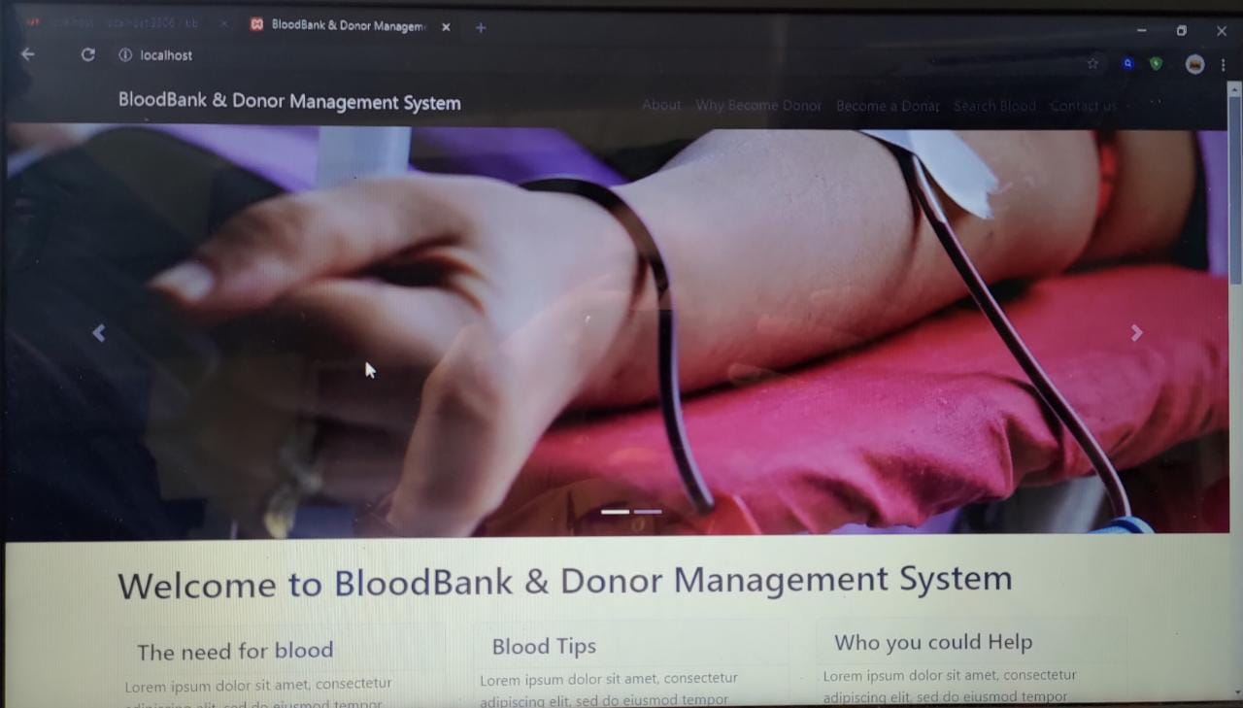
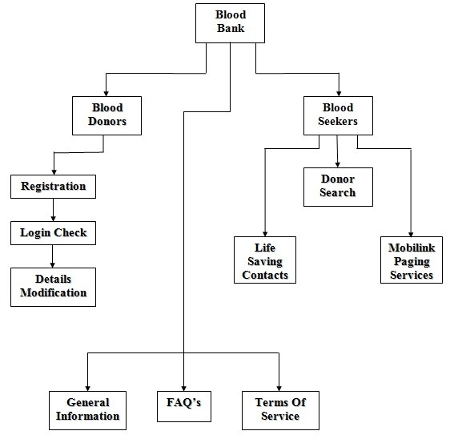
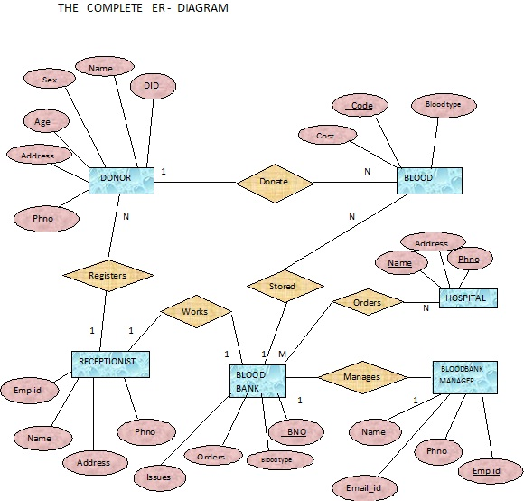
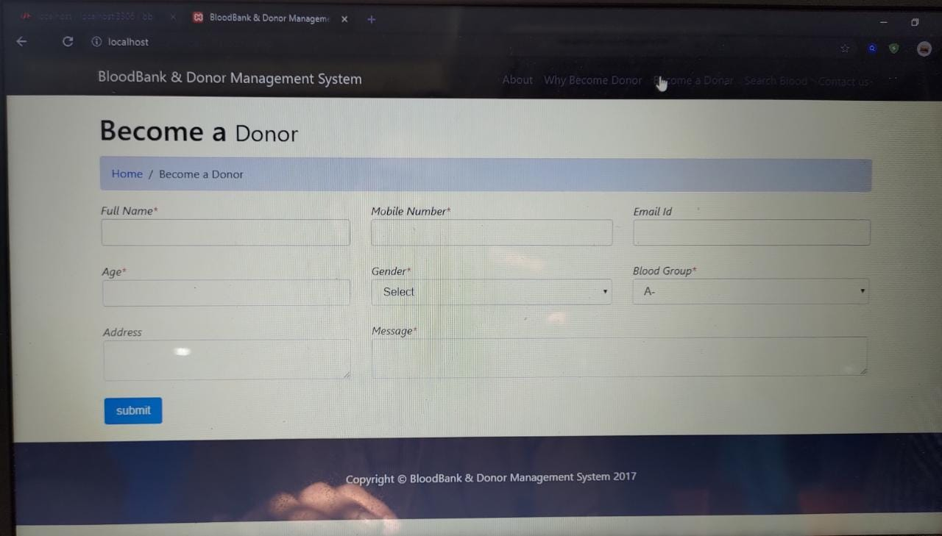
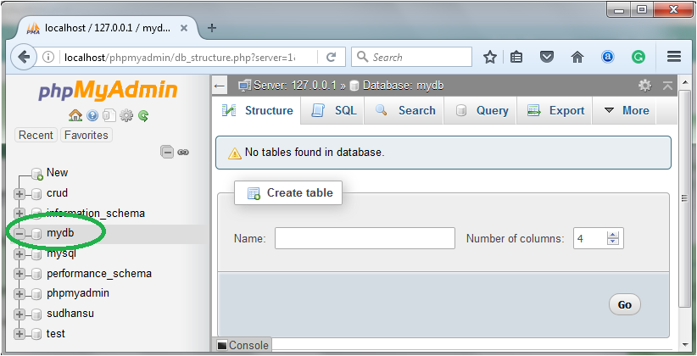
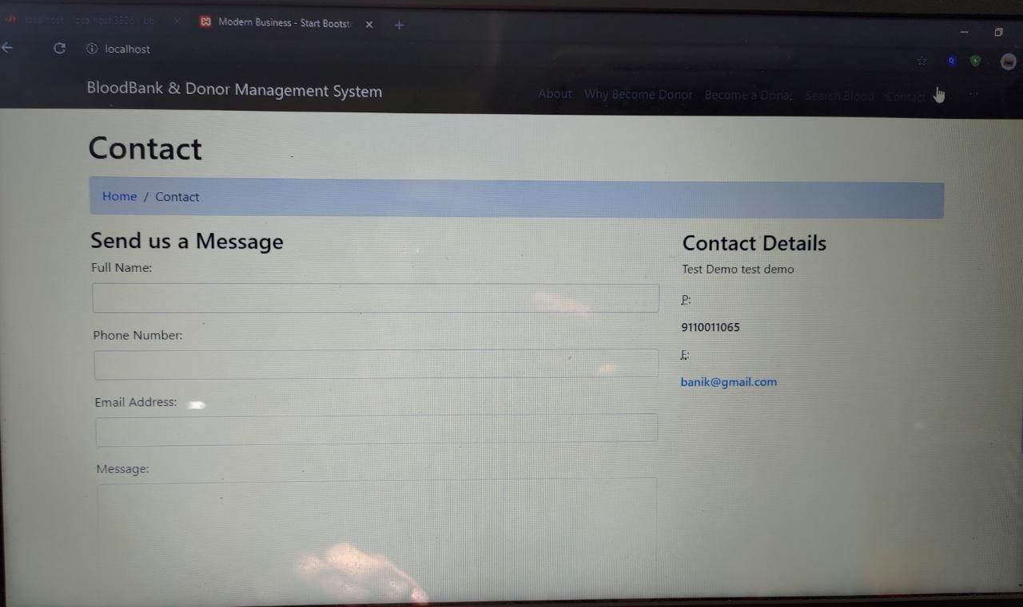
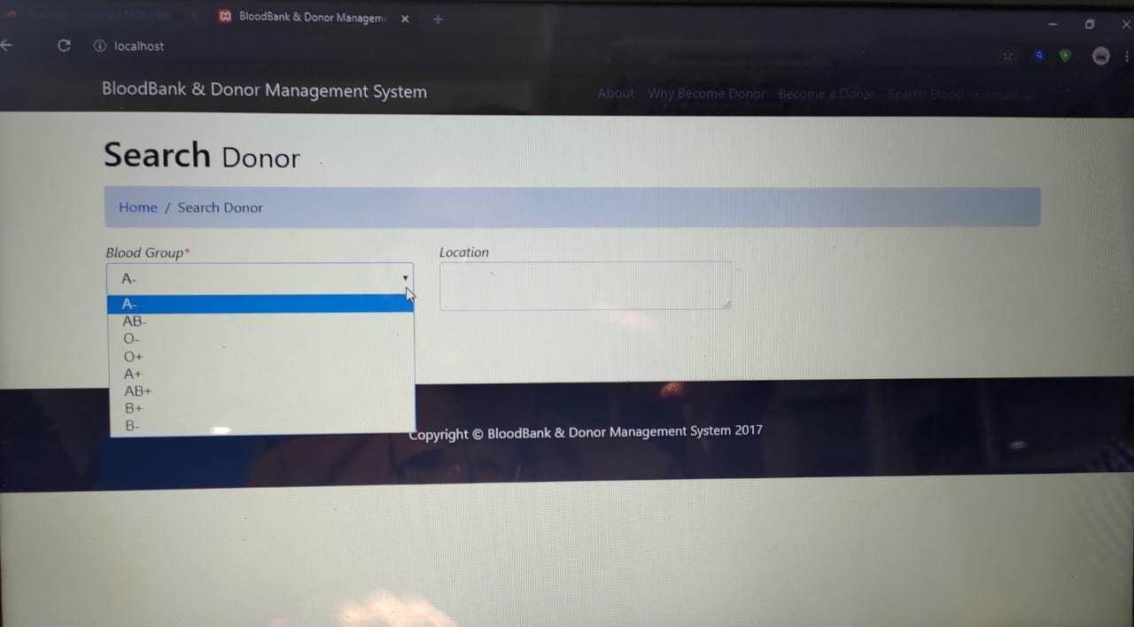
Blood Bank management system
Snehasish Banik , Sriyansh Ghosh , TV Poonam
Guide: Prof. Lakshmi J
REVA University, School of C& IT
rana2013.banik@gmail.com , hsriyanshghosh2000@gmail.com , tvpoonam2000@gmail.com ,
laxmijayannavar@reva.edu.in
The script phase is the center of the application where you control
the behavior of the app before the inputs by the user.
Results
Abstract
Proposed Solution
Conclusion
The Online Blood Donation management System is to create an e-Information about the donor and organization that are related to donating the blood. Through this application any person who is interested in donating the blood can register himself in the same way if any organization wants to register itself with this site that can also register. Moreover if any general consumer wants to make request blood online he can also take the help of this site. Admin is the main authority who can do addition, deletion, and modification if required.
The concept of this project The system that is going to be developed is Blood Bank Management System (BBMS). This is a web and android based application system that is to be used by the blood banks or blood centers as a means to advertise the nation wide blood donation events to the public and at the same time allow the public to make online reservation and request for the blood. The system keeps the record of all the donors, recipients, blood donation programs, rejected bloods. For internal works and activities intranet is used and for interaction with public internet is used.
The Concept of the project This system also has the ability to keep track of the donor's donation records and the blood stock in the blood bank. This project intends to computerize the blood and donor management system in a blood bank in order to improve the record management efficiency due to the grown size of records of data.
Our project is only a humble venture to satisfy the needs to manage their project work. Several user friendly coding have also adopted. This package shall prove to be a powerful package in satisfying all the requirements of the school. The objective of the software planning is to provide a framework that enables the manager to make reasonable estimates made within a limited time frame
The Android application can be used by the people interested in donating their blood by locating their nearest blood bank. The web application provides a way of communication and synchronization between the hospitals and the blood banks. It also provides them with the facility of communicating with the nearby donors in emergency. The database is a vital aspect of the system. The database of the hospitals and the blood banks must be checked for consistency on regular basis for smooth working of the system. The proposed system uses Google Maps which provides the user with an efficient way of locating the nearby donors/blood banks. The Android application is developed using Android Studio which is an open source software, while the web application for the hospitals and the blood banks is also developed using open source tools, hence the system developed is quite feasible.
References
Introduction
We reffered to the following for doing this project:
Link: https://ieeexplore.ieee.org
http://www.oaijse.com/VolumeArticles
Google for problem solving
Database Programming with PHP
https://www.tutorialspoint.com/
http://www.wampserver.com/en/
http://www.tutorialspoint.com/mysql/
IEEE papers
We also reffered to few books on PHP:
THE JOY OF PHP – by Alan Forbes
PHP & MYSQL NOVICE TO NINJA – by Kevin Yank
This project is designed for successful completion of project on blood bank management system. the basic building aim is to provide blood donation service to the city recently. Blood Bank Management System (BBMS) is a browser based system that is designed to store, process, retrieve and analyze information concerned with the administrative and inventory management within a blood bank. This project aims at maintaining all the information pertaining to blood donors, different blood groups available in each blood bank and help them manage in a better way. Aim is to provide transparency in this field, make the process of obtaining blood from a blood bank hassle free and corruption free and make the system of blood bank management effective.
The Blood bank system project report contain information related to blood like
• Blood type
• Date of Donation of blood
• validity of Blood s
• Available Blood group
Methodology
The database is stored in a local server XAMPP. Admin will be responsible for handling the data’s in the local server.
The main modules of this application are:
Donor/Recipent registration
Information details of Donor/Recipent
Operations performed by Donor/Recipents

