Slide 1
Constructing Pairing-Friendly Elliptic Curves
Peter Manohar
Xingyou Song

Slide 2
Definition:
For our purposes, an elliptic curve over a field is an equation of the form:
satisfying

Slide 3
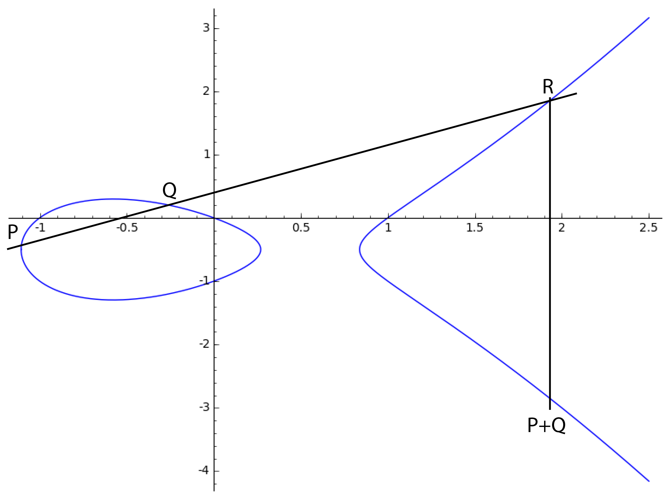
The Group Law

Slide 4
j-Invariant
Definition:
Fact: two elliptic curves (over an algebraically closed field) are isomorphic iff they have the same j-invariant.

Slide 5
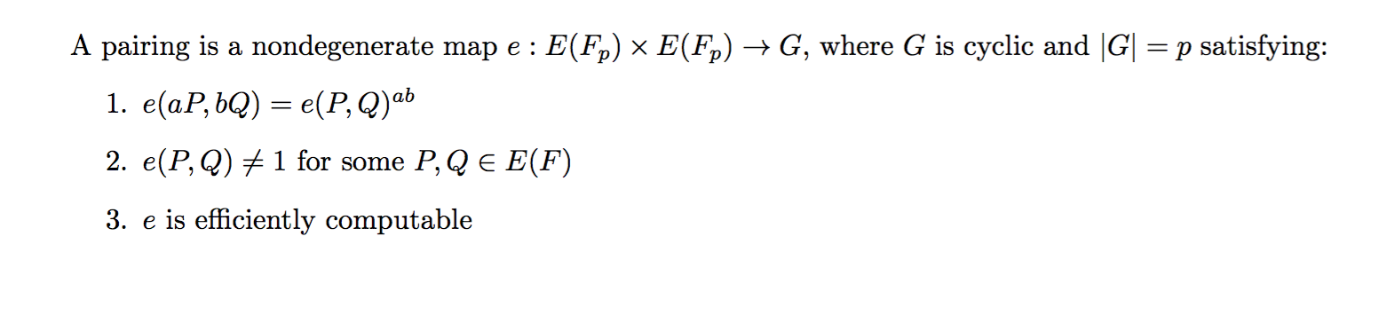
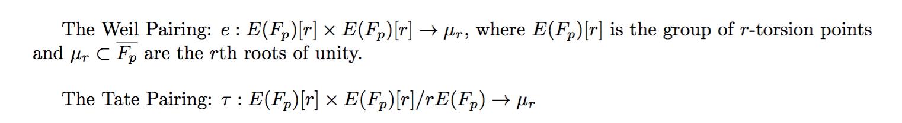
Pairings
Examples:

Slide 6
Pairing-Friendly Curves
Problem:
So we need to find a way to generate these curves on our own.

Slide 7
Complex Multiplication
The trace of Frobenius is the integer t satisfying:
The Hasse Bound:
CM Method:
Input: p,t
Output: An elliptic curve E over with trace t
Efficient when , with D small.

Slide 8
Cocks Pinch Method
Conditions:
Input: k,r,D, where D is a square mod r
Output: p,t

Slide 9
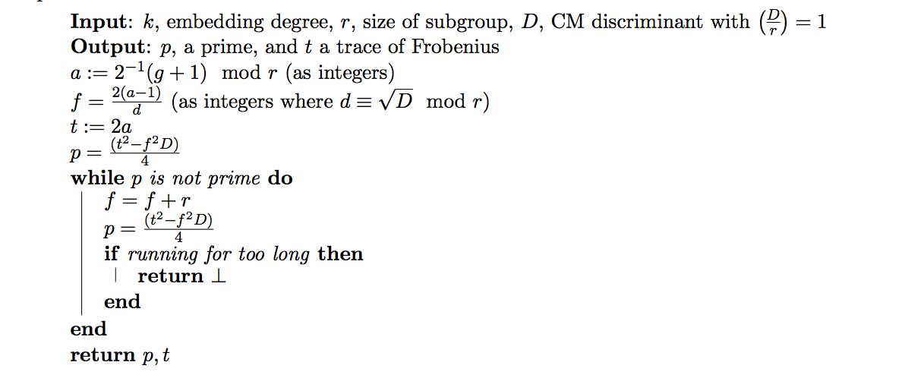
Cocks Pinch Method

Slide 10
Dupont Enge Morain Method

Slide 11
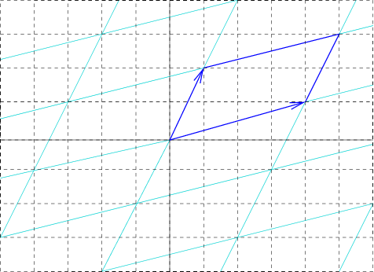
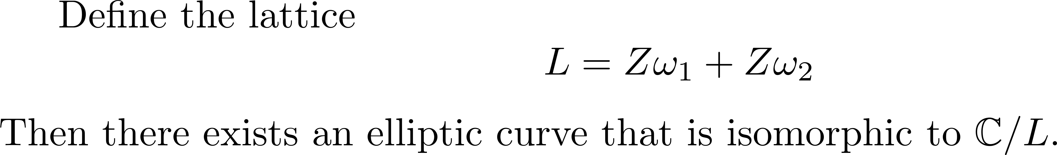
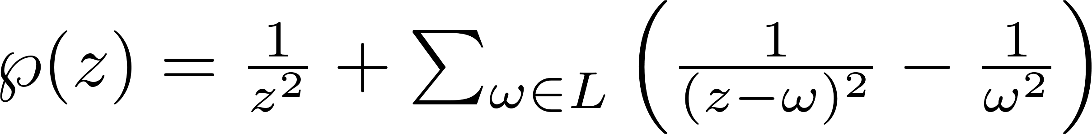
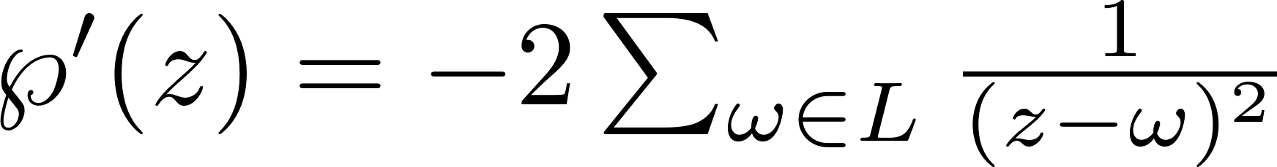
Complex Lattices
All elliptic curves are lattices, i.e.

Slide 12
Complex Multiplication
Note that this gives us a natural way to turn whatever algebraic transformations we have in the complex lattice to transformations on the elliptic curve points. For example,

Slide 13
Curve generation
So what these algorithms are actually doing is finding a good, squarefree D such that our lattice is built by

