Slide 1
Constructing Pairing-Friendly Elliptic Curves
Peter Manohar, Xingyou Song

Slide 2
Definition:
For our purposes, an elliptic curve over a field is an equation of the form:
satisfying

Slide 3
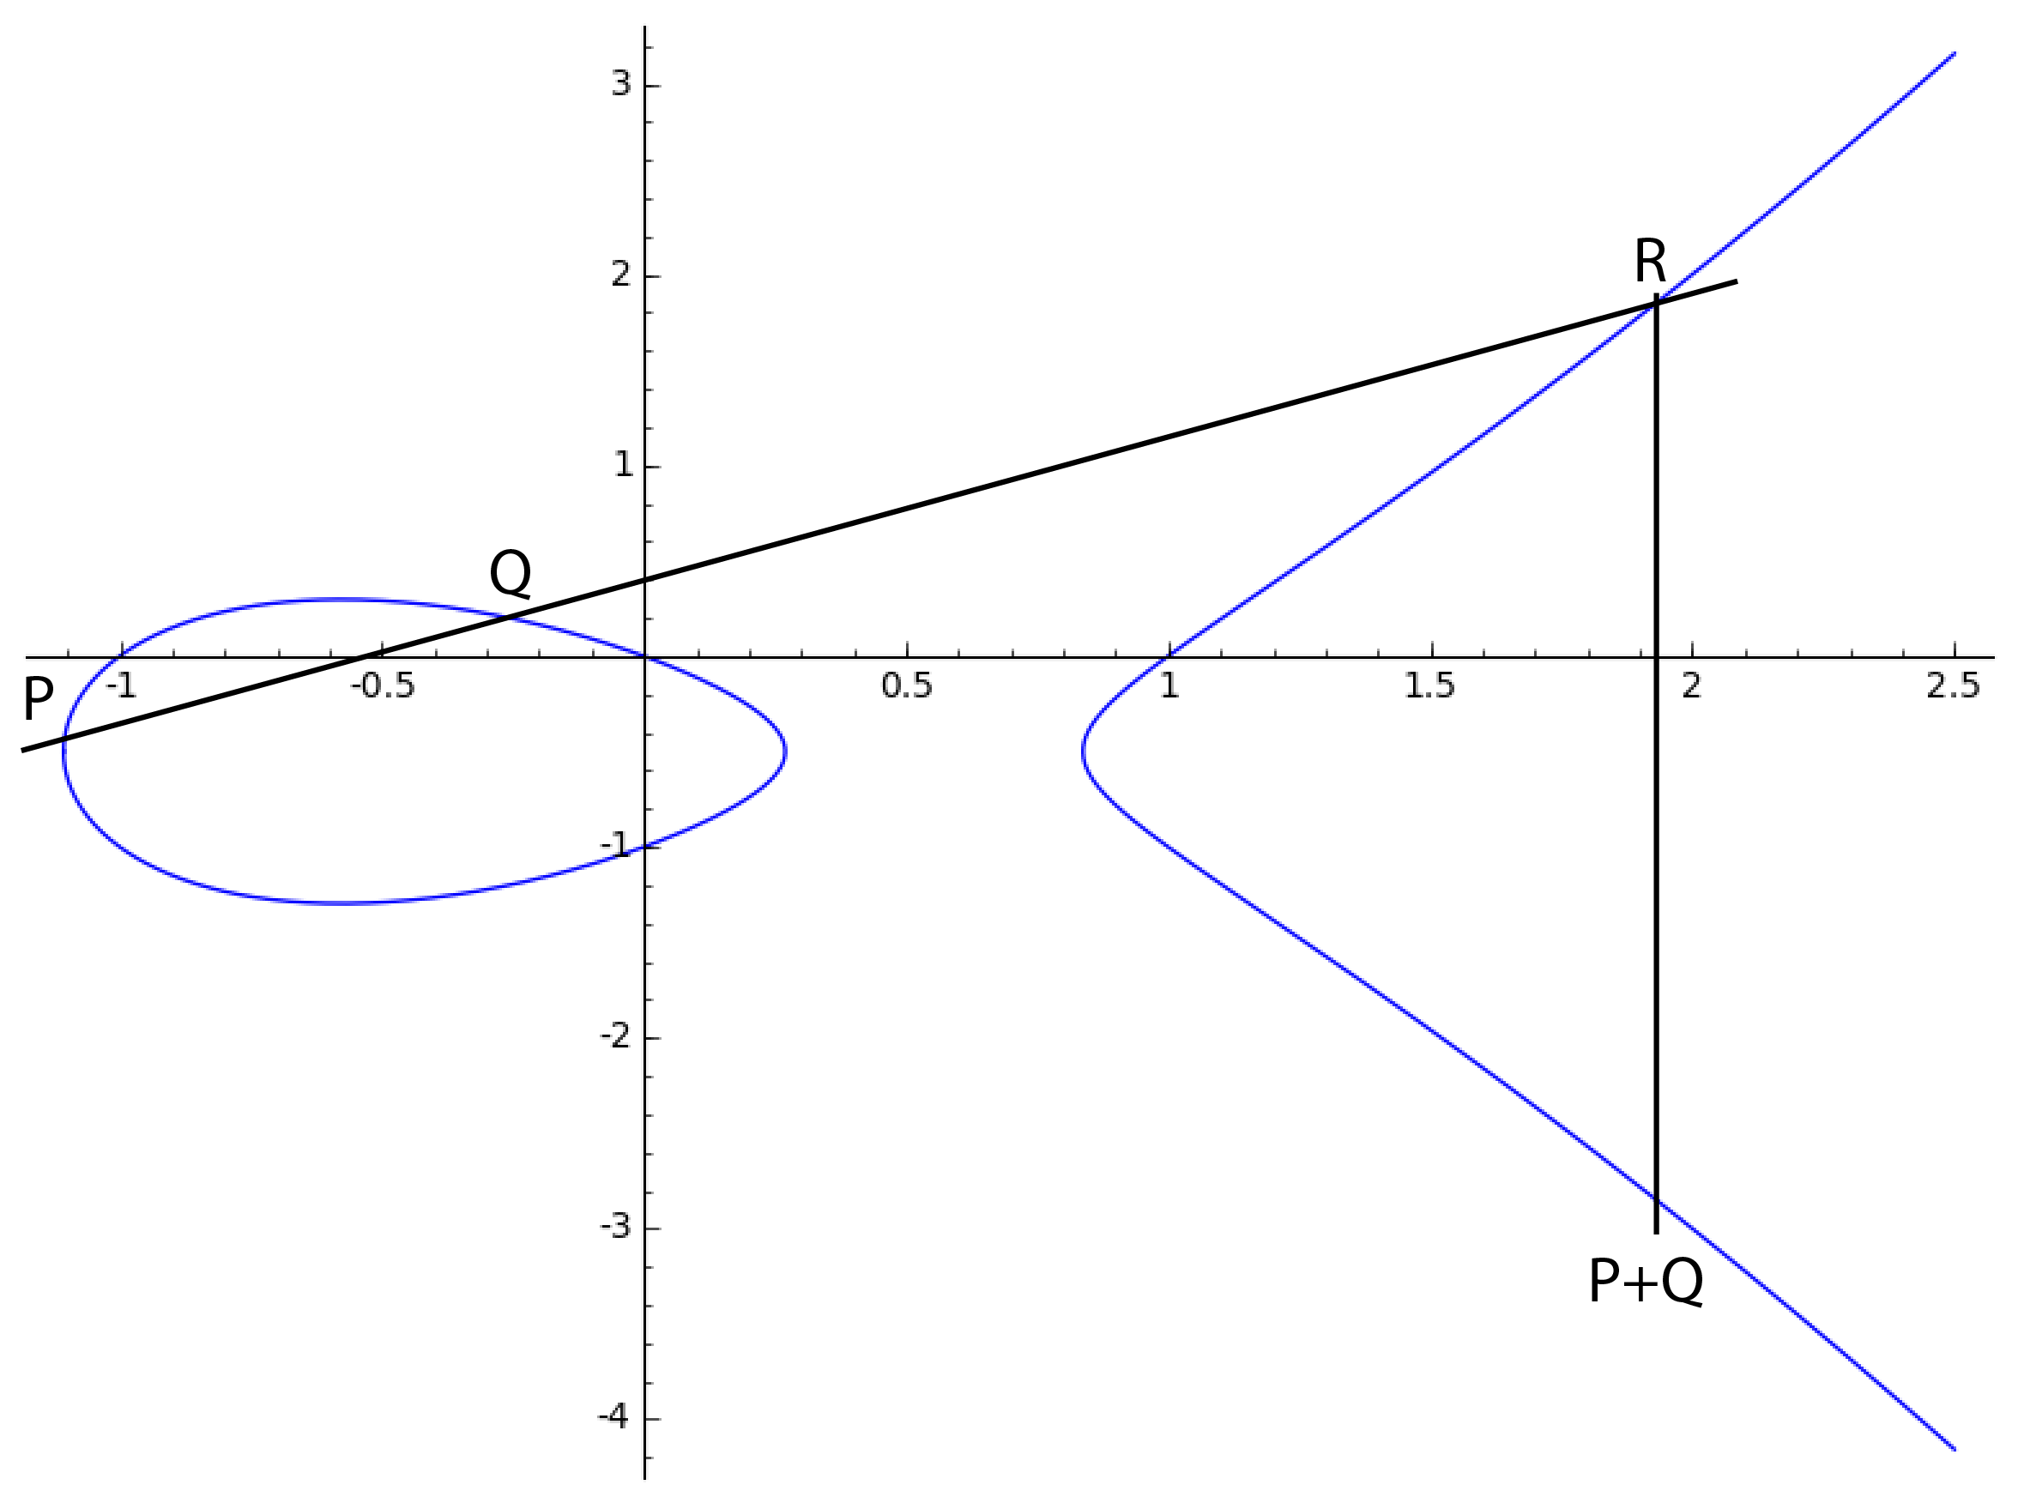
The Group Law

Slide 4
Isogenies
An Isogeny is a surjective morphism between two elliptic curves that is also group homomorphism.
Two elliptic curves are isomorphic if there is an isogeny from E1 to E2 and an isogeny from E2 to E1
Examples:

Slide 5
j-Invariant
Definition:
Fact: two elliptic curves (over an algebraically closed field) are isomorphic iff they have the same j-invariant.

Slide 6
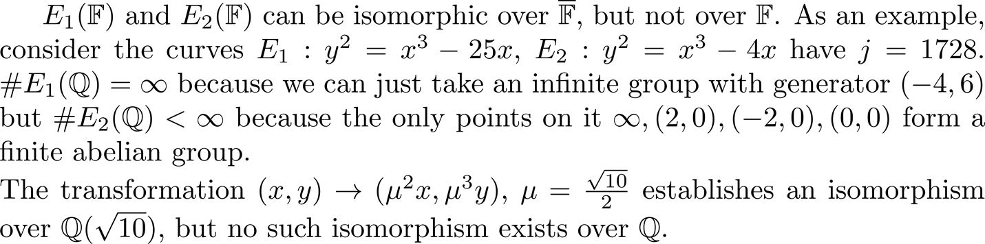
Quadratic Twists

Slide 7
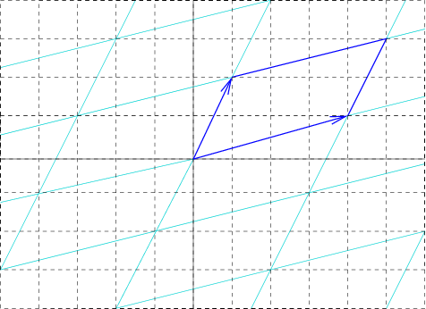
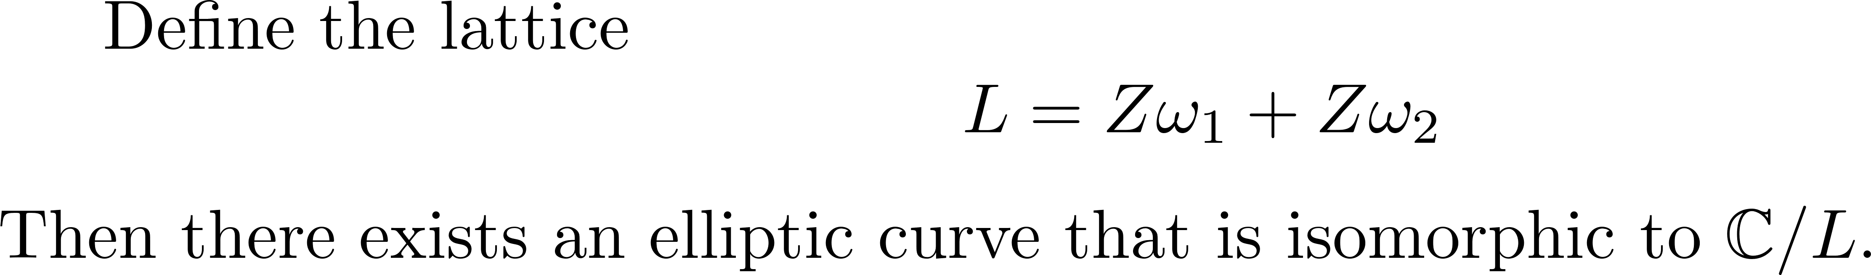
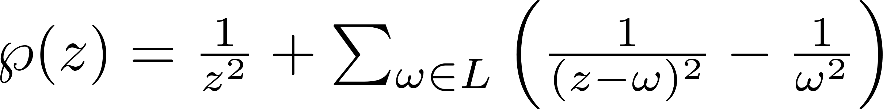
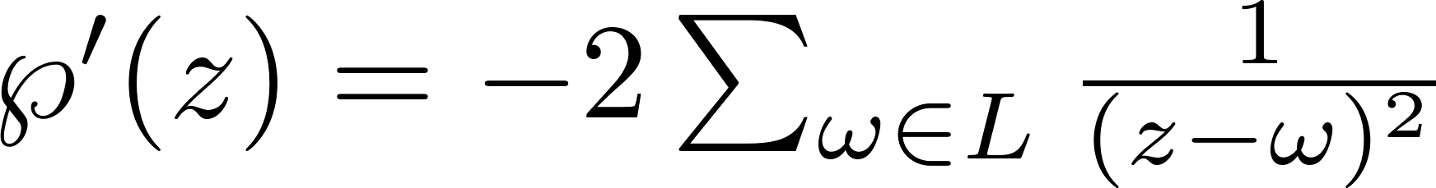
Complex Lattices
Where

Slide 8
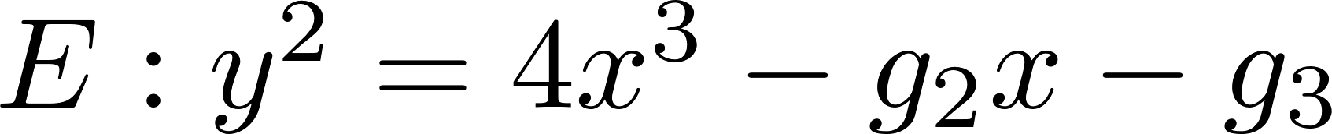
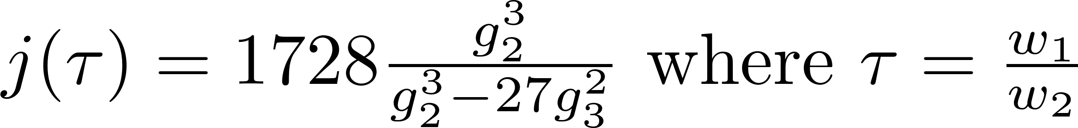
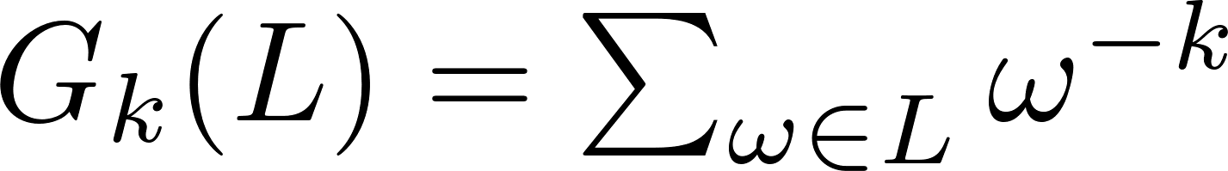
Lattice to Elliptic Curve
Note that now we can make a curve based on the two lattice parameters. Elliptic curve is explicitly defined to be
A special case is when the lattice is built by a quadratic field.

Slide 9
Fun stuff with complex lattices
Note that this gives us a natural way to turn whatever algebraic transformations we have in the complex lattice to transformations on the elliptic curve points. For example,
This is called “Complex Multiplication”.

Slide 10
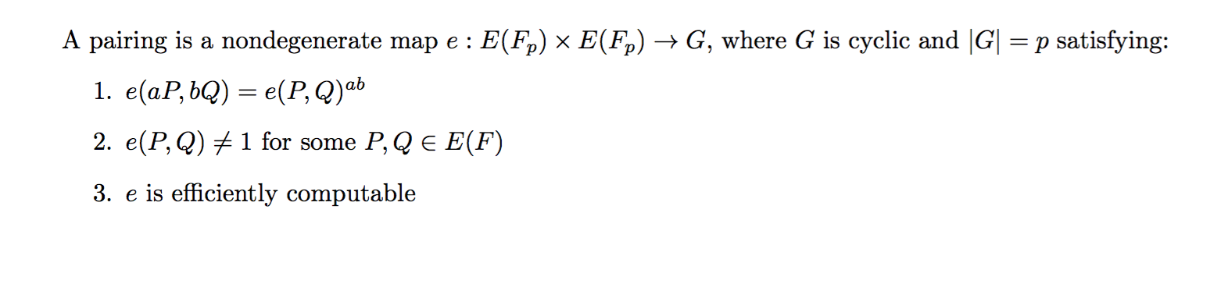
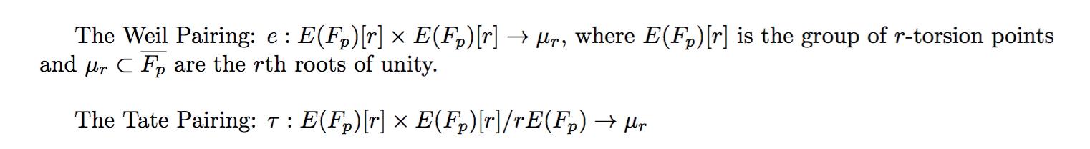
Pairings
Examples:

Slide 11
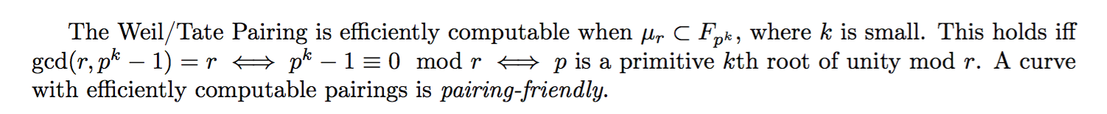
Pairing-Friendly Curves
Problem:
So we need to find a way to generate these curves on our own.

Slide 12
Complex Multiplication

