Slide 1
Constructing Pairing-Friendly Elliptic Curves
Peter Manohar
Xingyou Song

Slide 2
Definition:
For our purposes, an elliptic curve over a field is an equation of the form:
satisfying

Slide 3
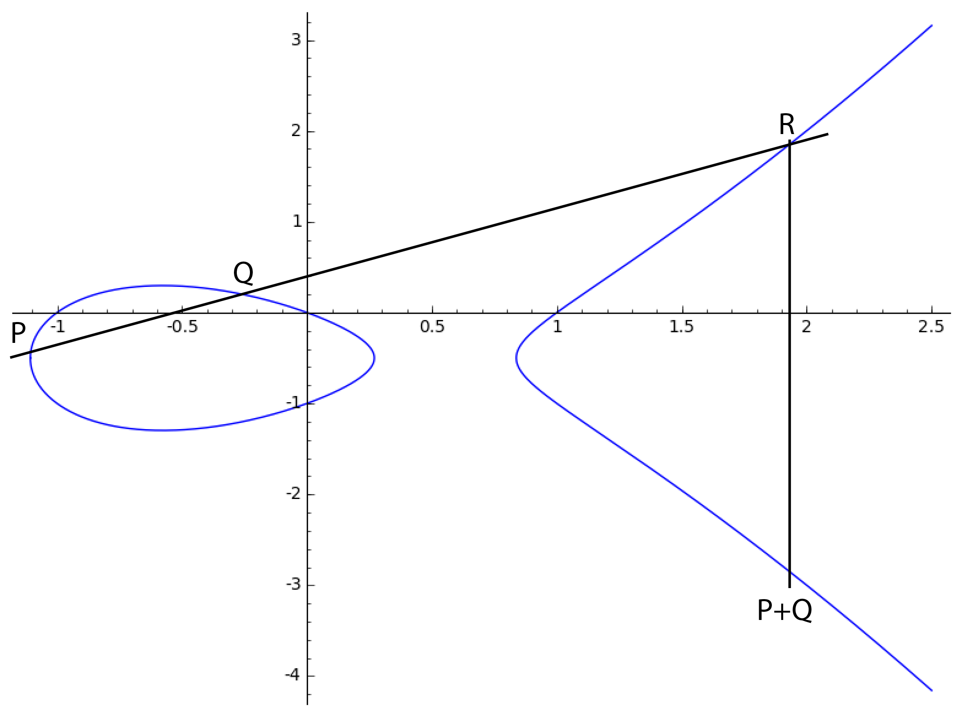
The Group Law

Slide 4
j-Invariant
Definition:
Fact: two elliptic curves (over an algebraically closed field) are isomorphic iff they have the same j-invariant.

Slide 5
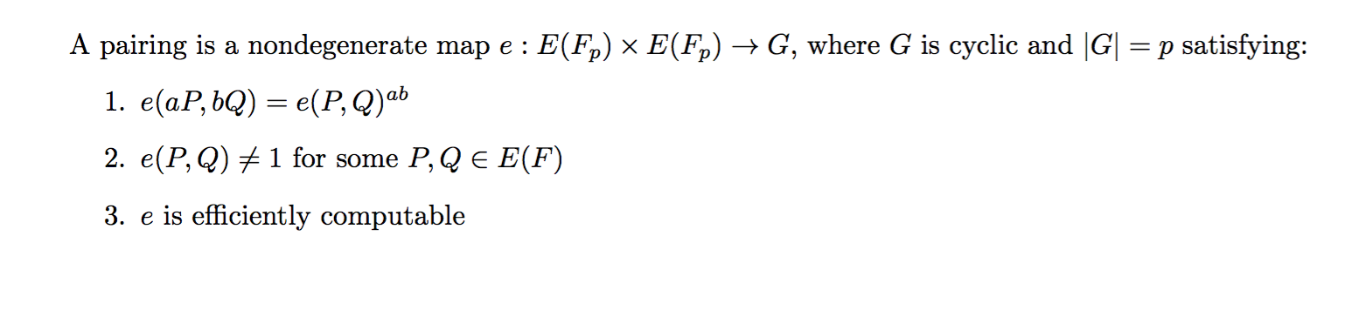
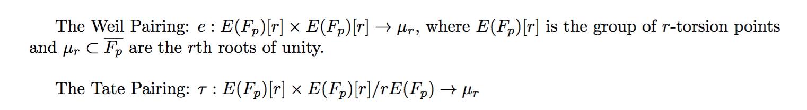
Pairings
Examples:

Slide 6
Pairing-Friendly Curves
Problem:
So we need to find a way to generate these curves on our own.

Slide 7
Complex Multiplication
The trace of Frobenius is the integer t satisfying:
The Hasse Bound:
CM Method:
Input: p,t
Output: An elliptic curve E over with trace t
Efficient when , with D small.

Slide 8
Cocks Pinch Method
Conditions:
Input: k,r,D, where D is a square mod r
Output: p,t

Slide 9
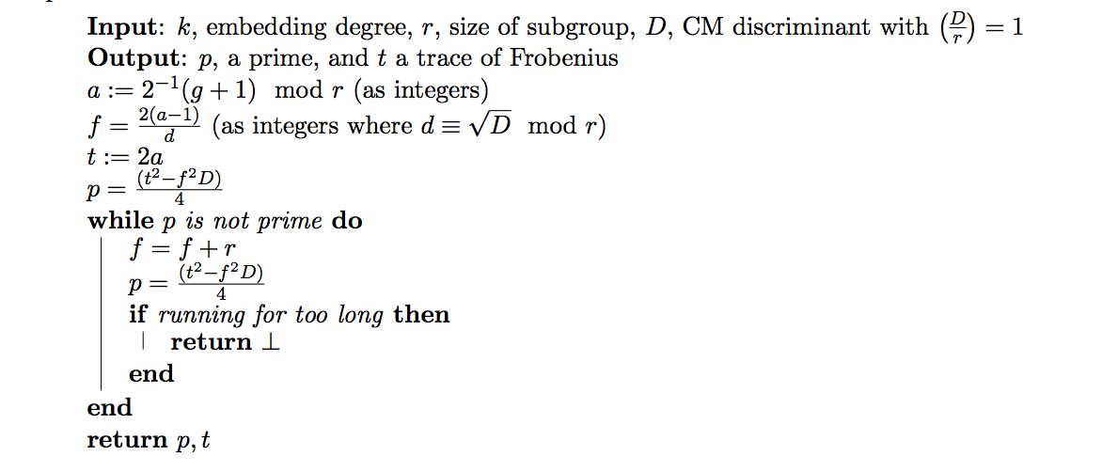
Cocks Pinch Method

Slide 10
Dupont Enge Morain Method

