Slide 1
Constructing Pairing-Friendly Elliptic Curves
Peter Manohar
Xingyou Song

Slide 2
Definition:
For our purposes, an elliptic curve over a field is an equation of the form:
satisfying
Reason: We need the tangent line at each point on the curve to be defined, so and cannot simultaneously be 0. Applying Vieta’s formulas, this is equivalent to E having nonzero discriminant.

Slide 3
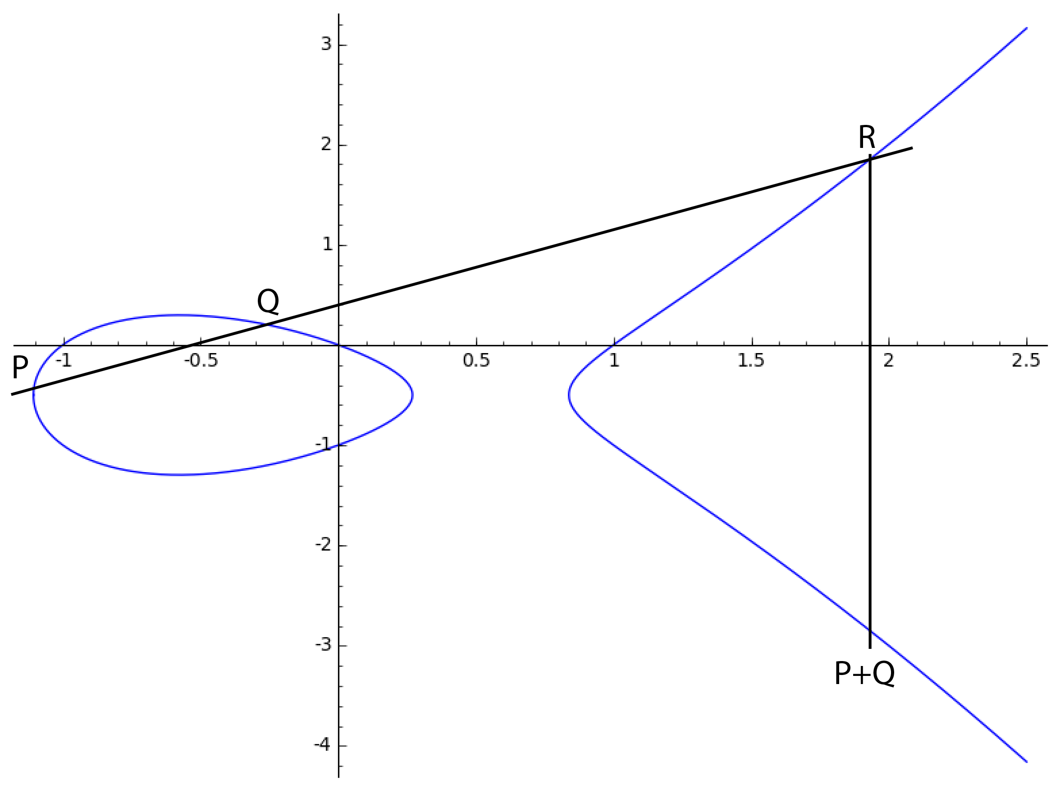
The Group Law
The points on an elliptic curve form an
abelian group:
To compute P+Q:
Find the line through P and Q.
This line will intersect the curve
at a third point R. Reflect R
about the y-axis to obtain P+Q

Slide 4
j-Invariant
Definition:
Fact: two elliptic curves (over an algebraically closed field) are isomorphic iff they have the same j-invariant.
There is a canonical curve E for each j:

Slide 5
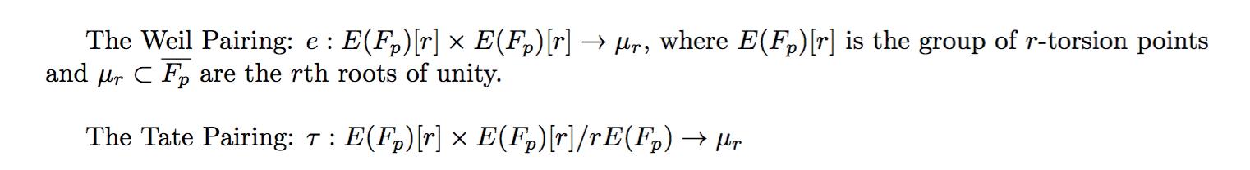
Pairings
A map satisfying
For elliptic curves, there are two pairings:

Slide 6
Pairing-Friendly Curves
Weil/Tate pairings are useful when DLP is hard in both and
Computing the pairings requires computation in an extension field containing .
The embedding degree is , so we are doing computations in
Efficient when k is small. But we don’t want k to be too small (otherwise DLP becomes too easy). We also need r to be sufficiently large.

Slide 7
Pairing-Friendly Curves
Alternative definition of embedding degree:
k is the smallest positive integer such that
Reason:
Problem:
so we need to find a way to generate these curves on our own.

Slide 8
Complex Multiplication
The trace of Frobenius is the integer t satisfying:
The Hasse Bound:
CM Method:
Input: p,t
Output: An elliptic curve E over with trace t
Efficient when , with D small.

Slide 9
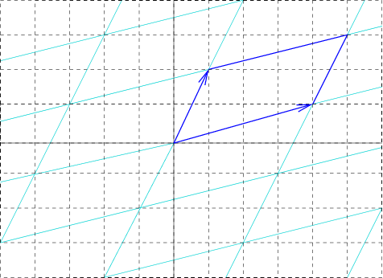
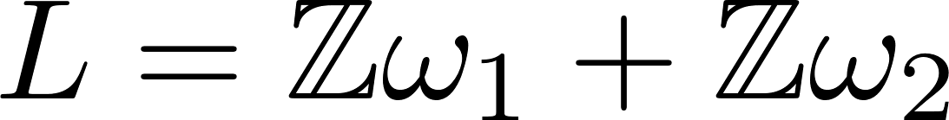
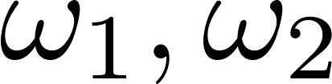
Elliptic Curves over Complex Numbers
Every elliptic curve over C is isomorphic to C/L for some lattice L by the function:
The curve E(C) is isomorphic to C/L as:
So given two parameters , we can construct any curve.

Slide 10
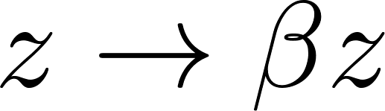
Endomorphism rings
Key result: All endomorphisms of elliptic curves are just multiplying points by a constant, i.e. Our lattice still remains the same, so
As it turns out, End(E) is isomorphic to an order in a quadratic imaginary field:
or
This ring has discriminant or , called the CM discriminant; this ring can be treated as a lattice on its own.

Slide 11

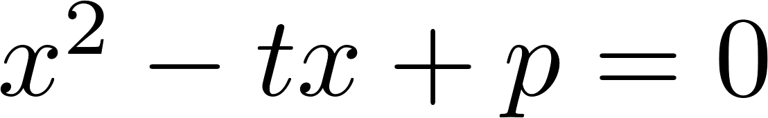
Back to Finite Fields
Every elliptic curve has
Over finite fields,
Reason: The Frobenius Endomorphism
After a change of basis, all will satisfy the quadratic
All curves over have complex multiplication
From this, we get the CM equation, or essentially the “discriminant”
or

Slide 12
Generating Curves
All curves with CM discriminant D have a j-invariant satisfying:
is the Hilbert Class polynomial
The idea: Compute
Compute and find a root
Find the curve equation of E
Bottleneck: computing

Slide 13
Cocks Pinch Method
Problem: We want to construct an Elliptic Curve with a subgroup of size r with embedding degree k
Input: k,r,D, where D is a square mod r
Output: p,t
Conditions:
(1) Is the CM equation. If (2) is satisfied, then the curve will have a subgroup of size r. (3) requires that the embedding degree is k

Slide 14
Cocks Pinch Method
Pick g, a primitive kth root of unity mod r
Pick an integer t satisfying
Set
Find a prime of the form
Then:
So
Also,
Then we construct E using the CM method.

