Slide 1
Constructing Pairing-Friendly Elliptic Curves
Peter Manohar
Xingyou Song

Slide 2
Definition:
For our purposes, an elliptic curve over a field is an equation of the form:
satisfying
Reason: We need the tangent line at each point on the curve to be defined, so and cannot simultaneously be 0. Applying Vieta’s formulas, this is equivalent to E having nonzero discriminant.

Slide 3
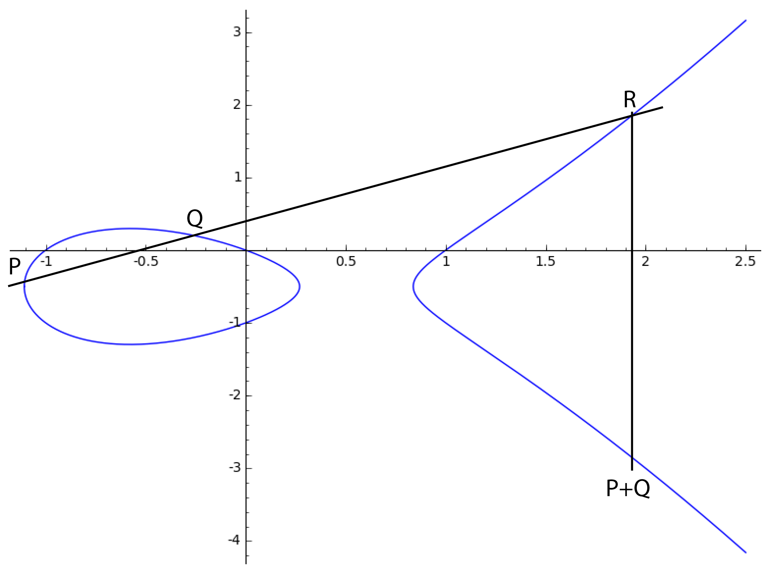
The Group Law
The points on an elliptic curve form an
abelian group:
To compute P+Q:
Find the line through P and Q.
This line will intersect the curve
at a third point R. Reflect R
about the y-axis to obtain P+Q

Slide 4
j-Invariant
Definition:
Fact: two elliptic curves (over an algebraically closed field) are isomorphic iff they have the same j-invariant.
There is a canonical curve E for each j:

Slide 5
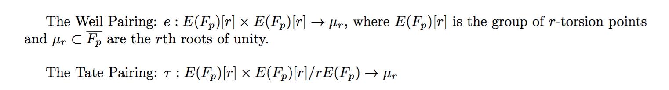
Pairings
A map satisfying
For elliptic curves, there are two pairings:

Slide 6
Pairing-Friendly Curves
Weil/Tate pairings are useful when DLP is hard in both and
Computing the pairings requires computation in an extension field containing .
The embedding degree is , so we are doing computations in
Efficient when k is small. But we don’t want k to be too small (otherwise DLP becomes too easy). We also need r to be sufficiently large.

Slide 7
Pairing-Friendly Curves
Alternative definition of embedding degree:
k is the smallest positive integer such that
Reason:
Problem:
so we need to find a way to generate these curves on our own.

Slide 8
Complex Multiplication
The trace of Frobenius is the integer t satisfying:
The Hasse Bound:
CM Method:
Input: p,t
Output: An elliptic curve E over with trace t
Efficient when , with D small.

Slide 9
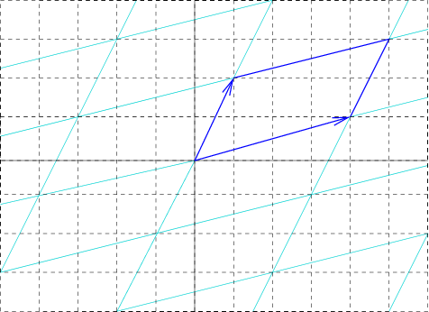
Elliptic Curves over Complex Numbers
Every elliptic curve over C is isomorphic to C/L for some lattice L by the function:
The curve E(C) is isomorphic to C/L as:

Slide 10
Endomorphism rings
Key result:
As it turns out, End(E) is isomorphic to an order in a quadratic imaginary field:
or
This ring has discriminant or , called the CM discriminant

Slide 11
Back to Finite Fields
Every elliptic curve has
Over finite fields,
Reason: The Frobenius Endomorphism
All curves over have complex multiplication
From this, we get the CM equation:
or

Slide 12
Generating Curves
All curves with CM discriminant D have a j-invariant satisfying:
is the Hilbert Class polynomial
The idea: Compute
Compute and find a root
Find the curve equation of E
Bottleneck: computing

Slide 13
Cocks Pinch Method
Problem: We want to construct an Elliptic Curve with a subgroup of size r with embedding degree k
Input: k,r,D, where D is a square mod r
Output: p,t
Conditions:
(1) Is the CM equation. If (2) is satisfied, then the curve will have a subgroup of size r. (3) requires that the embedding degree is k

Slide 14
Cocks Pinch Method
Pick g, a primitive kth root of unity mod r
Pick an integer t satisfying
Set
Find a prime of the form
Then:
So
Also,
Then we construct E using the CM method.

