Slide 1
Constructing Pairing-Friendly Elliptic Curves
Peter Manohar, Xingyou Song

Slide 2
Definition:
For our purposes, an elliptic curve over a field is an equation of the form:
satisfying

Slide 3
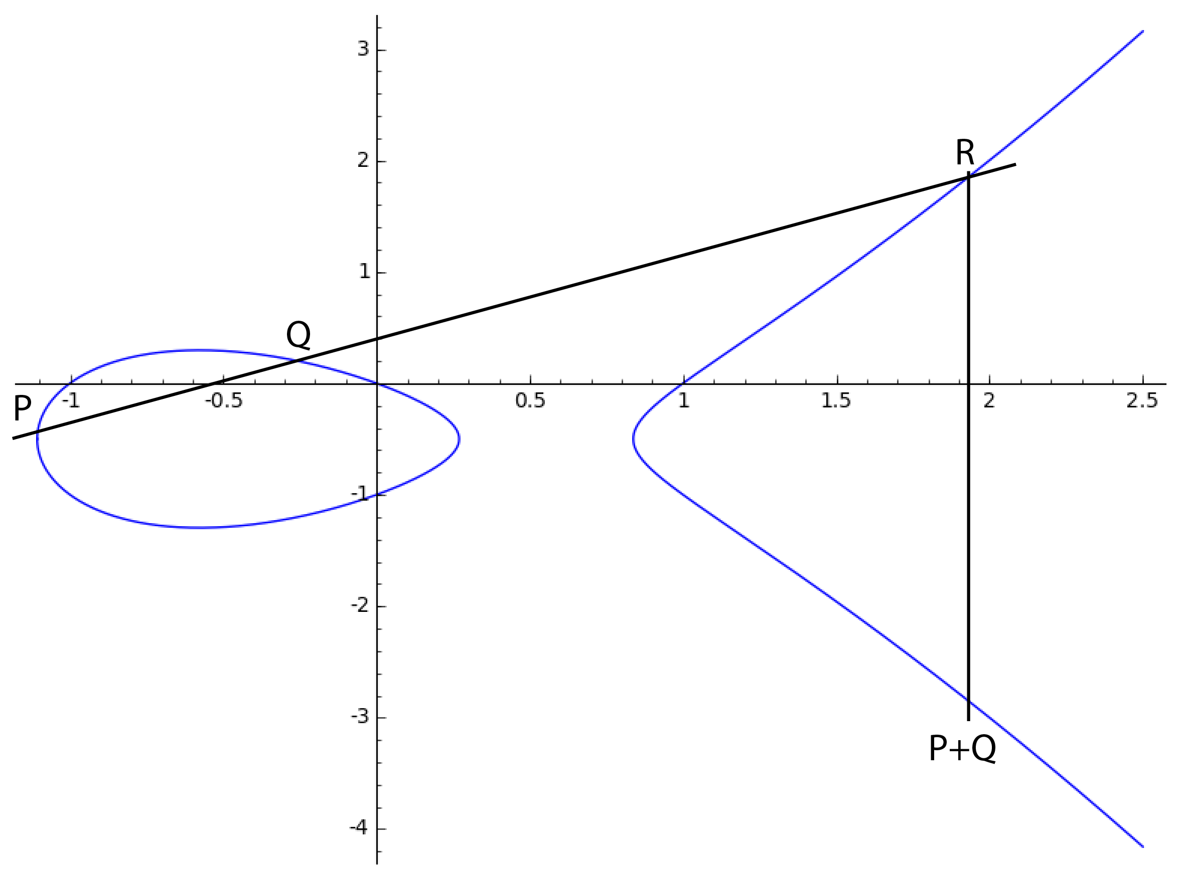
The Group Law

Slide 4
Isogenies
An Isogeny is a surjective morphism between two elliptic curves that is also group homomorphism.
Two elliptic curves are isomorphic if there is an isogeny from E1 to E2 and an isogeny from E2 to E1
Examples:

Slide 5
j-Invariant
Definition:
Fact: two elliptic curves (over an algebraically closed field) are isomorphic iff they have the same j-invariant.

Slide 6
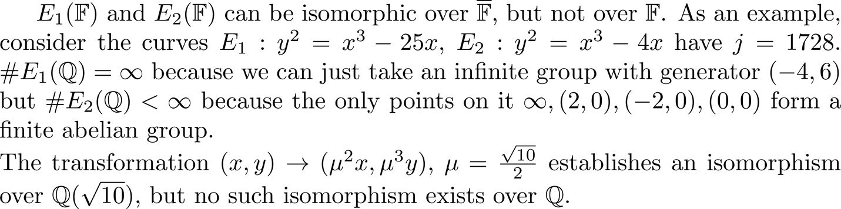
Quadratic Twists

Slide 7
Complex Lattices

Slide 8
Endomorphisms
An endomorphism is an isogeny from E to itself. The endomorphisms of an elliptic curve form a ring, which always contains a subring isomorphic to the integers.

Slide 9
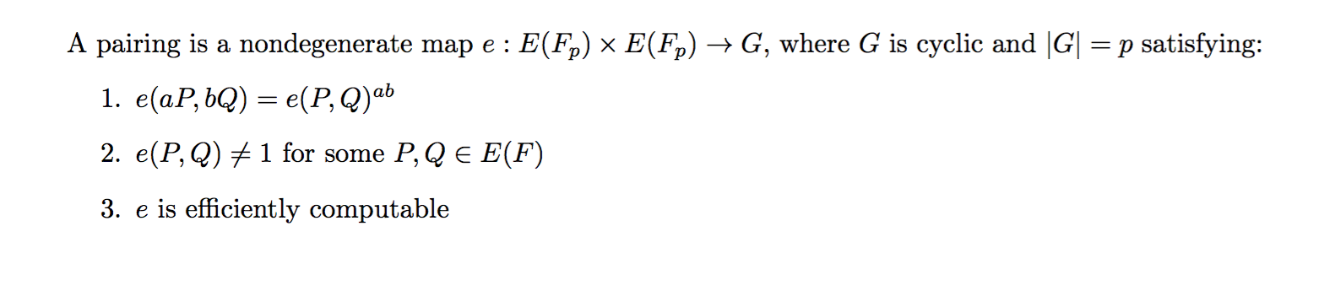
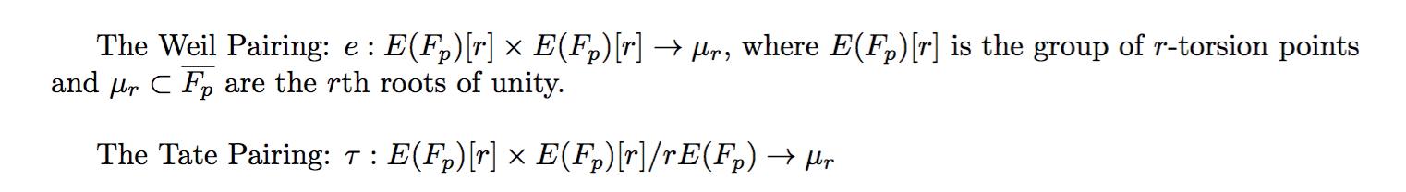
Pairings
Examples:

Slide 10
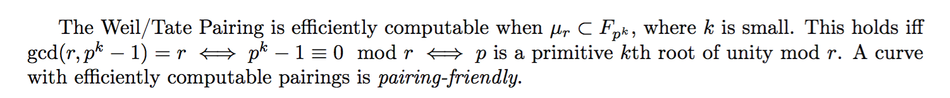
Pairing-Friendly Curves
Problem:
So we need to find a way to generate these curves on our own.

Slide 11
Complex Multiplication

